Slide 1


Ensure you read the guidance before teaching the lesson
Teacher
slide
Family Life: Exploring relationships, marriage and parenting
Long term commitments

Slide 2

Teacher
slide
Using this PowerPoint
The slides in this presentation are divided into two sections:
Teacher slides (purple) – provide key information regarding lesson preparation
Pupil slides (white) – provide a visual focus point for pupils during the lesson and delivery notes for teachers about the activities. Click ‘notes’ to view these.
Ensure that you select ‘Use Presenter View’ under the ‘Slide Show’ tab – this will allow you to preview the teaching notes on your monitor while the main presentation is displayed on a screen/smartboard.
© PSHE Association 2019

Slide 3



Challenge and support
Teacher
slide
The lesson includes suggestions for challenge and support activities, to help you differentiate appropriately for your class.
Challenge activities deepen and extend the learning for those who need more challenge or who finish the activity quickly.
Support activities are adapted to be more accessible for those who need it.
Look for the logo on the pupil slides. See delivery notes for details of the activities.
Support
Challenge
© PSHE Association 2019

Slide 4
Context
Teacher
slide
This lesson seeks to help young people develop their understanding of long term commitments, how to make these legally binding and the unacceptability of forced marriage.
This is the first of three lessons for Key Stage 4 focusing on relationships, marriage and families. It is intended for use in a comprehensive PSHE programme, to be taught as part of wider learning on healthy relationships and parenting.

Slide 5
Developing subject knowledge
Teacher
slide
Forced marriage is illegal.
In 2018, the Forced Marriage Unit gave advice or support related to a possible forced marriage in 1,764 cases via its public helpline and email inbox.
Victims are the largest category of caller to the FMU, accounting for 20% of cases. The use of the term ‘victim’ includes people thought to be at potential risk of future forced marriage, those currently going through a forced marriage, and those who have already been forced to marry. However, the majority of referrals (around 60%) come from professionals as well as other third parties e.g. non-governmental organisations. The other 20% of calls come largely from colleagues, friends or family members of the victim.
The fact that victims self-reporting represents only a fifth of cases may reflect the hidden nature of forced marriage and the fact that victims may fear reprisals from their family if they come forward.

Slide 6



Teacher
slide
      Learning objective
We are learning about different types of relationships, including legal marriage and forced marriage
      Learning outcomes
Pupils will be able to:
  describe the options available to people who wish to make a long term commitment
  explain how a long term relationship can become legally binding
  recognise the unacceptability of forced marriage and identify support for someone who may be at risk
© PSHE Association 2019

Slide 7




Teacher
slide
Preparing to teach
      Climate for learning
Make sure you have read the accompanying teacher guidance notes before teaching this lesson for guidance on establishing ground rules, the limits of confidentiality, communication and handling questions effectively.
      Resources required
Box or envelope for anonymous questions
Resource 1: True or False? [one per pair]
Resource 1a: True or False? Teacher answers and notes
Resource 2: Scenario cards [one per small group]
Resource 2a: Scenario cards answers
Resource 2b: Checklist (Support)
Resource 3: Forced or arranged? (Support – card sort)
Resource 3a: Support - Forced or arranged? Answers
      Duration
      This has been designed to be taught as a sixty minute PSHE education lesson
      Further guidance
      Members of the PSHE Association can access our website for further guidance www.pshe-association.org.uk
60
© PSHE Association 2019

Slide 8
Teacher
slide
Lesson summary
Activity | Description | Timing
Introduction | Introduce learning objectives and outcomes and reinforce ground rules. | 2 MINS
2. Baseline assessment | Draw and write: students draw and write about somebody getting married. | 10 MINS
3. True or false | Students complete a true or false quiz about marriage and civil partnerships, focusing on the process of getting married/forming a civil partnership. | 10 MINS
4. Scenario cards | In groups, students read a series of scenario cards and identify which ones show a legal marriage or an illegal/ void marriage. | 10 MINS
5. Forced or arranged | Students complete a table of differences between forced and arranged marriage. They then write advice to a young person at risk of being forced into marriage. | 15 MINS
6. Endpoint assessment | Students return to their draw and write, adding key learning from the lesson. | 10 MINS
7. Signpost support | Remind students how to access further advice, guidance and support related to marriage/civil partnerships, particularly highlighting support for anyone concerned about forced marriage. | 3 MINS
© PSHE Association 2019

Slide 9
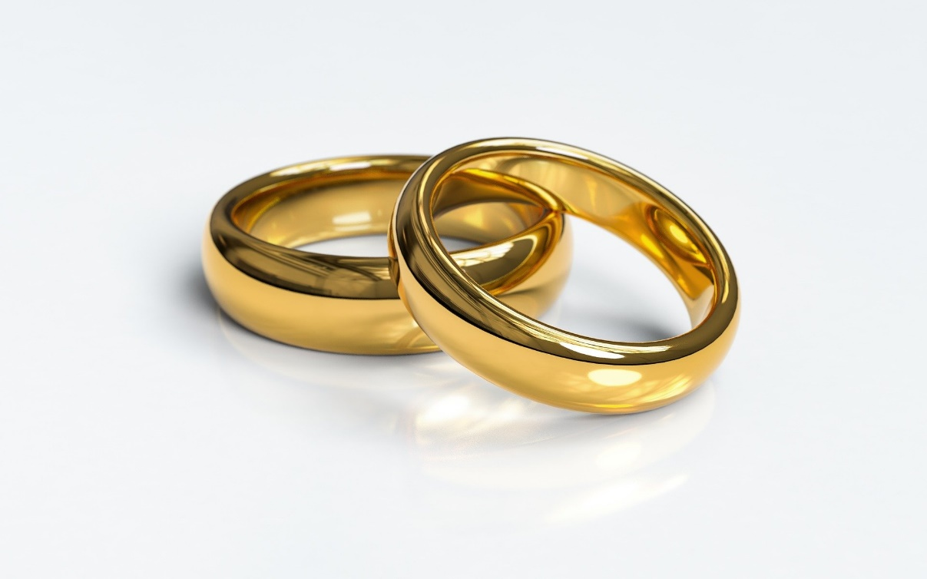
Long term commitments

Slide 10

Our class rules:
[Add your class rules here]
Notes:
Teacher Notes
Use this slide to display your class agreement / ground rules for PSHE education lessons.
- Everyone has the right to be heard and respected.
• We will use the correct terms, and if we don’t know them, we’ll ask the teacher.
• We will comment on what was said, not the person who said it.
• We won’t share our own, or anyone else’s, personal experiences.
• We won’t put anyone on the spot and we have a right to pass.
Egs. Of ground rules: everyone has the right to be heard and respected, we will use language that won’t offend or upset other people, we will comment on what was said, not the person who said it; we won’t share our own, or our friends’ personal experiences; we won’t put anyone on the spot and we have the right to pass; we won’t judge or make assumptions about anyone.

Slide 11
      We are learning about different types of relationships, including legal marriage and forced marriage
      We will be able to:
  describe the options available to people who wish to make a long term commitment
  explain how a long term relationship can become legally binding
  recognise the unacceptability of forced marriage and identify support for someone who may be at risk
Notes:
Teacher Notes – Learning objective and outcomes
Introduce the learning objective and outcomes and explain that today’s lesson will explore different types of long-term commitments and the differences between forced and arranged marriages.

Slide 12

Draw and write
Draw a person who is getting married
Draw or write what the person is thinking and feeling
Draw or write about where they are and who they are with
Draw or write about the things they have done to prepare for the marriage
Draw or write about why the person is getting married
Stretch: how important do you think marriage is to our society? Why do you think this?
Notes:
Teacher Notes - Baseline assessment (10 mins)
Ask students to independently complete a ‘draw and write’, using the prompts, to show somebody getting married.
Ensure that the language you use is neutral and non-biased, and do not give any further hints or tips, even if students ask questions. They should not share their ideas during the activity. This will give you the opportunity to see what students’ own beliefs and ideas are before the lesson begins.
Afterwards, they should share what they have drawn in pairs/groups and with you. Draw out any common ideas, misconceptions or stereotypes that students have about marriage (e.g. genders and ages of the couples, where the marriage is taking place, who is performing the ceremony etc.). Once completed, ask students to put their work aside, to be revisited at the end of the lesson.
Then, introduce the key terms – marriage, civil partnership (and why introduced/needed), cohabiting, ceremony, void/illegal, legal. Definitions can be found in teacher guidance document. Ensure students understand the difference between the different types of long-term commitments (see teacher guidance)

Slide 13



True or false?
Are the statements about getting married/forming a civil partnership true or false?
Write down your answers down in the boxes provided.
Notes:
Teacher Notes – True or false? (10 mins)
Ask students to complete the true or false quiz (Resource 1: True or False?) about the process of getting married. You could use a hands up/hands down or thumbs up/thumbs down approach to class feedback. After each statement, reveal the answer and share the supporting information, using Resource 1a: True or False? Teacher answers and notes.
Challenge: If a student has put ‘false’ for any statements, ask them to write what they think the true answer is

Slide 14

Scenario cards
In pairs, read the scenario cards and decide whether each shows a legal marriage or an illegal/void marriage.
Notes:
Teacher Notes – Scenario cards (10 mins)
In groups, ask students to read the scenario cards and decide whether each shows a legal marriage or an illegal/void marriage. Ask students to feedback, explaining why they have selected their answer. Reveal the correct answers and supporting information.
Challenge: For scenarios they think are illegal, ask students to discuss which part of the scenario is illegal and if anything could be done to make it legal
Support: Provide students with Resource 2b: Checklist (Support); a checklist against which they can assess each scenario.

Slide 15

Forced or arranged?
1. Draw a table, with ‘forced marriage’ on one side and ‘arranged marriage’ on the other. In pairs, write down what you think the features are of each type of marriage.
2. Re-read the forced marriage scenario with Jas and give advice about what Jas and her brother could do.
3. What might you do if Jas or her brother felt unable to follow this advice?
Notes:
Teacher Notes – Forced or arranged (15 mins)
In their books, students draw a table, with ‘forced marriage’ on one side and ‘arranged marriage’ on the other. In pairs, students write down what they think the attributes are of each type of marriage. Go through their answers as a class using Resource 3a: Forced or arranged? Answers to help you and provide supporting information and signposting.
Then, ask students to re-read the forced marriage scenario with Jas (scenario 4 in Resource 2: Scenario cards) and discuss and/or write a response, giving advice about what Jas and her brother could do. Then ask students to consider what they might do if Jas or her brother felt unable to follow their advice. Feedback advice and discuss ideas as a class.
Support: Provide students with statements to sort, using Resource 3: Forced or arranged? (Support – card sort)

Slide 16

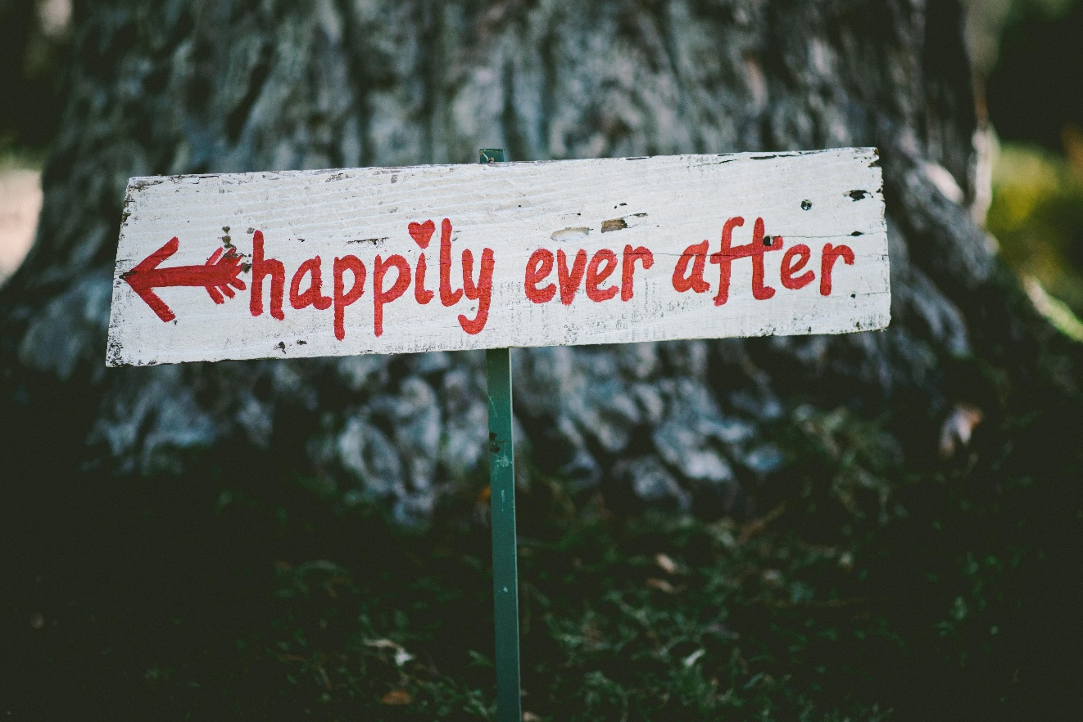
What has been learnt?
Go back to the draw and
write activity
Is there anything you would like to change?
Is there anything you would like to add?
Use a purple pen to amend your draw and write and show how your thinking has developed or changed.
Notes:
Teacher Notes – End-point assessment (10 mins)
Return to the draw and write from the start of the lesson. In another colour, ask students to use the original prompts and add their key learning or edit their initial ideas, using a different coloured pen.
Then, based on today’s learning and in preparation for the next lesson, ask students to come up with a list of 5 characteristics of a healthy, stable relationship. Feedback as a class.

Slide 17

Further support
Speak to a tutor, head of year or other trusted member of staff in the school
Contact the Forced Marriage Unit (FMU) if you are concerned about someone relating to forced marriage fmu@fco.gov.uk 020 7008 0151
Further information and support can be found:
Freedom Charity www.freedomcharity.org.uk
0845 607 0133
Childline www.childline.org.uk 0800 1111
Notes:
Teacher Notes – Signposting support
Remind pupils who they can talk to if they are worried.

Slide 18
More activities
Create an awareness campaign for younger students at school about the support available for those concerned about forced marriage. You should outline what forced marriage is and offer advice about where to and how to seek additional support, e.g. Childline, Freedom Charity, the FMU.
Use the information on the Childline website as a starting point: www.childline.org.uk/info-advice/bullying-abuse-safety/crime-law/forced-marriage.
Notes:
Teacher Notes – Extension activities
Ask students to imagine they are creating an awareness campaign for younger students at school about the support available for those concerned about forced marriage. They should outline what forced marriage is and offer advice about where to and how to seek additional support, e.g. Childline, Freedom Charity, the FMU. They may wish to use the information on the Childline website as a starting point: https://www.childline.org.uk/info-advice/bullying-abuse-safety/crime-law/forced-marriage/.

