Slide 1


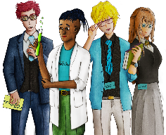




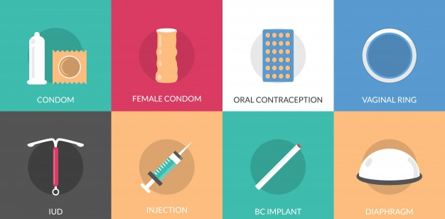



Types of Contraception available
Copy
title
Knowledge, Skills & Actions
IUS
Diaphragm
Patch
Abstinence
Injection
Femidom
To understand how a variety of different forms of contraception work
To be able to identify which types of contraception would be best used by different types of people
To explore which forms of contraception protect against pregnancy, STI’s or both
Vasectomy
Ring
IUD (Coil)
Implant
Pill
Condom
Withdrawal
Family planning
What does the term contraception mean?
Which is the odd one out and why?
Whose responsibility is it to organise and choose the right contraception?
New Vocabulary
IUD, IUS, Diaphragm, Patch, Injection, Vasectomy, Contraception Ring, Abstinence, Condom, Pill, Femidom
Tasks
Notes:
TEACHER NOTES & IDEAS
Remind students of the learning journey (What theme you are doing – Possibly recap what they can remember from last lesson.
ATTRIBUTION AND COPYRIGHT
– All icons and logos for Cre8tive Curriculum are created Inhouse by Michael Gillman ©
All images are sourced correctly – mainly through the following sites
either Premium licence at https://www.freepik.com/ or www.Pixabay.com or https://www.pixelscrapper.com/help
Some image have purchased also.
Factual information is not copyrighted.
Where information has been taken from reliable 3rd party websites – it is done so for analytical purposes in small pieces of text and for educational purposes.
Always check the content of any lesson and videos linked before teaching to ensure suitability for your classroom and your school
Further Terms and Condition regarding Copyright and our terms of use can be found on our website here https://cre8tiveresources.com/terms-of-use/

Slide 2


P9
Show respect
By listening
Not interrupting
Only 1 person talking at a time
Be open and honest but no personal comments – Discussions will be about ‘general situations’
Don’t make assumptions about people’s values, attitudes, behaviours, life experiences or feelings
P9 CLASSROOM RULES
You don’t have to say things about yourself if you don’t want to (You have the right to pass)
There are no stupid questions. A question box for anonymous Questions
It’s OK to get things wrong
Have a non-judgemental approach. No put downs and challenge the opinion not the person
Enjoy the lesson, Challenge your perceptions and understand how to seek further advice and support
Use the agreed appropriate Language (Avoid slang terms)
Conversations stay in the room unless it is a safeguarding issue
Don’t show the fact you are embarrassed through silliness
Notes:
TEACHER NOTES & IDEAS
Reinforce ground rules at the start of every new topic / new term
Adapt this set of rules to suit your classroom and your teaching.
Display your agreed PSHE classroom rules in a prominent place so students have a constant reminder and when/if a student breaks a rule you can use as a prompt to get them back on track.
If behavior is an issue revisit the ground rules – Use raffle tickets , positive behavior management (look for the good behavior)
Reward the behavior you want to see, be consistent and fair with students.
Create a classroom charter with the students (optional)

Slide 3













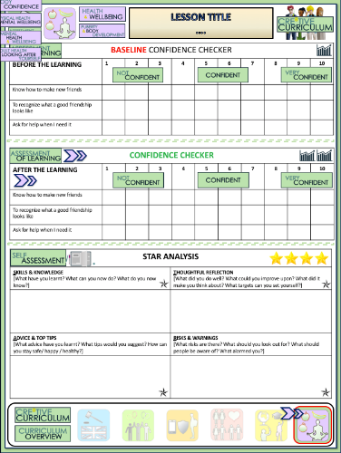







Types of Contraception Explained
BASELINE CONFIDENCE CHECKER
BEFORE THE LEARNING | 1 | 2 | 3 | 4 | 5 | 6 | 7 | 8 | 9 | 10
I can name a wide range of contraceptive methods
I understand how at least five different types of contraceptives work
I know where I can access further reliable information on this topic
Complete a baseline assessment of where you think you are at for this lesson
(Discussion or complete sheet)
2 Minutes
I’m not confident at all
I’m getting more confidence
Confident
Very
confident
Super
confident
Notes:
TEACHER NOTES & IDEAS
This could be done by writing a number down in the books
Show of fingers in the air. /Red amber Green Cards
Quick Partner Discussion
Print off the Assessment Opportunity Sheet – Fill in the Baseline Confidence Checker

Slide 4

Did you know?
ODD ONE OUT…
Why?
What does this term mean?
Abstinence is the practice of not having sex. Refraining from all aspects of sexual activity). IT is a safe, effective and free way to avoid getting pregnant and catching an STI
Notes:
Attribution: https://picpedia.org/handwriting/a/abstinence.html
The only one that doesn’t involve having Sex

Slide 5
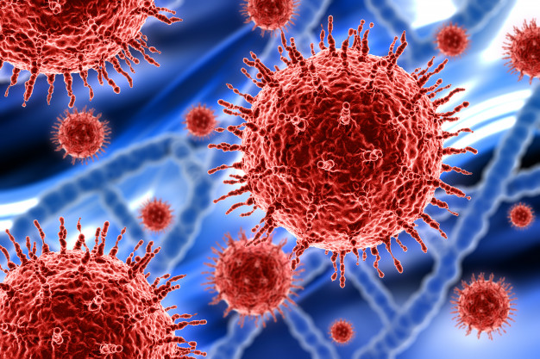
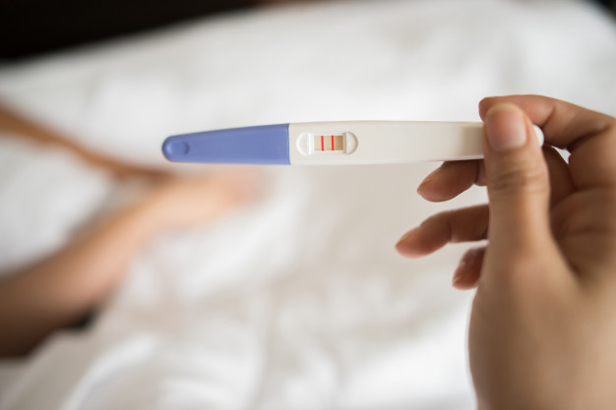
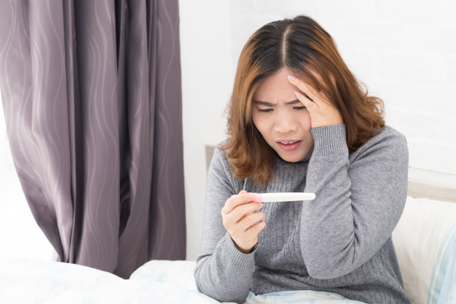
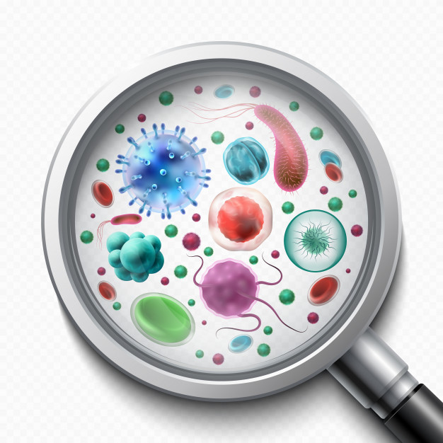
CONTRACEPTION HELPS TO REDUCE THE RISK OF TWO THINGS!
Notes:
Pregnancy and catching STI’s – Which can impact upon a person in many ways

Slide 6

You can get pregnant when standing up and having sex
Women and girls are more fertile at specific times of the month
Emergency Contraception (sometimes referred to as the morning after pill) only works the next day
Wearing two condoms (double bagging) makes sex safer
If a person is silent or doesn’t say no this means they have given consent
You can get many forms of contraception for free
You can use a small plastic bag or cling film instead of a condom
If a clinic gives you advice about contraception your parents will know
The contraceptive pill is effective at preventing STI’s
What do you think?
THE TRUTH
THE TRUTH
THE TRUTH
THE TRUTH
Notes:
TEACHER NOTES & IDEAS

Slide 7
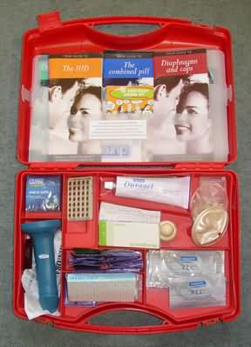
Contraception Kit – Show and Tell – If you own one
Helpful questions for today:
What is it?
Who uses it?
How does it work?
Where could you get it from?
How well does it protect against:
a) Pregnancy?
b) STI’s (Sexually Transmitted Infections)?
Did you know?
Some condoms are now vegan friendly and others are not made out of latex – There is a condom to suit almost everyone no matter what your allergy – ask at a pharmacy or your doctor
Notes:
TEACHER NOTES & IDEAS

Slide 8
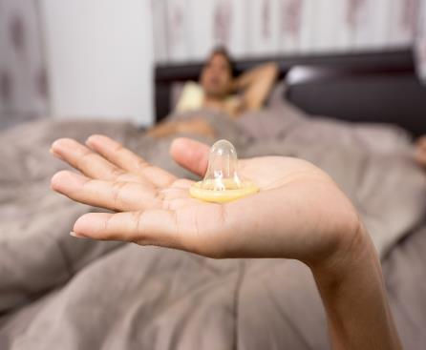
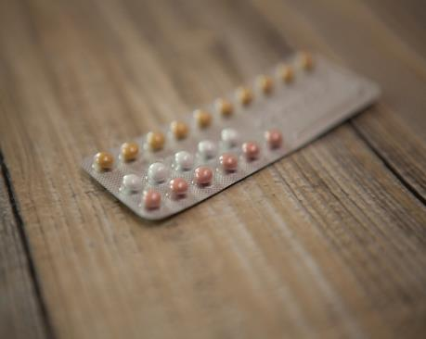
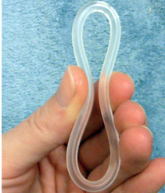
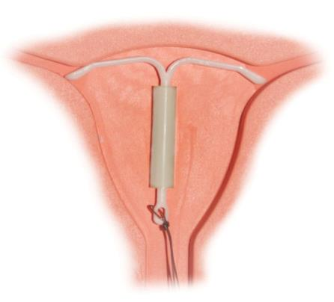
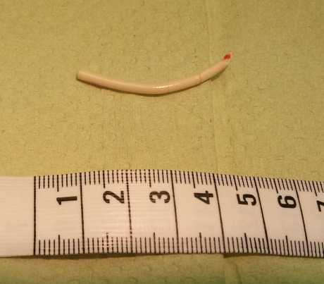
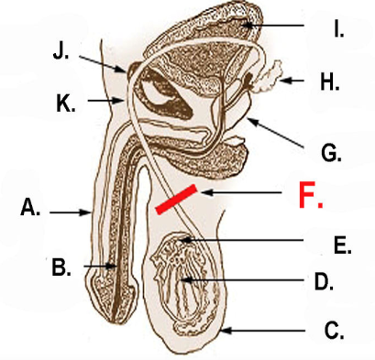
ROUND 1
IDENTIFY THE CONTRACEPTION METHOD
A
B
C
D
E
F
Implant
Pill
Condom
Vasectomy
Ring
IUD (Coil)
Notes:
A = Pixabay
B= from pixabay
C = Public domain author is sakky
D= Public Domain – Artist Waived Copyright
E= Attribution is to Vera De Kok
F= Copyright Waived on this piece
A list of licenses for the images used in this presentation can be found here: https://creativecommons.org/licenses/

Slide 9
ROUND 1
IDENTIFY THE CONTRACEPTION METHOD
A
B
C
Contraceptive Pill – Contains hormones and is taken daily at the same time by women. Stops the lining of the womb thickening.
Contraceptive Ring – Also known as the vaginal ring and is inserted into the vagina.
Condoms– Made of latex, put on to an erect penis before penetration
D
E
F
Vasectomy – Sterilisation, a surgery taken by men to prevent them from being able to produce children. For females this is called a Hysterectomy
IUD or Coil
– Small plastic and copper mechanisms that are placed in the womb. Prevents sperm meeting the egg
Implant–
A small tube inserted under the skin (usually in the arm). It releases hormones which prevent pregnancy
Notes:
A = Pixabay
B= from pixabay
C = Public domain author is sakky
D= Public Domain – Artist Waived Copyright
E= Attribution is to Vera De Kok
F= Copyright Waived on this piece
A list of licenses for the images used in this presentation can be found here: https://creativecommons.org/licenses/

Slide 10
ROUND 2
TRUE OR FALSE
A
You can get infected with AIDS but not HIV
E
Chlamydia is the most common form of STI in the UK
B
Taking the contraceptive pill will not prevent you from catching an STI
F
Most forms of contraception will also protect you from catching an STI
C
When used properly, condoms are 90% effective in preventing pregnancy
G
You can leave an IUD in the uterus for up to 15 years
D
The morning after pill is an effective form of regular contraception
H
HIV will eventually turn into AIDS if left untreated
Notes:
A list of licenses for the images used in this presentation can be found here: https://creativecommons.org/licenses/

Slide 11
ROUND 2
TRUE OR FALSE
A
You can get infected with AIDS but not HIV
E
Chlamydia is the most common form of STI in the UK
B
Taking the contraceptive pill will not prevent you from catching an STI
F
Most forms of contraception will also protect you from catching an STI
C
When used properly, condoms are 90% effective in preventing pregnancy
G
You can leave an IUD in the uterus for up to 15 years
They are 98% effective
3 – 10 Years
D
The morning after pill is an effective form of regular contraception
H
HIV will eventually turn into AIDS if left untreated
Notes:
A list of licenses for the images used in this presentation can be found here: https://creativecommons.org/licenses/

Slide 12
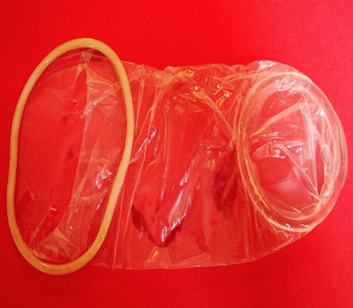
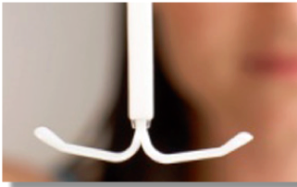
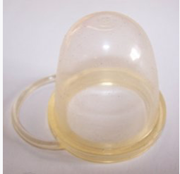
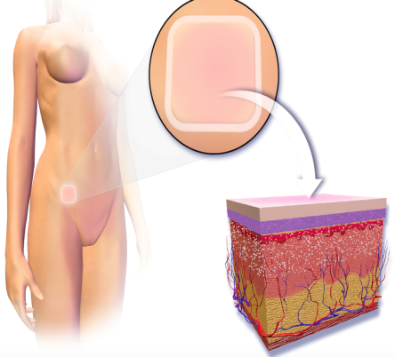

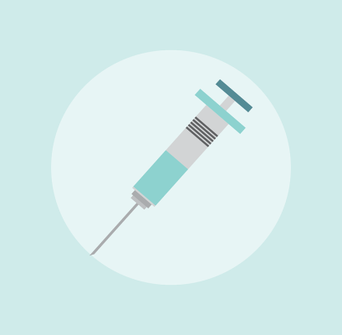
ROUND 3
IDENTIFY THE CONTRACEPTION METHOD
A
B
C
D
E
F
Abstinence
Injection
Femidom
IUS
Diaphragm
Patch
Notes:
A list of licenses for the images used in this presentation can be found here: https://creativecommons.org/licenses/

Slide 13
ROUND 3
IDENTIFY THE CONTRACEPTION METHOD
A
B
C
Femidom– A female condom used during intercourse as a barrier method of contraception. Similar to the condom
IUS Intrauterine System– Similar to IUD/coil, this contains contraceptive hormones and can last up to five years
Diaphragm or Cap –
A barrier methods of contraception it fits inside the vagina and covers the cervix
D
E
F
Contraceptive Patch
– Similar to the injection, placed on the skin it releases hormones into the body. Patches last 1 week and are worn for three out of every four weeks.
Injection– an injection that prevents pregnancy. Can last between eight and twelve weeks depending on the type
Abstinence – Restraining yourself from having any form of sexual contact
Notes:
A = Pixabay
B= Free under creative commons license
C = Pixabay
D= Blausen.com staff (2014). "Medical gallery of Blausen Medical 2014". WikiJournal of Medicine 1 (2). DOI:10.15347/wjm/2014.010. ISSN 2002-4436.
E= Copyright Waived on this piece
F= Pixabay
A list of licenses for the images used in this presentation can be found here: https://creativecommons.org/licenses/

Slide 14
ROUND 4
LINK THE KEY TERM
A
CONTRACEPTION
1
Union of a human egg and sperm
B
HUMAN FERTILISATION
2
Methods used to prevent pregnancy during sexual intercourse
C
COITUS
3
Often known as ‘a period’. The discharge of blood and mucus from the lining of the uterus
D
MENSTRUATION
4
Having sexual intercourse
Notes:
A list of licenses for the images used in this presentation can be found here: https://creativecommons.org/licenses/

Slide 15
ROUND 5
NUMBERS ROUND
What is the average age a girl starts her period?
A
8 -11
11-13
13-15
14-17
On average, how much is the morning after pill
(emergency contraception) from the chemist?
B
Free
£8-10
£13-18
£22-27
Roughly, how long is a women's menstrual cycle?
C
14 Days
28 Days
21 Days
35 Days
How many new STI cases were reported in the UK each year
between 2015 – 2017?
D
75,000
115,000
255,000
434,000
Notes:
A list of licenses for the images used in this presentation can be found here: https://creativecommons.org/licenses/

Slide 16
ROUND 6
ANAGRAMS –UNSCRAMBLE THE WORDS
Clue: All the words link to Contraception
A
N A G V I A
B
S T E A L I N G
C
M O D C O N
D
C A R T O N N P E C T I O
Notes:
A list of licenses for the images used in this presentation can be found here: https://creativecommons.org/licenses/

Slide 17
ROUND 7
MULTIPLE CHOICE – GUESS CORRECT
Which of these is a barrier method of contraception?
A
Condom
Patch
Contraceptive Ring
The Pill
Which of these is a long acting reversible (LARC) form of contraception?
B
Implant
Condom
Injection
The Pill
Which of these forms of contraception can be
used by males?
C
Femidom
The Pill
Injection
Condom
Which hormone is the male sex hormone?
D
Oestrogen
Haemoglobin
Progesterone
Testosterone
Notes:
A list of licenses for the images used in this presentation can be found here: https://creativecommons.org/licenses/

Slide 18


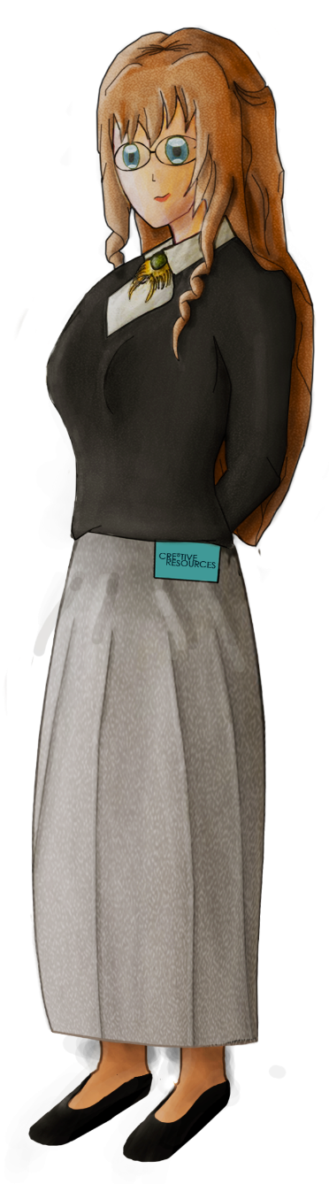





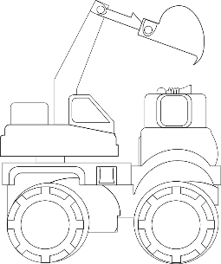
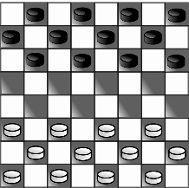

WHAT DO YOU THINK?
Talking points
I think that …
I don’t think… is right because…
My opinion is…
I would argue the same because…
I disagree with… because
Building on what ….
An alternate way of looking at this is…
I sort of agree, however….
In my view…
I would challenge what… said because …
“All contraception should be free of charge for everyone”
?
AGREE
ALTERNATE IDEA
DEVELOP
Disagree
Challenge
Alternative
Idea/option
DISAGREE
Develop
CHALLENGE
Notes:
TEACHER NOTES & IDEAS
Ask students what they think of this image (collection of images)
Reveal the talking points after some discussion time
To provoke discussion with a quiet class – play devils advocate
Challenge a student to a debate

Slide 19


3 Minutes
7 Minutes
6 Minutes
Play video
Play video
Play video
Femidoms
Contraceptive Pill
Contraception 101 Video
3 Minutes
2 Minutes
3 Minutes
Play video
Play video
Play video
LARC Methods
Barrier Methods
Contraceptive methods for males
Notes:
TEACHER NOTES & IDEAS
Pick and choose a video if more information is needed

Slide 20



Confidence Checker
AFTER THE LEARNING | 1 | 2 | 3 | 4 | 5 | 6 | 7 | 8 | 9 | 10
I can name a wide range of contraceptive methods
I understand how at least five different types of contraceptives work
I know where I can access further reliable information on this topic
Complete the confidence checker of where you think you are at for this lesson (Discussion or complete sheet)
3 Minutes
Notes:
TEACHER NOTES & IDEAS
This could be done by writing a number down in the books – Compare to the start of the lesson
Show of fingers in the air or use Red Amber Green Cards
Quick Partner Discussion & reflect on before the lesson and progress made
Print off the Assessment Opportunity Sheet – Fill in the Confidence Checker / Compare with the baseline
Author Attribution :https://pixabay.com/en/traffic-lights-traffic-light-phases-2147790/

Slide 21



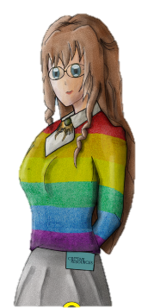
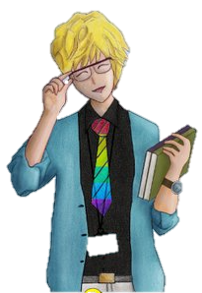





FOR MORE INFORMATION ABOUT THE TOPICS COVERED IN THIS UNIT
WE WOULD ADVISE ONE OF THE BELOW:
SPEAK TO YOUR PARENTS/GUARDIANS OR HEAD OF YEAR,
TRUSTED ADULT OR FRIEND IF YOU HAVE ANY CONCERNS ABOUT
YOURSELF OR SOMEONE YOU KNOW – IT IS ALWAYS IMPORTANT TO TELL SOMEONE!
VISIT THE BROOKE WEBSITE https://www.brook.org.uk/ FOR ADDITIONAL SUPPORT ON SEXUAL HEALTH AND WELLBEING FOR UNDER 25s
Enjoy the lesson, Challenge your perceptions and understand how to seek further advice and support
SPECIFIC FURTHER INFORMATION ON THIS TOPIC CAN BE FOUND HERE:
some pharmacies
a sexual health clinic (GUM clinic)
a contraception clinic
some young people's services – call the national sexual health helpline on 0300 123 7123 for details
Brook centers – for under-25s
GP surgeries
NHS Website https://www.nhs.uk/live-well/sexual-health/
2 Minutes
Notes:
TEACHER NOTES & IDEAS
Teachers should add in specific local signposting to charities, organizations or local NHS services in their area
Add / adapt or remove any suggested sites.
Print this slide and leave on door notice board after the lesson

Slide 22


I know if I need further
support or help I could
speak to…. or contact…
Before I could/would say
and do ... but now I feel I
am able to say
Before I only knew ...
now I also know ...
I supported others by…
One thing I didn’t
realise was… now I know that…
The key words for
this lesson are…
I always knew ... but now
I can see how it connects to…
The most important thing I
have learnt today is…
I’m really proud of the
way I have…
I used to feel ...
but I now feel ..
One assumption of
mine that was
challenged was…
I would like to learn…
A question I
would like to
ask is…
Before I thought that ...
but now I realise..
Today I have tried to…
Next lesson I would like to..
Before I would have done…
Now I will …
Before I would have
said ... but now I will say…
2 Minutes
A problem I overcame
today was…
Notes:
TEACHER NOTES & IDEAS
: Have students pick either 1/2/3 tickets depending on their ability and tell a partner
Pick a few students at random to feedback to the class
As students leave the room have them tell you their reflection on the way out

