Slide 1

English at LHS – Y9
Think: What is the average reading age of a GCSE exam paper?
15 years, 8 months

Slide 2
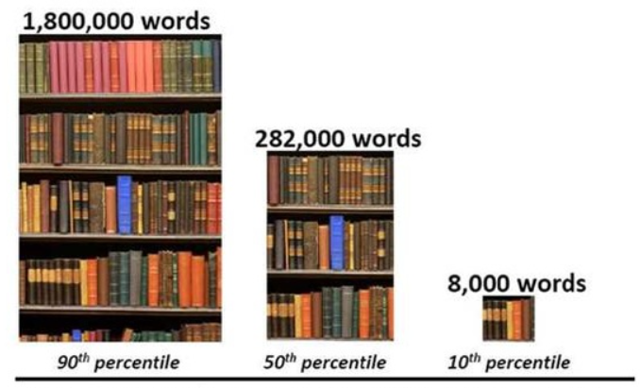
Did you know…?
"Research that we have done has shown that if children are reading and understanding on a daily basis for 19 to 24 minutes a day there's substantial growth. If they are reading and understanding for less than three minutes a day, they regress."
James Bell, director of professional services at Renaissance Learning
20 minutes per day (3,600 minutes per school year)
5 minutes per day (900 minutes per school year)
1 minute per day = 180 minutes per school year.
1,800,000 words
282,000 words
8,000 words
Notes:
AR until end of Y9 including DEAR time – important to extend vocabulary and understanding of more complex texts.
Students in Years 7 to 10 read for the first 20 minutes of the lesson
Students silently read their book
ZPD explanation
Home connect – parental information about which books have been read/quizzed on

Slide 3
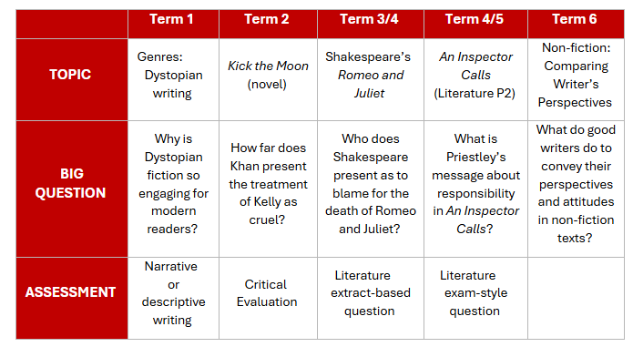
Year 9 Overview
Start of GCSE taught/ examined content
Reading Homework
Novel linked to unit
Revision Homework
Creating Flash Cards
Notes:
Explanation of the focus for units linked to GCSE Specs
Emphasise that R&J is not our examined GCSE text

Slide 4
English Language
Paper 1 – 1 hour 45 minutes
A: Exploring fiction [1 fiction extract] (25%)
B: Narrative and/or descriptive writing (25%)
Paper 2 – 1 hour 45 minutes
A: Comparing viewpoints [2 non-fiction extracts] (25%)
B: Viewpoint writing (25%)
Spoken Language assessment
Complete a speech and answer questions (up to 10 minutes)
Assessed in class in Year 10
Notes:
Show sample papers – explain amount that needs to be done in an hour for reading
Emphasise that every question must be answered for 4 and above

Slide 5
Spoken Language
Speech about a topic of interest for student
Speaking for between 4 and 6 minutes
Question and answer session to follow (2-4 minutes)
Marked as Pass, Merit or Distinction
All criteria in a level must be met to achieve a grade
This needs to be video recorded
  We must submit a sample of 30 videos – 10 of each grade – for moderation by the exam board.
Notes:
Explain spoken language requirements and that it is typically in front of class (fairness across students)
Appears on exam certificates.
Time to discuss topics that are of interest now. Mention complexity – e.g. ‘why I like football’ vs ‘sports psychology’ etc.

Slide 6
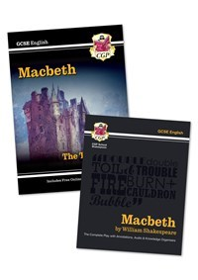



English Literature
Paper 1 – 1 hour 45 minutes
A: Macbeth
B: A Christmas Carol
Paper 2 – 2 hours 15 minutes
A: An Inspector Calls
B: Power and Conflict poetry
C: Unseen poetry

Slide 7
English Literature
Provided by school through exam board
Text bundle sold through school (start of Year 10)
CGP Macbeth text and guide
A Christmas Carol
Price checked at time of ordering currently around £7
Revision guides may be offered for purchase at cost price.
We choose best value at time of offering the bundle.
Sold earlier – end of Year 9

Slide 8
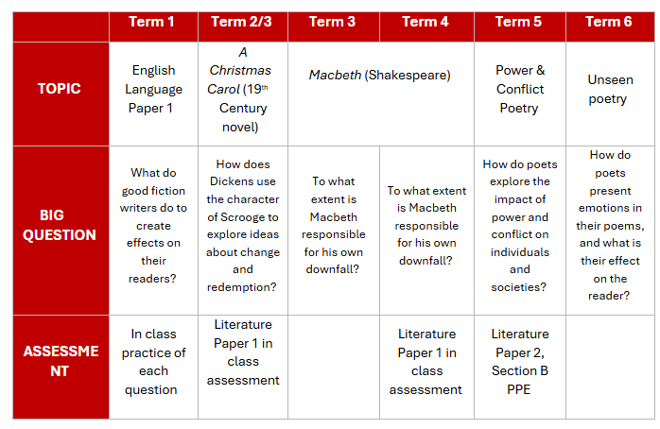
Year 10 Overview
Final exam taught in Y11 – English Language Paper 2

Slide 9
How do I support my child?
Wider reading
Establishing study/revision habits

Slide 10
Encourage wider reading (as early as possible)
  Read fiction through DEAR time/library books
  Engage in English reading homework
  Read fiction texts/extracts (20th/21st century)
  Read non-fiction opinion articles
    There are many good resources available online:
Non-Fiction-Anthology-Views-from-the-Verge.pdf (douglaswise.co.uk)
Fear-Anthology.pdf (douglaswise.co.uk)
Literary-Snapshots-PDF-.pdf (douglaswise.co.uk)
Narrative-Writing-Anthology.docx (live.com)
GCSE (9-1) English Language - Unseen 20th and 21st century literary texts (ocr.org.uk)
Notes:
Range of texts available
Build vocabulary – highlight/explore unknown words and revisit
Could have a notebook of new vocabulary (use in writing)

Slide 11

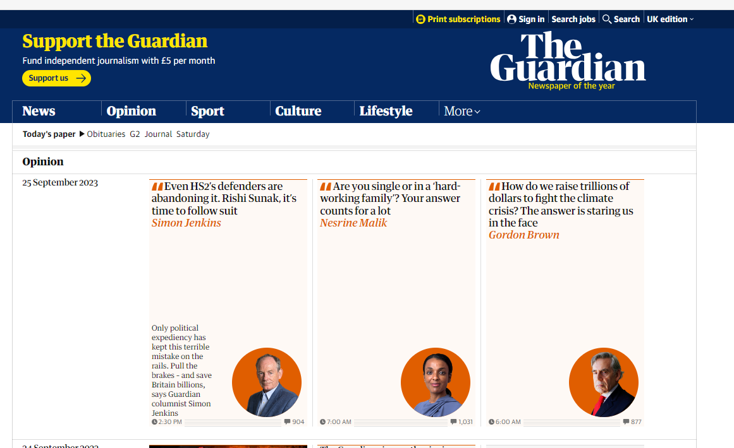
Encourage wider reading (as early as possible)
  Opinion | Theguardian | The Guardian
  Daily Mail Comment | Daily Mail Online
Similar articles from different sources/viewpoints
Notes:
Reading/discussing articles from multiple sources – start comparing viewpoints

Slide 12
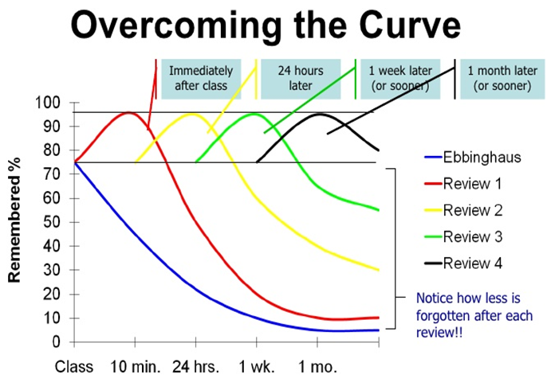
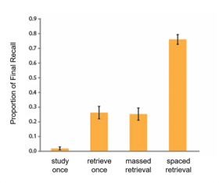
Encourage your child to test out a range of revision activities and space their retrieval/revision

Slide 13
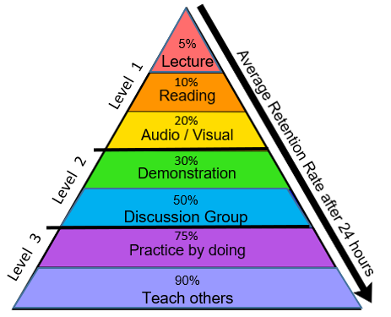
Level 1 RED – listen to audio recordings, listen to your teacher ORANGE – read class notes, revision guides, novel(s), poetry, webpage information YELLOW – watch videos, film adaptations, audiobooks; design a revision video or animation; produce a mind map; draw a diagram
Level 2 GREEN – record yourself and listen to notes, design a revision video or animation, produce a model, break down a topic into steps BLUE – hold a revision study group, attend after school sessions, discuss topics with friends, test others and share ideas
Level 3 INDIGO – complete exam-style questions, experiment and find out how things work VIOLET – explain, demonstrate or model an idea to another person (friend, relative, teacher etc.)

Slide 14
Encourage your child to test out a range of revision activities:
Posters/mind maps
Flash cards – homework in the Spring Term will help with this
Watch videos
  GCSE Pod
  Seneca
  YouTube (lots of links via
  LHS English website)
Make notes, lists etc.
LHS English Department (google.com)

