Slide 1

English at LHS – Y11
Think: What is the average reading age of a GCSE exam paper?
15 years, 8 months

Slide 2
English Language
Paper 1 – 1 hour 45 minutes
A: Exploring fiction [1 fiction extract] (25%)
B: Narrative and/or descriptive writing (25%)
Paper 2 – 1 hour 45 minutes
A: Comparing viewpoints [2 non-fiction extracts] (25%)
B: Viewpoint writing (25%)
Spoken Language assessment
Complete a speech and answer questions (up to 10 minutes)
Assessed in class in Year 10
Notes:
Show sample papers – explain amount that needs to be done in an hour for reading
Emphasise that every question must be answered for 4 and above

Slide 3
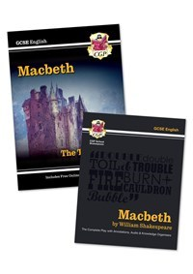



English Literature
Paper 1 – 1 hour 45 minutes
A: Macbeth
B: A Christmas Carol
Paper 2 – 2 hours 15 minutes
A: An Inspector Calls
B: Power and Conflict poetry
C: Unseen poetry

Slide 4
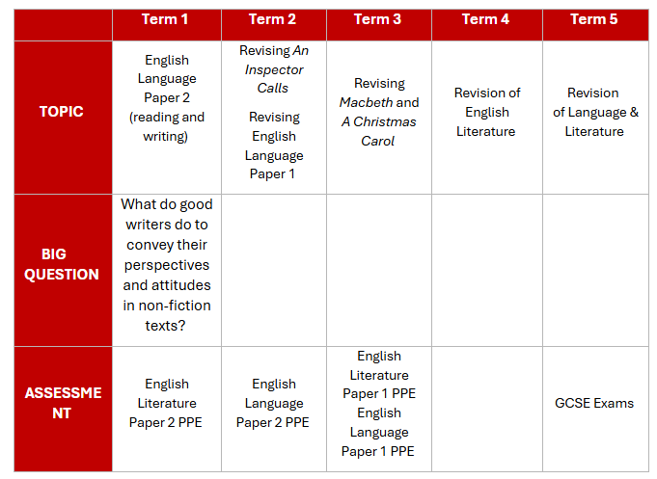
Year 11 Overview (dates for 2024-2025)
Upcoming PPEs
English Language Paper 2
An Inspector Calls essay, part of English Literature Paper 2
Language P1: 21st May 2026
Language P2: 5th June 2026
Literature P1: 11th May 2026
Literature P2: 19th May 2026
Notes:
Importance of knowing texts
re-read/listen to
Film adaptations/theatre trips
Range of revision tasks/revision packs to be provided
Revision work room

Slide 5
How do I support my child?

Slide 6
Encourage wider reading (it's never too late!)
Re-read Literature texts – Macbeth, A Christmas Carol, An Inspector Calls
Use revision guides and materials as part of their reading
Read fiction texts/extracts (20th/21st century)
Read non-fiction opinion articles
There are many good resources available online:
Non-Fiction-Anthology-Views-from-the-Verge.pdf (douglaswise.co.uk)
Fear-Anthology.pdf (douglaswise.co.uk)
Literary-Snapshots-PDF-.pdf (douglaswise.co.uk)
Narrative-Writing-Anthology.docx (live.com)
GCSE (9-1) English Language - Unseen 20th and 21st century literary texts (ocr.org.uk)
Notes:
Range of texts available
Build vocabulary – highlight/explore unknown words and revisit
Could have a notebook of new vocabulary (use in writing)

Slide 7
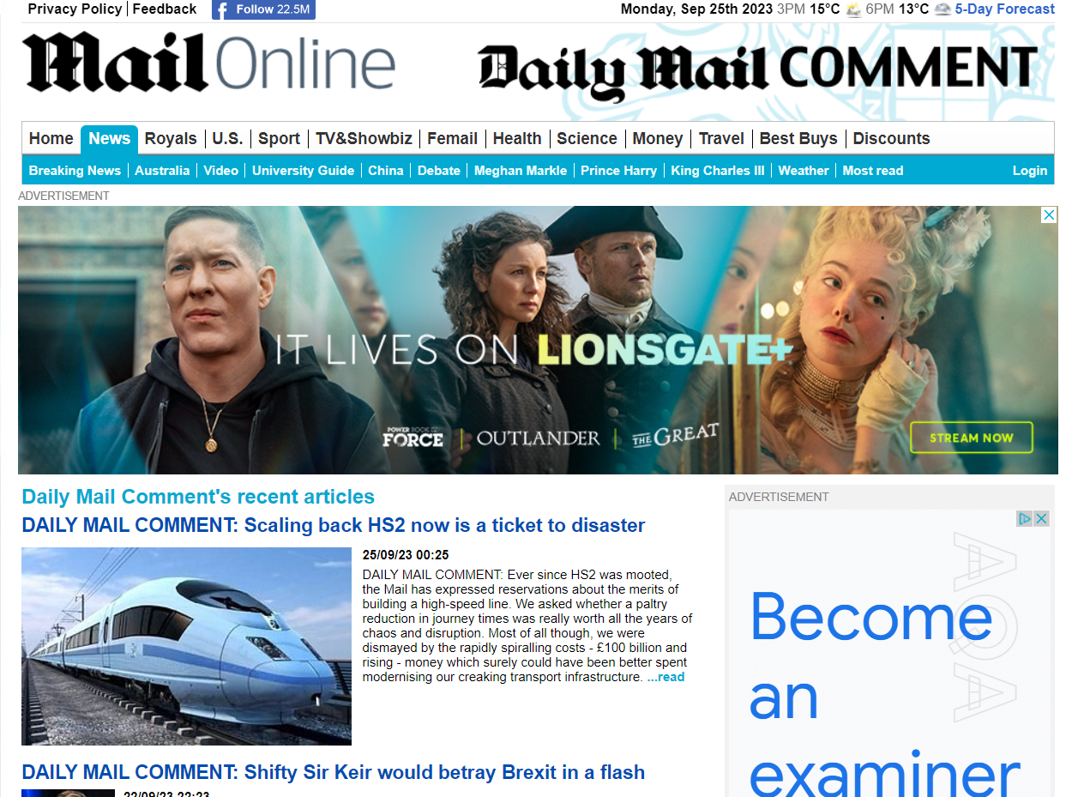
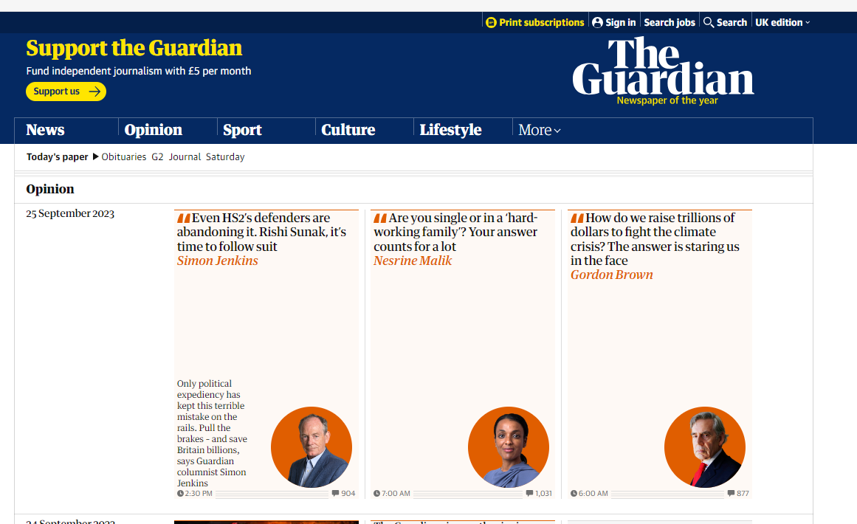
Encourage wider reading (it's never too late!)
Opinion | Theguardian | The Guardian
Daily Mail Comment | Daily Mail Online
Similar articles from different sources/viewpoints
Notes:
Reading/discussing articles from multiple sources – start comparing viewpoints

Slide 8
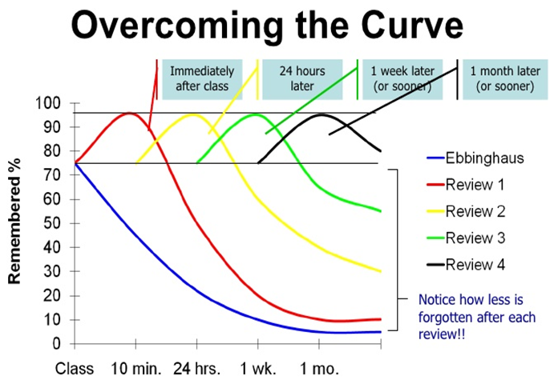
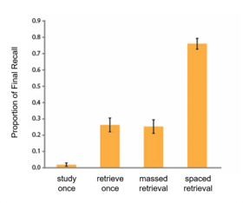
Encourage your child to test out a range of revision activities and space their retrieval/revision

Slide 9
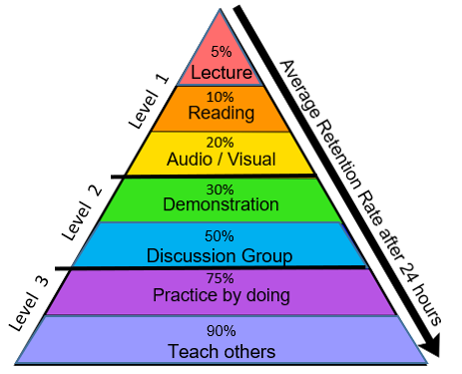
Level 1 RED – listen to audio recordings, listen to your teacher ORANGE – read class notes, revision guides, novel(s), poetry, webpage information YELLOW – watch videos, film adaptations, audiobooks; design a revision video or animation; produce a mind map; draw a diagram
Level 2 GREEN – record yourself and listen to notes, design a revision video or animation, produce a model, break down a topic into steps BLUE – hold a revision study group, attend after school sessions, discuss topics with friends, test others and share ideas
Level 3 INDIGO – complete exam-style questions, experiment and find out how things work VIOLET – explain, demonstrate or model an idea to another person (friend, relative, teacher etc.)

Slide 10
Revision websites
LHS English Department (google.com)
Links to YouTube/other sites for each text studied
Information about the structure of exams/papers
Links to revision materials/sample papers
Drama Online - Username: 8Hm-2Gh/p9 Password: 1Rc90U5&n#
Drama Online - Macbeth (dramaonlinelibrary.com)
GCSE Pod
Seneca
Macbeth Extracts | Shakespeare's Globe (shakespearesglobe.com)

Slide 11
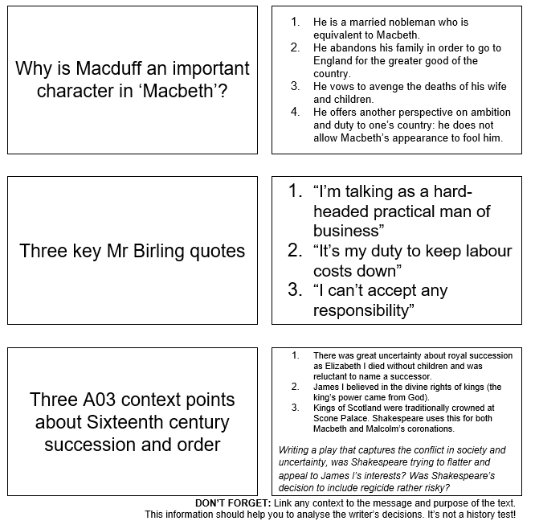
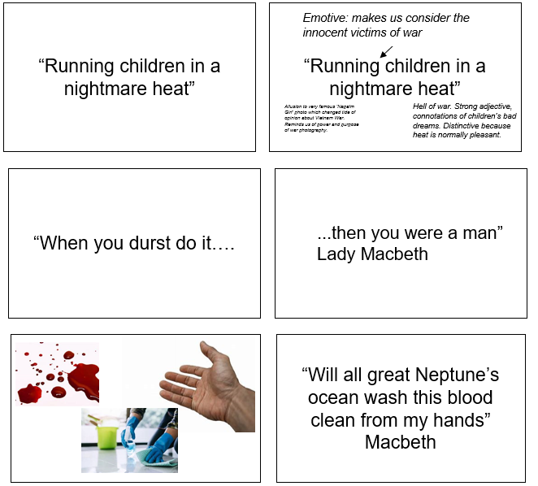
Flash cards
Department homework strategy
This term: Creating An Inspector Calls Flash Cards

Slide 12
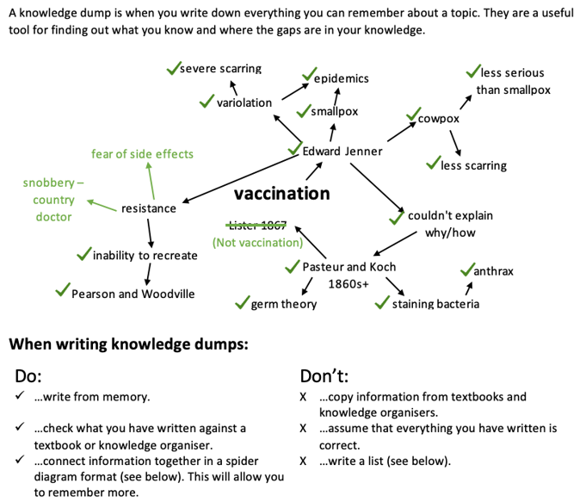
Knowledge dump

Slide 13
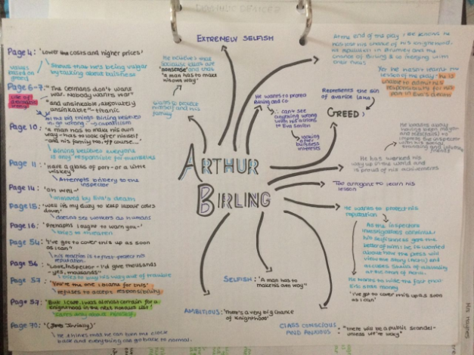
Mind map

Slide 14
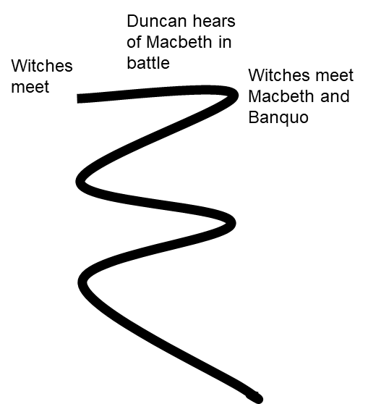
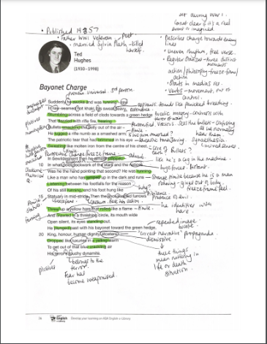

Annotation
timelines
Print out two copies of a poem.
Annotate it once using notes and/or a revision guide.
Cover it over.
Annotate a fresh copy from memory.
Compare and add in anything you missed in a different colour.
Revisit after a few days/weeks.
Create a timeline of the key plot points.
Then make one using only symbols to represent key events.
Repeat from memory.

