Slide 1
A level Spanish
6th form Induction Day
28/06/24

Slide 2
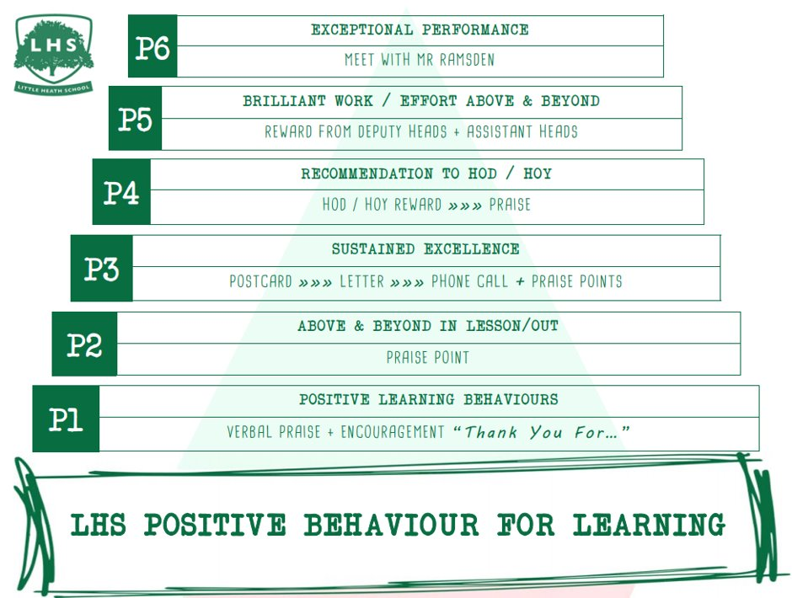
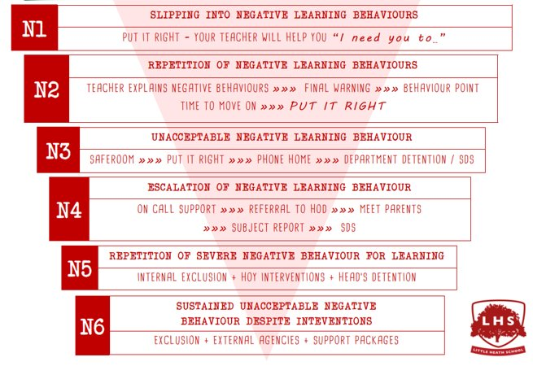


Title: Neuer Beruf: Influencer?
Aims:
To answer questions
in Spanish
2. To use different tenses
3. To use a model text
to help translate.
DNA:
On your board, write two sentences in Spanish about what you have done today already.
Thank you for being ready to learn!

Slide 3
A Level Spanish
Course overview

Slide 4
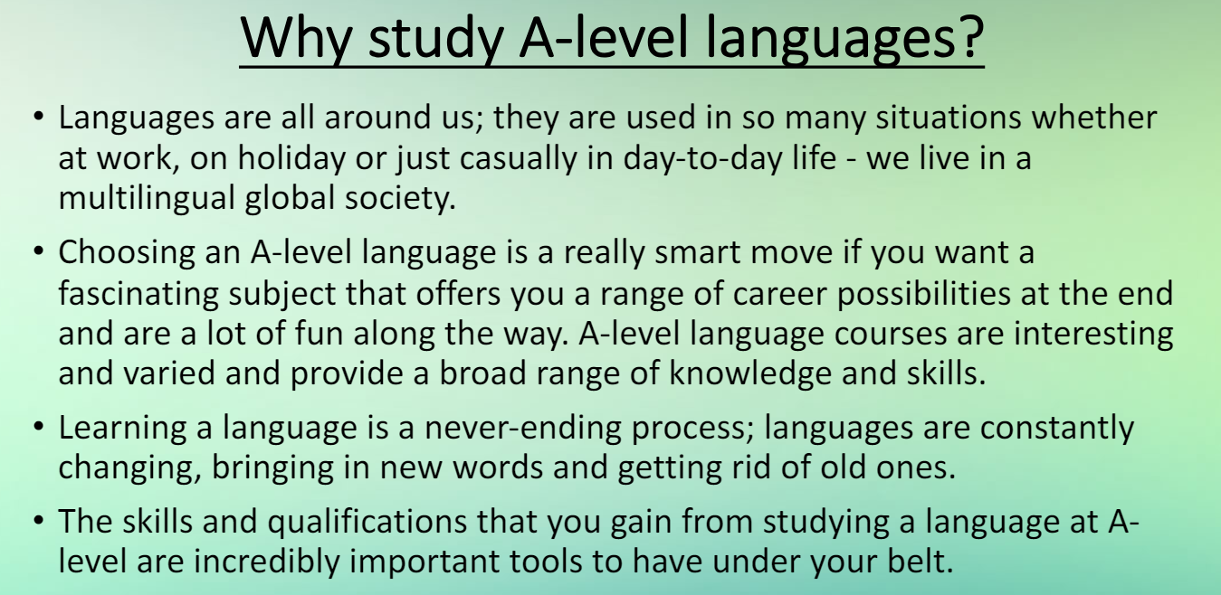

Slide 5


Slide 6
Students will study technological and social change, looking at the multicultural nature of Hispanic Society. You will study highlights odf Hispanic artistic culture, including a focus on Spanish regional identity and the cultural heritage of past civilisations. They will learn about aspects of the diverse political landscape of the Hispanic world

Slide 7
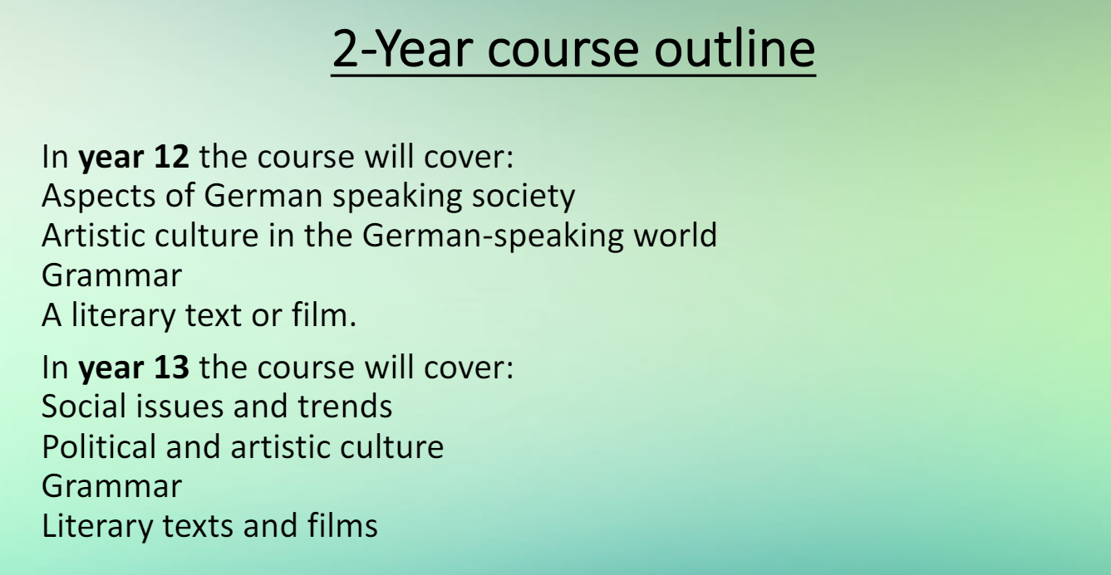

Slide 8
2 Year Course outline
In Year 12 the course will cover aspects of Spanish speaking societies
Artistic culture in the Spanish speaking world
Grammar
A Literary Text ( Como Agua Para Chocolate- Laura Esquivel) and a film ( Volver – Pedro Almodóvar).
In Year 13 the course will cover:
Social Issues and trends
Political and Artistic Culture
Grammar
Continuation of the same film and text chosen

Slide 9
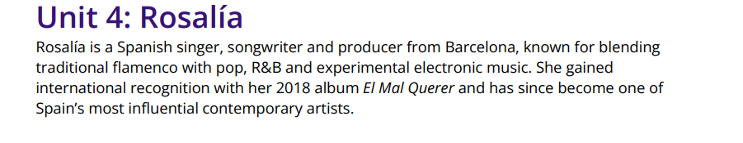
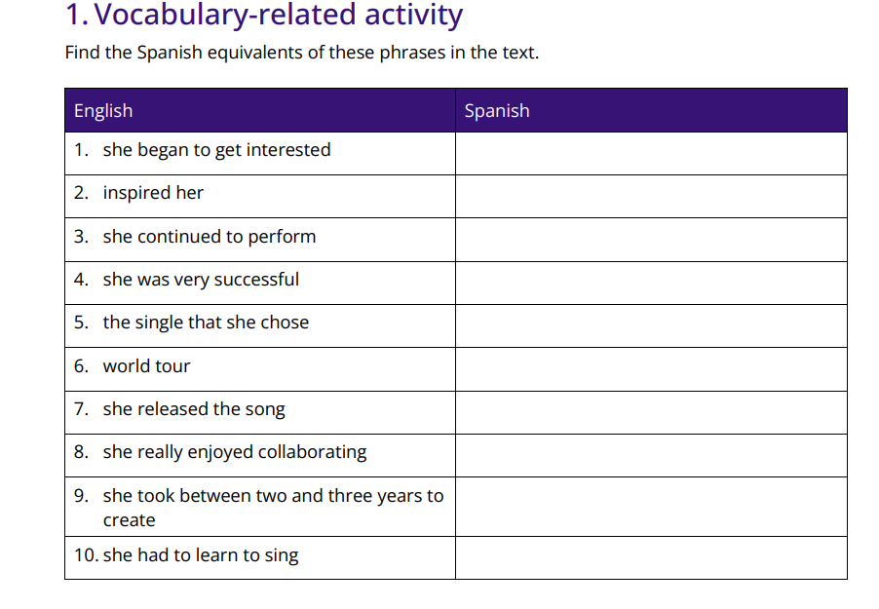

Slide 10
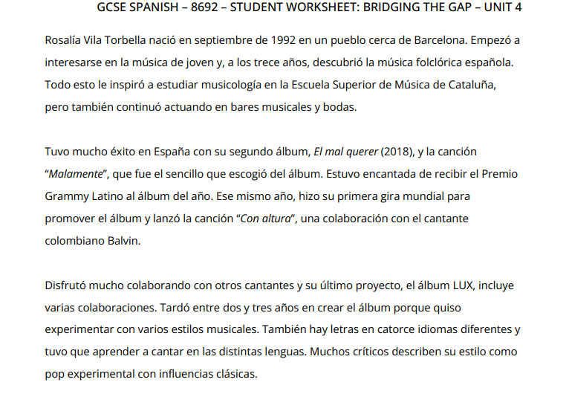

Slide 11
