Slide 1
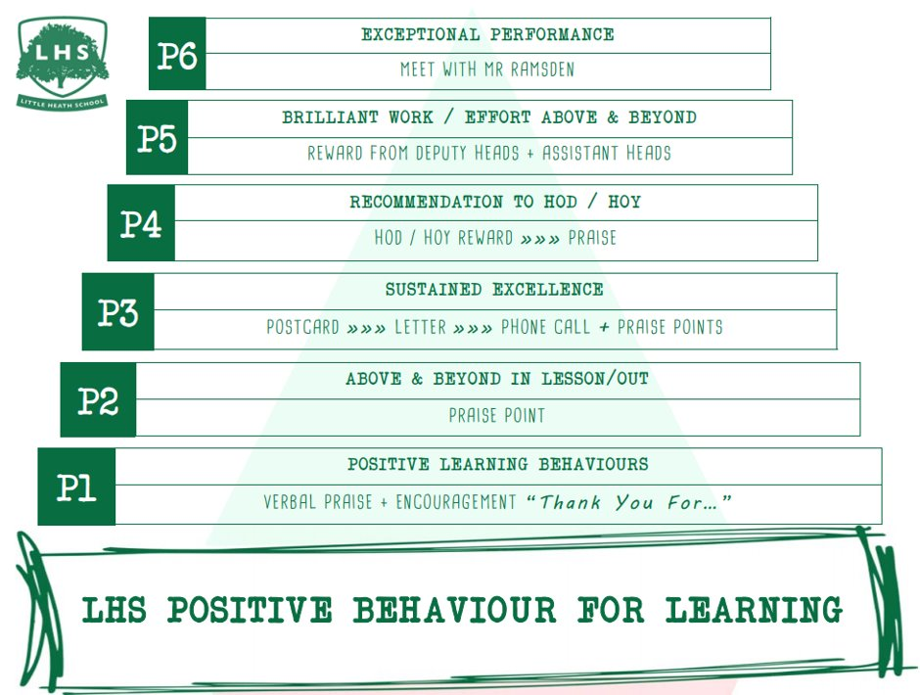
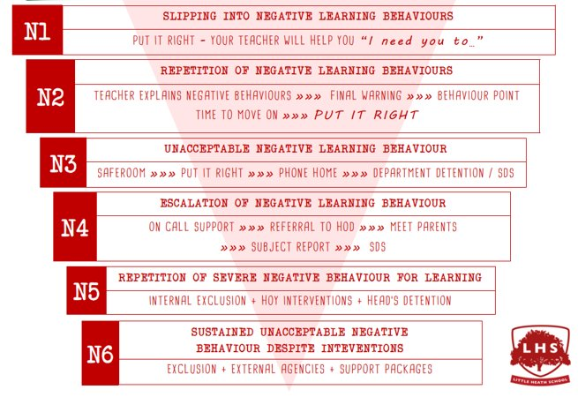


Title: A level Computer Science Induction
DNA:
Write in your notebook the names, symbols and truth tables of the logic gates that you learned at GCSE level.
Aims:
1 A level Computer Science Course structure and content
2 A means “Advanced” - more and “harder” work - think differently
Introduce/Revise Logical gates
Introduce Boolean Algebra
3 Programming - “Computer says no” - accuracy/fastidiousness is key
Beginner coding
Advanced coding
Thank you for being ready to learn!

Slide 2
Teachers - course delivery
Mrs P Bailey - Head of KS5/Computer Science
Programming Focused Y12
Theory Y13
Mrs Matthews

Slide 3
OCR A Level course structure H446
Paper 1 40% 2.5 hrs written exam
Paper 2 40% 2.5 hrs written exam
NEA (Project) 20%
https://www.ocr.org.uk/Images/170844-specification-accredited-a-level-gce-computer-science-h446.pdf
Notes:
There is a strong focus on programming, not an easy subject

Slide 4
Class challenges
Mixed abilities:
New to programming to A* at GCSE
v
A level focused (extending programming skills)
Required: Independent working students who can support each other

Slide 5
A means “Advanced” - more and “harder” work - think differently
For all A levels, it is about thinking at a higher level (as well as more work)
Introduce/Revise Logic gates
Introduce Boolean Algebra

Slide 6
Introduce/Revise Logic gates
GCSE students to explain logic gates and truth tables to other students

Slide 7
AND OR NOT Gates
These are electrical components from which circuits inside computer systems are built. The way that they are designed to work is called a truth table.
Electrical circuits can be designed from truth tables built of multiple gates.
To design a circuit, you would need to use Boolean Algebra.
3-boolean-algebra.pptx

Slide 8
NOT gate
If 0 is input it outputs 1
If 1 is input it outputs 0
A | P
0 | 1
1 | 0
INPUT
A
OUTPUT
P
Logic Diagram
Truth Table
Boolean algebra: P = NOT A
In Boolean notation: P = ¬A

Slide 9
AND gate
If both inputs are 1 then the output is 1
Otherwise the output is 0
A | B | P
0 | 0 | 0
0 | 1 | 0
1 | 0 | 0
1 | 1 | 1
INPUT
A
OUTPUT
P
INPUT
B
Logic Diagram
Truth Table
Boolean algebra: P = A AND B
In Boolean notation: P = A ∧ B

Slide 10
OR gate
If either input is 1 then the output is 1
Otherwise the output is 0
A | B | P
0 | 0 | 0
0 | 1 | 1
1 | 0 | 1
1 | 1 | 1
INPUT
A
OUTPUT
P
INPUT
B
Logic Diagram
Truth Table
Boolean algebra: P = A OR B
In Boolean notation: P = A ∨ B

Slide 11
OR Identities
1vA = 1
0vA = A
AvA = A
Av¬A = 1
1+A = 1
0+A = A
A+A = A
A+A’ = 1

Slide 12
AND Identities
A^A = A
A^¬A = 0
0^A = 0
1^A = A
A.A = A
A.A’ = 0
0.A = 0
1.A = A

Slide 13
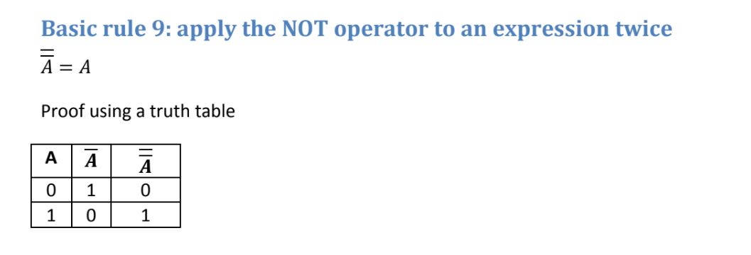
Also...

Slide 14
Basic Identities
1+A = 1
0+A = A
A+A = A
A+A’ = 1
A.A = A
A.A’ = 0
0.A = 0
1.A = A
A’’ = A
Write these down

Slide 15
Basic Identities
1vA = 1
0vA = A
AvA = A
Av¬A = 1
A^A = A
A^A’ = 0
0^A = 0
1^A = A
¬¬A = A
Write these down

Slide 16
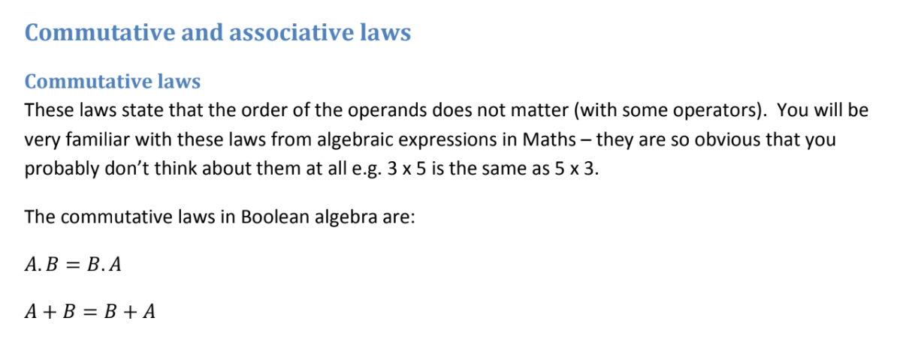

Slide 17
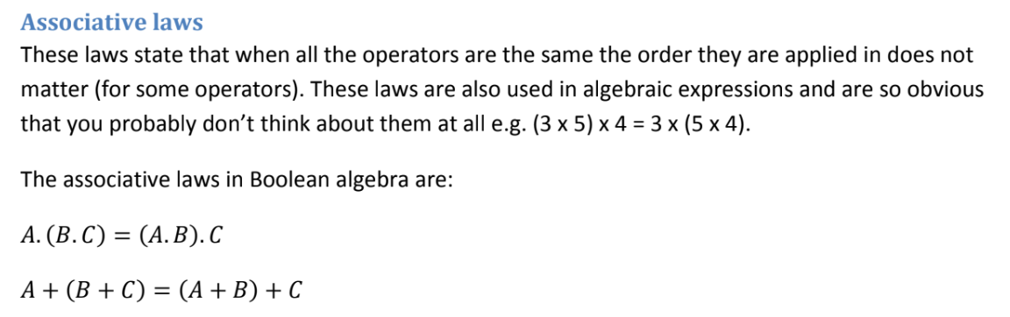

Slide 18
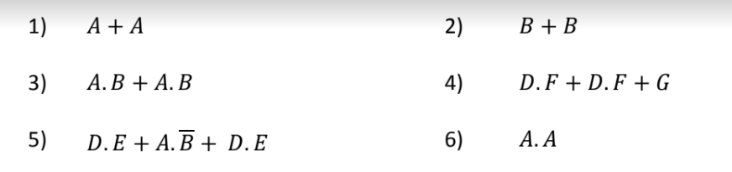
Questions to try

Slide 19
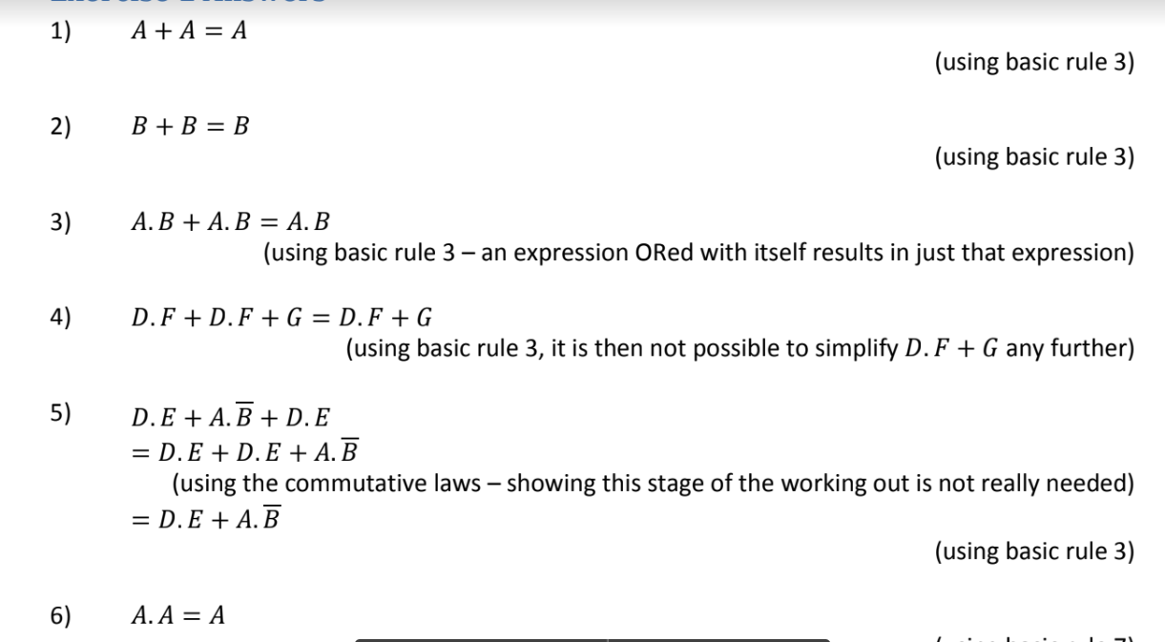

Slide 20
Programming - “Computer says no”
A large part of the course is programming
-structured logical thinking is needed
- accuracy/fastidiousness is key
At GCSE level you learn procedural style coding (7 lesson at A level)
At A level you learn Object oriented coding (7+ weeks at A level)
For a taster, you will be typing up sections of code to get it to run

Slide 21
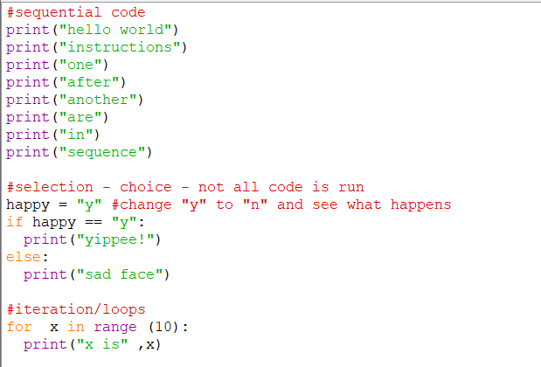
Basics of programming

Slide 22
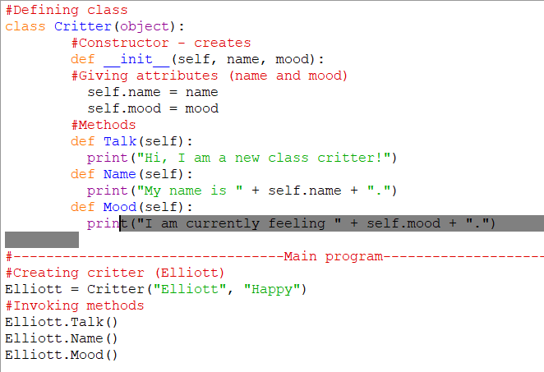
OOP style code

Slide 23
What you should have learnt from this lesson
Name of the course and an understanding of what will be taught in the course
How the course will be assessed
A ‘taste’ of the complexity of the thinking required but not a full understanding of Boolean Algebra
A ‘taste’ of programming

Slide 24
Questions
pbailey@littleheath.org.uk

Slide 25
#Defining class
class Critter(object):
#Constructor - creates
def __init__(self, name, mood):
#Giving attributes (name and mood)
self.name = name
self.mood = mood
#Methods
def Talk(self):
print("Hi, I am a new class critter!")
def Name(self):
print("My name is " + self.name + ".")
def Mood(self):
print("I am currently feeling " + self.mood + ".")
#---------------------------------Main program---------------------------------
#Creating critter (Elliott)
Elliott = Critter("Elliott", "Happy")
#Invoking methods
Elliott.Talk()
Elliott.Name()
Elliott.Mood()
Dylan = Critter("Dylan", "Sad")
Elliott.Talk()
Elliott.Name()
Elliott.Mood()

Slide 26
#sequential code
print("hello world")
print("instructions")
print("one")
print("after")
print("another")
print("are")
print("in")
print("sequence")
#selection - choice - not all code is run
happy = "y" #change "y" to "n" and see what happens
if happy == "y":
print("yippee!")
else:
print("sad face")
#iteration/loops
for x in range (10):
print("x is" ,x)

Slide 27
Resource Links
https://www.learnpython.org/
https://www.w3schools.com/python/default.asp
https://isaaccomputerscience.org/

Slide 28
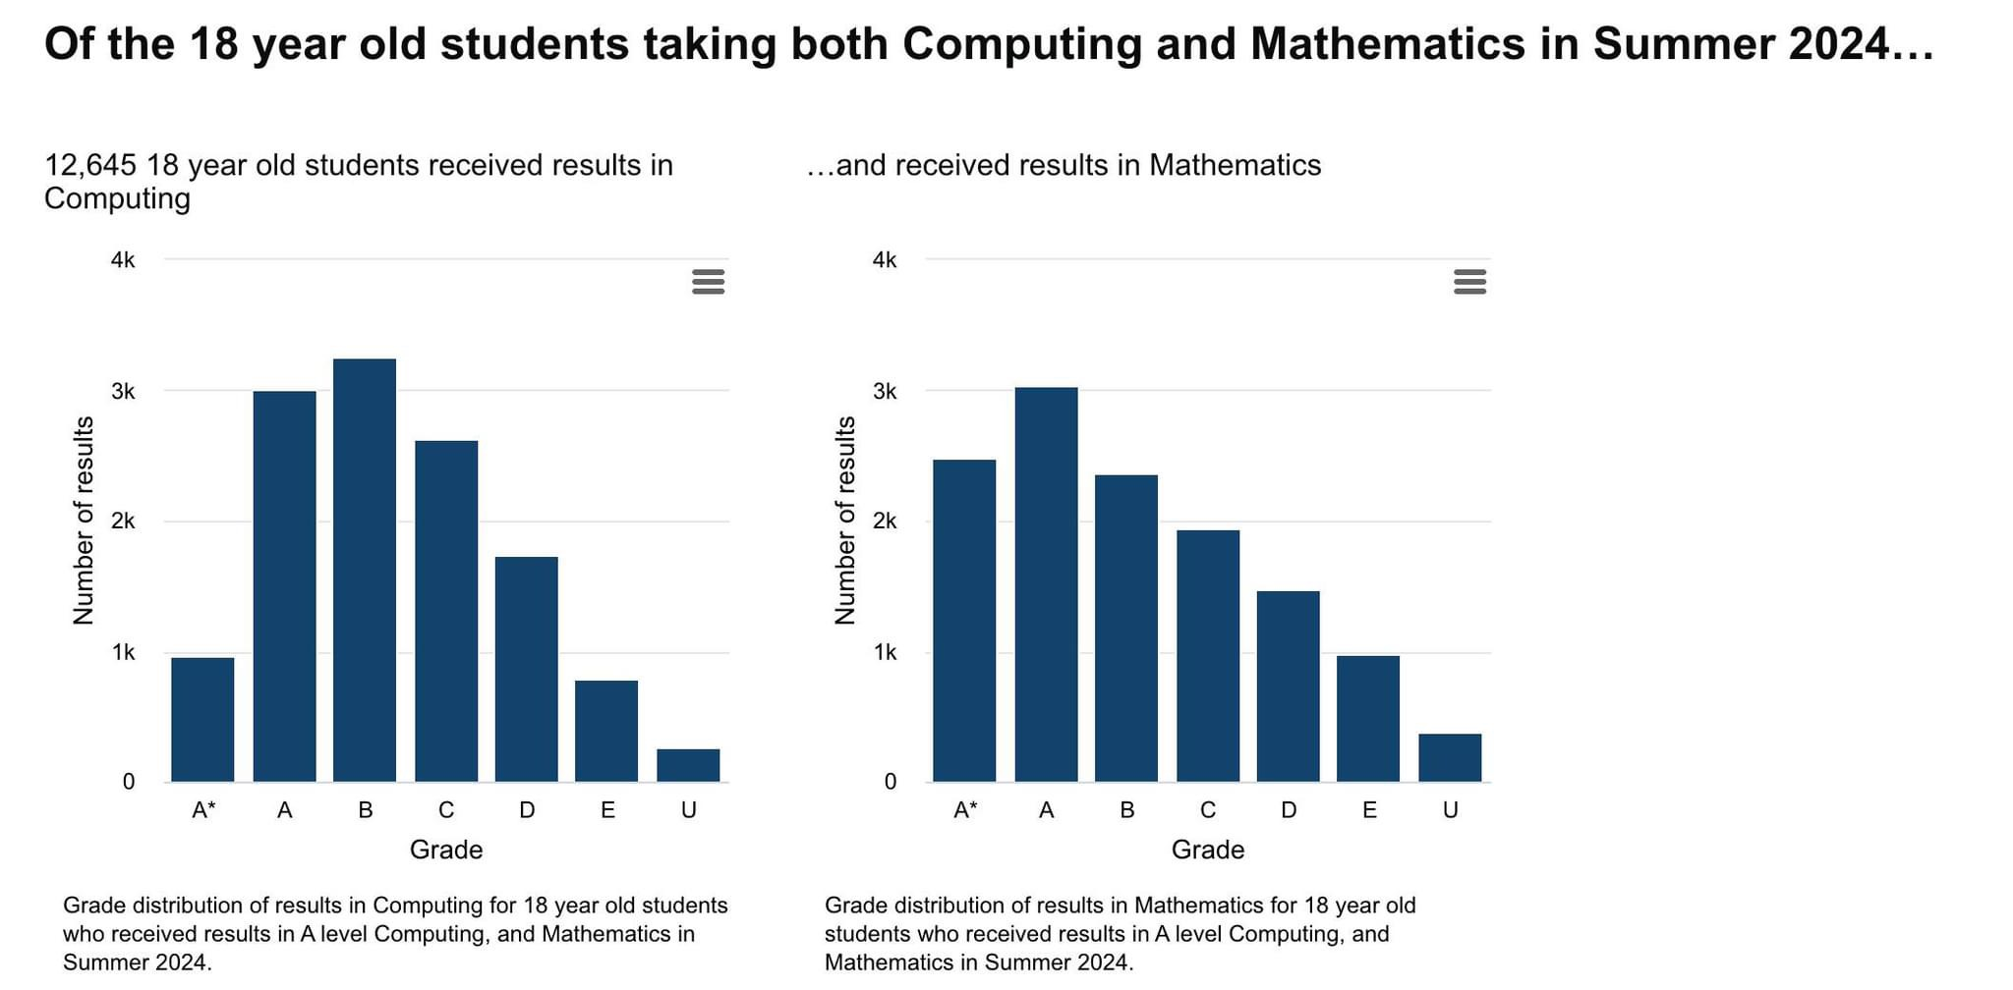

Slide 29
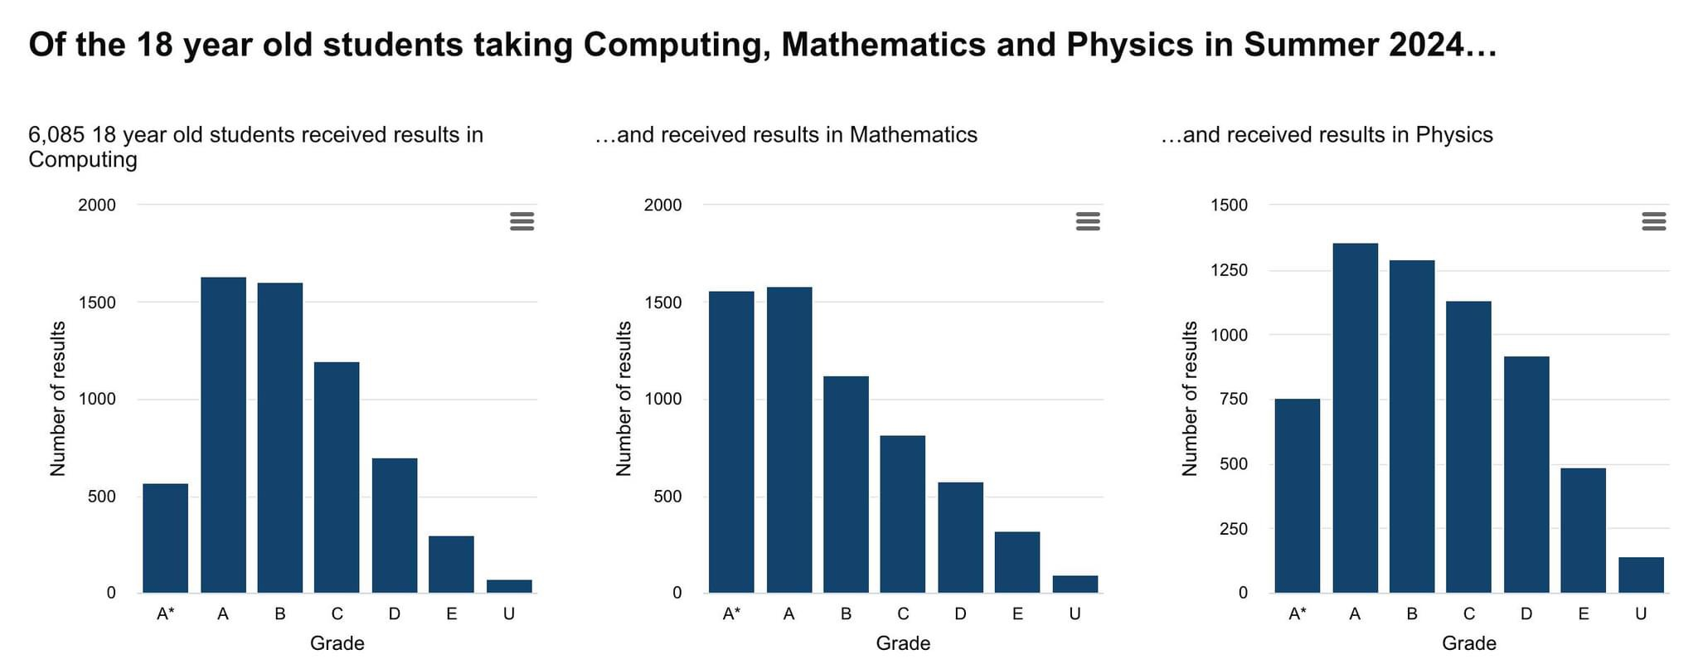

Slide 30
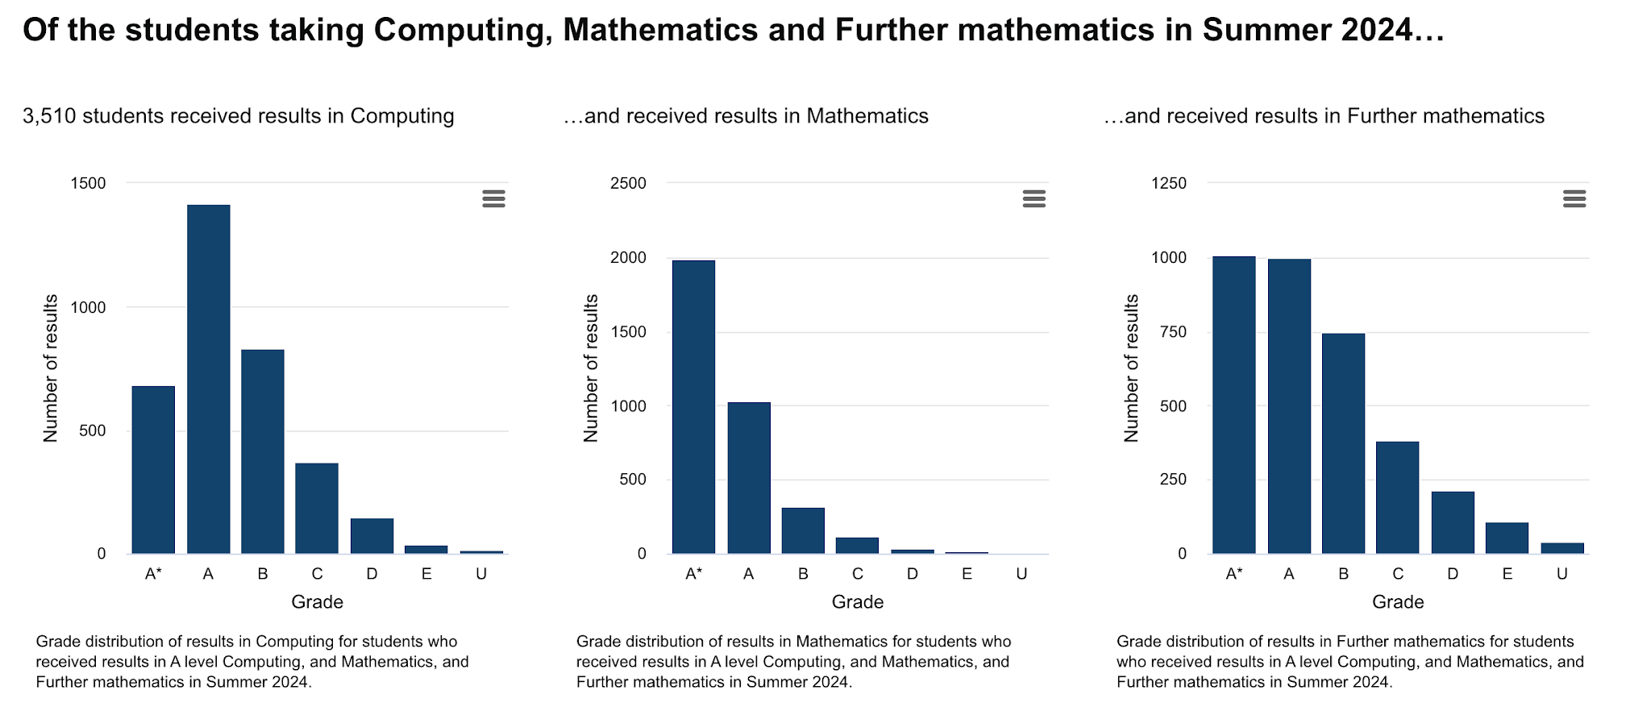

Slide 31
A level subject combinations and outcomes
https://analytics.ofqual.gov.uk/apps/Alevel/SubjectCombinations/

