Slide 1
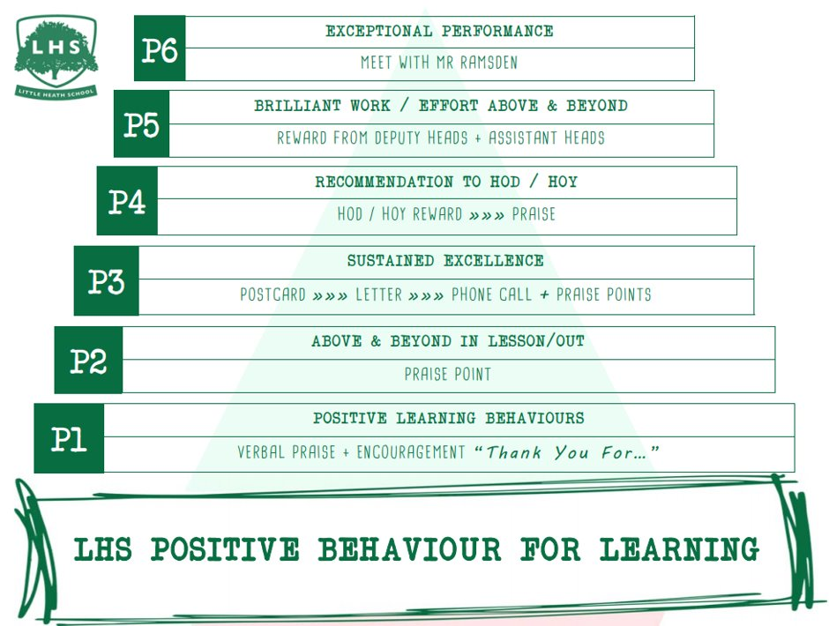
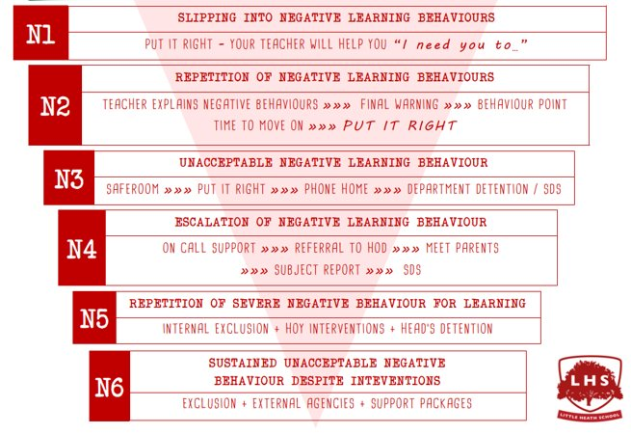


BTEC Sport
Intro to BTEC Sport exams and coursework.
Aims:
Introduction to the Anatomy and Physiology exam
Understand the unit 2 exam as a scenario task based exam
- Introduction to the coursework content of the course.
Thank you for being ready to learn!

Slide 2
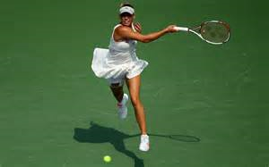
BTEC Sport
This course will cover 4 units
- 2 of these units will be exams
- 2 will be course work
The course will be over 2 years.
You will be graded with a: Pass, merit, distinction or distinction*

Slide 3
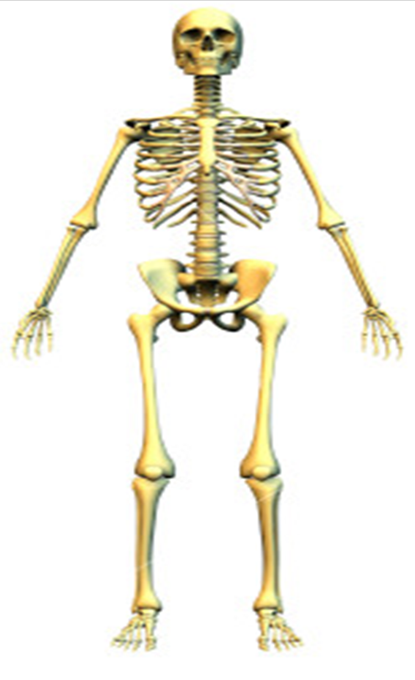
Principles of Anatomy and Physiology in sport
Exam – 1 hour 30 mins
Skeletal System (joints, bones, functions of the skeleton, how exercise can benefit the skeleton)
Muscular System (muscles, types of muscles, how exercise benefits the muscular)
Respiratory System (the function, the benefits of exercises on the system, factors affecting the system)
Cardiovascular System (key components, benefits of a healthy cardio system, how exercise benefits the system)
Energy Systems (key components, what each component does in relation to physical activity.

Slide 4
Task:
Using your previous knowledge please attempt to:
Label the skeleton work sheet, including the vertebrae column
Label the muscles work sheet
We will go through this together after.

Slide 5
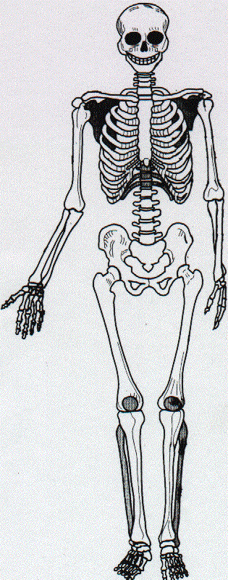
Cranium
Clavicle
Scapula
Sternum
Ribs
Humerus
Vertebral Column
Ulna
Radius
Carpals
Metacarpals
Phalanges
Femur
Pelvis
Patella
Tibia
Tarsals
Metatarsals
Fibula
Phalanges

Slide 6
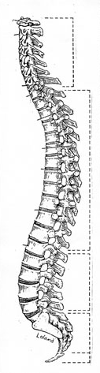
Vertebral Column
C1 (atlas)
C2 (axis)
What is in between the vertebrae?
Intervertebral disc
Cervical Vertebrae (7)
Thoracic Vertebrae (12)
How many vertebrae?
Which ones are fused?
Lumbar Vertebrae (5)
Sacrum (5 fused)
Coccyx (4 fused)
www.statemaster.com/encyclopedia/Vertebral-column

Slide 7
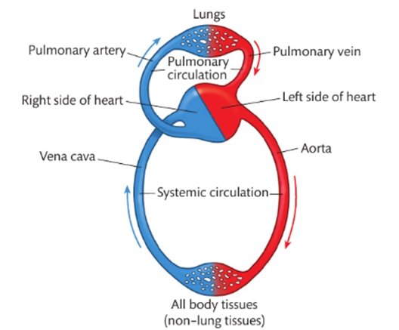
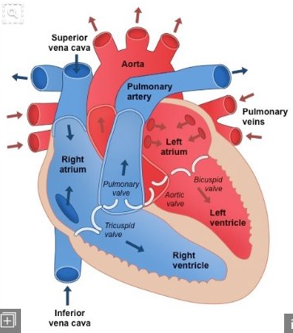
The cardiovascular system – complete the work sheet: label the structure of the heart

Slide 8
Unit 2 exam: Fitness training and programming for health and well-being
Task based exam – You will be given an scenario and required to answer questions using the content we have studied.
The effects of lifestyle choices on an individual’s health and well-being.
Fitness principles and theory, lifestyle modification techniques, nutritional requirements and training methods to an individual’s needs and goals.
Interpret screening information relating to an individual’s lifestyle questionnaire and health monitoring tests.
Evaluate how an individual’s health and well-being could be improve using a fitness training programme.

Slide 9
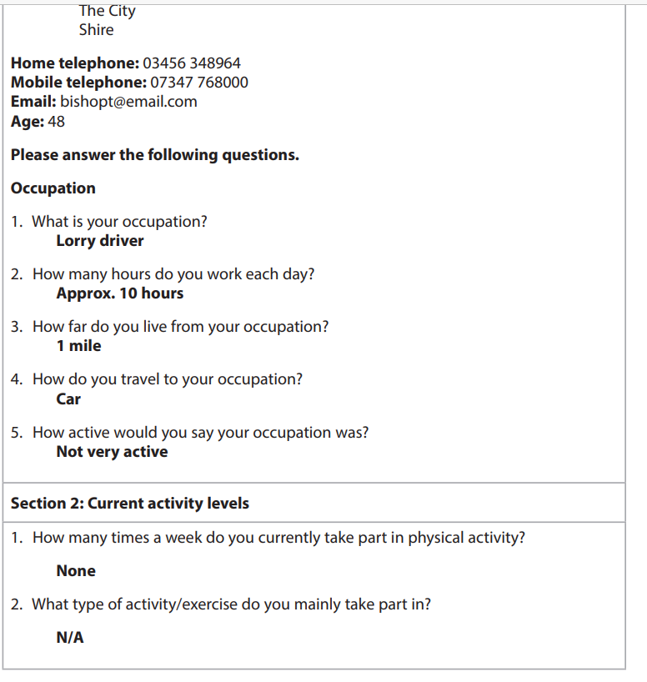
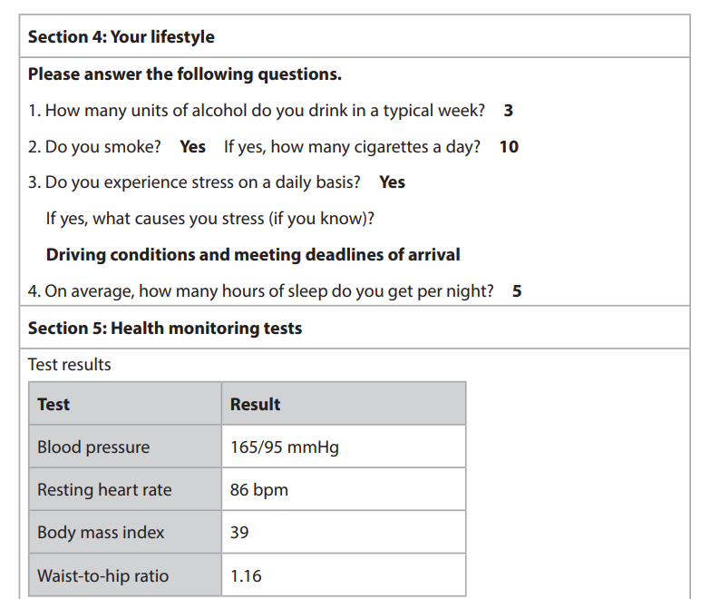
This Par Q questionnaire give us some ideas about how healthy our client is. What evidence can you identify which might provide suggestions about their health?

Slide 10
Task:
Looking at the previous information, what are the positives and negatives of their lifestyle?
What would you suggest they change for the better?
Research the NHS guidance for the average intake of alcohol, smoking, and health tests.

Slide 11
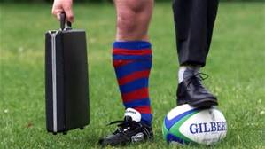
Professional development in sports industry
Coursework – A written assignment
Career and job opportunities in the sports industry.
Sports career development action plan.
Processes that can lead to a successful job in the sports industry.
offer in a selected career pathway.
The recruitment and selection process and your individual performance.

Slide 12
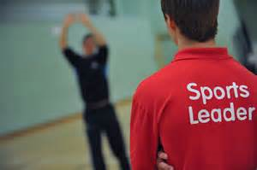
Sports leadership
Coursework – a written assessment.
The roles, qualities and characteristics of an effective sports leader.
The importance of psychological factors and their link with effective leadership.
Effective leadership style when leading a team during sport and exercise activities.
You will plan a lesson and teach it to a year 7 group.

Slide 13
Task:
Imagine you are year 4 pe teacher:
Create a pe lesson of your choice, which allows students to improve in a certain skill.
Think about:
  What drills will help them learn?
  What equipment will you need?
  How long will each drill need to be?
  Now can you justify why you have chosen these.

Slide 14

For success in the BTEC sport
You must be able to:
Work independently
Produce your own independent work to a high written standard
Research information and select important key information.
Be organise, determined, reflect on feedback.
Complete and submit work by deadlines.
Prepared to work in your own time away from
the structured lessons.

