Slide 1
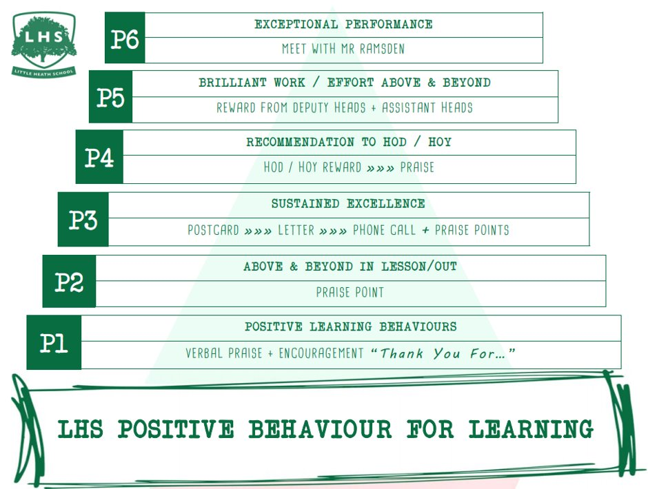
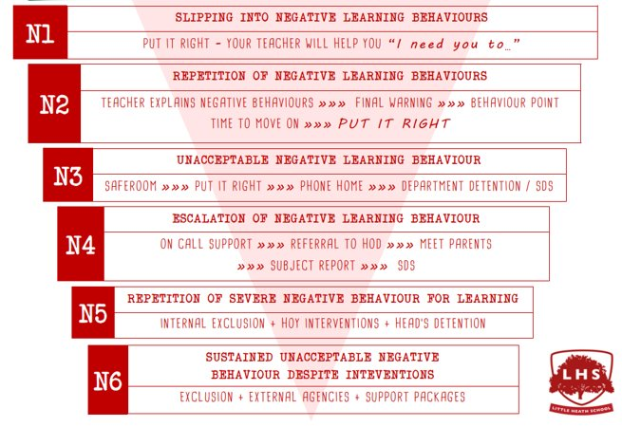


Title: English Literature Taster Lesson
DNA:
What makes you laugh?
Aims:
To entice you all into signing up for Eng Lit
Thank you for being ready to learn!

Slide 2
English Literature is divided into two papers:
Aspects of comedy:
Twelfth Night
Comedy Poetry
Elements of social and political protest:
The Kite Runner
A Doll's House
Blake's Songs of Innocence & Experience or Tony Harrison Poems
Unseen

Slide 3
Watch the video carefully and make notes on what is meant to be funny-
What do we need to know before watching?
What expectations do we have as an audience?
What different types of comedy appear?
How funny do you think it is?

Slide 4
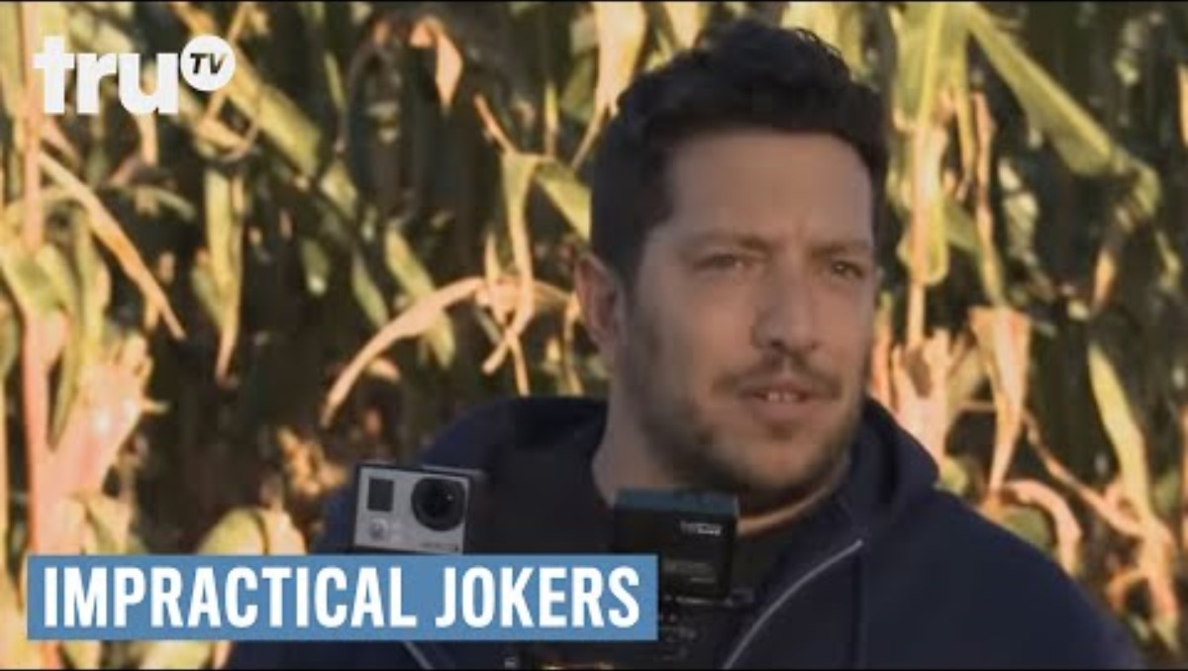

Slide 5

Still I Rise by Maya Angelou
What elements of social and political protest can you find in this poem?
How does Angelou present her ideas?

