Slide 1
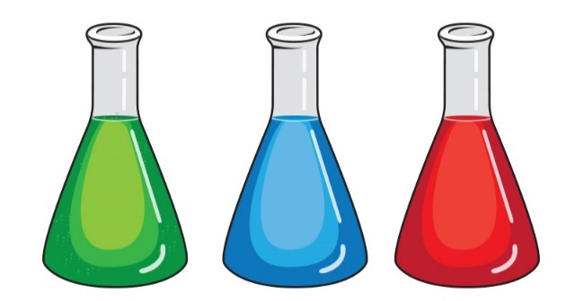
Year 11 : Chemistry taster lesson
Aims :
To find out a little bit more about A level Chemistry
To learn what an oxidation state is
To learn about the oxidation states of vanadium

Slide 2

Starter
Look at the demo of copper reacting with concentrated nitric acid.
What do you observe?
Can you explain any of your observations?

Slide 3
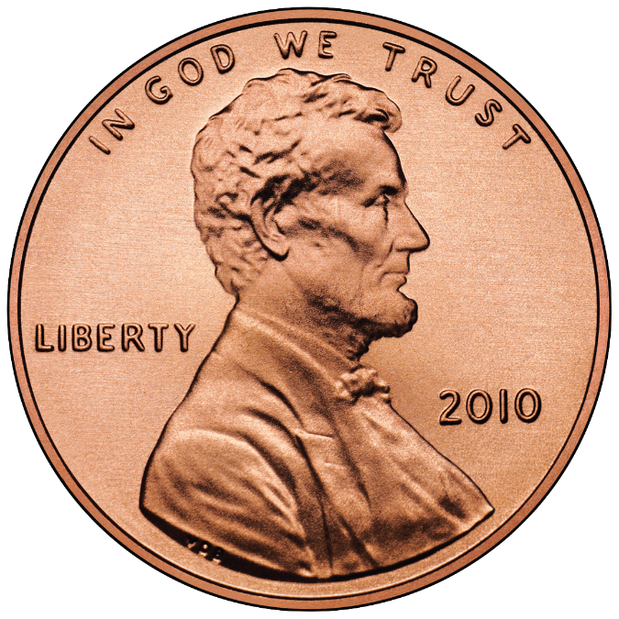
Nitric acid is a strong oxidising agent and can oxidise the copper :
Cu + 4HNO₃ → Cu(NO₃)₂ + NO₂ + 2H₂O
Why is this a REDOX (reduction and oxidation)

Slide 4
Oxidation state rules
1. ELEMENTS (e.g Na, Mg, O₂ and N₂) have an oxidation state of 0; they have not lost or gained electrons.
2. The oxidation state of simple ions (e.g. Na⁺ , Mg²⁺, O²⁻, Cl⁻¹) is the same as their charge e.g Na⁺ (lost one electron) , O²⁻ (gained two electrons)
3. In a compounds, all the oxidation states add up to zero.
E.g. H₂SO₄

Slide 5
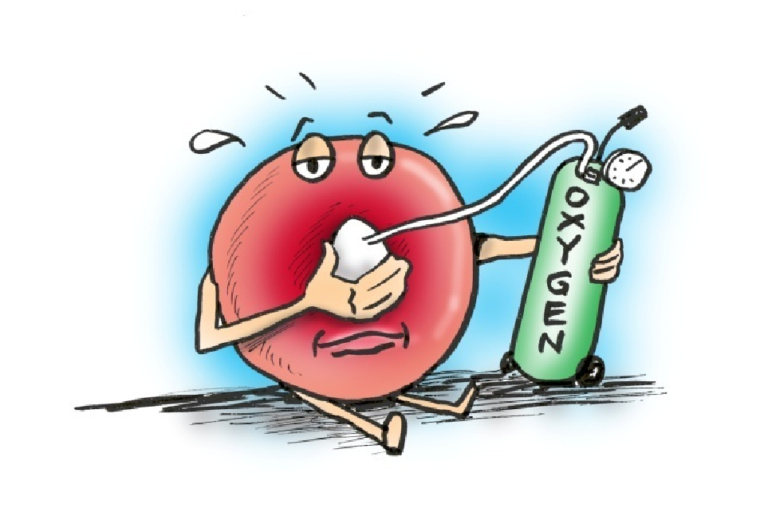
Complete the questions about oxidation state to practice

Slide 6
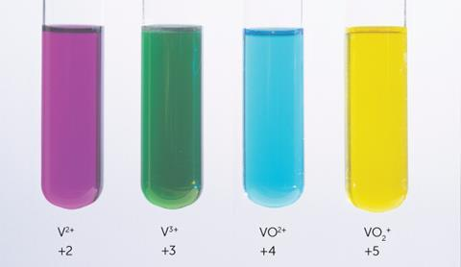
Oxidation states of vanadium
Vanadium is a compound that has a variety of different oxidation states. It is a transition metal.

Slide 7
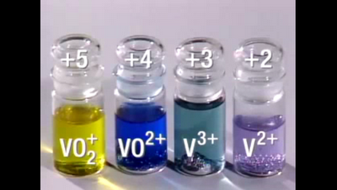
Practical results
Zinc is a reducing agent
Potassium permanganate is oxidising agent

Slide 8

Plenary
Any questions about the A level course?

