Slide 1


Careers in Berkshire:
Local labour market information
2021

Slide 2

Introduction
The purpose of this presentation is for schools and young people to understand:
The current landscape of the job market in Berkshire
Jobs that will be required in Berkshire now and in the future
Technical skills that will be required now and in the future
Soft skills that will be required now and in the future
The impact of COVID-19 on the job market in Berkshire

Slide 3
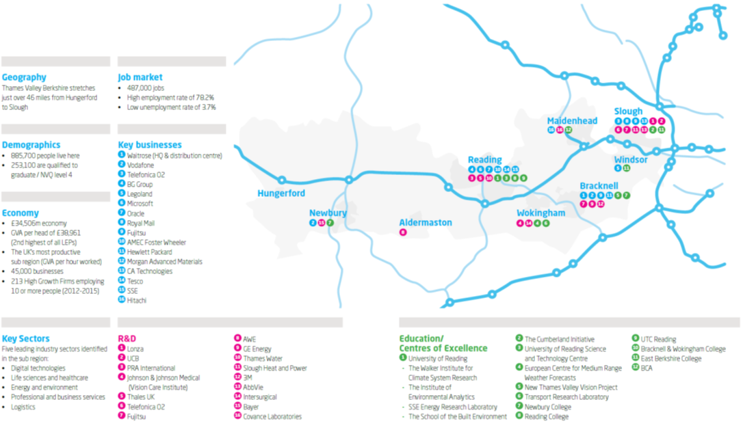
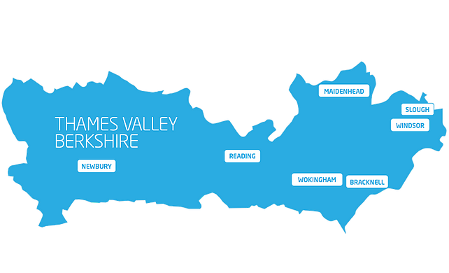
The Thames Valley Berkshire area
This pack provides information on careers in the Thames Valley Berkshire area.
Thames Valley Berkshire stretches from Hungerford in the West, to Slough in the East.

Slide 4
Key facts
The ‘digital tech’ information and communication sector dominates the economy in Berkshire.
The Digital Tech sector accounts for 14% of employees (compared to 5% nationally) and 18% of businesses in Berkshire. It is responsible for almost a quarter of Berkshire’s economic output.
The Berkshire labour market is dominated by ‘Digital Tech’

Slide 5
Key facts
The most common occupation is ‘Professional’ (28%), followed by ‘Associate Professional and Tech’ then ‘Managers, Directors and Senior Officials’
Breakdown of Occupations in Berkshire

Slide 6







































































Key facts
Berkshire has the highest proportion of Foreign Owned Companies in the UK and these companies employ nearly a third of the private sector workforce here.
However, the majority of workplaces in Berkshire are micro-size (1-9 employees).
Leading Berkshire Employers

Slide 7
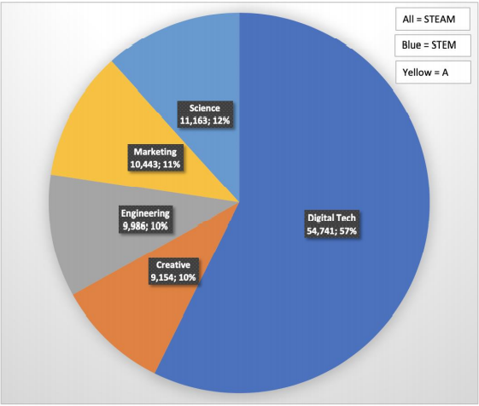
Key facts
18% of all jobs in Berkshire are classified as STEAM jobs, nearly twice the proportional national average.
The largest proportion by far are in Digital Tech which account for 57% or all STEAM related jobs.
Science, Technology, Engineering, Arts & Maths (STEAM) are important to employers in Berkshire
Breakdown of Berkshire’s STEAM employment, 2019

Slide 8
There are several different types of work in Berkshire:
Self employment, SME’s, Part-time Working & Portfolio Careers
Self employment
10.3%
of people working in Berkshire are self-employed. Self employment is highest amongst those in skilled trades including construction roles and process, plant and machine operatives.
SME’s
39%
of jobs in Berkshire are in small or medium-sized enterprises
Portfolio Careers
3.6%
of those employed in Berkshire have a second job, thereby suggesting portfolio careers aren’t especially popular.
Sector
82.4%
of Berkshire residents work in the private sector.
16.9%
in the public sector including the NHS, schools, local government and emergency services
Part-time Working
20.1%
of those in employment aged 16-64 work part time.

Slide 9
Key facts
A higher percentage of the Berkshire population have degrees, 2 or more A-Levels and 5 or more GCSE’s at grade 9-4 than nationally.
However less of the Berkshire population have trade apprenticeship compared to the national figure
Qualifications levels in Berkshire
Lower level qualifications
5 good GCSEs
2 A-levels or equivalent
Degree

Slide 10
Key facts
Approaching two thirds (63%) of all jobs in Berkshire require mid-level qualifications while 32% of jobs within the area require a degree.
From the graph, we can see that for Berkshire, at every level of qualification, there is a higher percentage of those who hold the qualification than there is a percentage of jobs which require it.
Level of qualification needed
for jobs in Berkshire
Jobs that require mid-level qualifications include:
Hotel & catering managers
Chefs
Teaching assistants
Office managers
Electricians
IT support technicians
Social care roles
Health care roles
Lorry drivers
Estate agents
Business sales executives
Retail workers
Sources: ONS, 2021- and EMSI, 2021

Slide 11
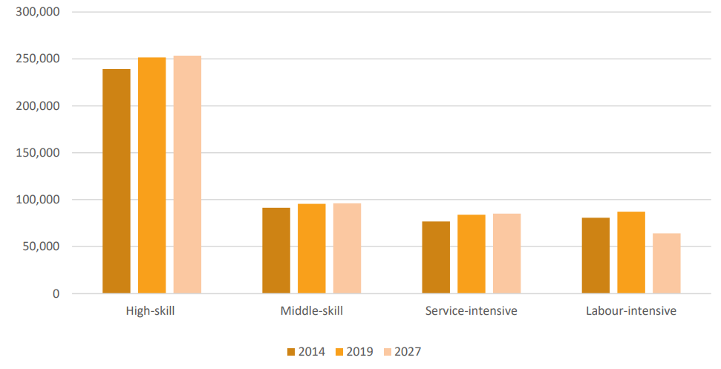
Key Facts
The projected occupational change in Berkshire depicts a decline in the labour-intensive occupations between 2019 and 2027 which will be further absorbed by the high-skill, middle-skill and service intensive occupations.
Change in skill level required in Berkshire from 2014-2027
Historic and projected occupational change in Berkshire, 2007 to 2024 (EMSI)

Slide 12
Diversity and Inclusion in the Workplace
in Berkshire
16% of the workforce in Berkshire were non-UK nationals in 2019, up from 12.4% in 2009 (compared t0 11.4% nationally in 2019 and 7.7% nationally in 2009)
13% of Berkshire’s workforce were aged 16-24 in 2021
The gender pay gap between male and female employees working in or resident in Berkshire is one of the largest in the country suggesting a gap in the nature of work for males and females
In Berkshire, 75.9% of women aged 16-64 are employed in the workforce compared to 81.4% of men.
Key facts
Thirteen percent of the workforce in Berkshire are aged 16-24%
The gender pay gap is one of the largest in the country suggesting a gap in the nature of work for males and females in Berkshire

Slide 13


Key facts
55% of Berkshire’s workforce are in managerial, professional or associate professional occupations (compared to 47% nationally)
Almost double the national average work as Science, Research, Engineering and Technology Professionals
Most Common Occupations in Berkshire (2020)
  Most Common Job Posts Dec 20- Dec 21 (EMSI)
  Programmers and software development professionals
  Sales related occupations
  Nurses
  Care workers and home carers
  Marketing and sales directors
  Primary and nursery education teaching professionals
  IT Business Analysts, Architects and Systems Designers
  Managers and proprietors in other services
  Customer service occupations
  Chartered and certified accountants
  Most common Occupations in Berkshire (ONS Annual Population Survey Jul 19 – Jun 20)
  Professional occupations
  Associate Prof and tech occupations
  Managers, Directors and Senior Officials
  Administrative and Secretarial occupations
  Skilled trades occupations
  Caring, leisure and other service occupations
  Elementary occupations
  Sales and customer service occupations
  Process, plant and machine operatives

Slide 14
Key facts
Vacancies for the working population in Berkshire:
Most Common Industries for Young Workers in Berkshire (2019)
  Distribution, hotels and restaurants
  Banking, finance and insurance
  Public admin, education and health
  Other services
  Transport and communications
  Manufacturing
  Construction
Leisure/hospitality: 9,076 unique job postings across Berkshire
Finance: 13,479 unique job postings across Berkshire
(May 2021 - May 2022)
Ranking of industries with workers aged 16-24 in Berkshire, 2019

Slide 15




Key facts
Approaching 1 in 5 organisations are recording skill deficiencies.
1 in 3 job vacancies are hard to fill.
There are concerns regarding supply and demand for skills at Level 3 and gaps in Apprenticeship provision in certain job families/industries.
Current Challenges in the Job Market
17% of organisations record skills deficiencies
33% of 5600 job vacancies are hard to fill (EMSI)
Potential mismatch between the supply of and demand for skills at Level 3 within the engineering, construction and digital technologies job families
Potential gaps in Apprenticeship provision in business administration subjects; engineering; health; education, construction and creative industries

Slide 16
Skills, Sectors and Companies of the Future
Skills in short supply
Key facts
Management skills of various descriptions are highly sought after in the current labour market. This is also the case for STEAM skills.
Companies of various different types working with STEAM sectors are greatly in need of workers in the future.
Management & Leadership | Entrepreneurialism
Digital skills | Scientific skills
Engineering | Project management
Sales | Marketing
Health care | Public service management
Sectors and Companies needing workers in the future
Company Type | Sector
Mid-market firms | Digital Tech
Scale Ups | Engineering
Start Ups | Life Sciences
Public Services | Construction
Knowledge Intensive Companies | Social Care
 | Hospitality
 | Transport and distribution

Slide 17
Wage Levels in Berkshire
Key facts
Wage levels in Berkshire are high with a 2021 mean of circa £31,000 per Anum.
Gross average annual pay, 2021 (£)

Slide 18
Key facts
The number of local job opportunities in different sectors / occupations varies considerably.
In IT, whilst there are lots of jobs, the skills required are very specific and therefore employers can struggle to fill roles.
Are there many jobs locally in…?
Occupation | Number of jobs in Berkshire | Level of competition for jobs? | Examples of employers
IT / Software development | 49,834 | Low – lots of jobs | Vodafone, Microsoft, NHS, O2, SSE, Oracle, Westcoast, Avanti, Verizon, Open Text Corporation, HP, Thales
Warehousing / distribution | 24,884 | Low – lots of jobs | Tesco, Waitrose, Kuehne & Nagel, Brakes Group
Construction | 17,664 | Low – lots of jobs | Costain, Wood Plc, Balfour Beatty
Social care | 18,230 | Low – lots of jobs | Local authorities, Voyage Care, Sunrise Senior Living
Accountancy | 10,096 | Medium | Deloitte, EY, PWC, KPMG, Grant Thornton
Engineering | 12,437 | Low – lack of applicants | Wood Plc, Jacobs, Xtrac, Honeywell
Sports and leisure | 4,641 | Medium | Reading Football Club, Nirvana Spa and Leisure, John Nike Leisuresports Ltd
Catering (chefs) | 3,804 | Low – lack of applicants | Fullers, Compass Group, Hilton, Whitbread
Law | 2,351 | Medium | Pitmans, Blandy & Blandy , Osborne Clarke
Beauty | 1,395 | Medium | Sally Beauty, Aura Spa, Indigo Rye
Veterinary | 399 | High | Falkland Veterinary Clinic, Moor Cottage Veterinary Hospital
Psychologists | 276 | High | NHS, schools and colleges, police service
Computer game developer | Very few | High | Try Surrey or London

Slide 19
Key facts
Job positions that employers in Berkshire find most difficult to fill include: engineers; social workers; chefs; waiting and bar staff; software developers; lorry drivers; health workers; teachers and Apprentices.
Jobs local employers find difficult to fill
“We are short of website coders; RPA project managers/coders; sales order processors; customer service agents; international shipping advisers; warehouse operatives”
Logistics and Warehousing Company
“Nursing vacancies increased over 41% from Dec 19 to Dec 20 and care and home worker vacancies increased 33% in the same period”
Health Care Organisation
“Demand for IT and telecoms professionals in Berkshire has risen 12% in the last year, with employers keen to attract those with transferable skills to support the thriving industry”
IT Industry
“The industry is short of web and software coders; IT sales and pre-sales technical staff; project managers; cyber security sales and technical experts; cloud-based telephony transformation experts”
IT Industry
“There are so many routes into a career in technology. We look for people with strong essential skills, character and potential and then upskill them and support them to flourish”
Technology Company

Slide 20
Key facts
Salaries in Berkshire are the highest in the country (outside of London).
Whilst starting salaries can be low in sectors such as hospitality, retail and warehousing, it is possible to rise up the ranks quickly.
Some high paying jobs in Berkshire
that you may not be aware of...
Occupation | No of Jobs in 2021 | Hourly Rate
Air Traffic Controllers | 15 | £41.33
Advertising & Public Relations Professionals | 335 | £41.30
Marketing & Sales Directors | 4,402 | £40.12
Legal Professionals | 573 | £37.97
Chief Executives and Senior Officials | 161 | £36.88
Medical Practitioners | 840 | £33.78
Information Technology & Telecommunications Directors | 2,810 | £33.66
Train and Tram Drivers | 8 | £30.16
Aircraft Pilots and Flight Engineers | 3 | £29.90
Senior Professionals of Educational Establishments | 452 | £28.96
Many of these require STEM skills...

Slide 21

Key facts
27% of Berkshire employers who recruit school leavers believe they are poorly prepared for work.
Of these, 12% say they believe young people have a poor attitude / lack motivation. So whilst most don’t think this, a fair chunk do.
The main employability skills
Berkshire employers are looking for

Slide 22

Key facts
By far the main essential skill that employers in Berkshire (and in the rest of the country) are looking for is good communication.
What activities could you undertake to improve yours?
The main general skills
Berkshire employers are looking for

Slide 23

Key facts
Computer programming skills, sales, and business management skills, are the main specialist skills being sought by Berkshire employers.
Computer programming skills including the use of programming languages such as Javascript, SQL, Python, GIT and Microsoft Azure.
The main specialist skills
Berkshire employers are looking for

Slide 24




Key facts
The world of work is changing. As we enter the Fourth Industrial Revolution, developments in fields such as robotics, AI, nanotechnology and autonomous vehicles, look set to change the way we live and work.
Across all sectors of the economy, different skills will be needed. Some roles will disappear and many more will evolve.
Looking to the future, according to the World Economic Forum, the 10 skills you need to have a successful career in 2025 are:
Analytical thinking and innovation
Active learning and learning strategies
Complex problem solving
Critical thinking and analysis
Creativity, originality and initiative
Leadership and social influence
Technology use, monitoring and control
Technology design and programming
Resilience, stress tolerance and flexibility
Reasoning, problem solving and ideation

Slide 25

The Effects of COVID-19 on Employment in Berkshire
Key Facts
The employment impacts of COVID-19 have been greater for young people and a higher than average proportion of young people in Berkshire (7.5%) will enter the labour market in the next 5 years.
Economic recovery in the region is dependent upon a number of factors, including the recovering of neighbouring areas such as London and Heathrow Airport. However, initial signs have been more positive than in many other areas of the country.
A lower than average percentage of employees were affected by the COVID-19 lockdown in Berkshire than nationally 15.5% vs 16.9%
The employment impacts of COVID-19 have been greater for young people and job entry for them could be significantly affected by future recruitment freezes. A higher than average proportion of young people in Berkshire (7.5%) will enter the labour market in the next 5 years.
Training and upskilling activities which the LEP is involved in will help ensure that Berkshire is resilient in the face of challenges such as an ageing population or the increasing automaton of job roles.
Economic recovery in Berkshire will be influenced by our neighbours including London & Heathrow airport due to the number of commuters to these areas.

Slide 26
The Effects of COVID-19 on Employment in Berkshire
Key Facts
Berkshire is well placed for recovery.
Young people will be disproportionally affected by the impacts of COVID-19.
Berkshire includes many businesses in traditionally more resilient sectors such as science based industries and business and professional services.
The full extent of the impact of COVID-19 on the economy in Berkshire is not yet known but there will be longer-term implications on the availability of entry level and lower skilled jobs
Young people, women and lower skilled workers will be disproportionately affected by the impacts of COVID-19
Berkshire has a track record of employment in more resilient sectors such as science-based industries and business & professional services.
We are already seeing the positive impact of our immediate recovery and renewal activity through, for example, the Berkshire Opportunities skills and employment portal.

Slide 27
Key facts
From the graph it is clear that Apprentice Technician and Engineers are the most in demand with 43 and 37 job postings respectively across 2021.
These top ten apprenticeship titles are all within the engineering and IT sectors.
Top advertised Apprenticeships
Sources: Emsi, 2022

Slide 28
Key facts
As is to be expected, the local authority in Berkshire with the greatest number of apprenticeships based within it was Reading; approaching double that of the second place local authority – West Berkshire.
Number of Berkshire employers
offering Apprenticeships by area
Sources: Emsi, 2022

Slide 29
Next Steps for Careers Leaders
Next Steps for Careers Leaders
Increase collaboration with businesses
Understand local skills shortages
Promote priority job families, apprenticeships and trainee opportunities
Increase collaboration with local businesses of all sizes to promote the benefits of work experience schemes (including virtual schemes)
Promote opportunities in the 10 priority job families of Digital Tech, Engineering & Science, Construction, Health Care & Welfare, Education, Transport & Distribution, Hospitality, Business (inc HR) & Finance, Sales & Customer Service and Creative
Promote apprenticeships and traineeships
Share the most common specialist skills gaps of Digital Tech, Engineering, Customer Service and Analytics
Share the most wanted generic skills of Communication, Leadership and Work Ethic

Slide 30



More information
Gateway to explore jobs, apprenticeships and courses in Berkshire
Spotlight on sectors urgently recruiting
Key information available for a wide range of jobs
www.berkshireopportunities.co.uk
Berkshire Opportunities is live on:
Twitter
Instagram
Facebook
LinkedIn
Berkshire Careers Guide

Slide 31


Useful resources:
National Careers Service - https://nationalcareersservice.direct.gov.uk/Pages/Home.aspx
Amazing Apprenticeships - http://www.amazingapprenticeships.com/apprenticeship-pack/
The Careers and Enterprise Company - https://www.careersandenterprise.co.uk/
Thames Valley Berkshire Local Enterprise Partnership Skills Priority Statement – http://www.thamesvalleyberkshire.co.uk/skills-and-employment
Berkshire Opportunities - https://www.berkshireopportunities.co.uk/
Berkshire Careers Guide
https://www.tvbintelligence.co.uk/
LMI for All –
https://www.lmiforall.org.uk/careerometer/
Apprenticeships -
Amazing Apprenticeship – Apprenticeship Service and Knowledge for Schools (ASK) - https://amazingapprenticeships.com/request-support/

