Slide 1
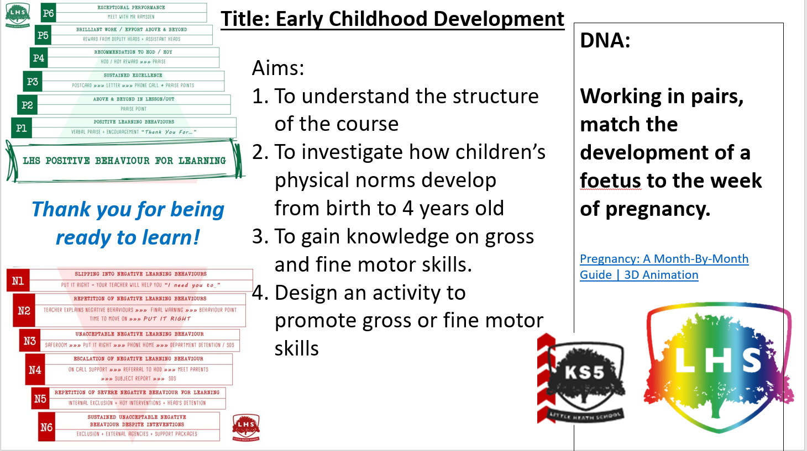
Pregnancy: A Month-By-Month Guide | 3D Animation​

Slide 2
The Pearson Level 3 Alternative Academic Qualification BTEC National in Early Childhood Development (Extended Certificate) is an Alternative Academic Qualification (AAQ) designed for post-16 students with an interest in Education and Early Years and aiming to progress to higher education as a route to graduate level employment.
Equivalent to one A Level in size, it is suitable for students looking to develop their applied knowledge and skills in Education and Early Years as part of a study programme alongside A Levels
Who is this qualification for?

Slide 3

Unit 1 - Children’s development
Children’s developmental progress from birth up to eight years, including the theories, principles and factors relating to development, and the potential impact of a range of factors on a child’s progress through the developmental milestones
Unit 2 -Keeping Children Safe
Health and safety and safeguarding responsibilities of an individual working in an early years setting; emergency best practices and when to address concerns about a child’s welfare.
What will you study over the next two years?
Unit 3 - Play and Learning
The concept of play, the influence of theories and approaches to play, and the benefits of play and learning activities for children.
Unit 4 - Research and Reflective Practice
The influence of research findings on policy and provision for children and how this influences the behaviours and expectations of an individual working in an early years setting.

Slide 4
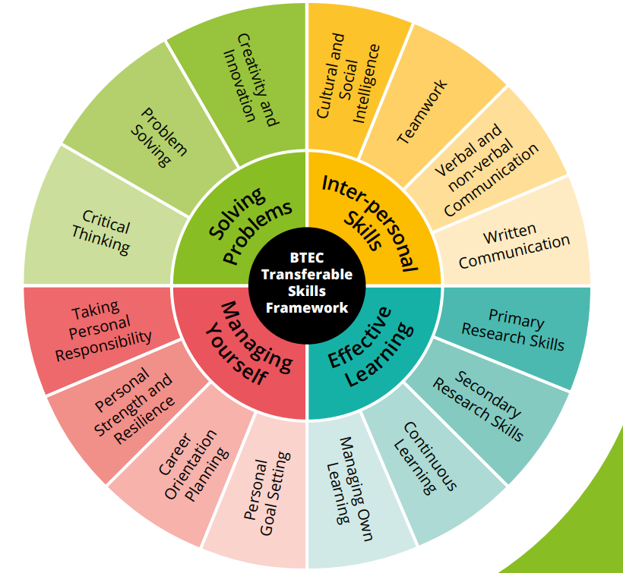
It is important to remember that this course will teach you many transferable skills, skills you can use for the future, whether it is employment or university.

Slide 5
What further learning will this qualification lead to?
• Nursing – BSc (Hons) Adult Nursing, Paediatric Nursing
– BSc (Hons)
• Teacher Training – Childhood and Early Years Studies BA (Hons)
• Social Work – BA (Hons) Social Work
• Psychology – Psychology BSc (Hons)
Which subjects will complement this qualification?
The following subjects would be suitable to combine with this qualification:
Sociology
Psychology
Biology
English
Health & Social Care

Slide 6
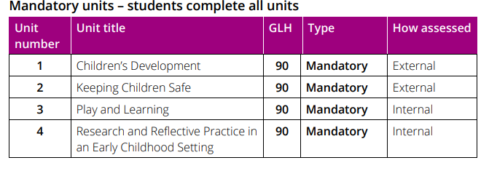
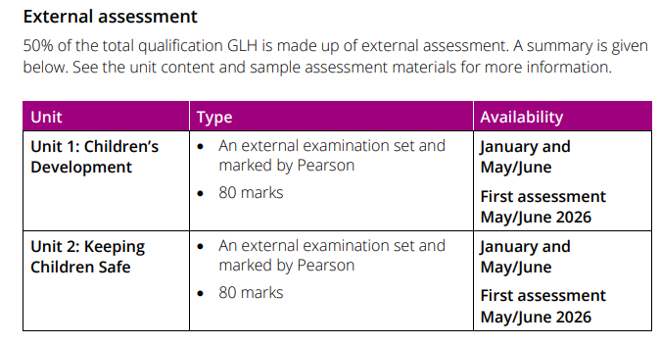
Exam Units 1 and 2
Coursework Units 3 and 4
Exam is worth 50% of the overall mark
Unit 1 Exam = 25%
Unit 2 Exam = 25%
Coursework (Pearson Set Assignments)
is worth 50% of the overall mark
Unit 3 CW = 25%
Unit 4 CW = 25%

Slide 7
How will we deliver the course?
Year 12
Mrs Kukkuk and Mrs Rayner will share the teaching of the course.
Mrs Kukkuk – 5 lessons
Mrs Rayner – 5 lessons
We will start by teaching Unit 1 - 'Children's Development'
We will both teach this Unit until early December.
You will start the first coursework Unit 3 - 'Play and Learning' before Christmas.
Coursework must be completed by the last week before Easter.
Unit 1 Exam in Summer 2026
Unit 3 Coursework – Summer 2026

Slide 8
How will we deliver the course?
Year 13
Mrs Kukkuk and Mrs Rayner will share the teaching of the course.
Mrs Kukkuk – 5 lessons
Mrs Rayner – 5 lessons
We will both be teaching Unit 2 - 'Keeping Children Safe'
We will both teach this Unit until early December.
You will start the coursework Unit 4 - 'Research and Reflective Practice' before Christmas.
Coursework must be completed by the last week before Easter.
Unit 2 Exam in Summer 2027 (+ re-sit of Unit 1 if needed)
Unit 4 Coursework – Summer 2027

Slide 9
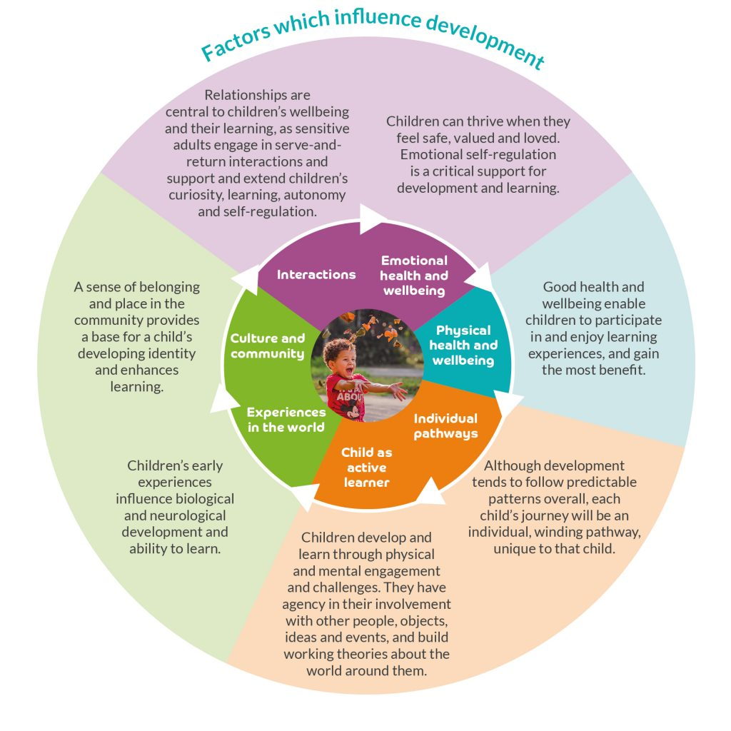
Unit 1 Children's Development
𝐓𝐡𝐞 𝐏𝐞𝐫𝐬𝐨𝐧𝐚𝐥 𝐚𝐧𝐝 𝐄𝐱𝐭𝐞𝐫𝐧𝐚𝐥 𝐅𝐚𝐜𝐭𝐨𝐫𝐬 𝐭𝐡𝐚𝐭 𝐀𝐟𝐟𝐞𝐜𝐭 𝐂𝐡𝐢𝐥𝐝 𝐃𝐞𝐯𝐞𝐥𝐨𝐩𝐦𝐞𝐧𝐭

Slide 10
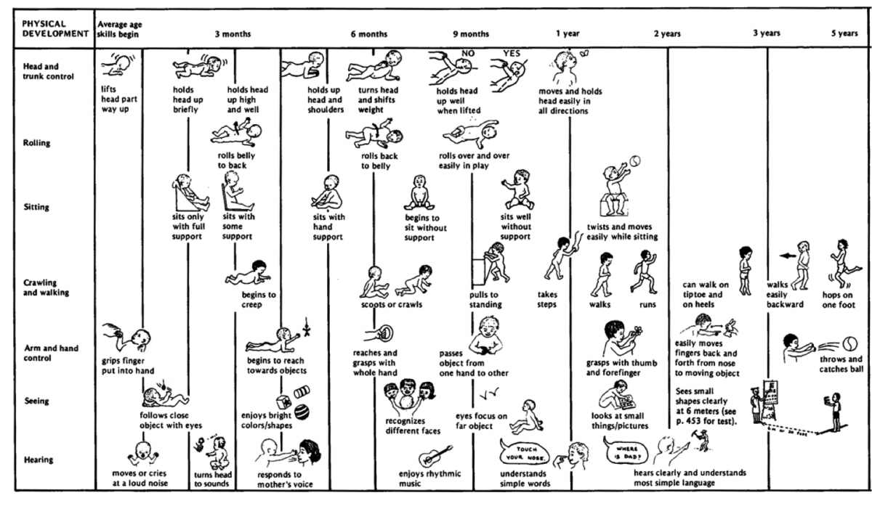
Unit 1 – Children's Development

Slide 11
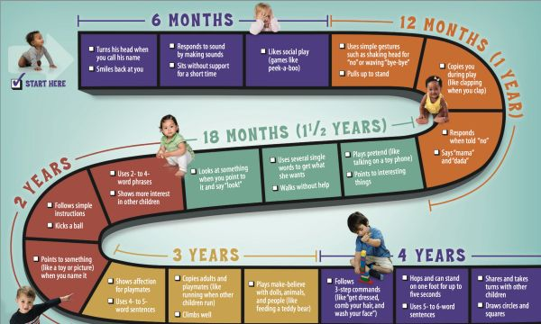
Unit 1 – Children's Development
Task
Using the 'Development Matters' document, on A3 paper, create your own Physical Developmental graph / flow diagram / graphic.
How and when do children develop between ages birth and 4, with a focus on Physical Development.

Slide 12
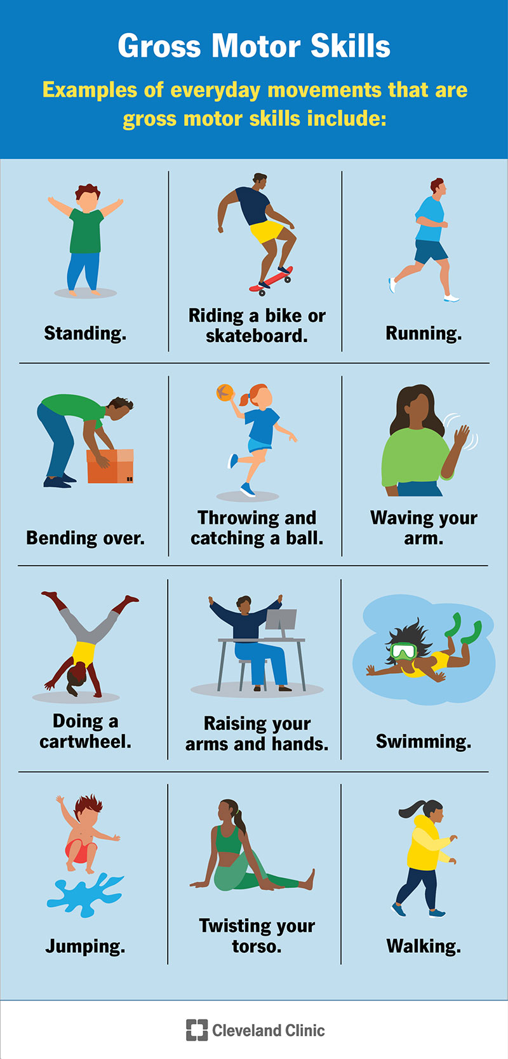
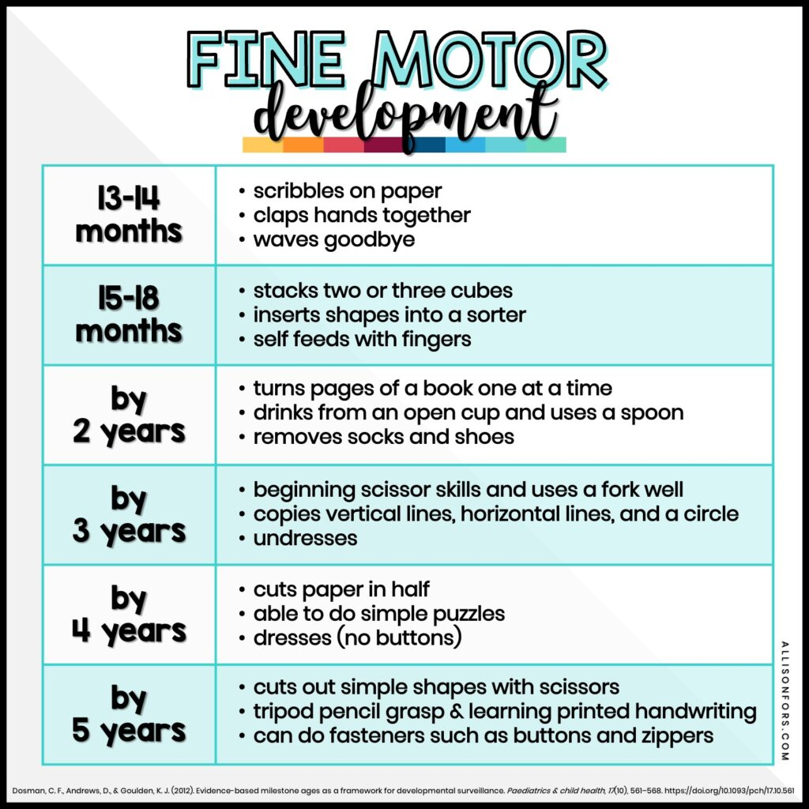
Unit 1 – Gross and Fine Motor skills
fine motor skills | sand | tracing | identification | pattern writing |
#shorts gross motor skill activity l physical Activity kids l preschool activities

Slide 13
Unit 1 – Gross and Fine Motor skills
Task
Your task is to design either a Gross motor skills or Fine motor skills activity. You should use the planning sheet and explain why you believe this activity is important to enhance Gross or Fine motor skills.
When you have designed your activity, introduce it to your partner and get them to do it :)
Evaluate your activity

Slide 14
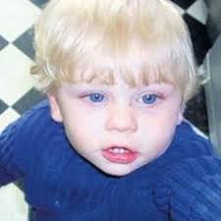
Unit 2 – Keeping Children Safe
Case study – Baby P
The Tragic Story Of Baby P | Peter Connelly
Thinking about keeping children safe in their homes, at school and outside in the community …
Whose responsibility is it to keep children safe?
Who should have been responsible for Baby P?
Who failed Baby P?

Slide 15
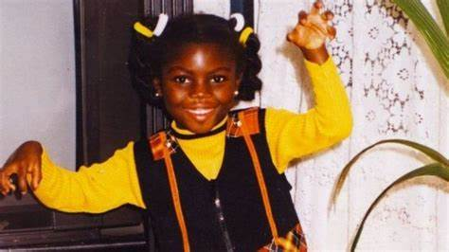
Unit 2 – Keeping Children Safe
Case study – Victoria
The Abuse and Murder of Victoria Climbié – YouTube
Thinking about keeping children safe in their homes, at school and outside in the community …
Whose responsibility is it to keep children safe?
Who should have been responsible for Victoria?
Who failed Victoria?

Slide 16
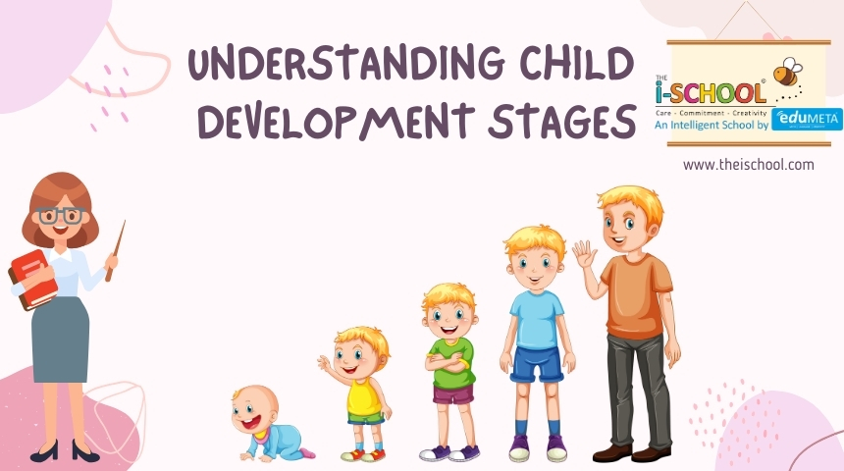
Please ensure you are doing the Summer Work, including the Reading tasks.
I am really looking forward to teaching you in September!

