Slide 1
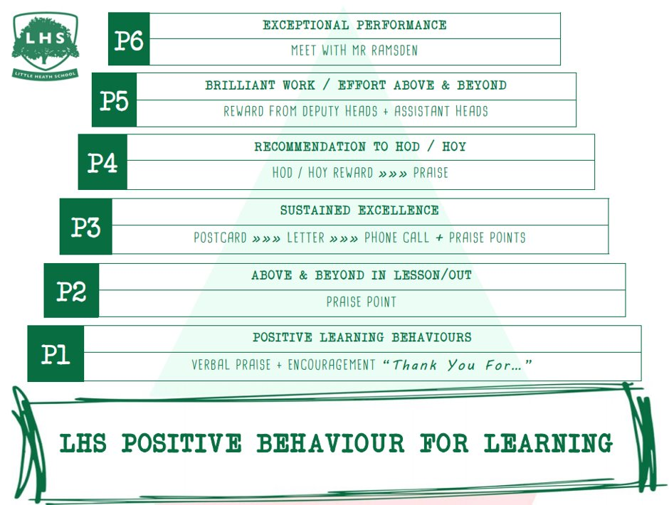
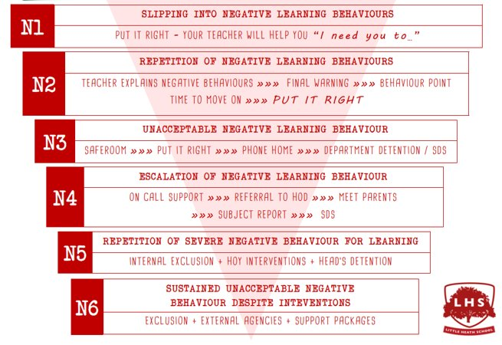


Title: English Language Taster Lesson
DNA:
Tell me about yourself:
Who are you?
Why do you want to study English Language at A-level?
Describe yourself in three words.
What is your favourite piece of punctuation?!
Aims:
To convince you A Level Lang is much better than GCSE
To entice you to sign up
Thank you for being ready to learn!

Slide 2
Take a moment to reflect on your own use of language:
E. How do you say ‘butter’ and ‘water’?
  With the ‘t’
  Without the ‘t’
  It depends who I’m talking to.
F. How do you feel when people interrupt or talk over you?
It’s the most irritating thing someone can do when you’re talking to them.
I just keep talking and don’t let them!
I’ll call them out.
I stop talking and let them carry on.
G. How would you describe the way Year 7s speak now in comparison to how you used to speak when you were their age?
It’s the same.
It’s worse.
It’s better.
H. Do you speak another language?
Yes I’m bilingual
Yes, but second language is conversational level
Does a GCSE count?
No – just the one for me!
How would you rate your use of vocabulary in everyday conversation on the scale below?
  Very basic
  Basic
  Not bad
  Pretty Good
  Vocabulary?! Surely you mean lexis?!
How do you think others view the way you speak?
  Quite common – in the gutter
  Pretty similar to everyone else
  They think I’m posh!
How often do you swear?
  Not at all – it’s highly offensive
  Not often – when I stub my toe!
  In some circumstances, fairly often.
  Everyday
  Nearly every word
What language do you use in text messages?
  Pretty much standard English, inc. punctuation.
  1-2 abbreviations
  ‘Text speak’ for most

Slide 3
What factors affect our language use?
TASK: Put yourself in the middle of a piece of paper and identify the many influences there have been in making you the user of language that you are.
Take it further: What have you ‘gained’ from them? Which are the top three influences on your language?
Before we think of any specific contexts in which we might communicate with someone, what factors have already influenced the way we use language?
How is your language use different from someone else’s?
Notes:
Trying to get them to think of what creates their idiolect, rather than how they might speak to different people in different situations

Slide 4
Family
Age
Interests
Education
Ethnicity
Gender
Region
Religion
Sexuality
Social class
Etc.

Slide 5
Some terminology for you:
Idiolect: the speech habits peculiar to a particular person
Familect: the language variant used by a family when speaking amongst themselves
Sociolect: the language variety used by a particular social group when talking between themselves

Slide 6
Name that thing…

Slide 7
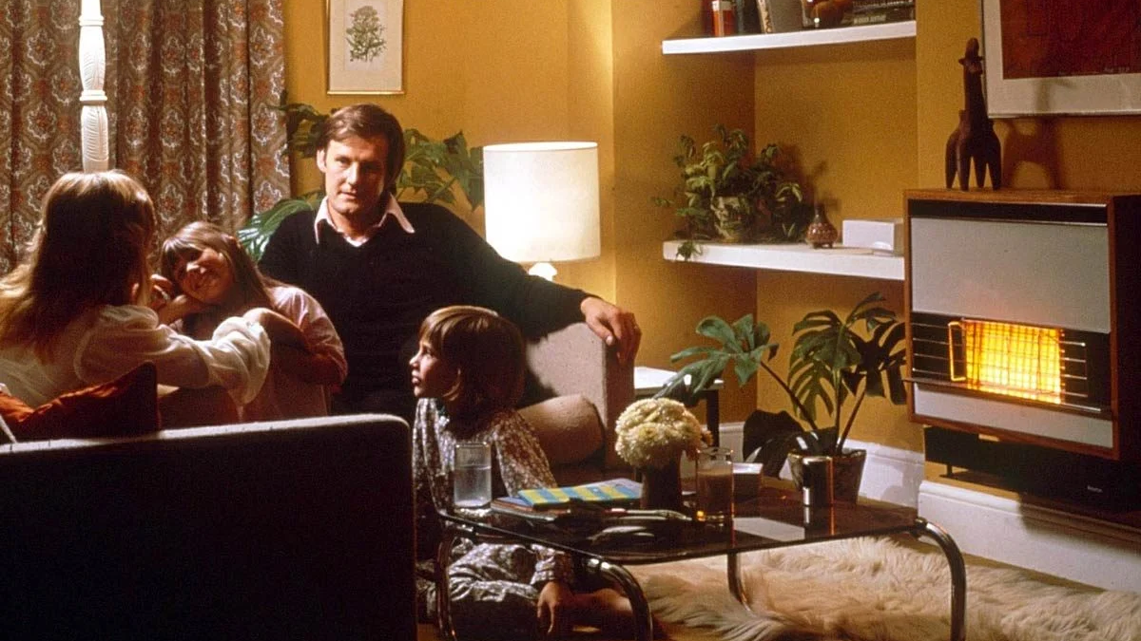
What would you call this room?
Notes:
These slides are getting them to understand their Familect, before we social class shame them

Slide 8
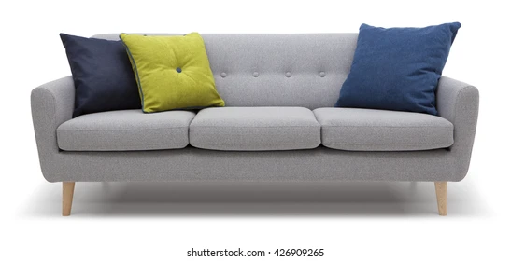
And what is this?

Slide 9

What do you call this?

Slide 10
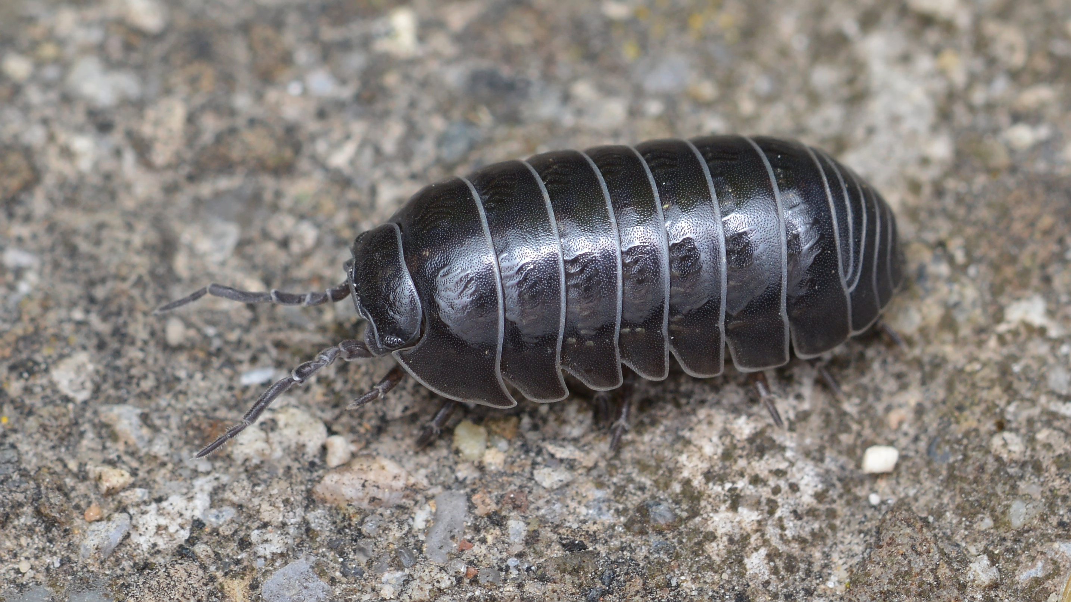
What about this little critter?

Slide 11

Often, factors such as region, ethnicity or social class can influence our familect
How would you rank these terms on a ‘poshness’ scale?
Drawing room
Front room
Living room
Lounge
Sitting room
Whitchurch Upon Thames
Pangbourne
Purley
Tilehurst
Calcot
Whitley
Notes:
Obviously I’m ‘representing snobbery to challenge it’ here, rather than embodying it! I think the point I’m trying to make is how we may or may not be aware of how our language identifies us to some people, and of course how wrong and stupid it is to judge people… Depending on time, I would also do the couch, settee, sofa test

Slide 12
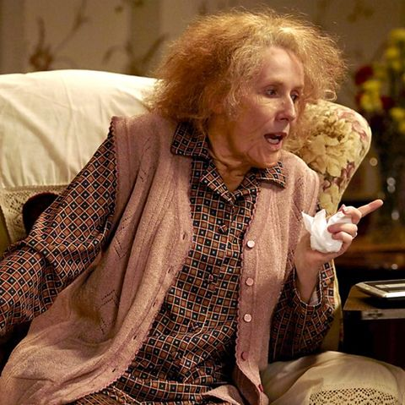
Why Grandma, what posh names you have!
How would you rate these names on a poshness scale?
Gran
Grandma
Grandmother
Granny
Nan
Nana
Nanny
Do you have any other names for your parents’ mums?
Notes:
I use this as another chance to break established views- they generally think G words are posher than N words, but my Nana was much posher than my Grandma, and my mother in law was Nana, and definitely less classy than the boys’ Grandma!

Slide 13
Judging people by their language use…
Lots of research (stemming from 1970s) shows how people interpret and make judgements about people’s ‘place’ in society, just by the way they speak. Traditionally, people who spoke with RP accents were judged to have high status but low solidarity. Regional language varieties scored more highly on the friendliness and sincerity side (Solidarity) and were perceived to be more persuasive than RP speakers.
STATUS |  | SOLIDARITY
Low | High | Low | High
Uneducated | Educated | Untrustworthy | Trustworthy
Poor | Wealthy | Unfriendly | Friendly
Unintelligent | Intelligent | Unkind | Kind
Illiterate | Literate | Awful | Nice
Lower Class | Upper Class | Hostile | Good natured
This research was first carried out over 40 years ago. How do you think this would apply to the varieties of language spoken in today’s society? What language traits do you think are ‘judged’ to have more ‘status’ or more ‘solidarity’? Does this perception have an impact on the way you use language?

Slide 14
My Language Life
What other factors could you consider for your transition work?
Reading material to help you:
Michael Rosen’s Article ‘Idiolect’ – he takes you through the process on reflecting on the different influences that make up your idiolect.
Daniel Pearce ‘Idiolect’ - an example language biography from an A-level student.
Notes:
Not sure if we’re physically giving them copies of the transition work here, or just drawing their attention to it, but hopefully this lesson will result in more considered, detailed essays

Slide 15
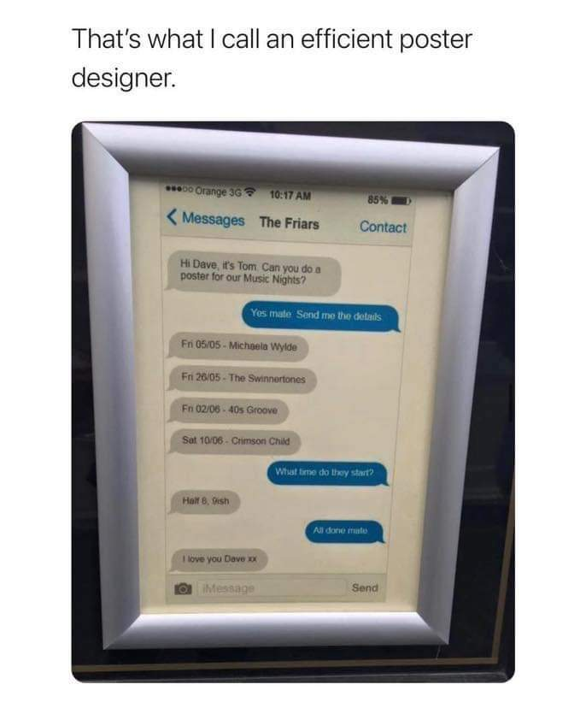
Show and Tell
What is linguistically interesting about this image?

