Slide 1
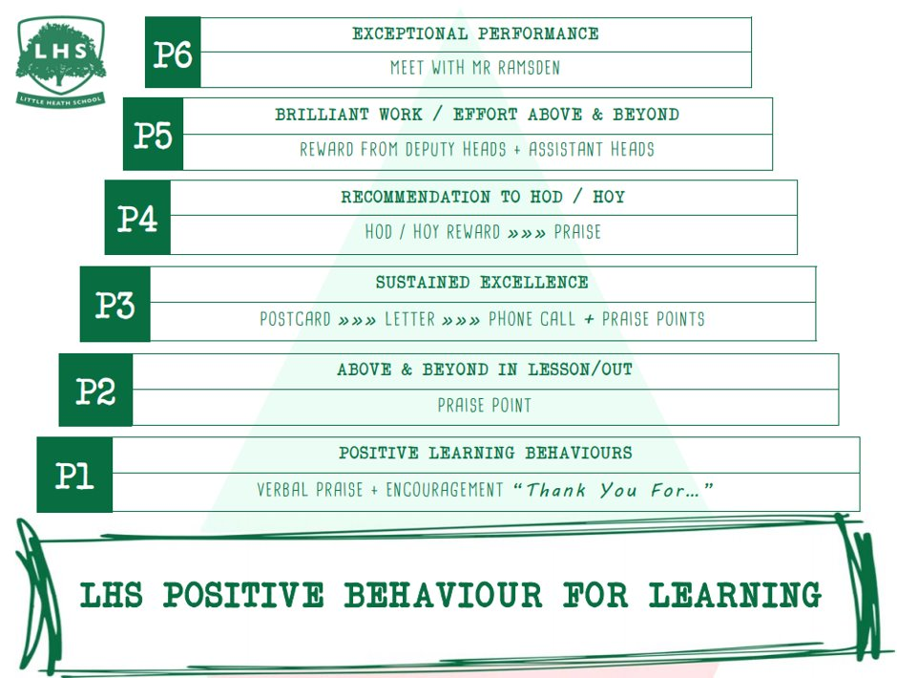
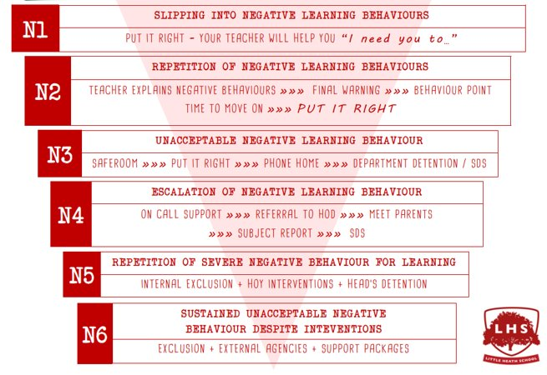


A LEVEL MATHEMATICS:
Exploring the Quadratic Function and its Graph
DNA:
Solving Same-ish, Yet Slightly Different
Equations
Aims:
Linking f(x)=ax²+bx+c to:
Factorising
Completing the square
Vertex
Intercept points
And the Graph
Thank you for being ready to learn!

Slide 2
Welcome!
DNA:
Solve these SAME-ish, yet slightly different equations:
Have a go at these on paper while I do the register!

Slide 3
Why study Mathematics at A-level?
Studying A-level Maths is beneficial for developing strong problem-solving, analytical, and logical thinking skills, which are valuable in many careers and university courses. It provides a solid foundation for STEM and economics degrees and can lead to higher earning potential. Furthermore, it's widely respected by universities and employers.

Slide 4
Post-16 Mathematics options
  Extends GCSE Maths and introduces new ideas
If you enjoyed GCSE maths (and gained at least grade 6)
If you want to learn new exciting topics and extend your skills.
If you are interested in achieving an A-level qualification in a subject attractive to employers
If you are happy to put in the work!
(AS)/A level Mathematics
AS/A level Further Mathematics
An additional AS or A level to add breadth & depth
If you were great at GCSE maths (and gained at least grade 7)
Love mathematics, solving problems, algebra …
And want to do more maths, even for just 1-year & get an AS qualification
Think about picking FMA as a 4th subject
You can even try it for 4-6 weeks!

Slide 5
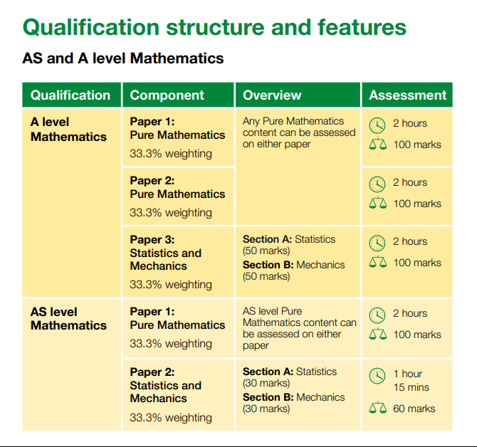
A level maths
All of the content in the AS/A level Mathematics qualification is compulsory and is the same for all examination boards (except LDS)
Pure Mathematics
66%
Statistics
17%
Mechanics
17%

Slide 6
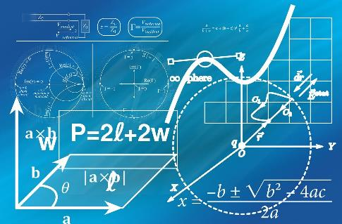
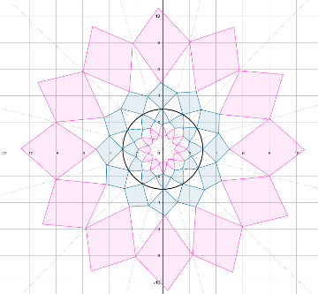
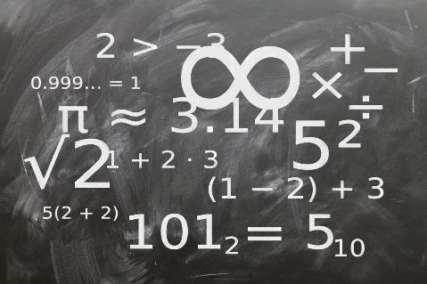
What is Pure Mathematics?
A Level Pure Mathematics focuses on the foundational, theoretical aspects of mathematics, emphasizing abstract concepts, logical reasoning, and mathematical proofs. It covers core topics like algebra, calculus, trigonometry, and geometry, forming the basis for more advanced mathematical study.
Pure mathematics is crucial because it lays the foundation for advancements in various fields, including applied mathematics and other sciences, by exploring abstract concepts and developing new mathematical tools. While its immediate applications might not always be obvious, pure mathematics often leads to breakthroughs in unexpected areas, like cryptography, and fosters critical thinking and problem-solving skills.

Slide 7


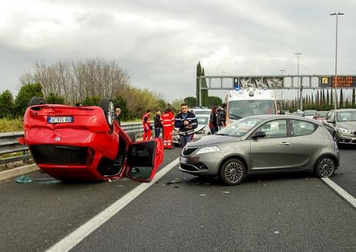
What is Statistics?
the discipline that concerns the collection, organization, analysis, interpretation, and presentation of data.
Studying statistics is valuable because it equips individuals with critical thinking, data analysis, and problem-solving skills that are highly sought after in various fields. It enables informed decision-making, effective research, and the ability to interpret and evaluate data, making it a valuable asset in both academic and professional settings.
Notes:
Images: https://pixabay.com/en/flood-danube-sandbag-park-139000/
Https://pixabay.com/photos/car-accident-clash-rome-highway-2165210/
https://pixabay.com/illustrations/analysis-statistics-chart-graphic-810025/

Slide 8



What is Mechanics?
In A-level mathematics, Mechanics is a branch of mathematics that deals with the motion of objects and the forces that cause or affect that motion. It involves applying mathematical principles to understand how things move and interact with each other in the physical world.
Studying mechanics in A-level maths provides a solid foundation for careers in engineering, physics, and related fields, and also develops valuable problem-solving and analytical skills. It bridges the gap between theoretical maths and real-world applications, preparing students for further study in applied mathematics and physics-based disciplines.
Notes:
https://pixabay.com/photos/water-drop-liquid-splash-wet-1759703/
https://pixabay.com/illustrations/world-globe-earth-planet-blue-1303628/
https://pixabay.com/photos/golf-golf-course-grass-sport-green-3685616/

Slide 9
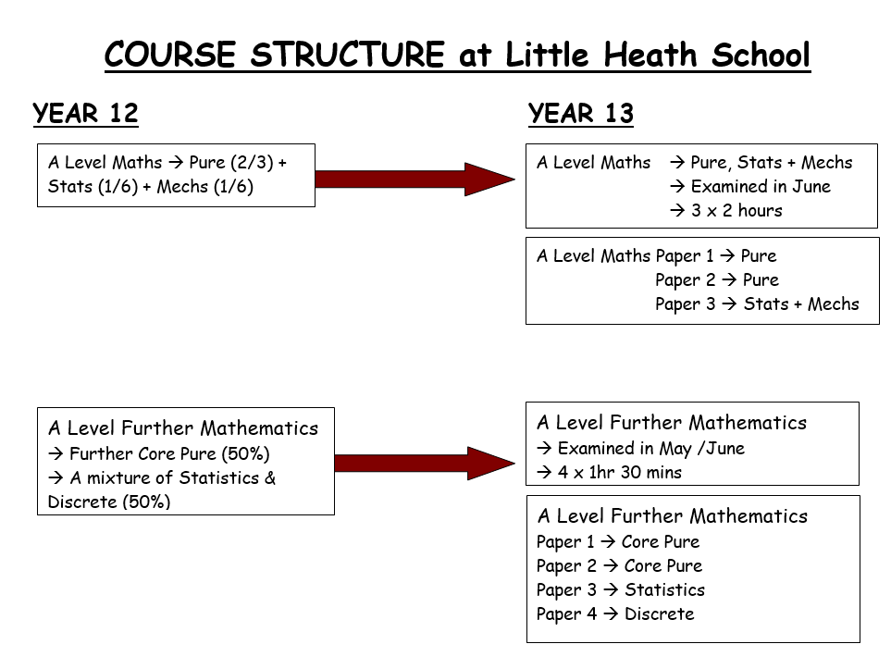

Slide 10
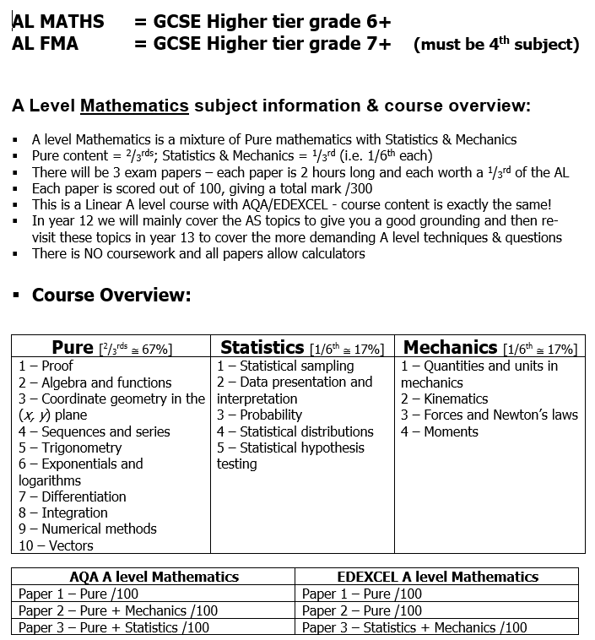

Slide 11
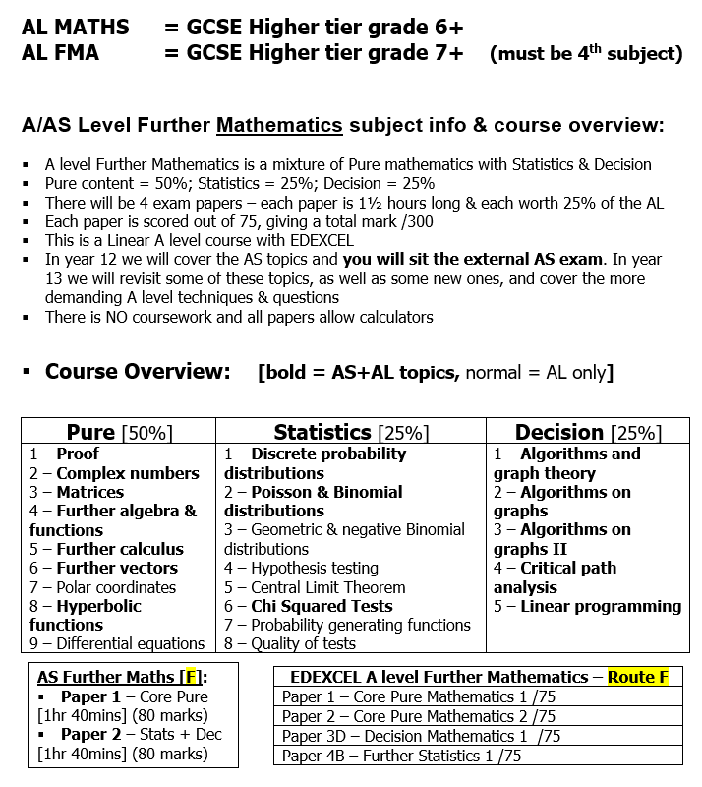

Slide 12
SUMMER WORK
Work through joining instruction steps on separate ppt.
ALL students to have created an Integral account for the transition materials before the end of the session.
Course certificate of completion to be brought into school during the first week or emailed to their class teacher as evidence.

Slide 13
Small Group Activity
→ DO NOT write on the cards
Orange cards – factorise, THEN …
Now match to Yellow cards – what is the importance of this?
Using the Orange Cards - complete the square, THEN …
Now match to Pink cards
Now match to the Green cards (Max / Min) – why can we do this now? What helps us?
What do the Red & Blue cards tell you? What are they called?
You can now put it altogether to match them to a graph. Job done!

Slide 15
STOP
Answers are next

Slide 16
Card Sort Answers

Slide 17
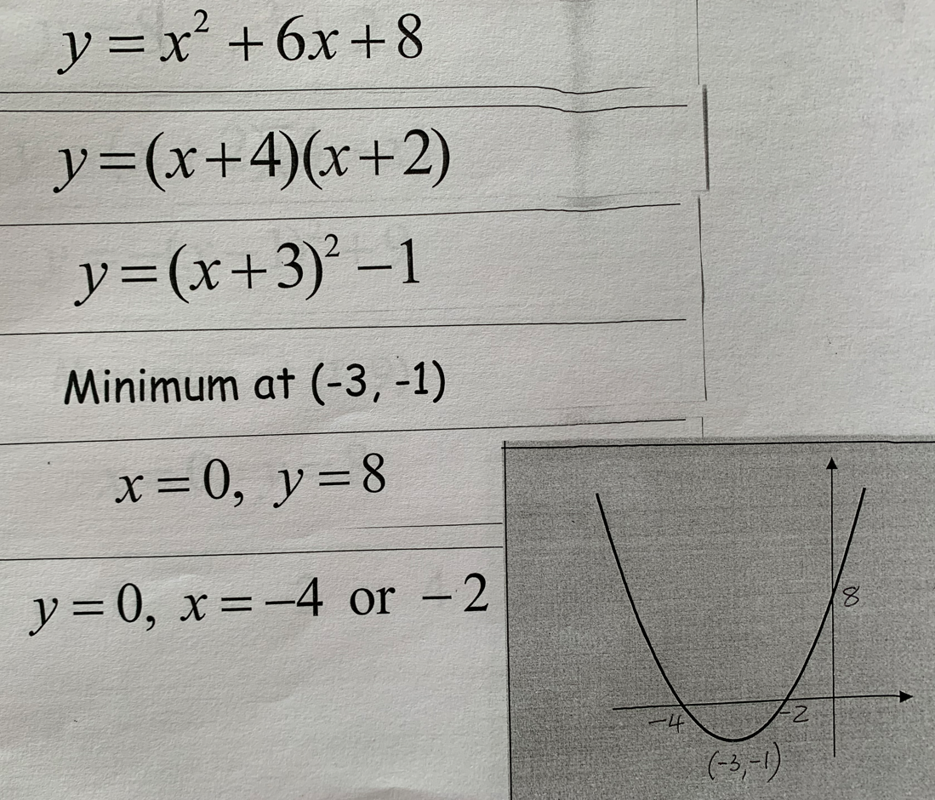
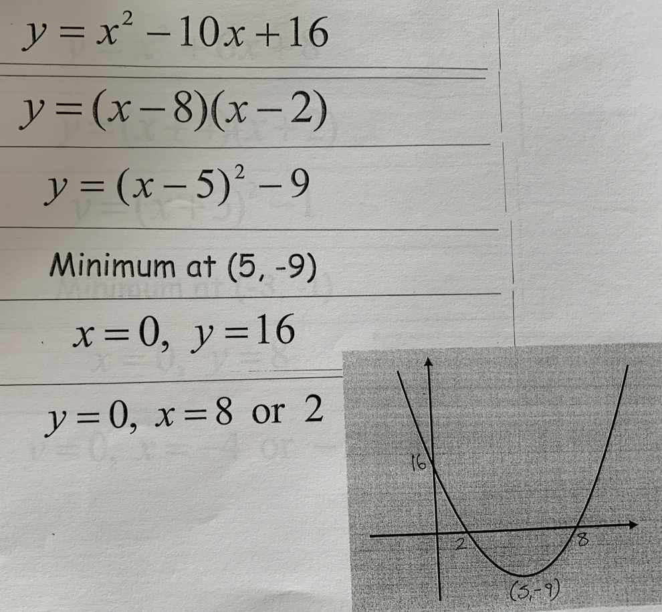

Slide 18
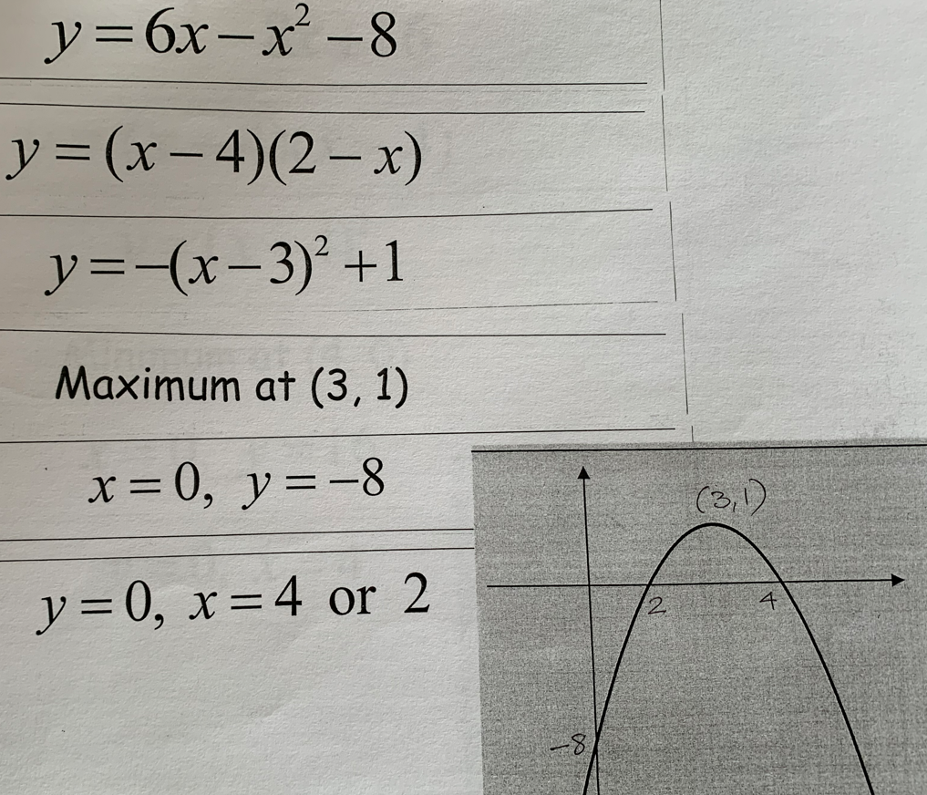
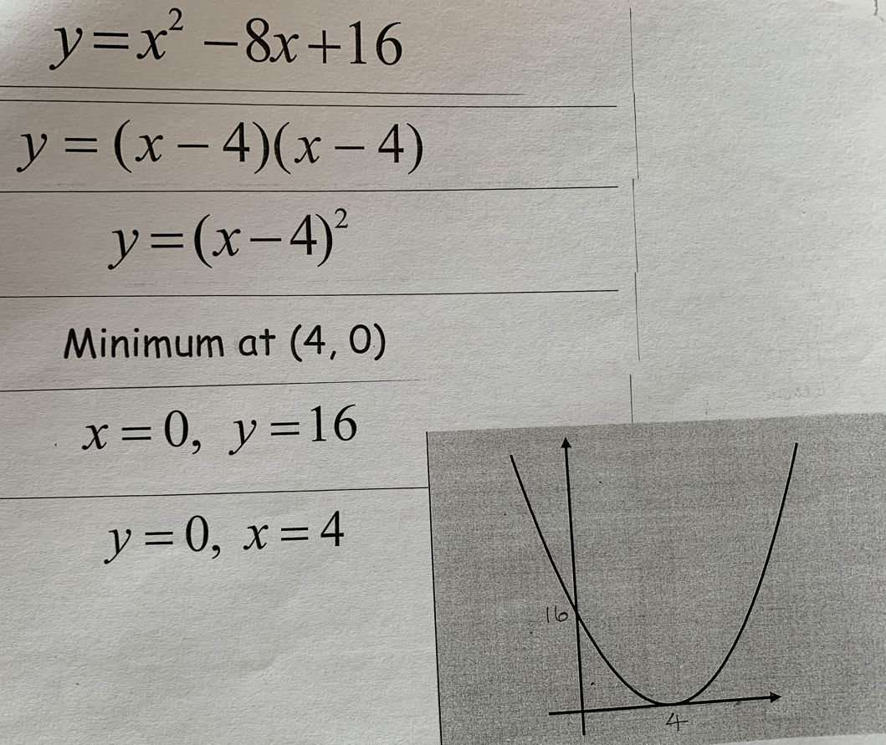

Slide 19
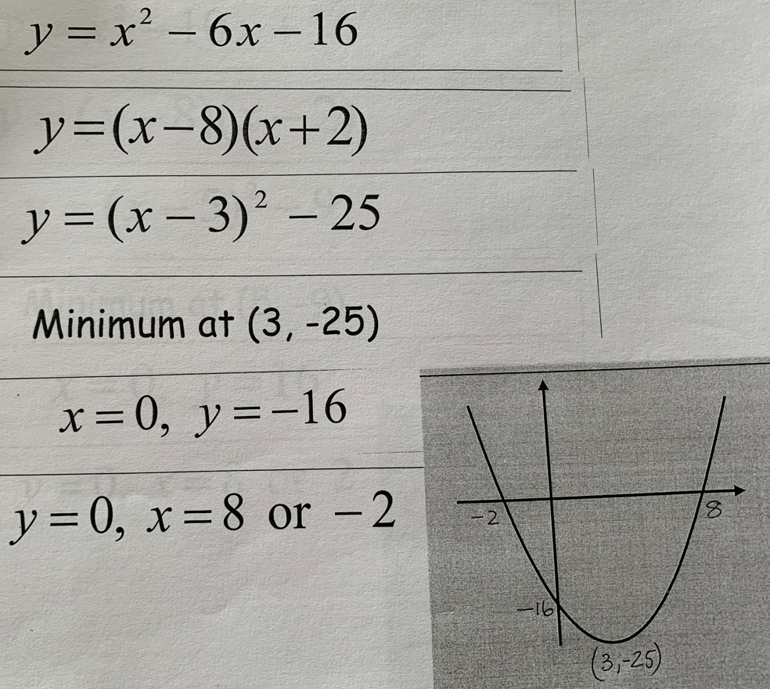

Slide 20
Why Mr. Rayner isn’t Very Good at Maths
Part One →Indices

Slide 21
1. 6.
2. 7.
3. 8.
4. 9.
5. 10.

Slide 22
☹
☹
Pathetic
☹
☹

Slide 23
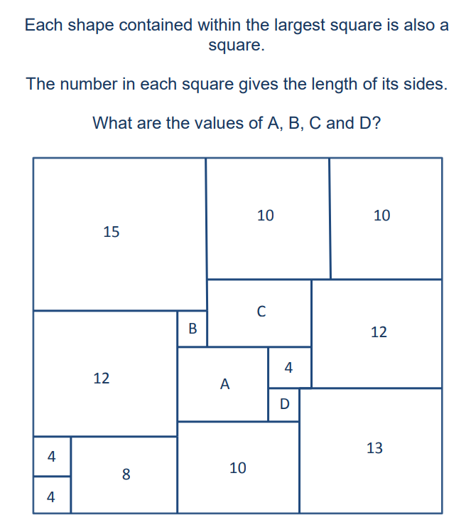
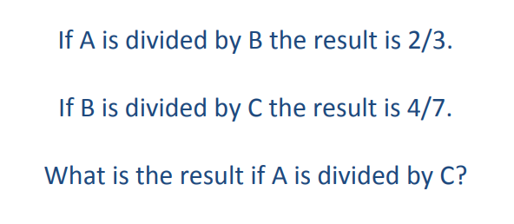
Plenary

Slide 24
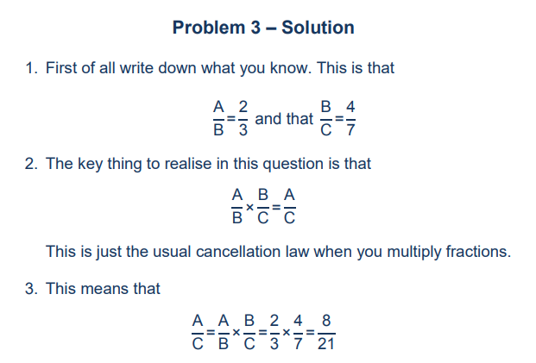
Solution

Slide 25
