Slide 1
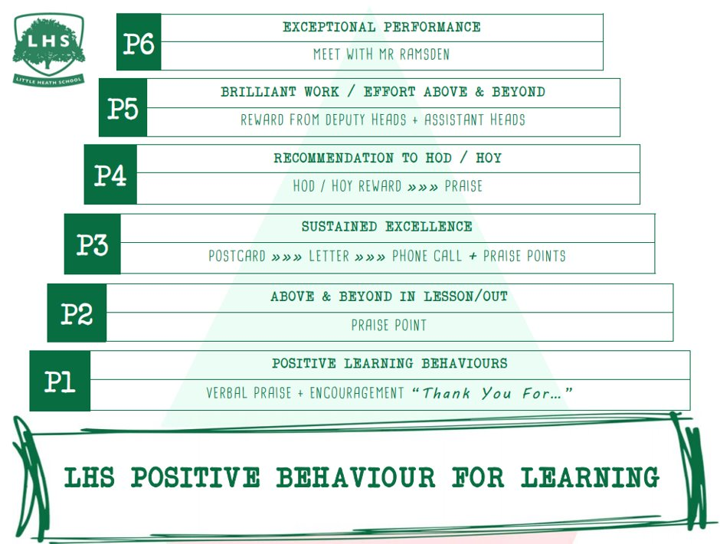
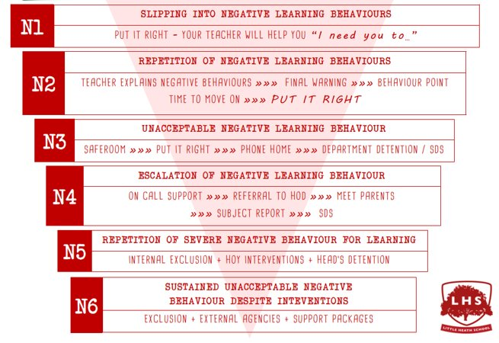


AS/A LEVEL
FURTHER
MATHEMATICS
DNA:
If you did not know our number system, how would/could you go about counting?
Where did zero come from? It is a counting number, or not?
How many different types of numbers do you know?
Aims:
Exploring the world of numbers
Thank you for being ready to learn!

Slide 2
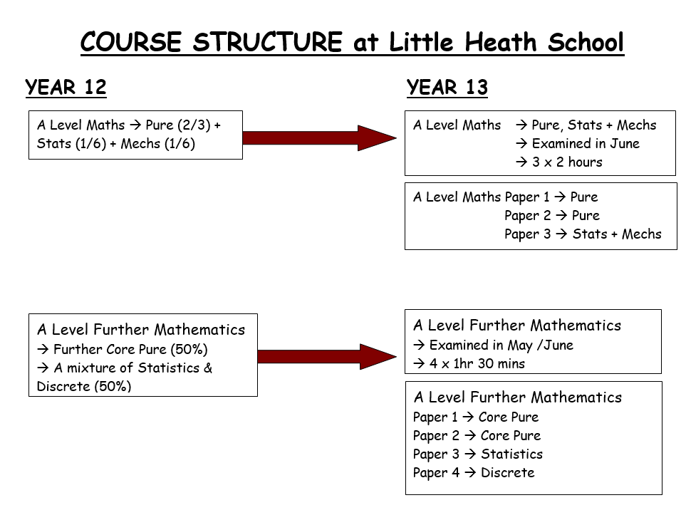
AS Exam in May of Year 12:
2 x 1hr 40min Exam Papers – Core Pure & FS1/D01
An actual external AS grade in August
Stay on for Y13 and the full A Level in FMA OR stop with an AS grade ‘in the bag’. The choice is yours!

Slide 3
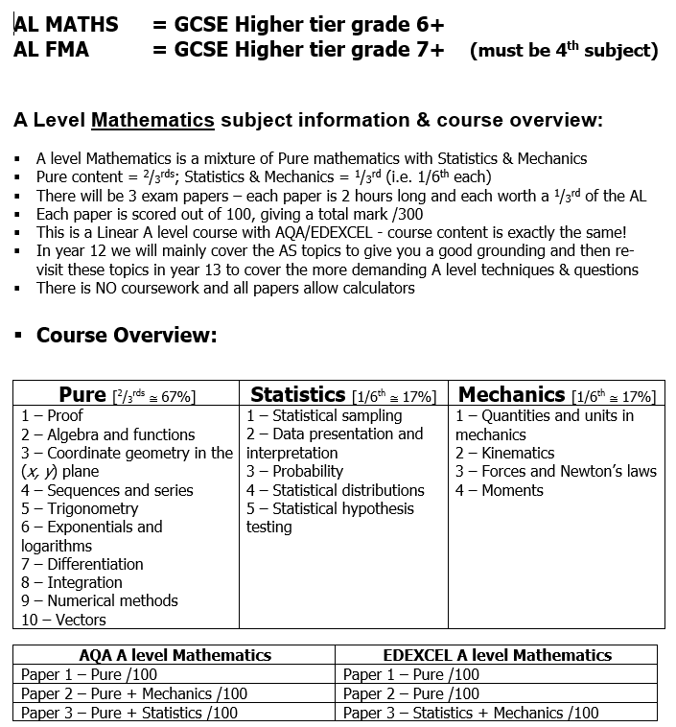

Slide 4
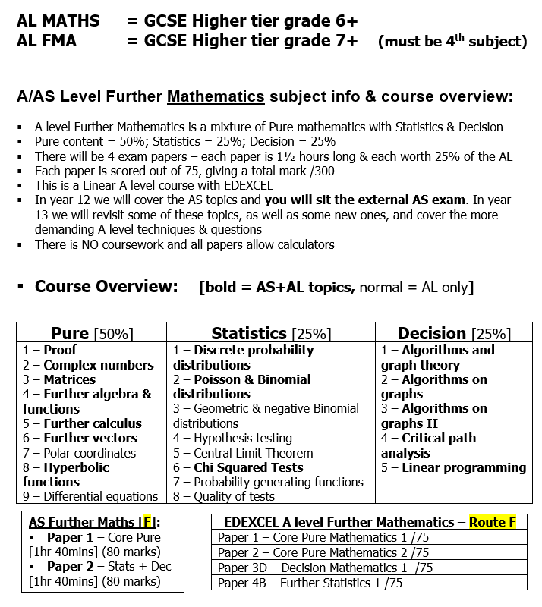
What will it be like to study AS / AL Further Mathematics?

Slide 5
Why pick AS/AL Further Maths – from The FMA support network:
Students taking Further Mathematics overwhelmingly find it to be an enjoyable, rewarding, stimulating and empowering experience.
It is a challenging qualification, which both extends and deepens your knowledge and understanding beyond the standard A level Mathematics. Students who do it often say it is their favourite subject.
For someone who enjoys mathematics, it provides a challenge and a chance to explore new and/or more sophisticated mathematical concepts. As well as new learning new areas of pure mathematics students will study further applications of mathematics in mechanics and statistics.
Students who take Further Mathematics find that the additional time spent studying mathematics boosts their marks/grades in single A level Mathematics. Any student capable of passing an AS/A level in Mathematics should also be able to pass AS Further Mathematics. Studying Further Mathematics consolidates and reinforces your standard A level Mathematics work, helping you to achieve your best possible grades.

Slide 6
WHY PICK A LEVEL MATHS/FMA ????
1. FUNBUS – every Thursday afterschool for additional support
2. New calculators
3. Specialist & experienced maths team
4. Everyone does Pure + Mechanics + Statistics for A Level Maths
5. Fantastic results across the whole range, including a good number of A*s in both Ma & FMa
6. A shining light as a subject here at LHS and across the county
7. Students make great progress (C to B, B to A etc.)
8. FMA is a 4th subject option, IF you are good at maths, like maths and love doing more maths with a formal AS qualification at the end of Y12 and then you have the option to either - drop out OR continue with the course
9. A fantastic A level to have that puts you in a very select group of students
10. Supports lots of other subjects and is needed for various Degree courses
11. Also goes well with English, History etc. if you were wanting to study Law, for example.
12. HWK after most lessons, so constant feedback
13. [Revision weekend in Y13 – YES, a whole weekend of maths]
14. Probably the best A Level subject – but perhaps I am a little biased?
15. No COURSEWORK in either Maths or FMA!!

Slide 8
ACTIVITY
Introduction to numbers – yes it’s video time!
Summer Work:
To the best of your ability, just complete the Mathematics work, so nothing additional for FMA – BONUS!

Slide 9
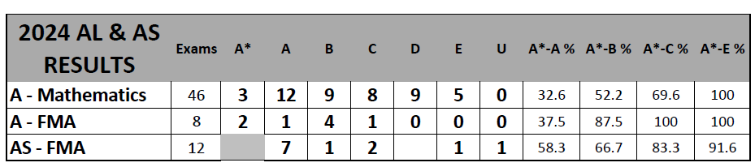
2024: AL Maths / AL & AS Further Maths Results

