Slide 1
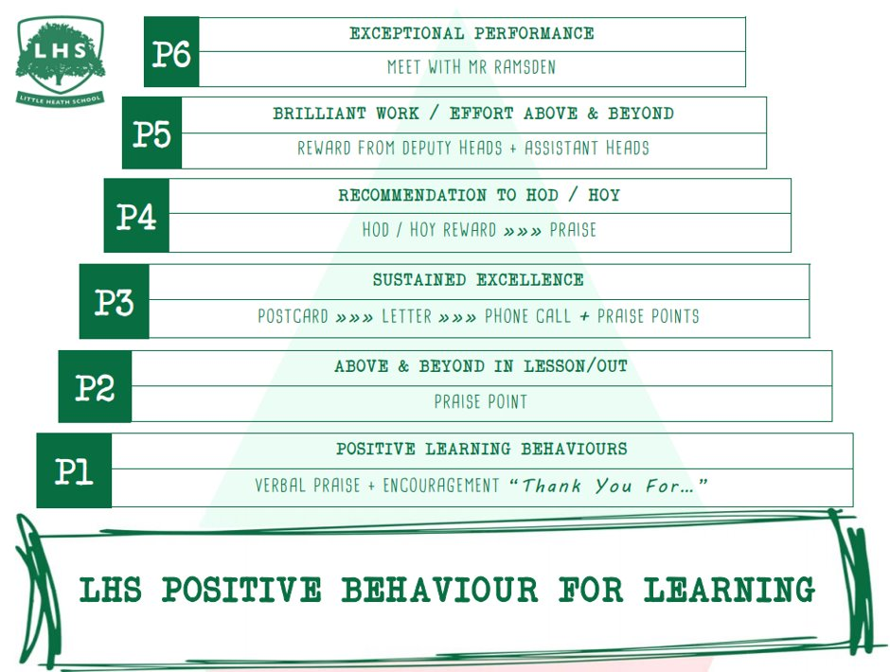
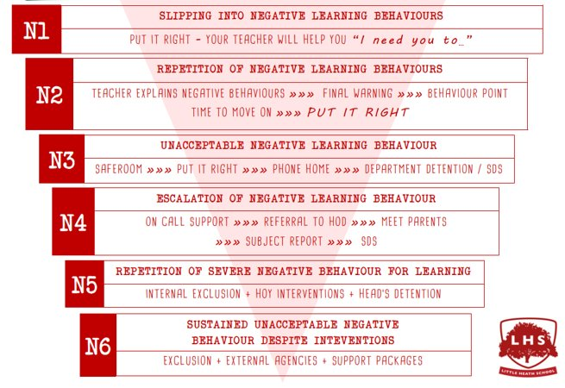


DNA:
Title: Computer Science A Level
Aims:
Course overview – understand the nature of the course
A programming task – an introduction or revisit to some simple programming
Summer work – what will you have to do? What do I expect when you return in September
Thank you for being ready to learn!

Slide 2
OCR A level Computer Science
At its heart lies the notion of computational thinking: a mode of thought that goes well beyond software and hardware, and that provides a framework within which to reason about systems and problems.
In this course you will naturally learn about software, hardware and programming, but the root of computer science lies in the decomposition of problems, algorithmic and computational thinking. If you were not expecting this, then this may be the wrong course for you.

Slide 3
Assessment Overview
Content Overview | Assessment Overview
• The characteristics of contemporary processors, input, output and storage devices • Software and software development • Exchanging data • Data types, data structures and algorithms • Legal, moral, cultural and ethical issues | Paper 1 Computer systems 140 marks 2 hours and 30 minutes written paper (no calculators allowed) | 40% of total A level
• Elements of computational thinking • Problem solving and programming • Algorithms to solve problems and standard algorithms | Paper 2 Algorithms and programming 140 marks 2 hours and 30 minutes written paper (no calculators allowed) | 40% of total A level
• Analysis of the problem • Design of the solution • Developing the solution • Evaluation | Programming project 03* – Moderated upload 70 marks Non-exam assessment | 20% of total A level

Slide 4
You need to be aware
Computer Science can be an engaging and fascinating subject for the right candidate who is will to put their head down and work at it, but it is intellectually challenging as well as stimulating. So, if you were thinking gentle third A level to go with Physics and Maths, or walk in the park, this isn’t it.

Slide 5
Programming task - Basic
How will you generate two random numbers and assign the vales to variables?
How will you add the two numbers?
How will you determine whether the sum of the two numbers is odd or even
How will you output the results

Slide 6
Improved
How will you get player names?
How will you get player choice of outcome
How will you correctly identify the winner
How will you loop round to play again?

