Slide 1
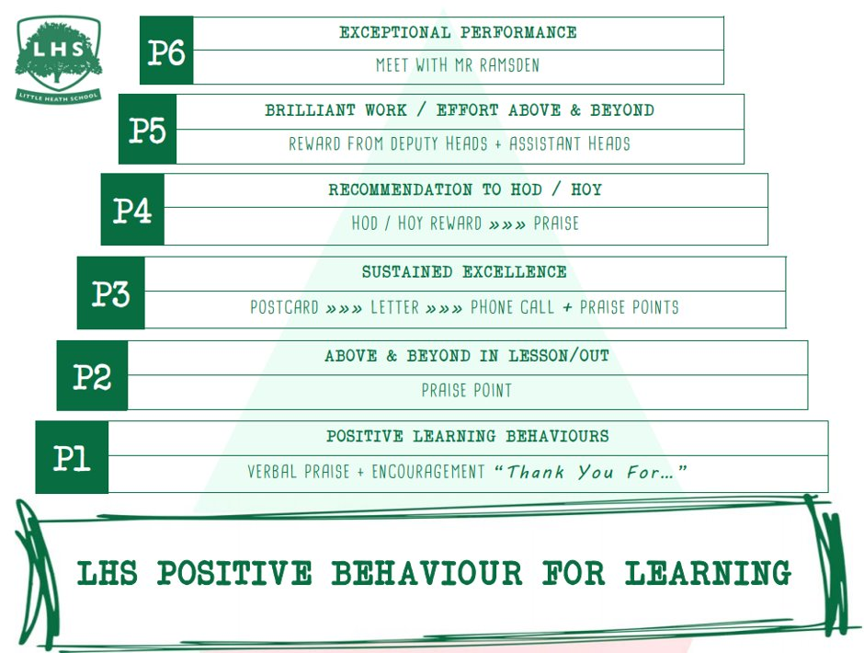
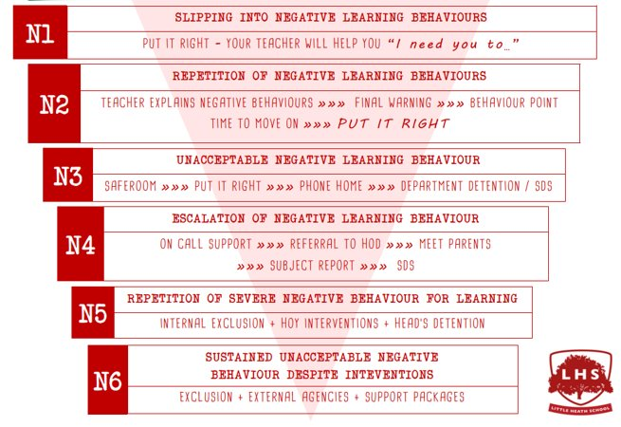


DNA:
What are the main features of a wave?
Write down one difference and one similarity between longitudinal and transverse waves.
Write at least one example of each type of wave.
Title: A Level Physics Taster Lesson
Aims:
Learn about A Level Physics curriculum.
Where can Physics bring you?
To acquire a deeper understanding of physics investigative
procedures.
Thank you for being ready to learn!

Slide 2

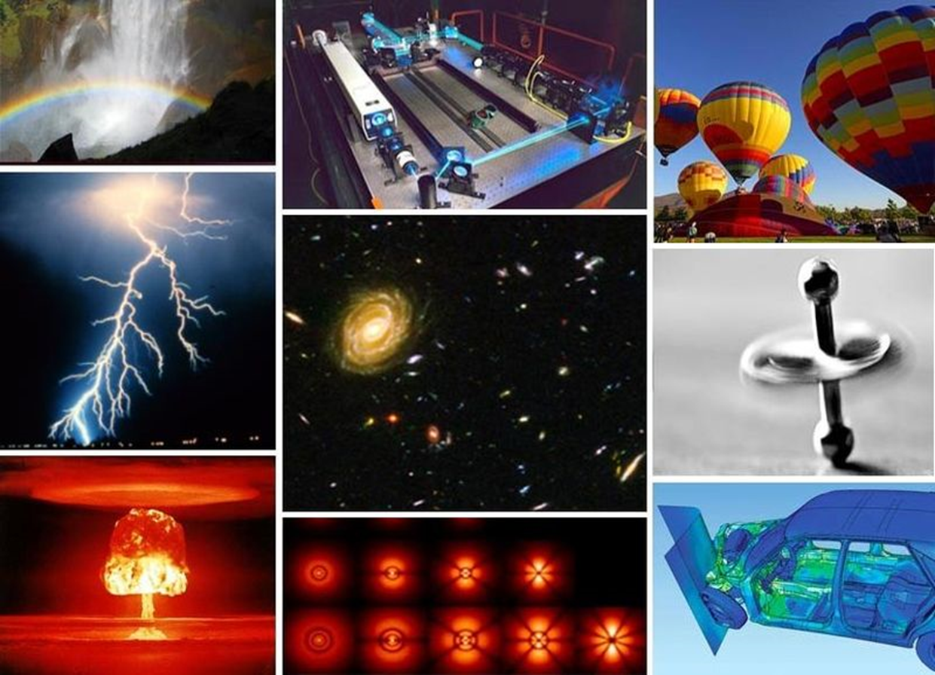
WELCOME TO PHYSICS!!!

Slide 3
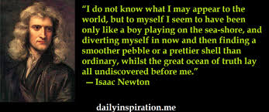

Slide 4

Helps with Other A-Levels
Physics A-Level can help support other subjects at A-Level especially…
Maths
Further Maths
Chemistry
Biology

Slide 5



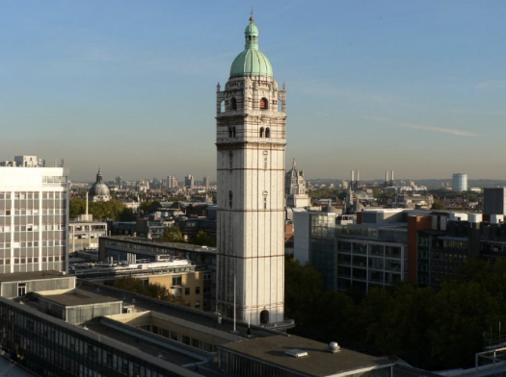
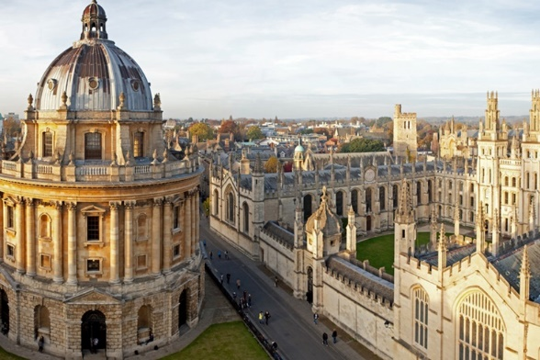
Why Do Physics?
Physics A-Level is a facilitating subject – the top universities now look at what you study as well as what grade you get when giving you an offer.
If you don’t know what you want to do with your life yet, Physics A-Level will keep options open to you.
.

Slide 6
What can I do with Physics?
A background in Physics can help you get started in many careers…
Electrical Engineering Green Energy
Space Scientist Computer Games Design
Medicine Visual Effects
Radiographer Architect
Accountancy Aerospace Engineering
Production manager Logistics manager
Sound engineer Geologist
AI researcher …
…or if you’re really desperate – Teaching!!!

Slide 7
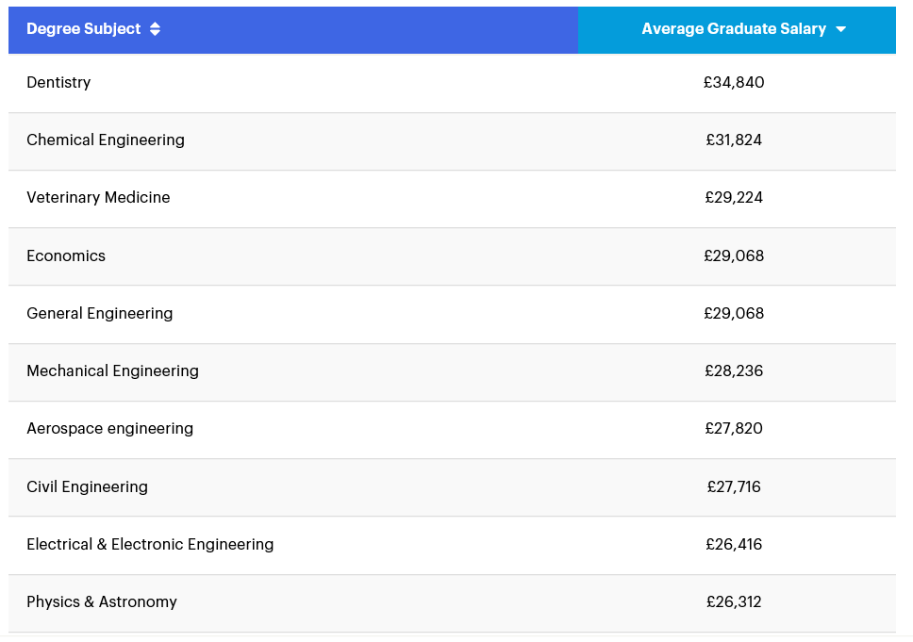
What Will I Earn?
The study of Physics should arise from a natural curiosity about how the mysteries of the Universe make sense. But we all like the money as well…
A Level Physics is needed for almost all top degrees by starting salaries!

Slide 8
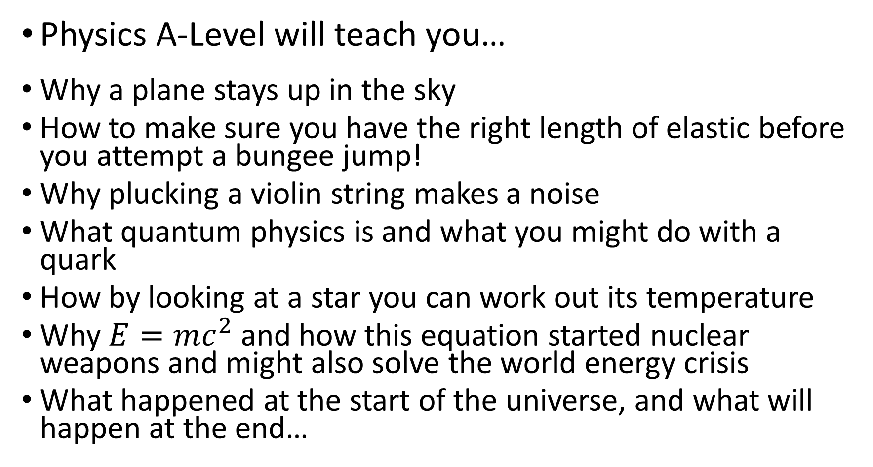
And Physics is Interesting Too!
Physics A-Level will teach you…
Why a plane stays up in the sky
How to make sure you have the right length of elastic before you attempt a bungee jump!
Why plucking a violin string makes a noise
What quantum physics is and what you might do with a quark
How by looking at a star you can work out its temperature
Why $E=mc^{2}$ and how this equation started nuclear weapons and might also solve the world energy crisis
What happened at the start of the universe, and what will happen at the end…

Slide 9


Slide 10
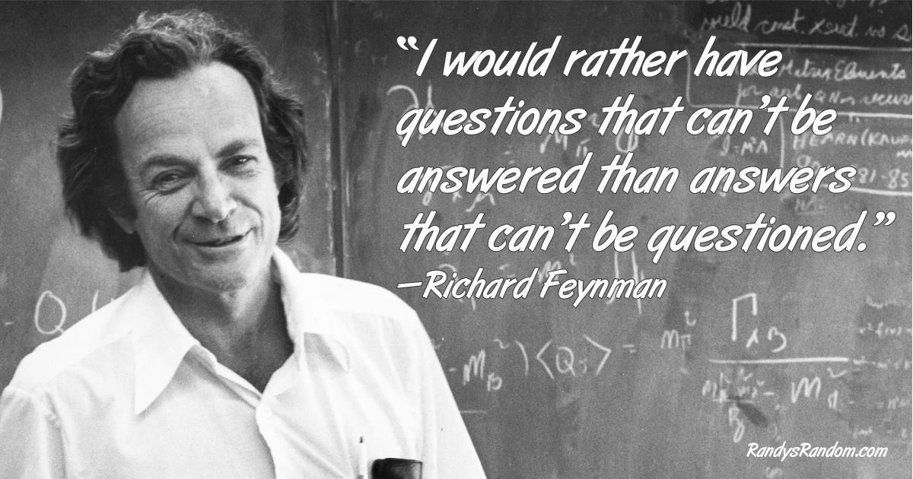

Slide 11

What can you expect from this course?
Math is tailored to GCSE level
It is both a theoretical and practical subject
We follow the book “OCR A Level Physics”, including the topics:
Y12: Forces and motion, materials, electricity,
waves and quantum physics
Y13: Introduction to thermodynamics, advance
motion, astrophysics, electromagnetism, particle
physics and medical physics
And we will ask you to do a lot of independent work!

Slide 12
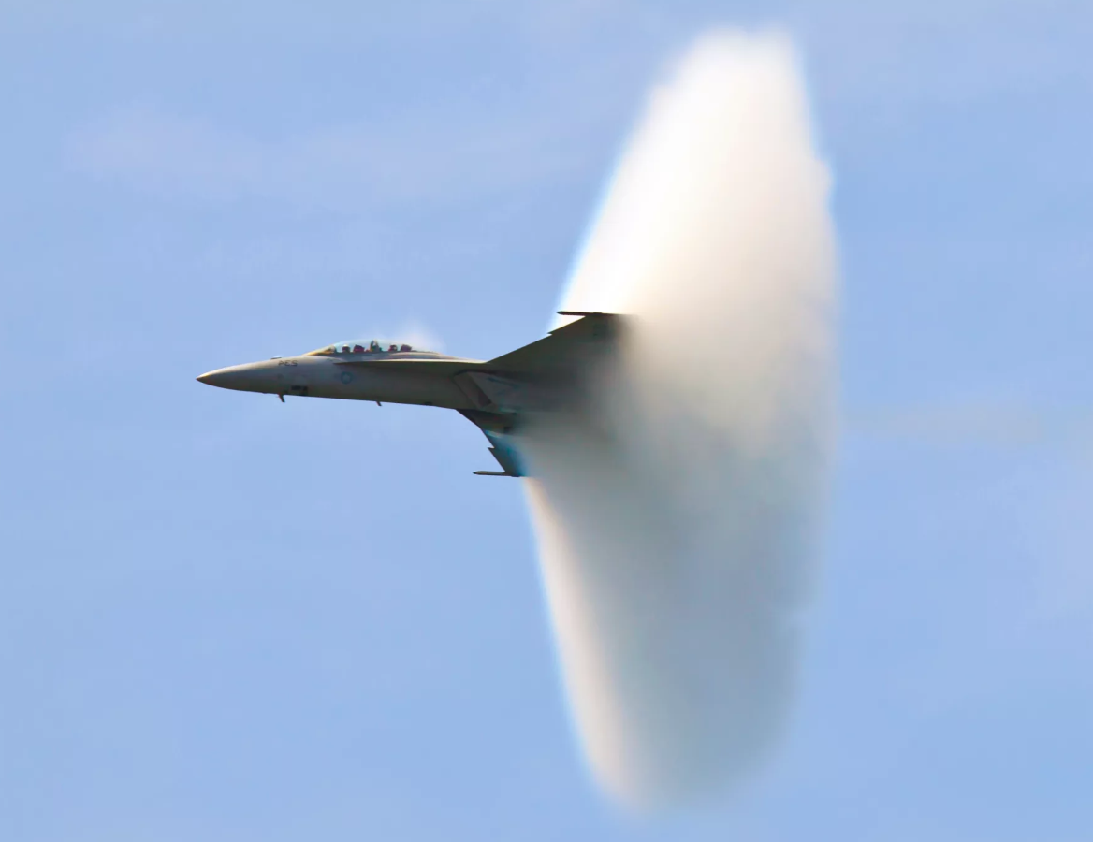
SOUND WAVES
What you are looking at is a shock wave:
You already know that sound is a longitudinal wave with compressions and rarefactions.
A shockwave is produced when an object moves faster than sound itself, creating a huge compression behind it. So intense, that it can condense water vapor and we can see it!
TOP 7 INSANE SONIC BOOMS ON CAMERA

Slide 13
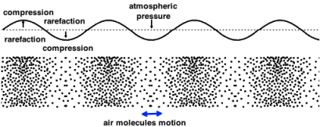

SOUND WAVES
The speed of sound, as any other wave, can be calculated as
$$v=λ x f$$
Where:
$v$ is the speed of the wave
$λ$ is the wavelength
$f$ is the frequency of the wave

Slide 14
SOUND WAVES
The speed of sound varies depending on the medium it is travelling through. On air, at a given pressure and temperature, sound travels at a speed of approximately 330 m/s.
How do we know it?
Let’s make an attempt to discover it today!

Slide 15
SOUND WAVES
Before we start, we need to learn a basic concept:
Stationary waves.
Stationary waves are waves that, instead of travelling, keep on oscillating on fixed positions.
The easiest way to create a stationary wave is to make a wave bounce back on a surface. It will interfere with itself creating a standing wave:
Standing wave (explanation by superposition with the reflected wave)

Slide 16
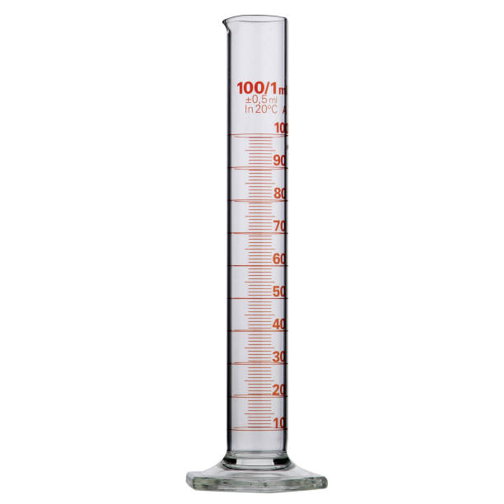
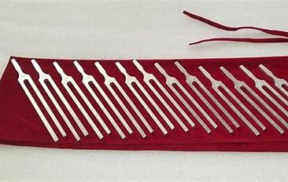
SOUND WAVES
To carry out this investigation, we just need:
A measuring cylinder
A ruler
Some water
A tuning fork

Slide 17

SOUND WAVES
The amplitude of the sound wave is the maximum volume we can hear.
By creating a standing wave inside the measuring cylinder, when we are finally able to hear maximum volume, we will have created a standing wave inside the cylinder with a crest at the edge. This is exactly how wind instruments work!
As sound travels inside the measuring cylinder and bounces back, creating a stationary wave, if we know the frequency of the sound (look at your tuning forks) and we look for the maximum volume we can hear, we can calculate the wavelength of that sound, and therefore the speed of sound.
$$v=λ x f$$

Slide 18
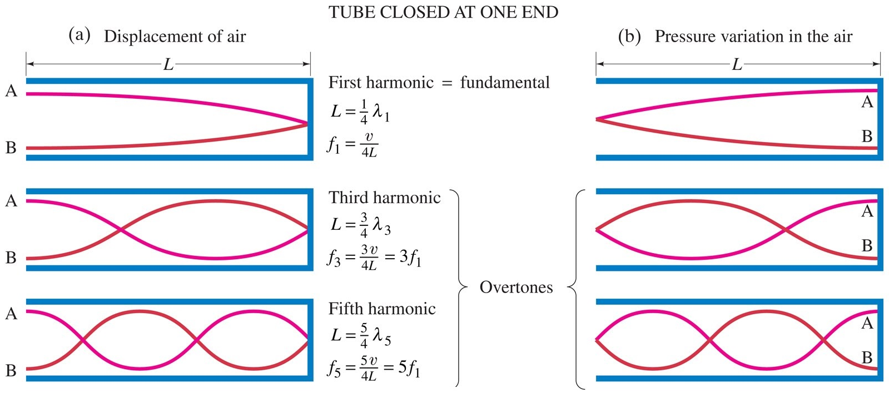
SOUND WAVES
We will learn about these harmonics during Y12

Slide 19
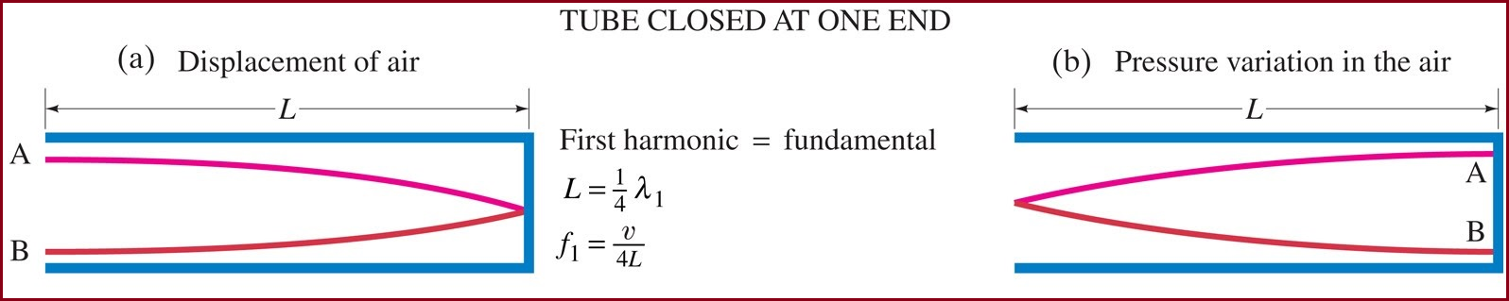
SOUND WAVES
Today we are looking for the first harmonic:

Slide 20
SOUND WAVES
Procedure:
1. Fill the measuring cylinder with water (It is a good idea to start filling it up to the middle).
2. Hit your tuning fork on the cork and take it close to the edge of the measuring cylinder (BE CAREFUL TO NOT TOUCH THE GLASS WITH IT, AS YOU MAY BREAK IT!)
3. Notice the sound you can hear
4. Add (or remove) some water. Repeat!
5. Use your skilled scientific judgement to decide when the volume you can hear is maximum: this means the standing wave inside the cylinder has a crest on its edge!

Slide 21
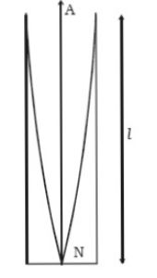

SOUND WAVES
Procedure:
6. Once you are happy with the volume you can hear,
measure the distance between the open end of the
measuring cylinder and the water level.
This will be equal to: $l=\frac{λ}{4}$
7. Calculate your wavelength
8. Multiply this value by the frequency of the sound you
are producing with your tuning fork.
9. The speed of sound will be: $v=λ x f$

Slide 22
SOUND WAVES
Risk assessment:
This investigation is safe, but we always need to do a risk assessment.
Can you think on the main risks for this practical?

Slide 23
SOUND WAVES
Risk assessment:
This investigation is safe, but we always need to do a risk assessment.
Can you think on the main risks for this practical?
We are using glass. We need to be careful to not break it. If glass is broken in a lab, it needs to go in a safety bin bag and has to be notified to a technician to avoid cuts!
We are using water. Be careful with sockets and appliances to avoid electrical shocks!

Slide 24
SOUND WAVES
Compare your results for different frequencies. The speed of sound on air is normally between 330 – 340 m/s.
Are your results accurate?
What may be the main sources of error?
How can we improve the accuracy?
This is the type of information that scientists needs to include in their reports!

Slide 25

SOUND WAVES
To finish the lesson, I would like you to take a look at this picture:
What we investigated today is basically
what a sound engineer does, for instance in
order to provide the best experience at a
concert at the Albert Hall (with much better
equipment, of course!). These “mushrooms”
are placed where they are, at different
heights, to ensure the best sound and
volume at every single place of the
auditorium!

Slide 26
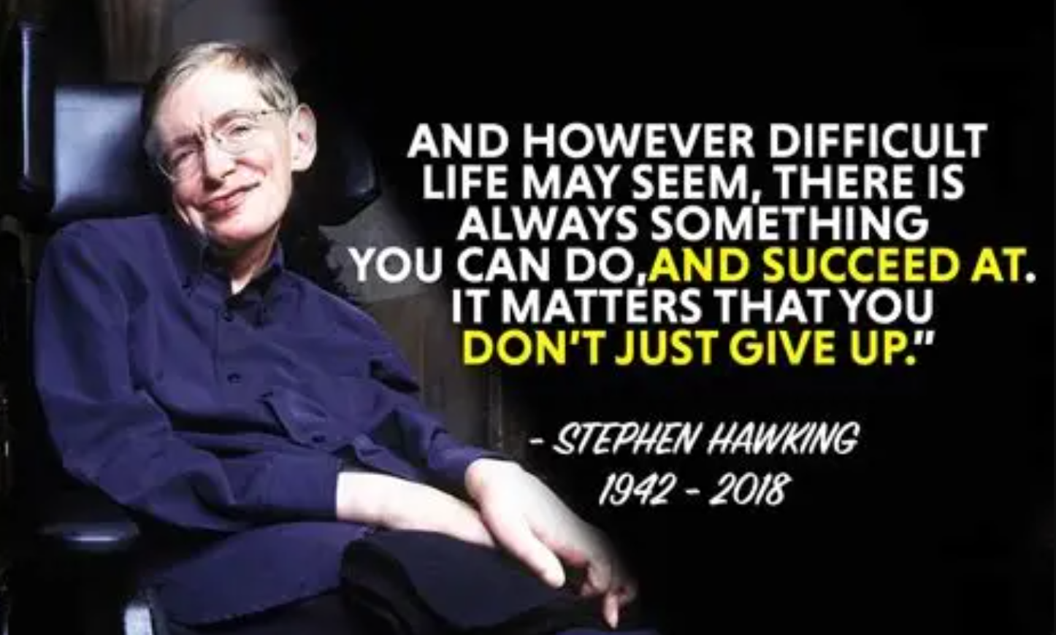
THANK YOU FOR COMING!
Physics is not only a very valued subject, both academically and professionally, it is a beautiful and elegant tool to discover and understand the wonders of the Universe!
And do not forget to complete your summer work to get the best of Physics from the very first day when you come back in September!

Slide 27
“AND NOW FOR SOMETHING COMPLETELY DIFFERENT”
Take a look at these videos if you want to see something amazing!
What does the Solar System really look like?
What does the Solar System REALLY look like? 🪐 🤩 #shorts
The size of the Universe
Universe Size Comparison | 3d Animation Comparison | Stars Real Scale Comparison
“…it is NOT rocket science”
Animation vs. Physics

