Slide 1
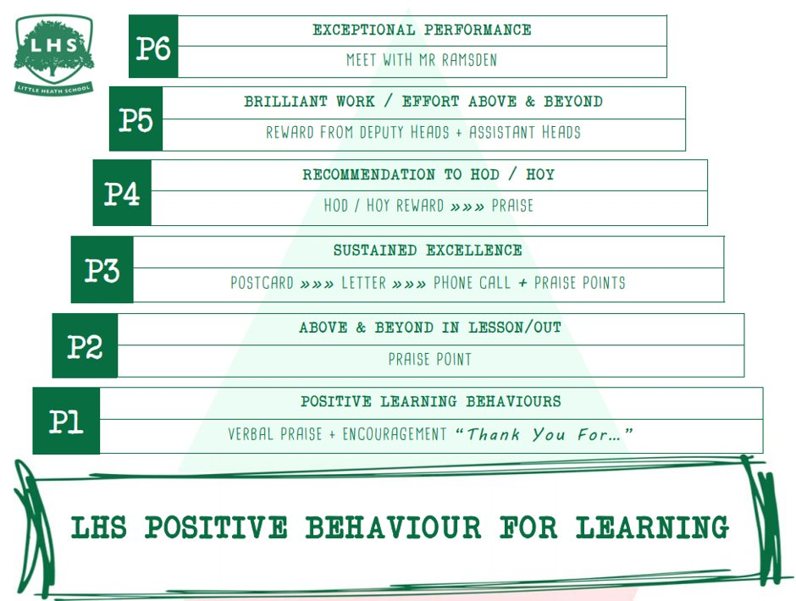
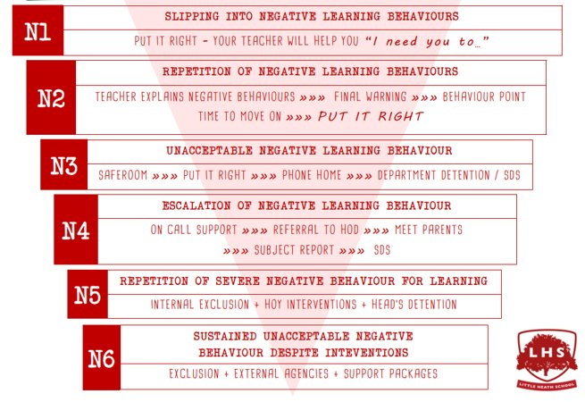
DNA
Pick one object from the pile in the middle of the room. It has now become something else – and you need to explain in 30 seconds to the group what it does and how it works, as though you are selling it as a sales pitch.
Aims:
To understand the basic demands of the course so that we are ready to learn come September
To experience the ‘Devising’ unit of the course by responding to a stimulus and its themes, creating a piece of theatre inspired by the stimulus.
To explore how interpretation and presentation of Drama can impact audience experience.
Thank you for being ready to learn!

Slide 2
Introduction to A Level Drama & Theatre Studies
OCR Specification

Slide 3
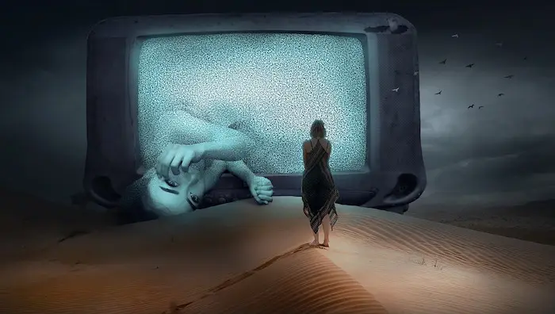
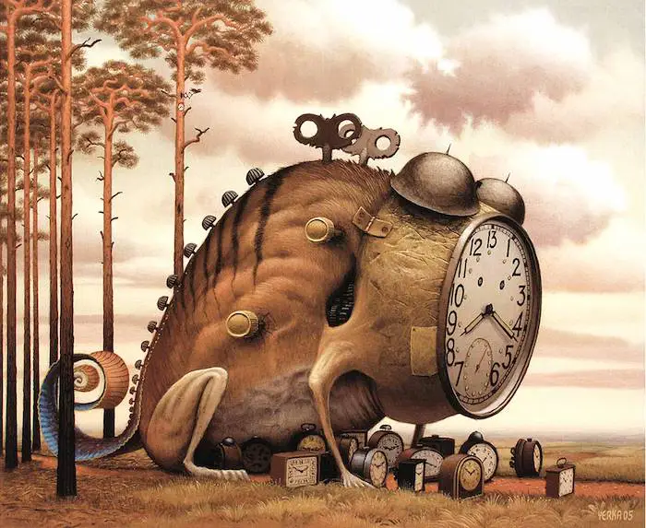
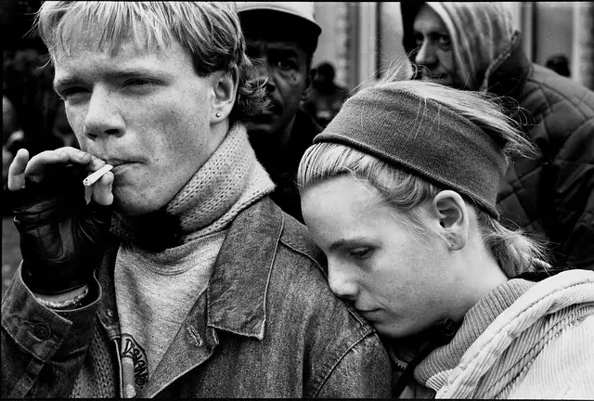
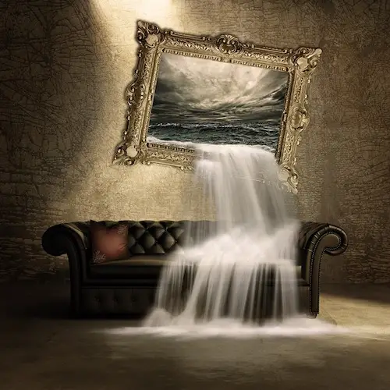
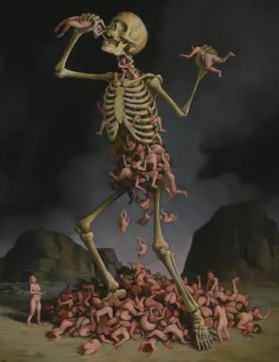
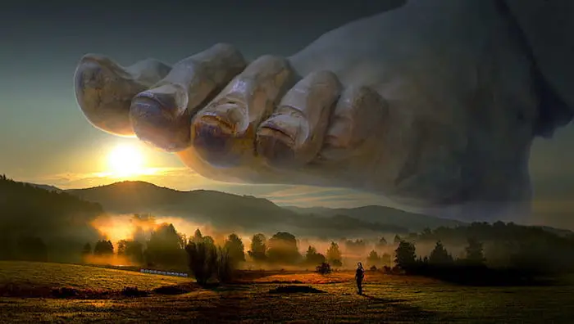
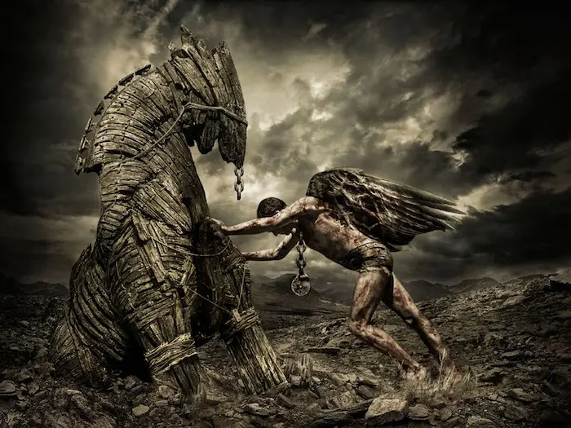

Slide 4
Today
Look at the different stimulus photos – choose the one that excites or interests you the most.
Working in groups of five, share your image.
Put them in an order of events, coming up with a link or narrative between each of them – it can be as straightforward and as simple as you like or equally as weird and wonderful.
Key Vocabulary
Theme = an idea that is repeated/recurring throughout
Stimulus = a starting point; something that causes or drives action

Slide 5
Bringing it to life
Complete the following tasks:
Create five tableaux (still images) of what is happening in each of the photos/your story. Use everyone in the group!
Now add in a maximum of five movements and five lines of dialogue per tableaux. Consider how you move from image to image.
Listen to the first piece of music I play – discuss with your group the tone of this and the emotions it provokes. Perform your images in a style that matches the tone of the music.
Listen to the second piece of music – do the same thing! How do the two performances differ?

Slide 6
Bringing it to life
You will now perform your string of tableaux in the following styles/with the following constraints:
As a piece of Victorian Melodrama – completely over the top and exaggerated
In a tiny box created by the sticks – you cannot step outside of this box!
In the biggest amount of space possible where every time you move or speak you have to “fill” the stage
Mute – you must communicate everything you would with speech…. Without speech!
In the style of a gangster or action movie

Slide 7
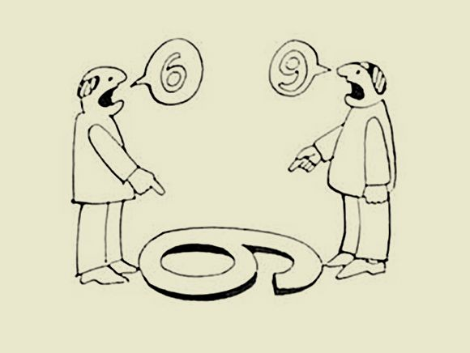
How does an interpretation or style affect the overall audience experience or message?

Slide 8
Key information for next year

Slide 9
Equipment
Comfy clothes you can move in (please be aware this won’t fit with the dress code so you may need to get changed)
Pen, highlighter and pencil for every lesson
A4 work pad
Folder – dividers, tabs – you will study 4 different plays
Antigone (Jean Anouilh); Love of the Nightingale (Timberlake Wertenbaker); Frankenstein (Nick Dear)

Slide 10
OCR A Level Drama!
We have chosen to complete the A Level Course
This will take place over 2 years
You will complete 1 formal assessment next year
We will prep for the final examinations in year 12 and complete the rest of the assessment in year 13

Slide 11
Component 1: Practitioners in Practice
Worth 40% of your whole A Level and is worth 120 marks
Internally assessed by the department, filmed and moderated by OCR
We study a range of practitioners from the 20th century right up to modern day.

Slide 12
Component 1: Practitioners in Practice
We will look at an extract from a text and explore practically looking at two practitioners in particular. From this work you will create a research report that will show your understanding of the practitioners we have studied in class. This is worth 30 marks
You will then create a devised performance influenced by your exploration of your two chosen practitioners. This is performed before Christmas and is an official mark for your A Level. Alongside this you will put a short document together that explains your artistic intentions. This is worth 40 marks
You will also produce a portfolio that evidences your practical process and how you developed your ideas in class. This portfolio will also evaluate the work of others. This is worth 50 marks

Slide 13
The department’s top tips!
This is a really challenging but exciting course that will show you how theatre makers today approach staging theatre as well as looking at theatre of the past. Here are just a few top tips to help you along…
Stay on top of deadlines! If you miss a key deadline there are sanctions – please keep open communication with us if you are struggling.
Throw yourself into every lesson – sometimes things might seem a bit scary, but that’s good!
Talk to your teachers if you are struggling or unhappy.
Use and check Satchel One and emails regularly!
Support each other – you’re all here for many reasons, but a love of drama is something you all have in common.
See as much theatre as you can! We will run trips but there is loads of local stuff on too. We will keep you updated if anything exciting is on.
Read plays… There is so much amazing stuff out there; get reading and expand your knowledge!

Slide 14
Transition work
Practitioner research file – Brecht/Stanislavski/Artaud/Berkoff
Modern Practitioner research file - DV8/Katie Mitchell/Paper Birds/Punch Drunk/Splendid/Kneehigh/Gecko /Pina Baush
Watch a documentary – Be prepared to discuss in first lesson. This can be anything of your choosing! Some recommendations are Black Fish; Making a Murderer; The Last Dance; Lewis Capaldi: How I’m Feeling Now.
Watch 4 videos on National Theatre YouTube – again you will need to be prepared to discuss this in your first lesson

