Slide 1
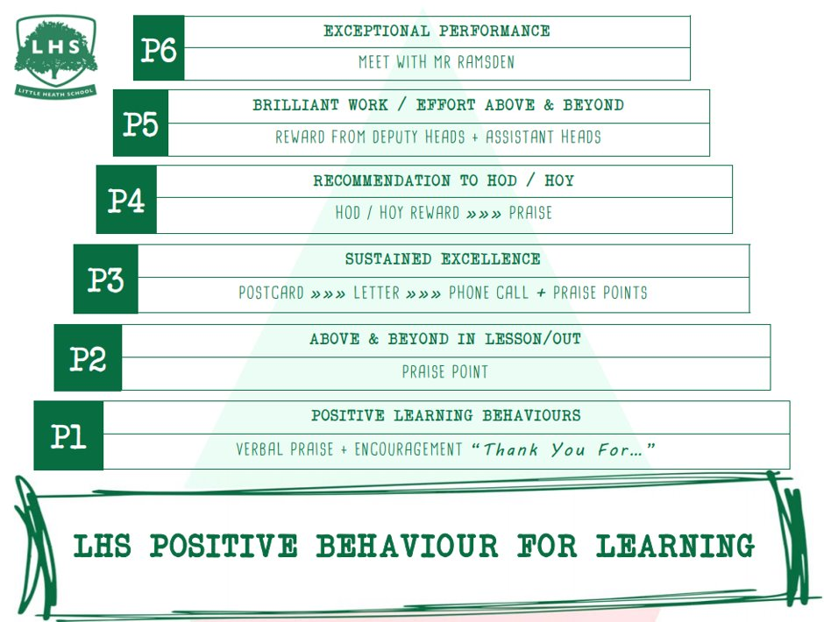
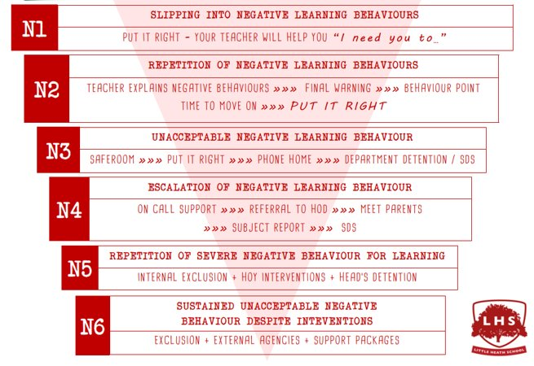


Title: English Literature Taster Lesson
DNA:
What issues in society do we need to protest about?
Aims:
To entice you all into signing up for Eng Lit
Thank you for being ready to learn!

Slide 2
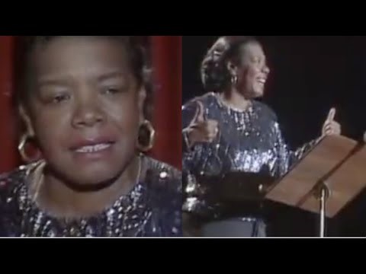
Still I Rise by Maya Angelou
What elements of social and political protest can you find in this poem?
How does Angelou present her ideas?

