Slide 1
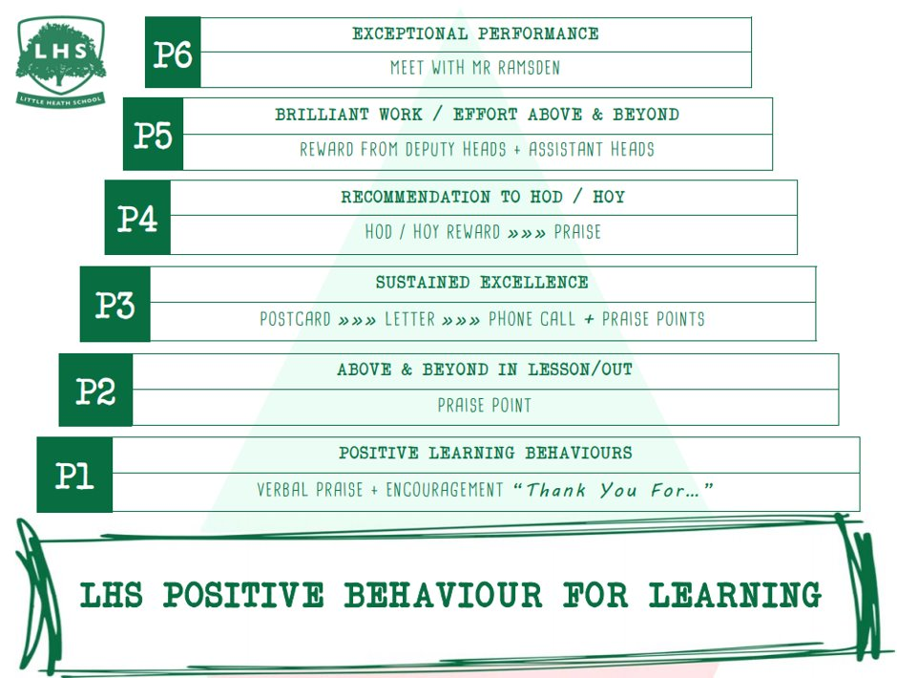
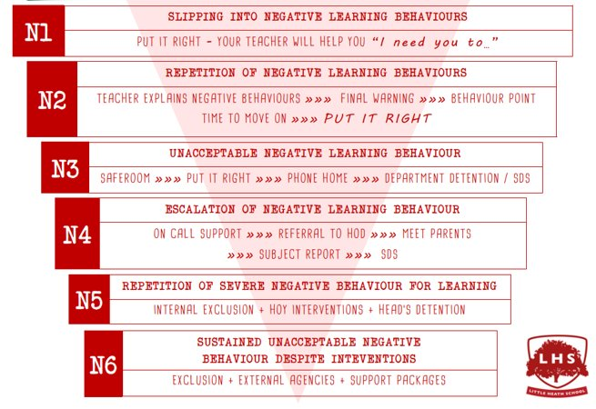


DNA:
Title: Biology A Level
Aims:
Taster Session
Thank you for being ready to learn!

Slide 2
WHY A LEVEL BIOLOGY ??

Slide 3
Growing cases of cancer and still no cure
Rapid population growth and not enough food to feed everyone
Animals globally continue to become extinct
Stem cell developments to improve quality of life for those with genetic disorders
WHY BIOLOGY IS THE MOST IMPORTANT SUBJECT IN SIXTH FORM
Bacteria resistant to all forms of antibiotic and no development into new antibiotic drugs
Outbreaks of deadly viruses sweeping across countries
Development of early screening tests for genetic disorders

Slide 4
A Level Biology induction day 2025
WALT:
Outline of the AS & A level biology courses
Biology department expectations and what it takes to be successful
Sample application of level of skills required of the AS/A level biology course

Slide 5
AS Level biology course outline

Slide 6
1. BIOCHEMISTRY
2. Cell Biology
3. Organisms Exchange of substances with environment
4. genetics
FOUR UNITS OF STUDY (AS Level, paper 1& 3)

Slide 7
5. Energy Transfer in and between organisms
6. Organisms response to change in both internal and external environments
7. Genetics, Populations, Evolution & Ecosystems
8. Control of Genes expression
A Level biology course outline (paper 2 & 3)
Four units of study;

Slide 8
Assessment of A Level biology May 2027

Slide 9
3 x 2 hour examinations worth 2x35% and 30% of the course paper 1: will cover all units (1-4)of AS Bio course & assessment of practical skills
Paper 2:
Units 5-8 of A level course including practical skills
Paper 3:
Units 1-8, all of As & A level courses including practical skills AND a 25 mark Synoptic essay

Slide 10
the following weightings apply
Assessment breakdown and weightings

Slide 11
So where does this fit on the different levels of learning??
35-40% Knowledge and understanding of concepts and techniques
40-45% Application Knowledge and understanding of concepts including data handling, qualitative and quantitative data handling
3. 20-25% Analysis, interpretation & evaluation of scientific information. Judgements & conclusions regarding practical's and practical designs

Slide 12
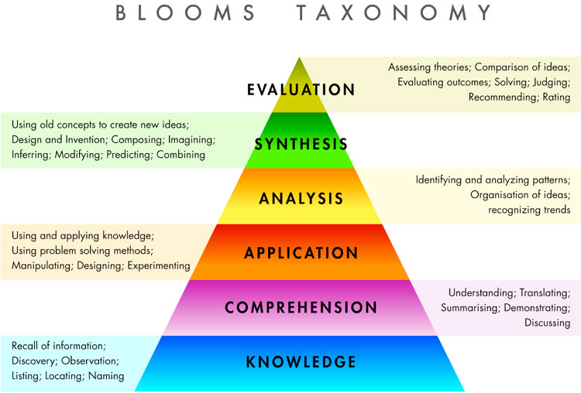

Slide 13
Arithmetic & Numerical computation
Data handling
Algebra
Graphs
Geometry & Trigonometry
Statistics
Geometry and Trigoff
The Maths……
Assessment weighting 10% of your total final grade.

Slide 14
WALT:
Outline of the AS & A level biology courses
Biology department expectations and what it takes to be successful
Sample application of level of skills required of the AS/A level biology course

Slide 15
Biology department expectations and what it takes to be successful

Slide 16
For every hour of lesson time you will need to spend 1 hour of independent study
Be organised, notes, E/L, filing of notes into a designated biology folder
Perfect attendance……
Initiative….. seek assistance early, be proactive in YOUR LEARNING
Entry test in September Theory AND Maths skills and following unit assessments. Minimum target grade Required. ‘Head start’ text listed on discovery list.
Passion, resilience, perseverance & engagement….Love, Live Biology!!!... don’t do the subject just because you need a 4th subject and biology was your best GCSE Science mark. Find another subject!!!!!

Slide 17
WALT:
Outline of the AS & A level biology courses
Biology department expectations and what it takes to be successful
Sample application of level of skills required of the AS/A level biology course

Slide 18
Skills we are looking for you to display
1.AO1: 35-40% Knowledge and understanding of concepts and techniques
2. AO2. 40-45% Knowledge and understanding of concepts including data handling, qualitative and quantitative data handling
3. AO3. 20-25% Analysis, interpretation & evaluation of scientific information. Judgements & conclusions regarding practical's and practical designs
Many animals show turn alternation.
If an animal is forced to turn in one direction it is more likely to turn in the opposite direction next time it has a choice.
This investigation you are required to study whether this is the case with a well known invertebrate…………

Slide 19
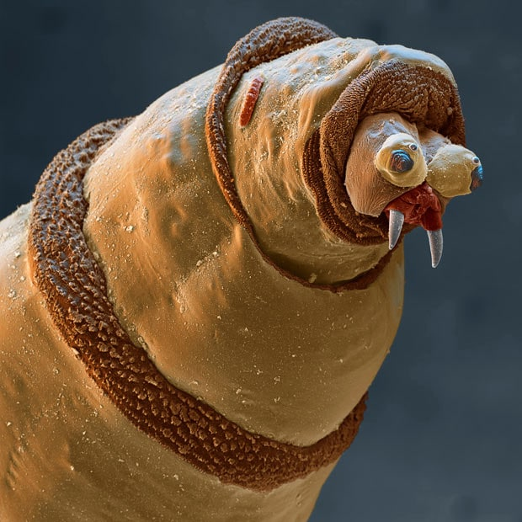
MAGGOTS

Slide 20
You are to carry out an investigation into whether maggots have a turn alternation, that is, if they turn left then the next time, they will turn right then left again and so on and so on.
You are to;
Carry out investigation (Part one then Part two)
Collect results data appropriately
Carry out a statistical test on your data to confirm your results as significant… or not
Conclude whether maggots have an instinctive turn alteration
You will also be required to consider aspects of your method and why you carried out the procedures that you did

Slide 21
Maggots when required to turn will alternate between left and right
HYPOTHESIS:

Slide 22
What is the Null Hypothesis?

Slide 23
There is no alternation in whether a maggot turns left or right
It is just a statement that is the opposite of the hypothesis

Slide 24
Complete Task One
Complete associated questions
Break Time as & when appropriate
Complete Task Two
Carry out a Chi Squared (χ² Test) Statistical test on your results
Use your stats results to write a conclusion as to whether maggots have turn alternations

Slide 25
Results table???
Do practical and appropriate questions associated

Slide 26
Results Table
Maggot Repeats | Direction
 | Left turn | Right turn
1
2
3
4
5
How many maggots do you expect to turn left or right?

Slide 27
No, I here you say…well we therefore need to carry out a statistical test to support your findings.
So……looking at your results can you say whether there is turn alternation in maggots?
Is there enough evidence?
Are your results Significant?
Can you be CONFIDENT?

Slide 28
Do a Chi Squared test
To compared the observed with the expected (with the hypothesised)

Slide 29
Maggots when required to turn will alternate between left and right
HYPOTHESIS:

Slide 30
There is no alternation in whether a maggot turns left or right
NULL HYPOTHESIS

Slide 31
Chi-Squared = Sum of (Observed no. - Expected no. )²
Expected Number
χ² ⁼ ∑ (O-E)²
E
The value of Chi-Squared is then converted in to a probability value

Slide 32
Chi-Squared = Sum of (Observed no. - Expected no.)²
Expected Number
χ² ⁼ ∑ (O-E)²
E
The value of Chi-Squared is then converted into a probability value

Slide 33
Two categories (Left turn or Right turn)
Behaviour of Musca domestica. (the maggot)
Choice chamber/maze – Left turn V right turn

Slide 34
The Data Crunch
Experiment set Use 4 other peoples data | Number of turns.
 | Left turn | Right turn
1 your totalled results from the 5 trials
2
3
4
5
Any trend? Is there any significant preference?

Slide 35
The Data Crunch
Experiment set Use 4 other peoples data | Number of turns.
 | Left turn | Right turn
1 your totalled results from the 5 trials
2
3
4
5
Any trend? Is there any significant preference?

Slide 36
The Data Crunch
Experiment set Use 4 other peoples data | Number of turns.
 | Left turn | Right turn
1 your totalled results from the 5 trials
2
3
4
5
Any trend? Is there any significant preference?

Slide 37
The Data Crunch
Experiment set Use 4 other peoples data | Direction
 | Left turn | Right turn
1 | 3 | 2
2 | 4 | 1
3 | 4 | 1
4 | 3 | 2
5 | 2 | 3
Mean observed | 2 | 3
Any trend? Is there any significant preference?

Slide 38
The Data Crunch (group data)
Experiment set Use 4 other peoples data | Direction
 | Left turn | Right turn
1 your totalled results from the trials | 0 | 5
2 | 3 | 2
3 | 2 | 3
4 | 4 | 1
5
Mean observed | 9 | 11
Any trend? Is there any significant preference?

Slide 39
Continued
Count all Musca domestica in each half.
? Turned left, ? Turned right. These are ‘Observed’ (O) values
If there was no preference we would Expect same number for each. This is the (E) value based on the Null Hypothesis

Slide 40
Now Calculate chi squared (χ²)on your results
Category | O E | (O-E) | (O-E)² | (O-E)² /E
Left turn | ?? ? | ? | ? | ?
Right turn | ?? ? | ? | ? | ?
χ² ⁼ ∑ (O-E)²
E
∑ = ??
Doesn’t matter if (O-E) is a negative value

Slide 41
Now Calculate chi squared (χ²)on your results
Category | O E | (O-E) | (O-E)² | (O-E)² /E
Left turn
Right turn
χ² ⁼ ∑ (O-E)²
E
∑ =
Doesn’t matter if (O-E) is a negative value

Slide 42
Degrees of Freedom
To determine the degrees of freedom, take the number of categories and minus 1.
This example; two categories (left & right) minus 1 = 1 df.
So we have 1df and χ² = ???
Now to determine whether your results are statistically significance …

Slide 43
Determine Significance.
Use the values 1df and χ² = ?? in the probability table at 5% or p = 0.05
 | Increase p values Decrease
Df | 0.99 0.95 0.90 0.50 0.10 0.05 0.01 0.001
1 | 0.00016, 0.0039, 0.016, 0.46 2.71, 3.83, 6.63, 10.83
Not Significant Significant

Slide 44
Conclusion:
Not significant Option: “There is a greater than 5% probably that the results are due to chance
I therefore accept my null hypothesis
OR
Significant Option: “There is a less than 5% probably that the results are due to chance.
I therefore reject my null hypothesis

Slide 45
Collect a biology preliminary sheet on way out
Summing up induction day…
SO …..DO MAGGOTS HAVE A TURN ALTERNATION????
Course outline
How to be successful
Sense of real Biology, keenness ,
positive excitement for Sept 2024

Slide 46
A Level Biology induction day 2025
WALT:
Outline of the AS & A level biology courses
Biology department expectations and what it takes to be successful
Sample application of level of skills required of the AS/A level biology course

