Slide 1
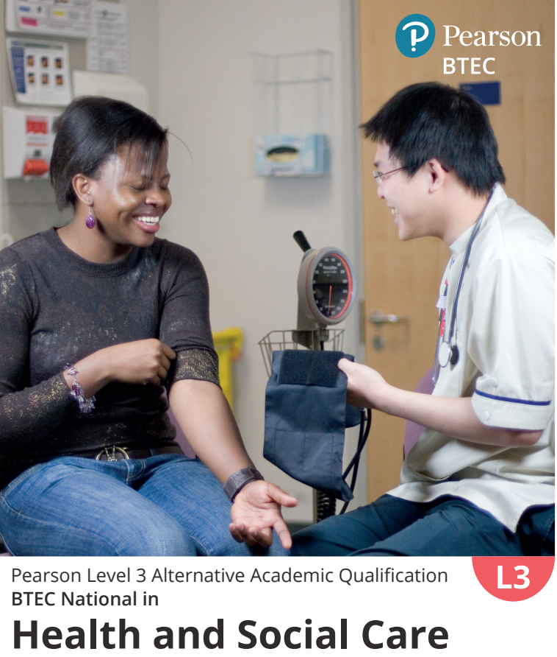
Welcome to the
Health and Social Care taster session

Slide 2
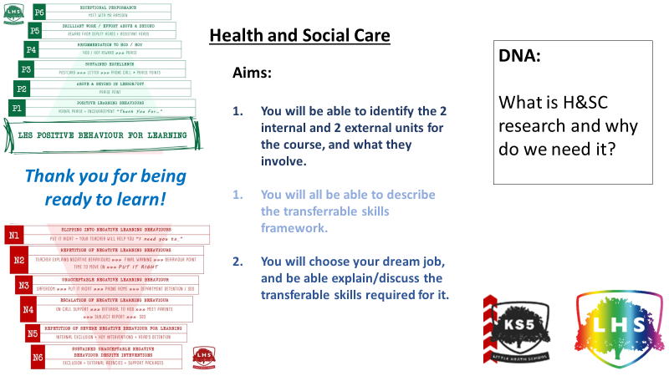
Write your name on your label and stick it on you! ☺
Speak to your partner, and discuss the reasons for selecting the HSC course.

Slide 3
The Pearson Level 3 Alternative Academic Qualification BTEC National in Health and Social Care (Extended Certificate) is an Alternative Academic Qualification (AAQ) designed for post-16 students with an interest in health and social care and aiming to progress to higher education as a route to graduate level employment.
Equivalent to one A Level in size, it is suitable for students looking to develop their applied knowledge and skills in Health and Social Care alongside two A Levels or other Level 3 courses.
Who is this qualification for?

Slide 4

Unit 1
Human Lifespan and Development
Physical, Intellectual, Emotional & Social (PIES) factors affecting growth and development, interventions and the different professionals providing care and treatment.
Unit 2
Human Biology and Health
Human body structure and systems, normal physiological functioning and the impact of common disorders.
What will you study over the next two years?
Unit 3
Health and Social Care Practice
Core principles, values and legislation that underpin and influence health and social care, and the effect of social determinants on an individual health status.
UNIT 5: Promoting Health Education
For this Pearson-set Assignment Brief, you should focus on one health and wellbeing issue from the following:
• diet and nutrition • sexual health.

Slide 5
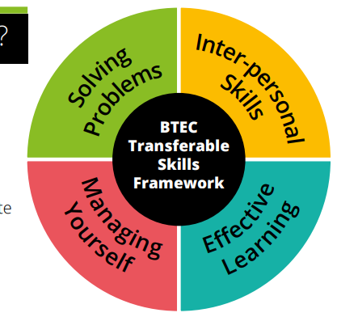
Transferable skills can be defined as skills that are not specifically related to a particular job, task, academic discipline or area of knowledge and can be used in a wide variety of situations and work settings. They are the skills everyone needs to do any job and to successfully navigate everyday life.

Slide 6
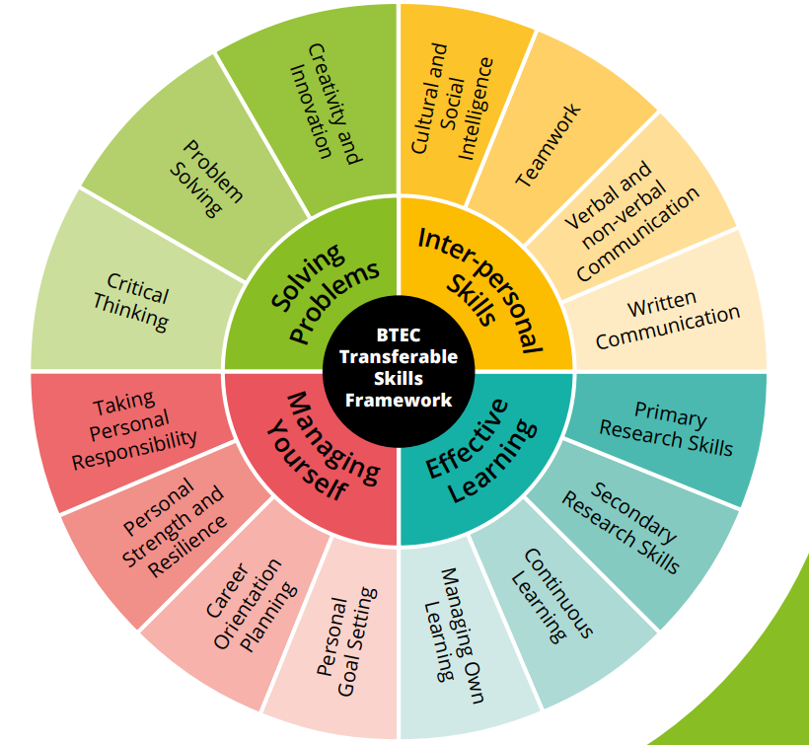
It is important to remember that this course will teach you many transferable skills, skills you can use for the future, whether it is employment or university.

Slide 7
What further learning will this qualification lead to?
• Nursing – BSc (Hons) Adult Nursing, Paediatric Nursing
– BSc (Hons)
• Subject allied to Healthcare works
• Social Work – BA (Hons) Social Work
• Psychology – Psychology BSc (Hons)
Which subjects will complement this qualification?
The following subjects would be suitable to combine with this qualification:
Sociology
Psychology
Biology
English
Early Childhood

Slide 8
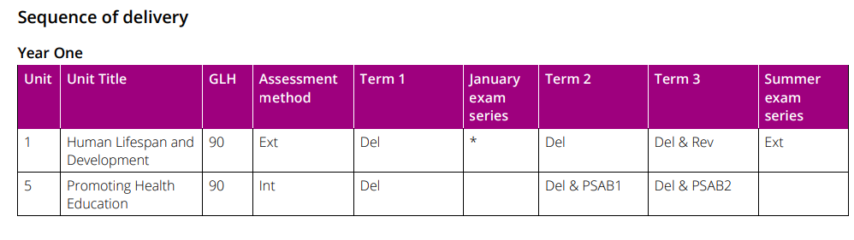
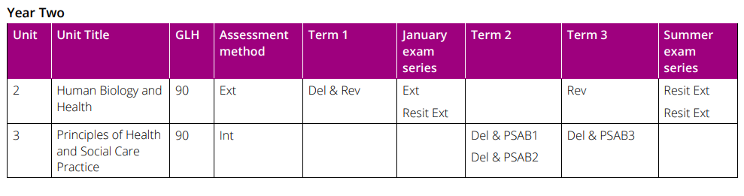
Exam Units 1 and 2 taken in Year 12
Coursework Units 3 and 6 taken in Year 13
Exam is worth 50% of the overall mark
Unit 1 Exam = 25%
Unit 2 Exam = 25%
Coursework (Pearson Set Assignments)
is worth 50% of the overall mark
Unit 3 CWK = 25%
Unit 6 CWK = 25%

Slide 9
Unit 1- Exam: What are health inequalities?
Health inequalities
The shocking reality of health inequality – BBC
How Covid exposed the UK’s health inequalities
Reducing health inequalities for people experiencing homelessness
Think about…
What is a health inequality?
Who is at risk from health inequalities?
What is trying to be done to reduce health inequalities?

Slide 10
Unit 2 – Exam
Content Area | Topics
A: Organisation of the human body | A1 Cells A2 Tissues A3 Energy in the body A4 Homeostatic mechanisms
B: Body systems | B1 The cardiovascular system B2 The respiratory system B3 The nervous system B4 The endocrine and renal systems B5 The musculoskeletal system B6 The function of further body systems
C: Disorders of the body and effect on body systems | C1 The main disorders of the body systems

Slide 11
Unit 3 – Assignment
Learning Aim | Topics
A Understand the principles of health and social care practice which underpin meeting the care and support needs of individuals | A1 Values essential to health and social care practice A2 Person-centred care and approaches A3 Communication in health and social care A4 Confidentiality A5 Duty of care A6 Working with vulnerable children and adults at risk
B Examine how organisations, legislation and guidance inform practice in health and social care | B1 Organisations, legislation and guidance affecting health and social care services B2 Organisation of health and social care services B3 How health and social care services are organised to benefit the population B4 Using critical thinking skills to draw valid conclusions
C Examine how social determinants affect the health status of individuals and the importance of equality, diversity and inclusion in practice | C1 The effect of social determinants on individuals’ health status C2 Improving health outcomes in practice C3 Potential barriers to improving health outcomes in practice

Slide 12
Unit 5 – Assignment
Learning Aim | Topics
A Understand the purpose of health education | A1 Purpose of health education A2 The role of health education A3 Organisations influencing health education A4 Legislation and regulations impacting on health education A5 Monitoring the health of the nation
B Explore key issues nation is monitored. and priorities for health and the factors that affect health and wellbeing | B1 Health issues and priorities B2 Factors affecting health and wellbeing
C Examine approaches to health education campaigns and their impact on health and wellbeing | C1 Current and ongoing health education C2 Models and approaches used in health education to promote health and wellbeing C3 Planning a health education even

Slide 13
Think of your dream job role…
Pick 4 skills from the framework, and write a short paragraph of what specific abilities you may need for a successful career.

