Slide 1
We are learning how meaning is created in media products so that we are able to apply this to our analytical writing
Everything in media studies can be explored or created using four key areas, which make up the ‘theoretical framework’. Each of these areas links to all of the others.
Media Language
Media Industries
Representation
But what do these terms mean?
Audiences
Look back at your KOs from last lesson and find the answers

Slide 2
Media Language
Media language is the way in which the meaning of a media text is conveyed to the audience.
They use a combination of recognisable signs and symbols to communicate ideas and messages and to evoke emotional responses from those consuming them.
Different forms of media have different ’language’ (terms) that we need to understand
Ultimately it is the way the product communciates!

Slide 3
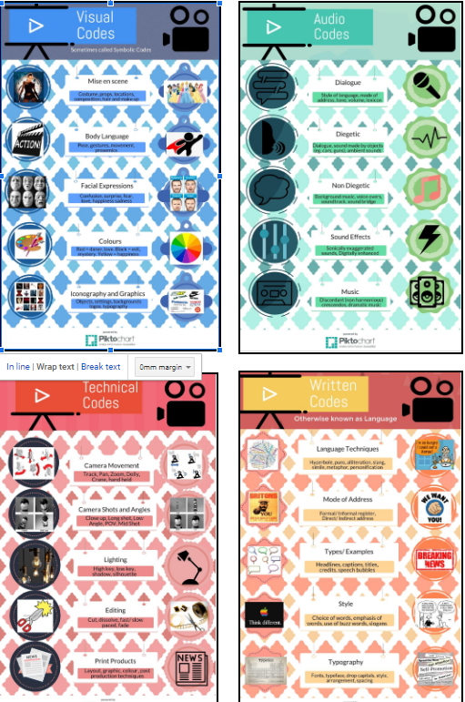
Media Language
Media language is broken into different areas as a universal language.
This makes it possible to compare different forms of media.
Technical Codes
Audio Codes
Visual Codes
Written Codes
The creators of media products encode messages and meanings within the products through a combination of media language codes.
Audiences then decode these messages.

Slide 4
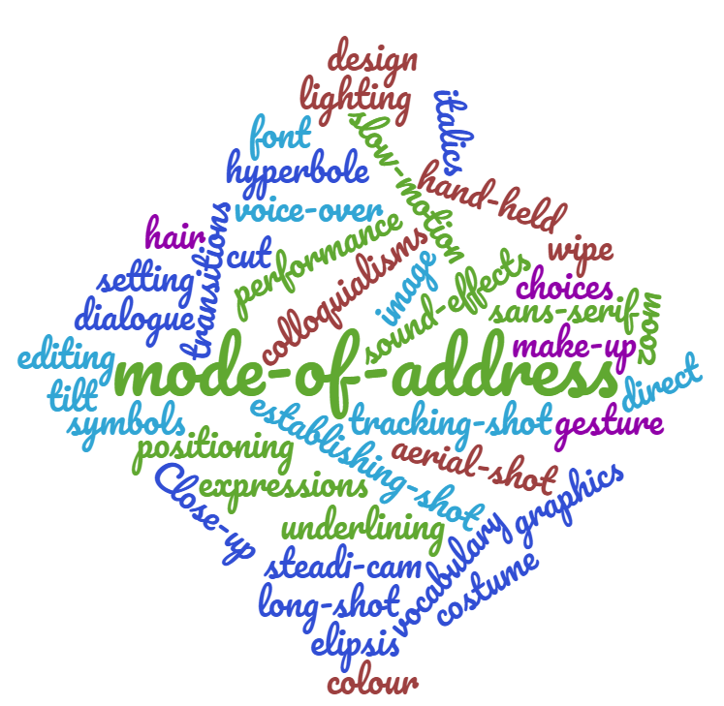
Using the word cloud...
...sort the codes in the cloud into
the correct groups
Technical Codes
Audio Codes
Visual Codes
Written Codes
The colours do NOT connote a code!

Slide 5
Exploring meaning
Partner up!
Label yourselves A & B
What is this?
Person A:
Describe literally what you see to your partner...it shouldn’t take long!
Is there only one meaning for this symbol?
Person B:
Explain what this image means to you. What does it stand for?

Slide 6
Key Terms
Denotation:
Denotation refers to the literal meaning of a word, the "dictionary definition.
What is denoted by an image, then, is what the image is. Saying “what is denoted in this image?” is the same as saying “what is this thing?”
Connotation:
The connotations of an image, sign or symbol are the meanings and messages it communicates. Saying “what does this image connote?” is the same as saying “what is the meaning of this thing?” or “What does this suggest to me?”
Task: Summarise these definitions in your notes in your notes into one short sentence.

Slide 7
You should have something like this?
Check your definitions and make sure they are correct...
Denotation: DESCRIPTIONS of what something is
Connotation: The MEANINGS we associate with a particular thing.
Denotation:
A red heart shape
Connotation:

Slide 8
So many meanings!
There are lots of other things we associate with the heart symbol other than love!
TASK:
Draw a heart in your books and annotate it with everything you can think of that links to the symbol. You can use these ideas as well as your own!

Slide 9
Media language is Polysemic
Signs and symbols in media texts are polysemic which means they are open to many interpretations.
Poly = Many Semous = signs
Task: Consider this Colgate advert:
What different interpretations could there be for why it has been constructed in this way?
Write down what you think.

Slide 10
How is the media language constructed? What do you see?
What different meanings are created?
How is this achieved?

Slide 11
We are learning how meaning is created in media products so that we are able to apply this to our analytical writing
Without looking at your notes… work in pairs to discuss and define the following terms:
Denotation
Connotation
Polysemic

Slide 12
Use a whole page of your book
THEORY
MEDIA LANGUAGE
ROLAND BARTHES

Slide 13
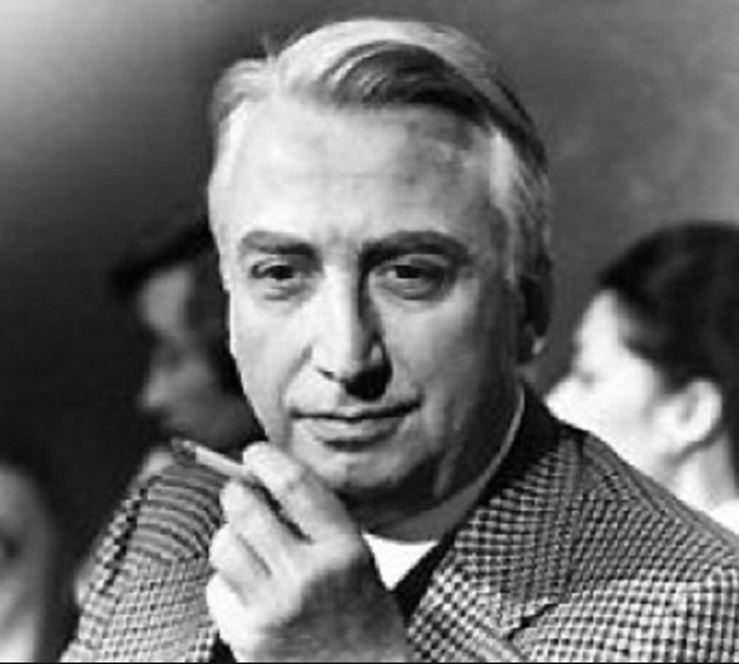
Theory Alert!
Media Language - Roland Barthes
Roland Barthes was a French writer who studied a range of areas about how texts of all kinds communicate meaning to audiences.
He argued that all texts communicate their meaning through a set of signs that needed to be decoded by the audience.
He was particularly interested in the way signs take on the ideology of a specific society and their meanings become accepted, appearing natural through repetition over time.

Slide 14
Barthes Codes
Enigma code
Action code
Semantic/ Symbolic code
Referential code
Each of the codes has its own role in constructing meaning and helping audiences make sense of a media product.

Slide 15
Enigma codes
This code refers to mystery within a text. Clues are dropped, but no clear answers are given.
Enigmas within the narrative make the audience want to know more.
Unanswered enigmas tend to frustrate the audience.

Slide 16
Action codes
In a similar way to the enigma, action codes build interest or suspense
It applies to any action that implies a further narrative action.
E.g. when a gunslinger draws his gun - we wonder what the resolution of this action will be. We wait to see if he kills his opponent or is wounded himself.
Suspense is thus created by action rather than by the need to have mysteries explained as with Enigma codes.

Slide 17
Semantic/Symbolic codes
These codes refer to parts within the text that link to wider, additional meanings.
Semantic codes refer to something within a product that has meaning; often multiple meanings.
Symbolic codes refer to an element that 'stands in' for, or means something else.
These are sometimes difficult to distinguish so we think of them going together!

Slide 18
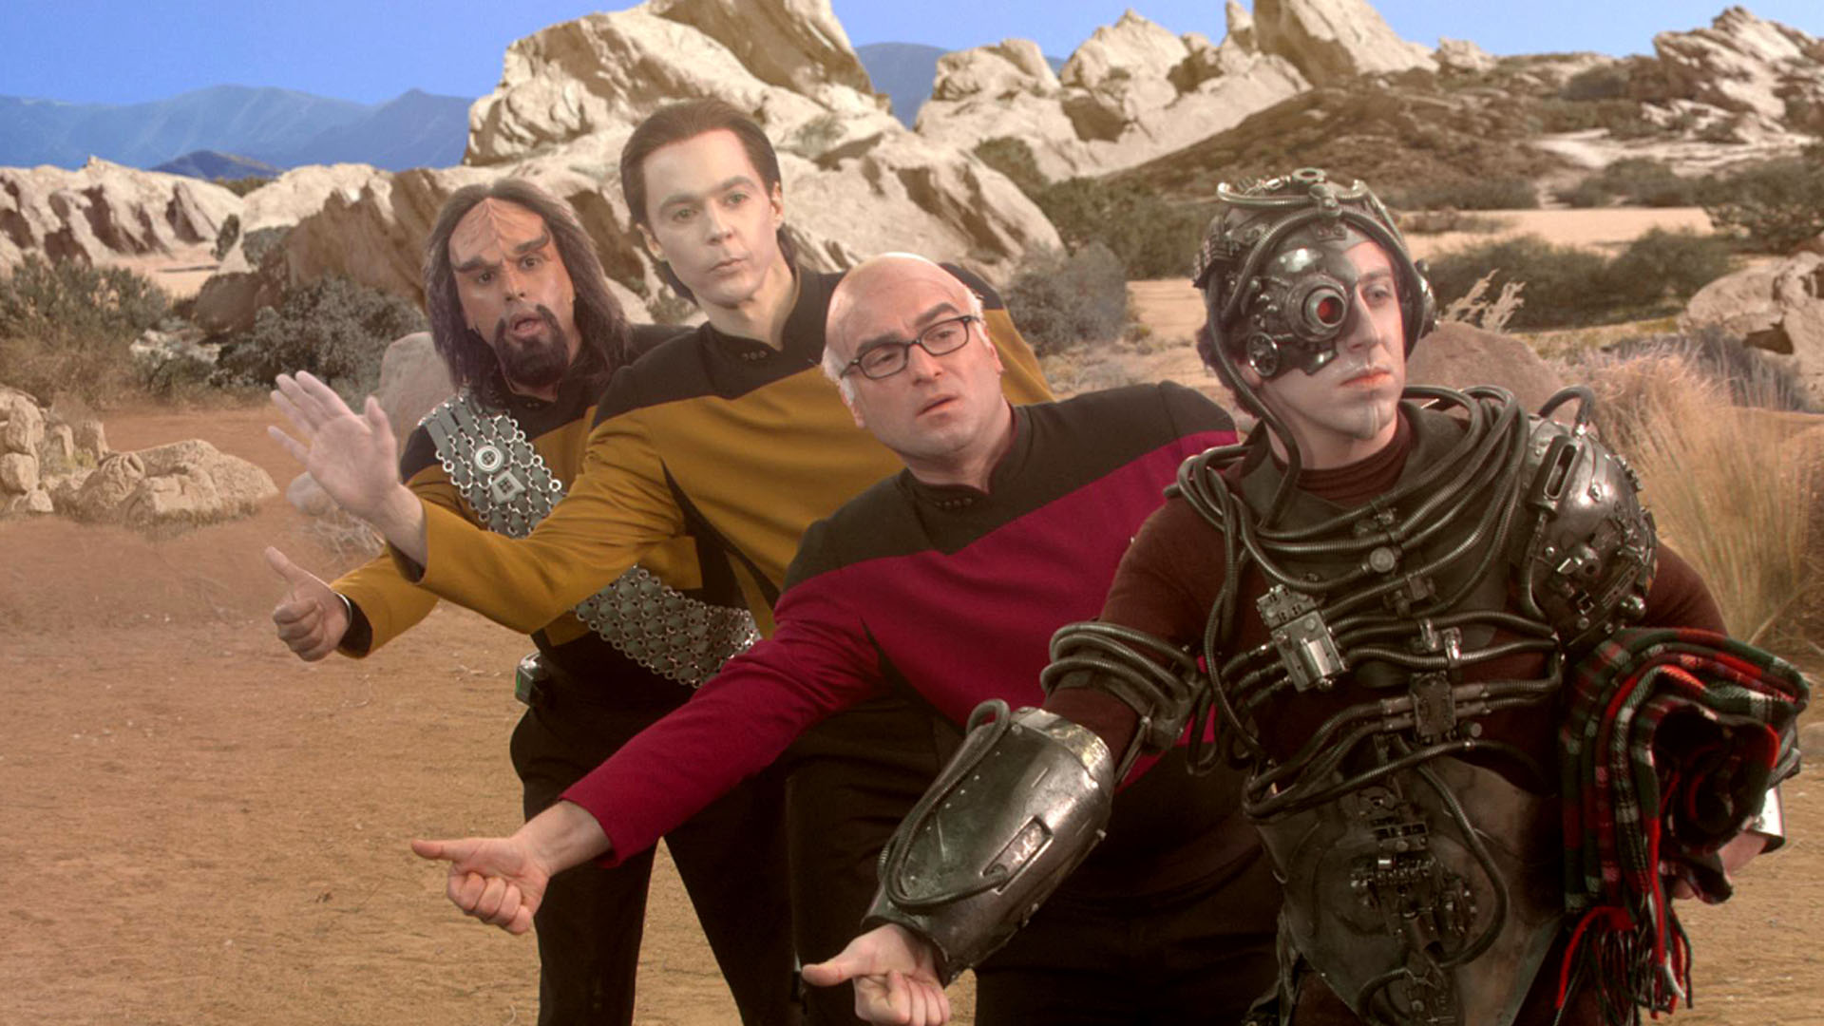
Referential codes
Where a part of a media product refers to something outside of the product itself. (This assumes the audience has knowledge of whatever it is that the text is referring to.)
This is closely related to intertextuality, and often it can be the basis for humour.
For example, The Big Bang Theory makes frequent reference to other texts, including Star Trek, Star Wars, and other aspects of 'nerd culture'. As an audience, you are more likely to get the joke if you have knowledge of these texts.

Slide 19
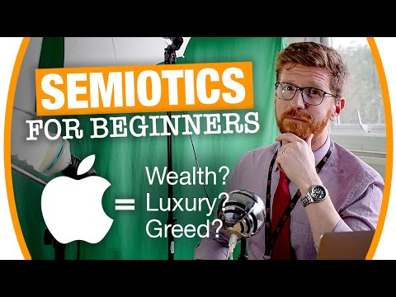
Homework
Watch this video + complete the tasks
Task 1:
Summarise semiotics in your books in your own words - use bullet points and give some examples.
Task 2:
Using the advert on the next slide - complete a semiotic analysis of the way signs are used to communicate meaning.
Try to reference some of Barthes codes!

Slide 22
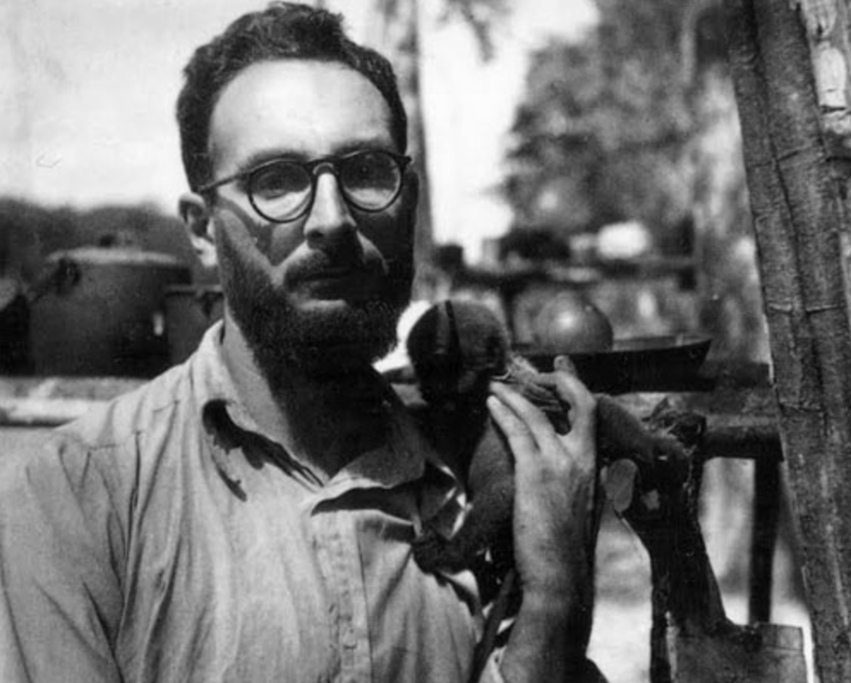
Theory Alert!- Media Language Claude Levi-Strauss
Claude Lévi-Strauss was a French anthropologist whose work was key in the development of the theory of structuralism -The theory that elements of human culture must be understood by way of their relationship to a larger, overarching system or structure. It works to uncover the structures that underlie all the things that humans do, think, perceive, and feel.
Key Idea – Binary Oppositions

Slide 23
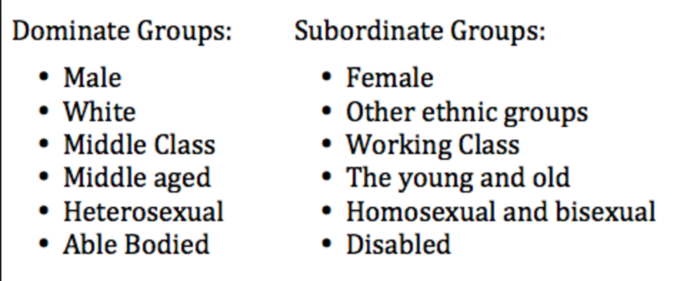
Theory Alert!- Media Language Claude Levi-Strauss
The idea that texts can be best understood through an examination of their underlying structure
Meaning is dependent upon (and produced through) pairs of oppositions
The way that these binary oppositions are resolved can have particular ideological significance ( for example one part of the pair is often viewed in a more positive light than the other)

