Slide 1
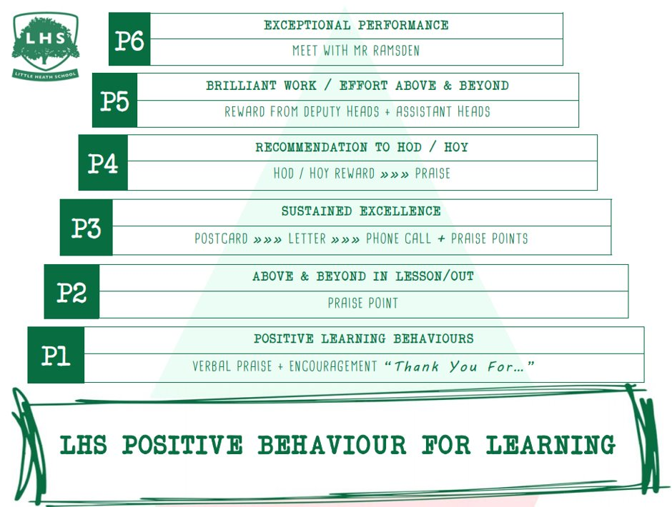
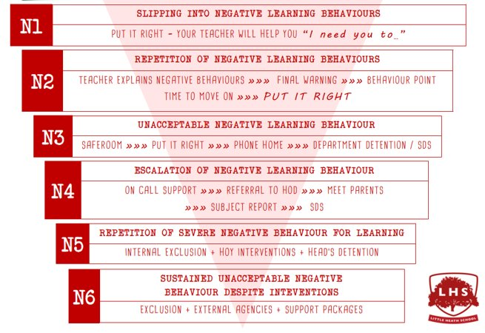


Elizabeth I – A complicated day in the life of the Queen
Aims:
To experience some of the content covered and skills required for A Level History
To know what the A Level History course consists of, what you can expect from us and what we expect from you
To have an opportunity to ask questions about the A Level History course
Thank you for being ready to learn!
DNA:
Write down what you already know about Elizabeth I, on your whiteboards

Slide 2
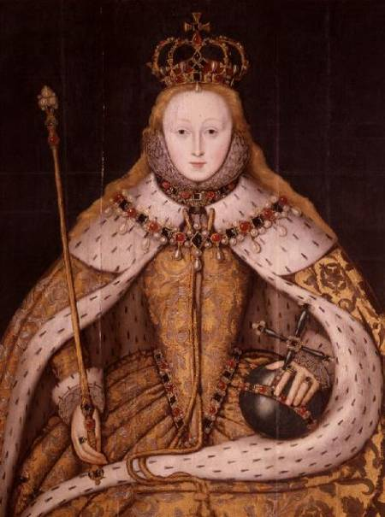
Elizabeth I – A complicated day in the life of the Queen
Aims:
To experience some of the content covered and skills required for A Level History
To know what the A Level History course consists of, what you can expect from us and what we expect from you
To have an opportunity to ask questions about the A Level History course

Slide 3

What do we already know about Queen Elizabeth I?
What problems does she face as Queen?
https://www.youtube.com/watch?v=-KOw9WPgays

Slide 4
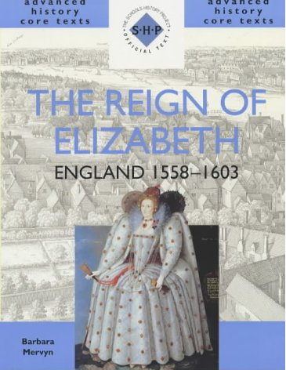
What early problems did Elizabeth face?
‘Oh Lord, the Queen is a woman!’
‘It would be far better for the Queen and her kingdom if she would take a consort who might relieve her of those labours which are only fit for men.’
‘Pray God would send our mistress a husband, and by time a son, that we may hope our posterity shall have a masculine succession.’

Slide 5
What early problems did Elizabeth face?
In your groups, read pages 27 – 28 and pick out the main problems facing Elizabeth.
1. Write each new problem on a post-it note.
2. Now, try to put them in order of importance
Most important
Least important

Slide 6


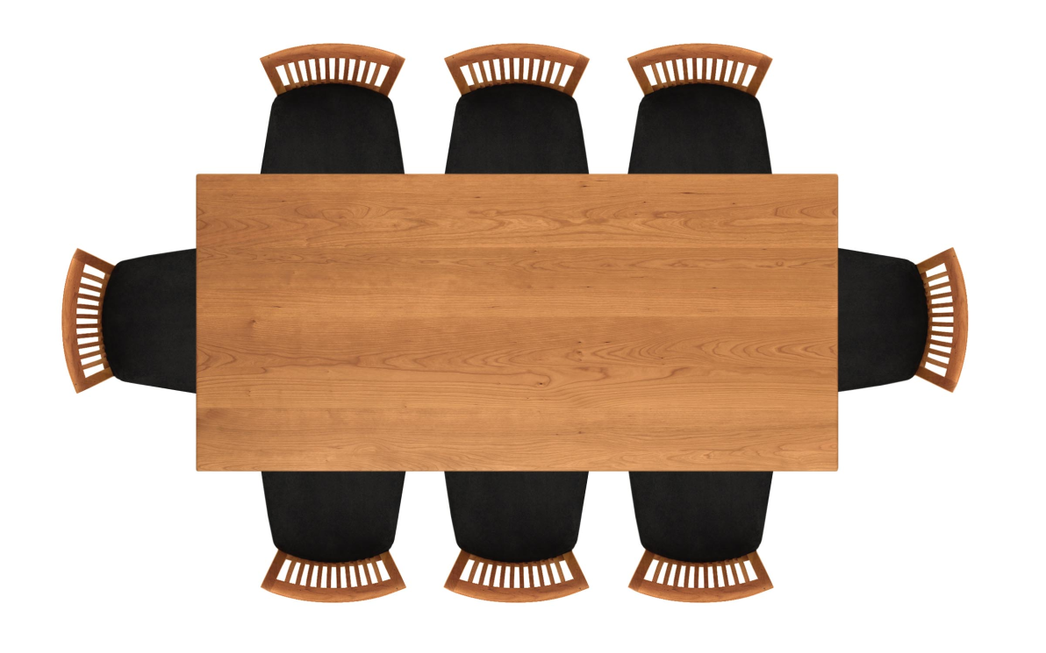
Come dine with me
Imagine the people on the cards have all been invited to dinner with the Queen. You need to work together to decide where they should sit, so that they can enjoy a nice meal together without arguing. You need to be able to explain your decision. Oh, and one other small problem. Too many guests were invited and they are all coming. Decide who to un-invite and explain why.
Guest List
Elizabeth I
Mary Queen of Scots
Francis Walsingham
Robert Dudley
Edward VI
William Cecil
Catherine of Aragon
Mary I
Philip II of Spain
Lady Jane Grey
Queen Elizabeth I:
Come dine with me

Slide 7
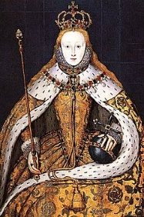
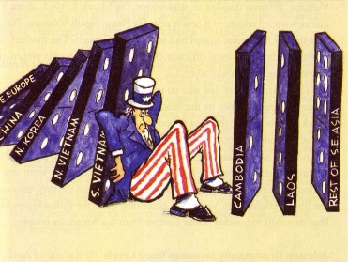
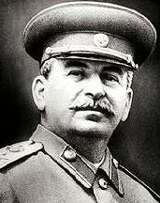
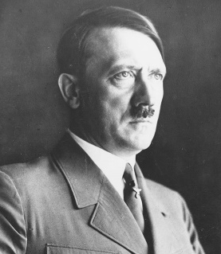
What do we study at A Level?
Year 12
England: 1547-1602 the later Tudors
Exam - pick one essay question out of a choice of two on Elizabeth I .
Complete one question using 4 contemporary sources for Edward and Mary (Mid Tudor Crisis)
Exam is 1.5 hours worth 25%
The Cold War in Asia
Exam - answer 1 (2-part) question from a choice of 2
Exam is 1 hour and worth 15%
Year 13
Russian History – from the Tsars to the Communists
Exam – pick two questions from a choice of three.
One question on historian’s interpretations
Exam is 2.5 hours worth 40%
Independent Enquiry: Choose your own question
Coursework – 3,000 – 4,000 word enquiry. Worth 20%

Slide 8
Why study history at A Level?
If you enjoy the study of the past both for its own sake and also for the light it throws on the present, then History A level is for you.
History trains you in skills that will equip you for a wide variety of careers:
  To select relevant information
  To assess the validity of an argument
  To think and write logically
  To make informed judgements about controversial issues
  To present a well-ordered case backed by supporting evidence
  The skill most developed by History is that of critical analysis and the ability to express ideas, knowledge and interpretations clearly and coherently.
Many employers regard A level History as an excellent training in the marshalling of arguments and in decision-making. As a well respected academic discipline, History is considered a worthwhile
A level subject for entry to almost all degree courses.

Slide 9
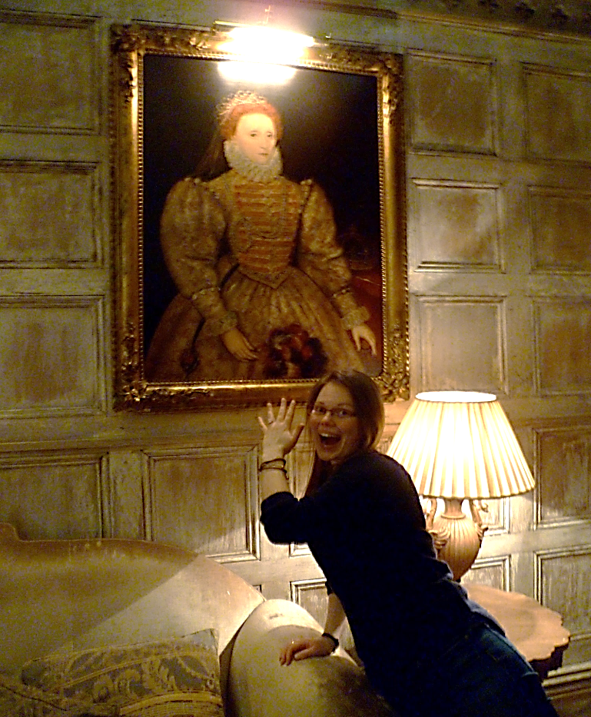
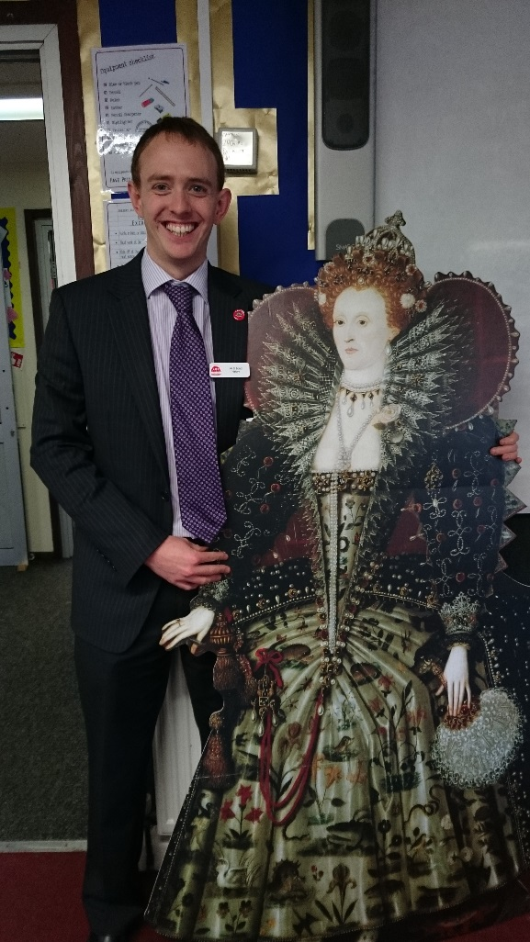
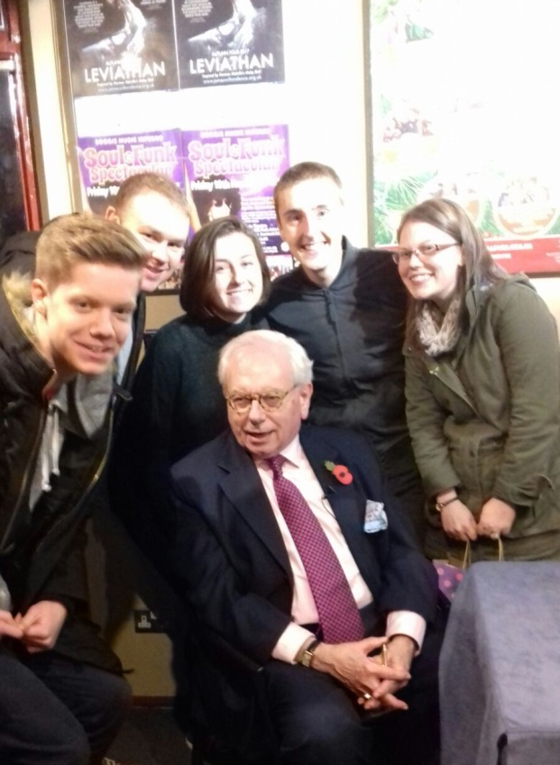
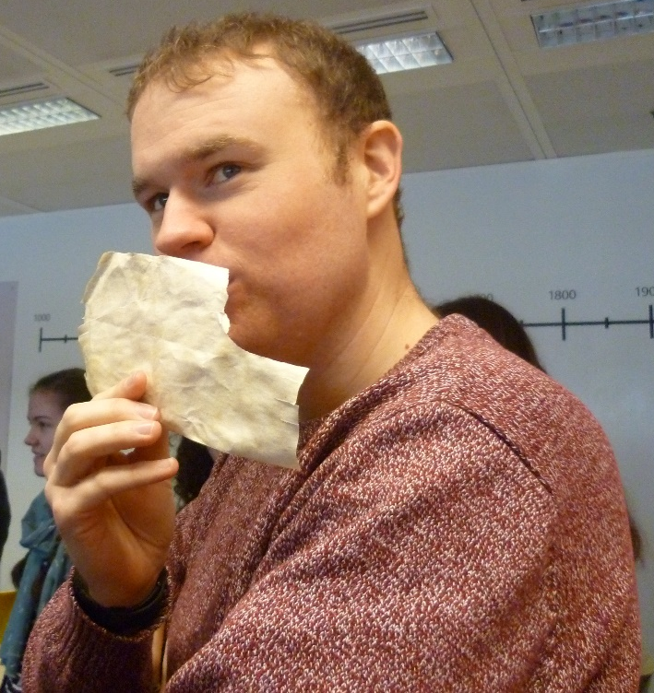
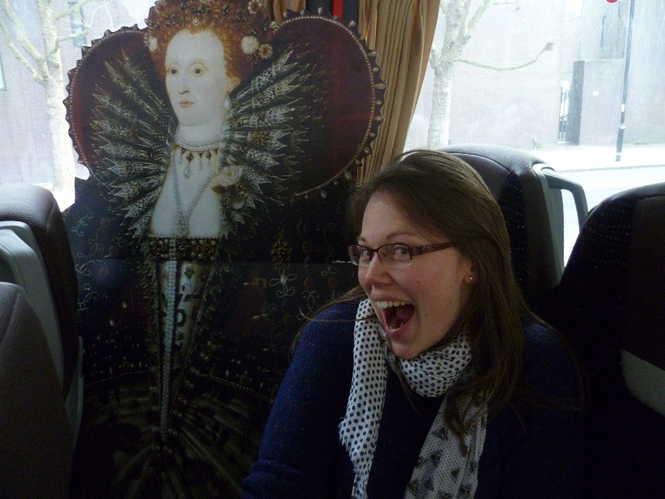
Expectations
of us
  Passionate about our subjects

Slide 10
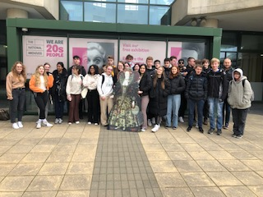
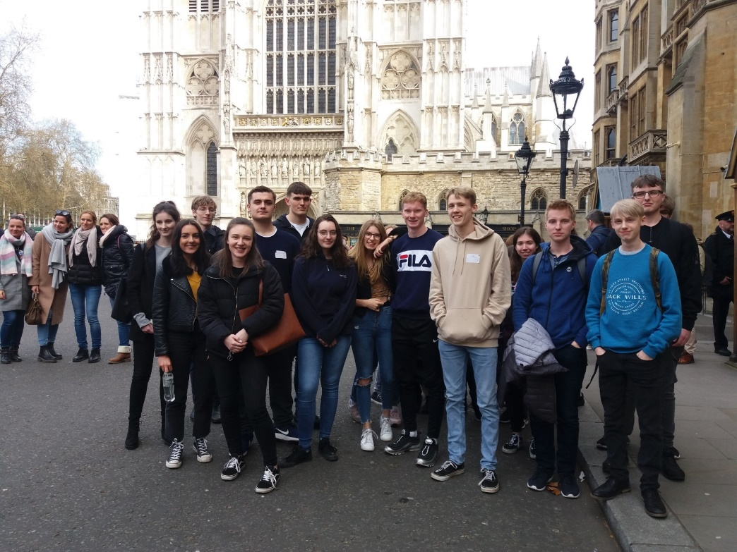
Expectations
of us
of you
  Passionate about our subjects
  Interesting lessons
  Support
  Regular quality feedback
  Revision sessions
  Great trip(s)
  Proactivity (reading, revision, asking questions)
  To work hard and meet deadlines
  Willingness to read and write!
  To want to think / question / challenge
  To get involved in class discussions
  5 or more in History at GCSE

Slide 11
Any questions?

Slide 12
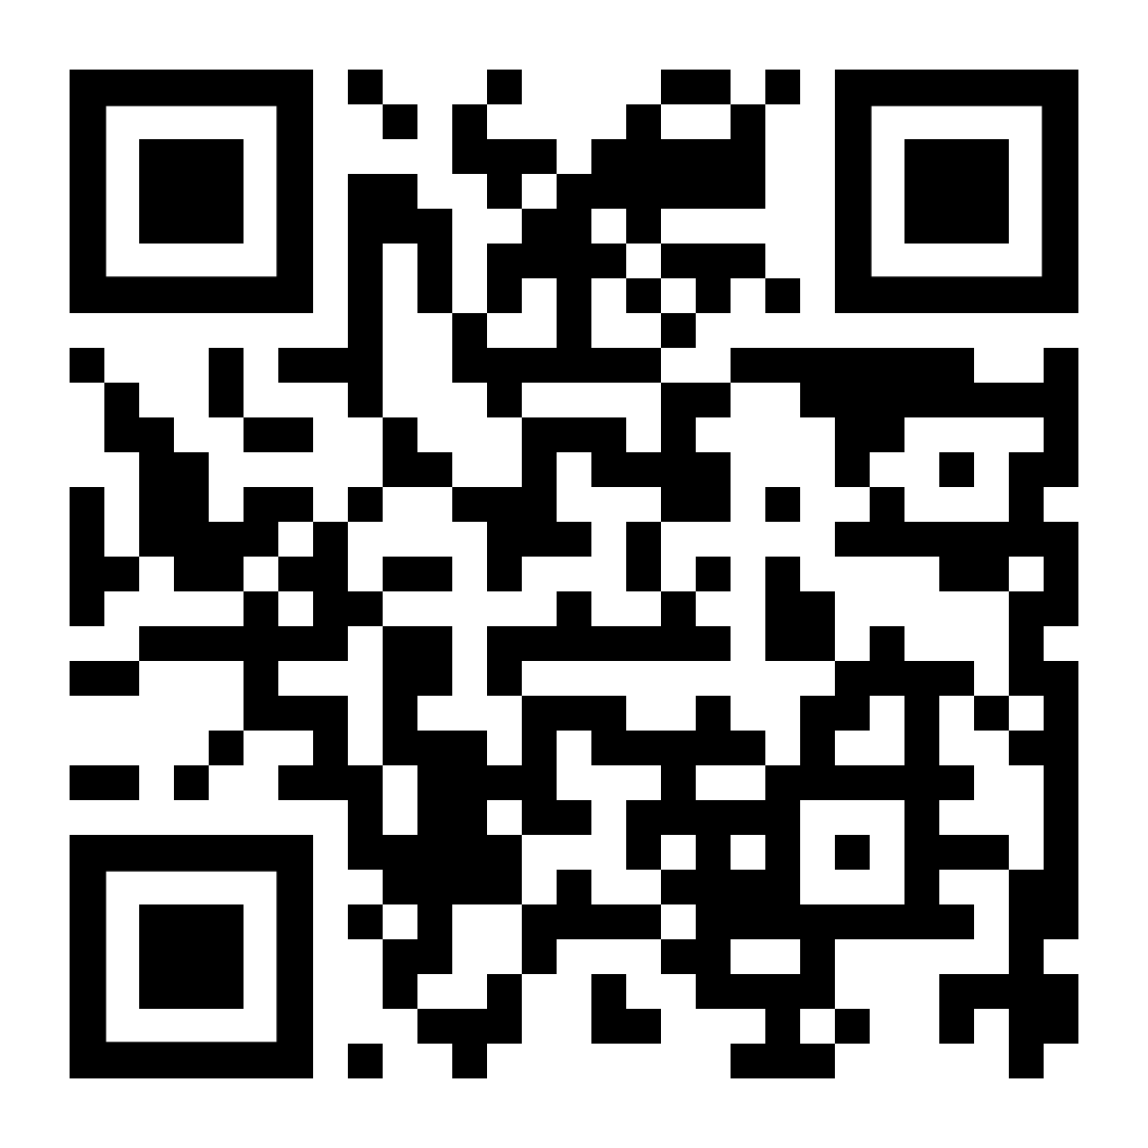
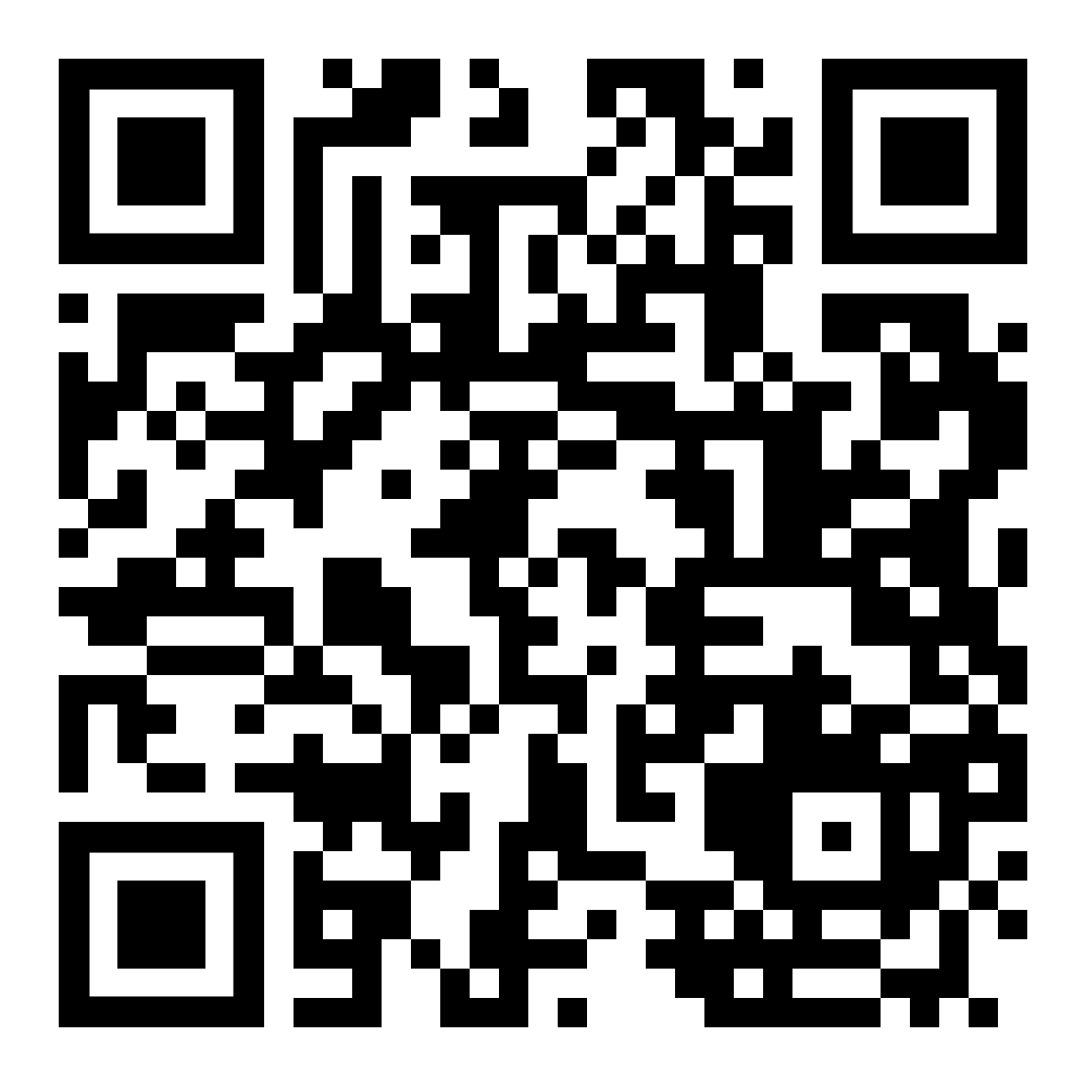
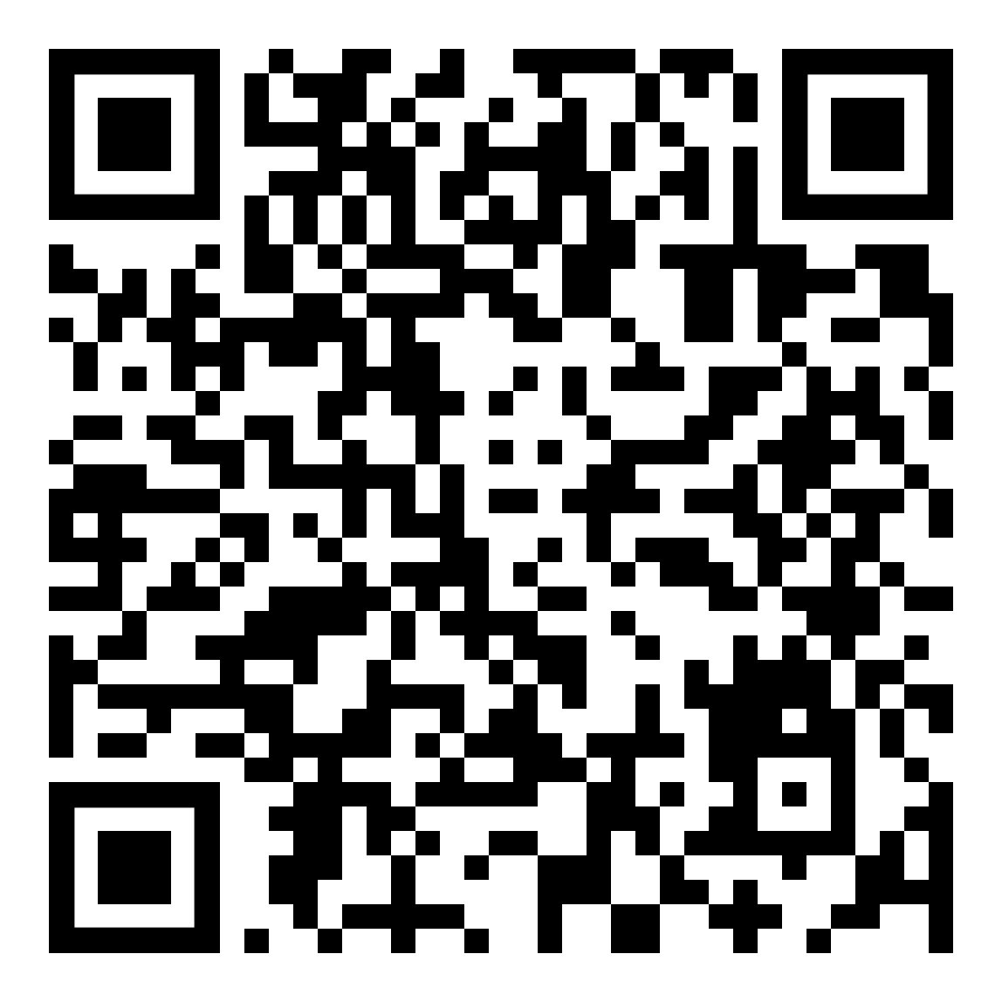
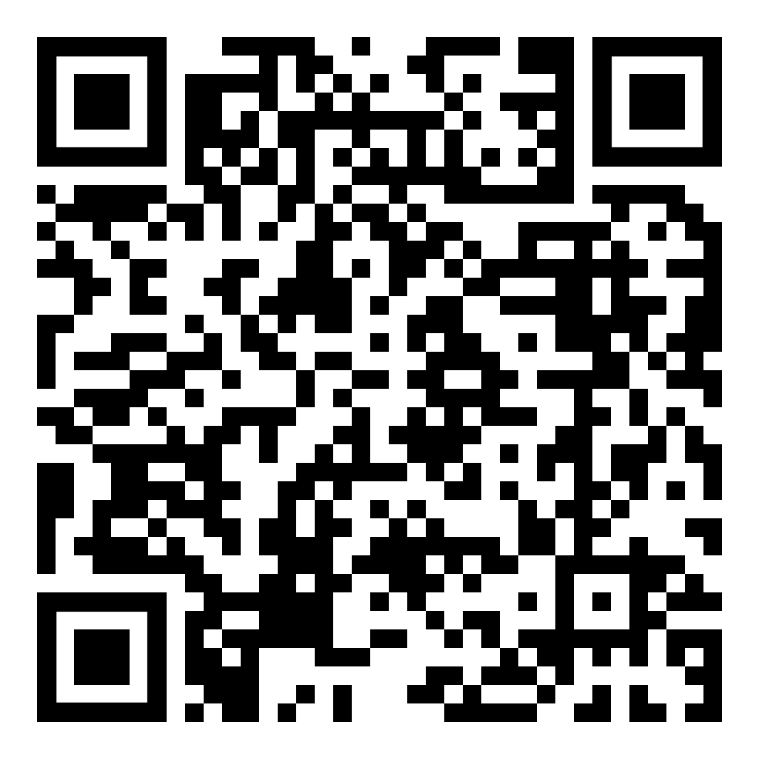
Further information...​
​
Later Tudors – documentary on Elizabeth by historian David Starkey https://youtu.be/Jmhak-RI67o
Russia - documentary on the Tsars in the lead up to the Russian Revolution
https://www.youtube.com/watch?v=ohVPrV3PsH0
Cold War in Asia - Introductory videos: https://www.youtube.com/playlist?list=PL71zh3pL6uUxXB_sLJwFhhtSHDoXGH0Km
More challenge: https://www.youtube.com/playlist?list=PLmFpuLsumHidmOqHk37PfB4NCR7G7mtbd

