Slide 1
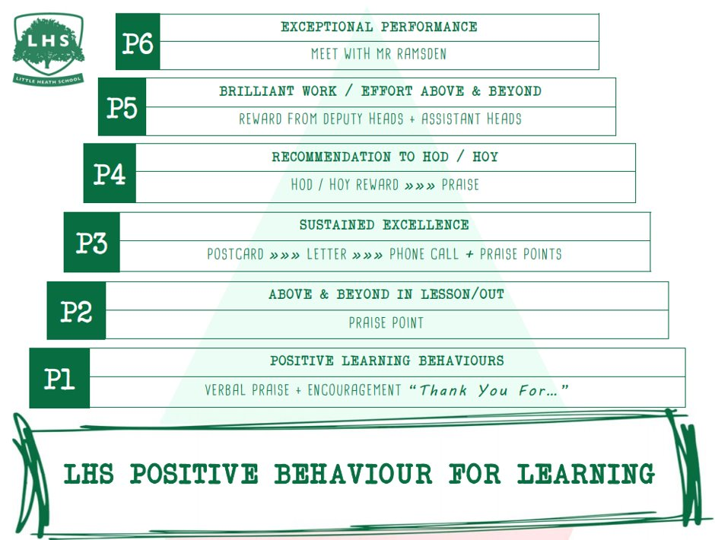

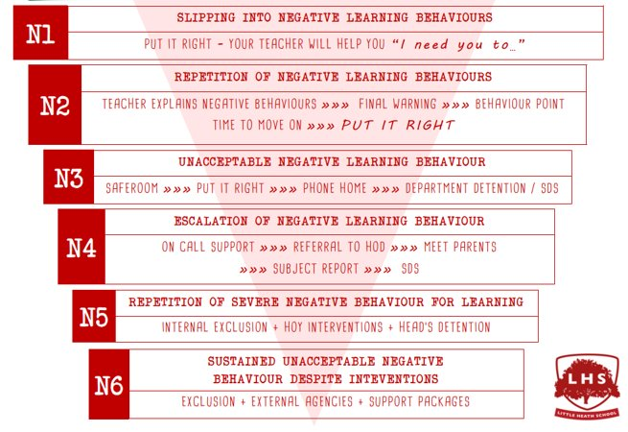

DNA
Reflect on the devising process that you completed at GCSE Drama. With the person next to you, evaluate (make a judgement) on how successful this was. What worked well, and where would be your areas for development moving into Sixth Form?
Aims:
To understand the basic demands of the course so that we are ready to learn come September
To experience the ‘Devising’ unit of the course by exploring a technique and using it to create a piece of theatre
Thank you for being ready to learn!

Slide 2
Introduction to
A Level Drama & Theatre Studies
OCR Specification

Slide 3
Equipment
Comfy clothes you can move in (please be aware this won’t fit with the dress code so you may need to get changed)
Pen, highlighter and pencil for every lesson
A4 work pad
Folder – dividers, tabs – you will study 4 different plays
Antigone (Jean Anouilh); Love of the Nightingale (Timberlake Wertenbaker); Frankenstein (Nick Dear)

Slide 4
Transition work
Practitioner research file – Brecht/Stanislavski/Artaud/Berkoff
Modern Practitioner research file - DV8/Katie Mitchell/Paper Birds/Punch Drunk/Splendid/Kneehigh/Gecko /Pina Baush
Watch a documentary – Be prepared to discuss in first lesson. This can be anything of your choosing! Some recommendations are Black Fish; Making a Murderer; The Last Dance; Lewis Capaldi: How I’m Feeling Now.
Watch 4 videos on National Theatre YouTube – again you will need to be prepared to discuss this in your first lesson

Slide 5
OCR A Level Drama!
We have chosen to complete the A Level Course
This will take place over 2 years
You will complete 1 formal assessment next year
We will prep for the final examinations in year 12 and complete the rest of the assessment in year 13

Slide 6
Component 1: Practitioners in Practice
Worth 40% of your whole A Level and is worth 120 marks
Internally assessed by the department, filmed and moderated by OCR
We study a range of practitioners from the 20th century right up to modern day.

Slide 7
Component 1: Practitioners in Practice
We will look at an extract from a text and explore practically looking at two practitioners in particular. From this work you will create a research report that will show your understanding of the practitioners we have studied in class. This is worth 30 marks
You will then create a devised performance influenced by your exploration of your two chosen practitioners. This is performed before Christmas and is an official mark for your A Level. Alongside this you will put a short document together that explains your artistic intentions. This is worth 40 marks
You will also produce a portfolio that evidences your practical process and how you developed your ideas in class. This portfolio will also evaluate the work of others. This is worth 50 marks

Slide 8
Verbatim
What does it mean?

Slide 9
Do any of you know what Verbatim Theatre is?

Slide 10
Verbatim
Dictionary definition:
“in exactly the same words as were used originally.”

Slide 11
Verbatim Theatre
Verbatim theatre is a form of documented theatre in which plays are constructed from the precise words spoken by people interviewed about a particular event or topic.

Slide 12
Topics / events
What topics or events do you think would make good verbatim plays?

Slide 13
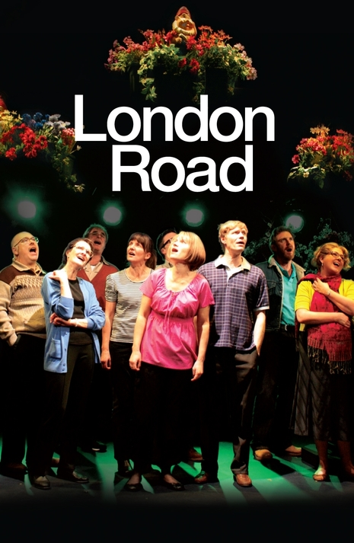
In 2006 the everyday life of the Suffolk town of Ipswich was shattered by the discovery of the bodies of five women.
The occupant of No. 79 London Road is arrested, charged and finally convicted of the murders. Caught in the headlines and the invasion of their quiet road, the community grapples with what it means to be at the epicentre of the tragedy.
Using their own words set to an innovative musical score, London Road is a moving story of ordinary people coming together during an extraordinary time.

Slide 14
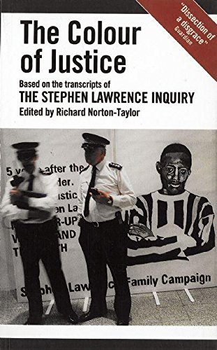
Court transcripts from the investigation into the police handling of Stephen Lawrence’s murder

Slide 15
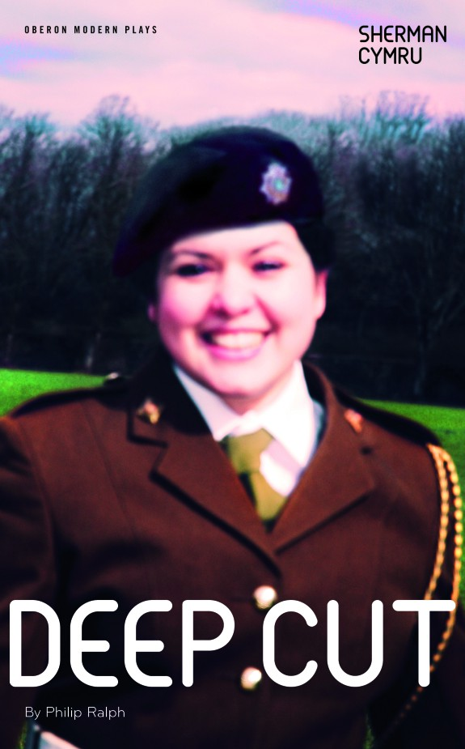
Philip Ralph's play explores the mysterious deaths at Deepcut Barracks 1995 (Cheryl James)

Slide 16
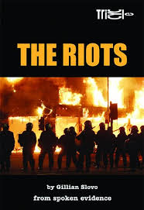
The Riots is a play created by Gillian Slovo from evidence spoken in court, which explains and evaluates the events that took place during the 2011 England riots.

Slide 17

Based on interviews with former soldiers, it portrays soldiers in the Black Watch regiment of the British Army serving in Iraq during 2004

Slide 18
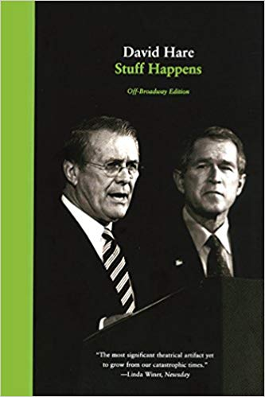
The play presents a mix of viewpoints, including arguments for and against the attack on Iraq. It mixes verbatim re-creations of real speeches, meetings, press conferences and fictionalized versions of private meetings between members of the Bush and Blair administrations.

Slide 19

With one in three women in the UK having had an abortion I Told My Mum I Was Going on an R.E. Trip… explores what seems to be one of society’s last taboos.

Slide 20
Recorded Delivery
Recorded voice delivery is form of verbatim theatre in which actors have recorded interviews played back to them during the performance through headphones, allowing them to directly mimic the accents and manner of speech, as well as the words, of the people they portray.
What do you think the benefits are of using this technique?
What do you think the risks are of using this technique?

Slide 21
Practical
Get into pairs and you will each need your phone and a pair of headphones
You are going to ask each other two questions (on the next slide) you need to record the audio of the answer, but also as your partner is answering, you need to take note of physically what they are doing as they answer
Are they stood or sat? How are they stood sat? Do they use any gestures as they talk? What are their facial expressions like? Are there any changes in their physicality as they are talking?
Notes:
They can share if needs be. They can write the physical stuff on a whiteboard or just memorise

Slide 22
Interviews
What is your most favourite part of your body?
What is your least favourite part of your body?

Slide 23
Rehearse
You now need to play back the recording and you speak the words of your partner directly after you hear them
You need to try to replicate exactly how they are speaking
As well as physically replicate what they did when speaking
Spend some time practicing this on your own

Slide 24
Perform

Slide 25
Feedback
Did they manage to replicate their partner both physically and verbally?
Actors – how did it feel to perform as your partner? Particularly knowing that they were in the audience?
Audience – how did it feel watching someone play you?
How might these pros or cons apply to a professional piece of Verbatim Theatre? Think specifically about the topics that they are usually depicting

