Slide 1
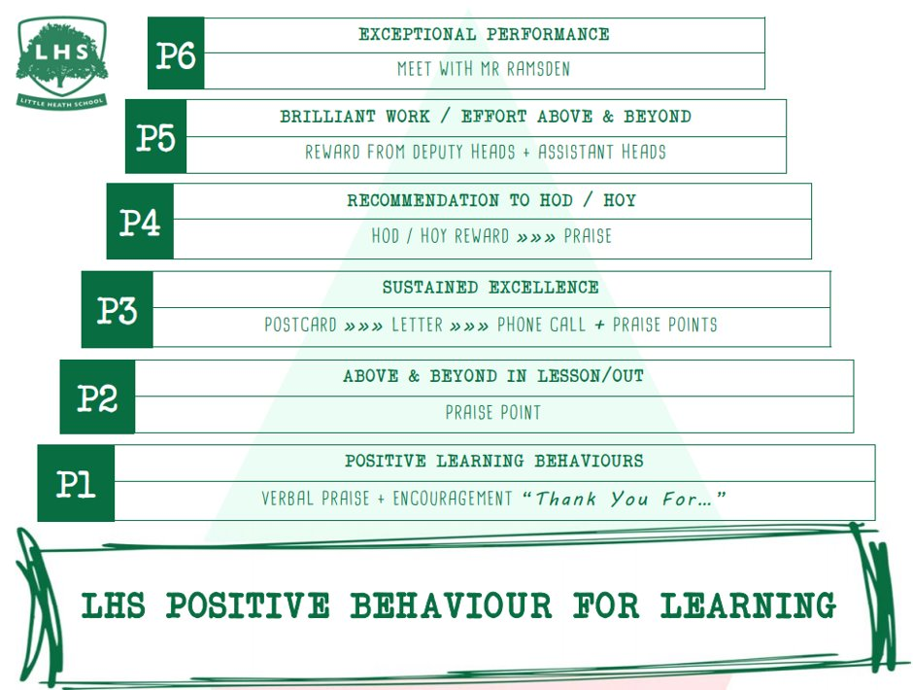
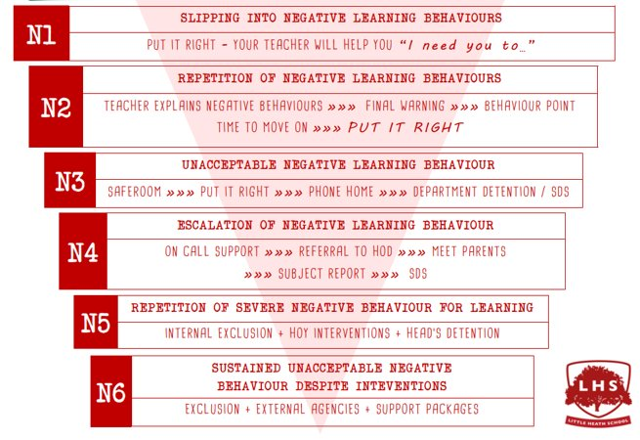


Title: Data Analytics
DNA:
Get your notebook out and something to write with.
Aims:
1 Understand the structure and content of the course
2 Sample of F200 - Data
3 Sample of F202 - Spreadsheets
Thank you for being ready to learn!

Slide 2
Teachers - course delivery
Mrs P Bailey - Head of KS5/Computer Science
Mr Glancy F200
Mr Ahmed F202

Slide 3
OCR Cam Adv Nat IT: Data Analytics
For this qualification, students must complete five units:
• Two mandatory externally assessed units
• One mandatory NEA unit
• Two optional NEA units
Specification:
IT: DATA ANALYTICS
Notes:
There is a strong focus on programming, not an easy subject

Slide 4
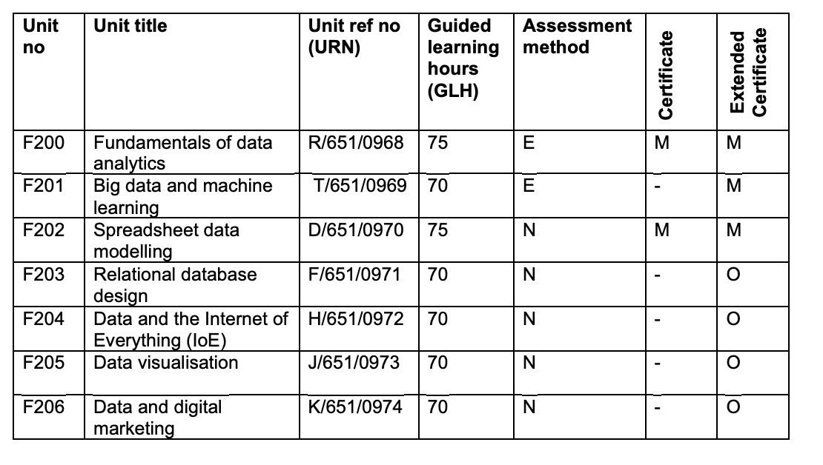

Slide 5
Approach: Mandatory units first
Y12:
Fundamentals of data analytics (E) Jan/June
Spreadsheet data modelling (N)
Y12/Y13:
Big data and machine learning(E) Jan/June
Y13:
2 of the optional units, to be decided.

Slide 6
The subjects that complement this course
These subjects might complement this qualification:
• A Level Business
• A Level Computing
• A Level Geography
• A-Level Maths
• A Level Psychology

Slide 7
The types of courses you may progress to
Both the subject-specific knowledge, understanding and skills, and broader transferable skills developed in this qualification will help you progress to further study in related areas such as:
• Business Analytics
• Information Technology
• Digital Marketing

Slide 8
The student who would do well on this course
• Interested in IT and would like to study/work in this field
• Good problem solving skills
• Good organisational skills
• Self motivated - course work is the more difficult option

Slide 9
Lessons today
We will do two mini lessons on the Y12 units

Slide 10
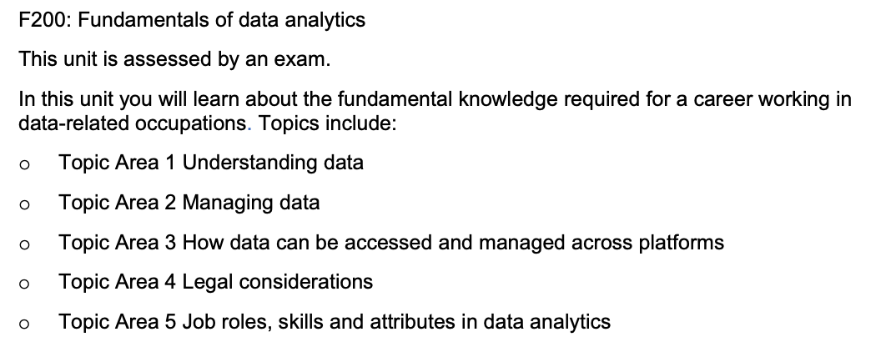

Slide 11







Starter:
What do all these have in common?

Slide 12

Starter:
They’ll all examples of data.
Key term
Data Consists of raw facts and figures.

Slide 13
Specification point(s):
that data consists of raw facts and figures
that information is data which has been processed by the computer
that knowledge is derived from information by applying rules to it
the need for good quality data.
the potential benefits of encoding data and the reasons for doing it.
Lesson objectives:
To understand how data becomes information and then knowledge.
To understand the purpose of GIGO (Garbage In Garbage Out) to find accurate data.
To understand the purpose of encoding data and the benefits and drawbacks of doing so.

Slide 14
New information:
Long number
This data is represented by a fixed length to represent a phone number.
Images (Dashboard icons)
These lights might appear if there is something wrong.
Date:
This data is designed to inform you of the time or a time.
Text
Words that we can read that have a meaning.
Currency
The pound sign suggests a monetary value.
Short number
This data is designed to inform us of a date on a calendar.
Sound
A auditory form of data. (e.g. A fire alarm that goes off.)
Notes:
.

Slide 15
Worked example - Information
Data that has been processed by a computer so that it makes sense and some form of meaning. Put some context to this data to transform it into information.
DATA
INFORMATION
Today we’re going to learn some new words.
The time at the moment is 12:00
To get in touch can you please call 1 (234) 567-8900
The total cost of your shopping is £30.00

Slide 16
Worked example - Knowledge
Information becomes knowledge when the it’s been accepted and understood by a user
INFORMATION
KNOWLEDGE
Today we’re going to learn some new words.
Today we’re going to learn some new words. This is in preparation for a spelling test next week.
The time at the moment is 12:00
The time at the moment is 12:00 and my lesson started at 11.30 so I’m late.
To get in touch can you please call 1 (234) 567-8900
To get in touch can you please call 1 (234) 567-8900 so you can book an appointment for next week.
The total cost of your shopping is £30.00
The total cost of your shopping is £30.00. I paid with £40 so I should get £10 in change.

Slide 17
New information:
Data collection
Sources of data can either be indirect or direct.
Direct
The data collected is used to fulfil a specific purpose. For example, when a customer buys a product using their supermarket loyalty card which will be used to inform the company and what consumers have purchased.
Indirect
Data collected that is directly related to the original purpose. This might involve consumer data being sold to third parties because it has some commercial value.
Quality of data
The quality of information depends on the quality of data. For data to be valuable it must be accessible, consistent, complete, accurate, timely, relevant, cost effective and clear.
Garbage in-Garbage out (GIGO)
This concept is common when data lacks quality. For example, a user completes a form incorrectly and the data becomes erroneous.
The internet is a good example because if you put garbage in, you will get garbage out and this is why it’s easy publish content that is not always accurate and up-to-date such as fake news.
Impact of technology.
Data might be inaccurate, out of date or incomplete due to the ICT systems in place. For example:
Incorrectly entered by a data entry clerk.
System may fail to detect faults in recording data (lack of validation)
Data on the system might be out of date.

Slide 18

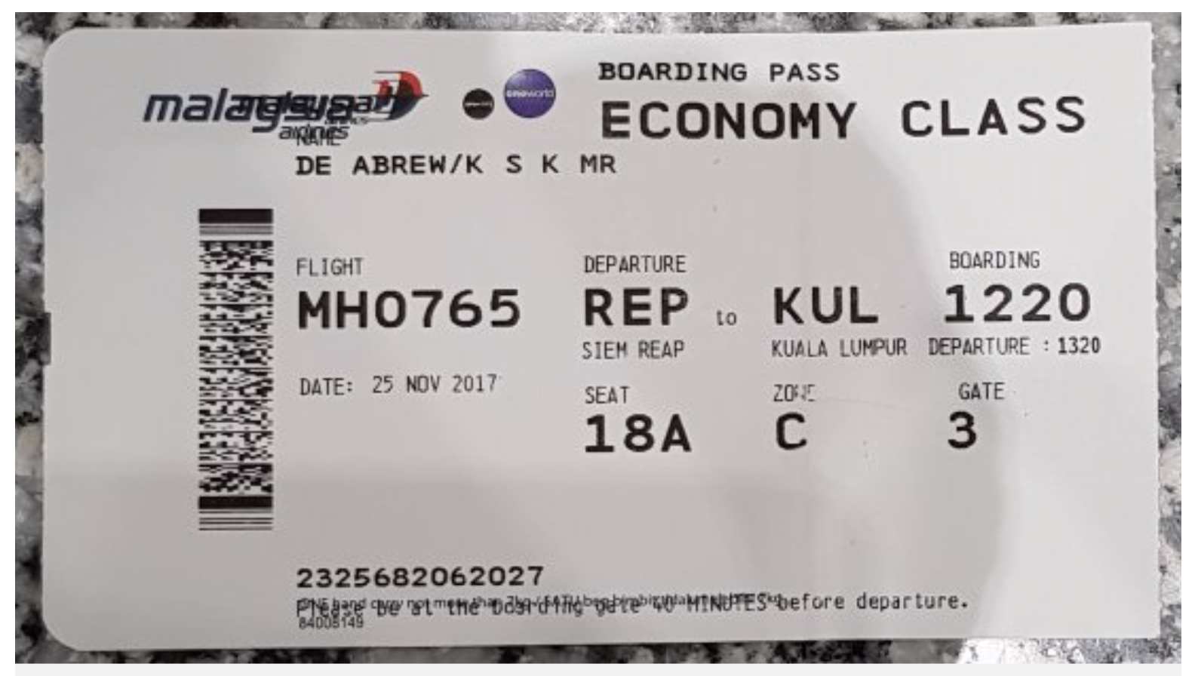
New information:
Encoding
Encoding of data refers to the process of transforming collected data into a set of meaningful, cohesive categories.
Example
Systems will need to collect and store data. One method of storing data is to assign codes to it. As you can see on the left, airports use three letter codes to represent each airport. This three letter code will also appear on your boarding pass.
Pros
Fewer data errors.
Less time spent on data entry.
Greater data consistency.
Less memory required.
Cons
Data does not always fit into a particular category.
Subjective judgements which makes it hard to measure.

Slide 19
Unit 1: ICT in society
Topic: IT21: Quality of data
Name:
RAG:
Assessment criteria:
Criteria | Emerging | Developing | Secured | Mastered
To know the difference between data, information and knowledge.
To know how the quality of data is measured (use of GIGO)
To know how data is encoded and the benefits of doing so.
Interim feedback:
Final feedback:

Slide 20
Task 1: Match them up
Activity
Match up each definition with the correct key term.
Data |  | A. A collection of data etc put into context, i.e. to give them meaning.
Information |  | B. Consists or raw facts and figures.
3. Knowledge |  | C. To apply rules to information, then you can make decisions based on that understanding.
Notes:
Other answers/responses can be accepted for this task.

Slide 21
Task 2: Data, information and knowledge
Scenario
Students’ test scores are recorded in the table below. The pass mark is 40.
Activity A
Complete the table below, the Data and Knowledge must be linked to the Information example.
Student Name | Test Scores
Elsa | 50
Jimmy | 47
Molly | 33
Jonny | 52
Information | Elsa scored 50 Jimmy scored 47 Molly scored 33 Jonny scored 52
Data
Knowledge

Slide 22
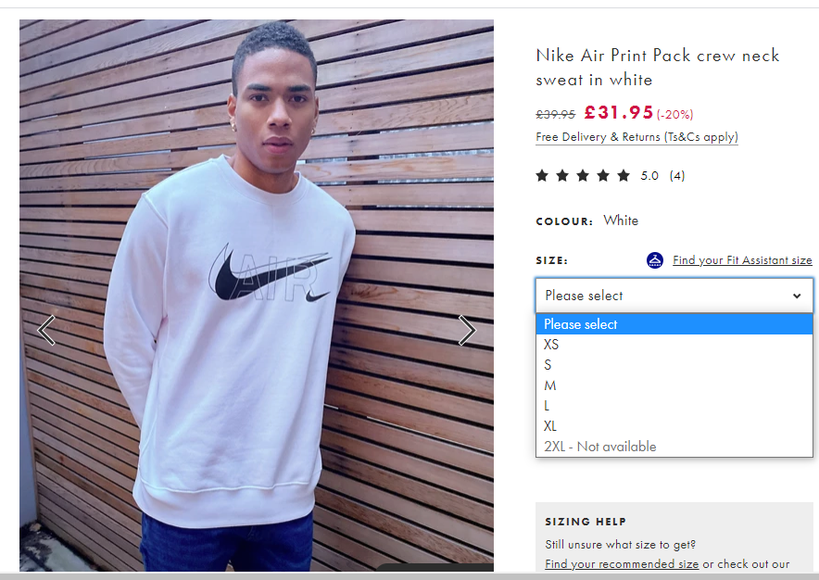
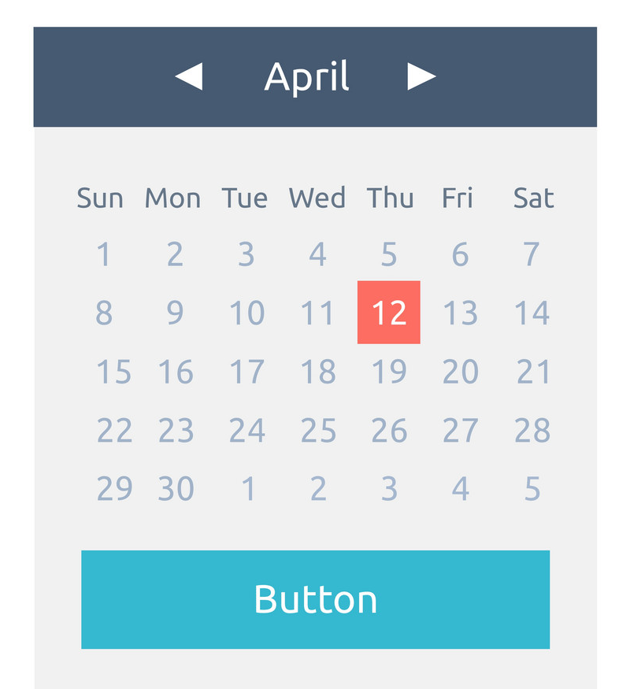
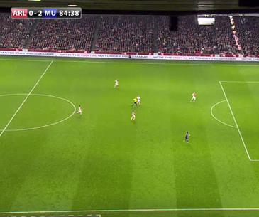
WJEC LEVEL 1/2 VOCATIONAL AWARD ICT (TECHNICAL AWARD)
Task 3: Encoding data
Activity
Explain how data in these three scenarios can be encoded.
Size of clothes
Days of the week
Football matches
©SIMPLY TEACH 2023 | www.mysimplyteach.co.uk | info@mysimplyteach.co.uk

Slide 23
Task 4: Quality of data
Activity
Using the diagram below and list of options provided, match up each characteristic with the correct description/example.
Accessible | Consistent | Clarity | Complete
Accuracy | Cost | Relevant | Timely
Data can be easily used even if they’re not data experts.
Data is formatted so that it maintain the defined rules of a system.
Any delay in data will mean the data could be out of date.
Data must be for its intended purpose.

Slide 24
Task 5: Checkpoint
RAG:
Activity A:
Tick the correct box to show which of the following is data, which is information and which is knowledge.
Activity B:
Identify which of the following is data, which is information and which is knowledge.
Statement | Data | Information | Knowledge
Tim is over 16 so now he can learn to drive.
Tim’s date of birth is 14th January 1996
14011996
Statement | Data, Information or Knowledge.
Jocelyn raised the highest amount of charity money with £120 and a certificate was awarded.
£37, £44, £120, £110 are all amounts raised by students in the sponsored car wash.
37, 44, 120, 110
ND18FLX
Feedback:

Slide 25

Task 6: Quality of data
Activity A
List the three measures used to check the value of data.
Activity B
A client fills out a membership form and they make a mistake when entering their address.
What impact could this have on the client?
Activity D
“Fake news is certainly not a new concept, but social media makes it more difficult than ever to sort the real news from the phoney.”
Explain why the internet is unable to produce data that is consistently accurate, up-to-date and complete.
Activity C
A local library collected data about their customers, such as books loaned, when it’s due and whether they have any outstanding fines.
Is this source of data direct or indirect?

Slide 26
Task 7: Data, Information and Knowledge
Activity A
A hotel has recorded the daily temperature by the pool at the same time every day.
Complete the table below to shown an example of data and information.
The data and information must be linked to the example of knowledge given below.
Activity B:
Identify which of the following is data, which is information and which is knowledge.
Statement | Data, Information or Knowledge.
The pub quiz team with 50 points had the highest points of the day and were the winners.
50, 49, 37, 18, 6
50 points, 49 points, 37 points, 18 points, 6 points.
Team A consisted of Kyle, Jack, Riley, Jessica and Tina.
Knowledge
Data
Information
Notes:
Any other reasonable answers accepted.

Slide 27
Task 8: Encoding data - Benefits
Scenario
A local train station has recently upgraded their ICT systems so they can monitor timetables and incoming bookings. The train station encodes data by representing each station with three letters. For example City Park is encoded to CYP
Activity A
Why will this help the data entry clerks at the train station make fewer errors?
Activity C
Why will this increase data consistency?
Activity D
Why will the encoding process enable the new system to use less memory?
Activity B
Why will the data entry clerk spend less time entering data?

Slide 28
Task 9: Encoding data - Drawbacks
Activity A
Explain the problems associated with encoding data from an ICT system point of view. Use the key drawbacks provided to further develop your point.
Coarsening of data (can some data become lost):
Meaning of data becomes obscured:
Subjectivity in data

Slide 29
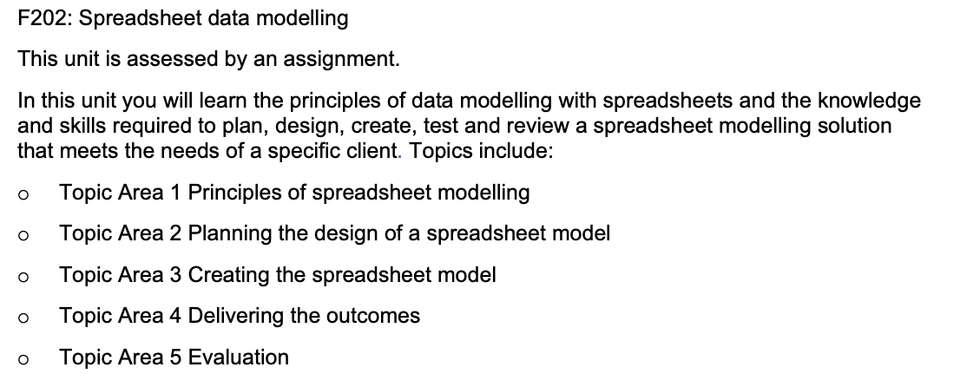

Slide 30
Example spreadsheet Lesson
With all of your sixth form courses, there will be some repetition on content unless it was a compulsory subject like maths/English. (Those curriculums are controlled at a national level.)
We have to start from the beginning so you may have covered this work before.
Over the holidays, we would like you to practice Excel on this website:
https://www.w3schools.com/excel/index.php

Slide 31

Spreadsheets
Notes:
New title page in their class books

Slide 32

Learning Objectives
Understand the layout of a spreadsheet
Know what a cell reference is
Create a simple formula
Format a spreadsheet

Slide 33

What are Spreadsheets?
why would we need to use them?
Think and discuss?

Slide 34
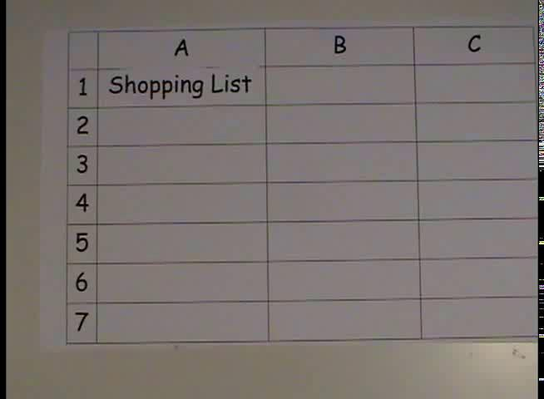
Notes:
This video is also available in the folder, called Spreadsheet_for_beginners.WMV

Slide 35
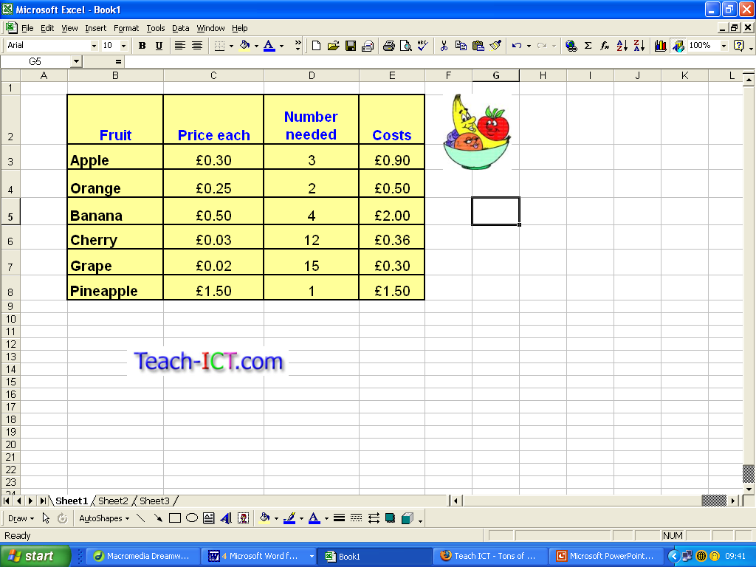


Columns
(letters)
Text labels
Rows
(numbers)
Text labels
Value
Active Cell
A
worksheet
Each cell has a unique cell reference e.g. D11

Slide 36
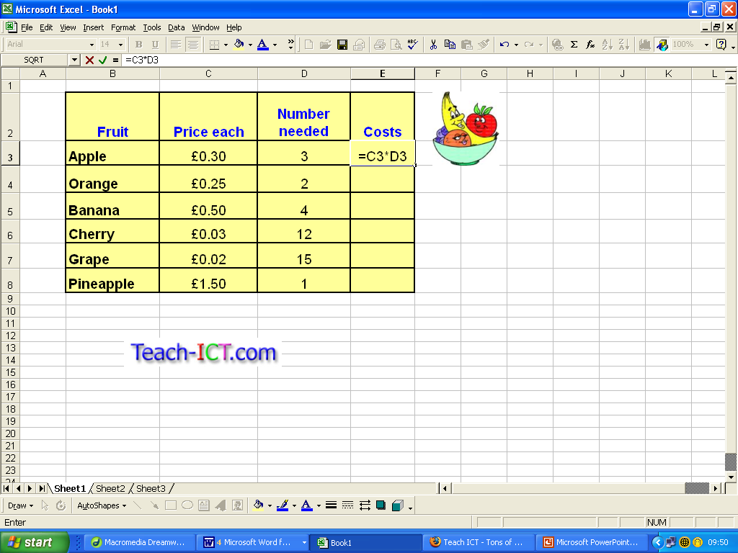
Formulae can also be viewed and edited here in the formula bar.
Formula
Start with =
then
create the formula
When you press Enter, the formula will automatically be calculated.

Slide 37

Formula
All formula must start with =
To add something, use +
To subtract something, use -
To multiply something, use *
To divide something, use /

Slide 38
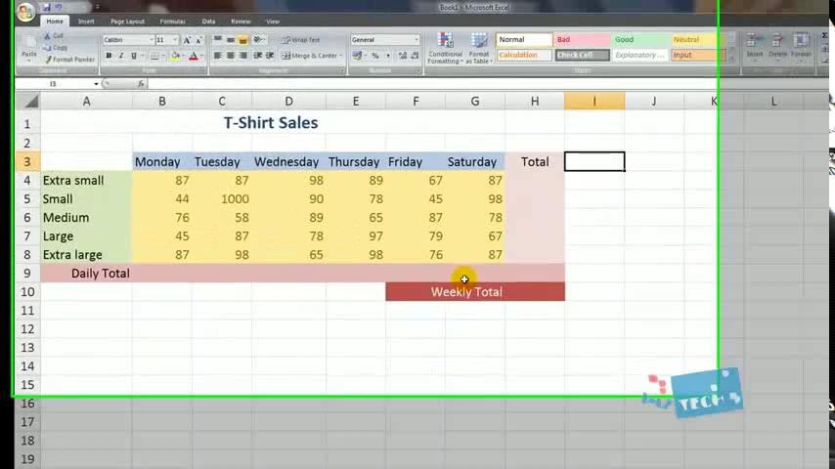
Second video for Spreadsheet basics
Notes:
This video is also available in the folder, called Spreadsheet_for_beginners_12_mins.WMV
You may want to click through and check first

Slide 39
So let's complete task 1
1. Cell Referencing in Spreadsheets
Now let's practice these spreadsheet skills
10 minutes
(You will have your own copy of the file in Google classroom)

Slide 40
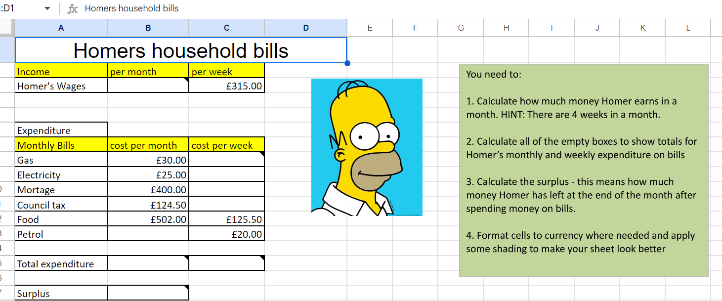

Task 2
open 2. Main task with extension pupils resource spreadsheet document, Food for the month is £502.00
Read the instructions in the green box.
Extension task
Does Homer have enough money for Duff and doughnuts? Click on the second worksheet and find out.
Answer the tasks on the worksheet

Slide 41
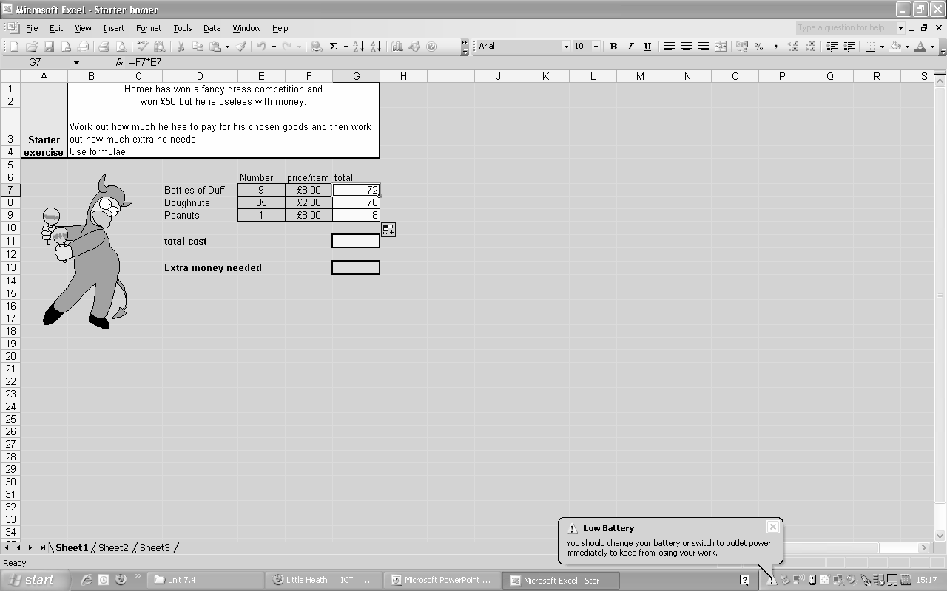
Remember that all formulas start with an
= sign
We also have to input the cell reference number not the actual number. E.g. F7
Below is an example of a formula
=F7*E7
Formula in the fx bar
= F7*E7

Slide 42
Purple pen let's check your answers
Main task teachers example

Slide 43
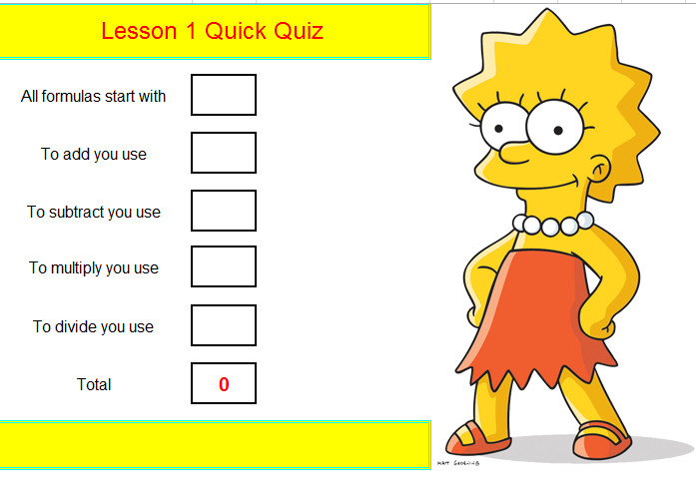

Let’s check what you know
Open the file called 3.Lisa’s Quiz
You will need to type a single speech mark before you add the mathematical operator in!
Then press enter to see if you are correct

