Slide 1
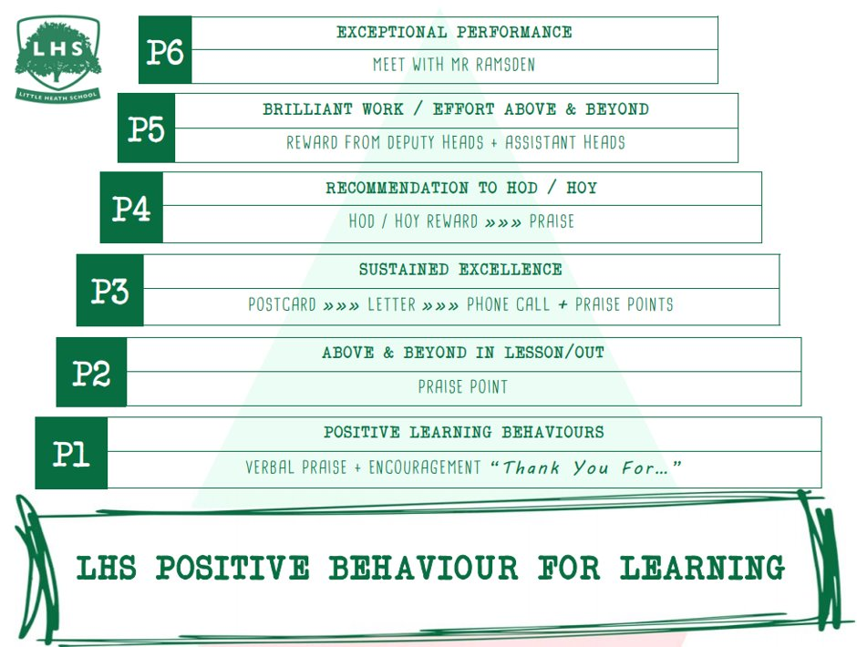
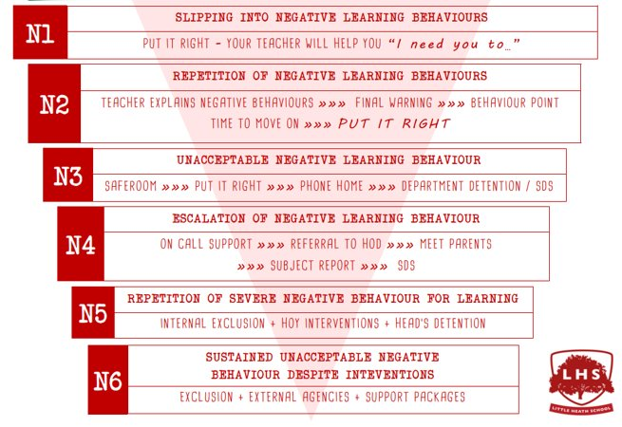


What do the political parties believe in 2025?
How does this influence their poll rating?
Aims:
To examine left and right wing political views
To evaluate where the political parties are in 2025
To analyse why the parties are popular or unpopular
DNA:
Have a go at the questions on your whiteboard:
What is a general election?
What does Left Wing and Right Wing mean?
Go further – which political parties are left wing and right wing?
Thank you for being ready to learn!

Slide 2


Welcome to the Politics Transition lesson!
Have a go at these questions:
What is a general election?
What does left wing and right wing mean?
Go further – which parties are left wing or right wing?
An election that happens every 4 to 5 years where every MP in the United Kingdom is elected
Left wing – wants higher taxes and more public spending
Right wing – wants lower taxes and less public spending
Left wing – Labour, Greens, Liberal Democrats
Right wing – Conservatives and Reform UK

Slide 3


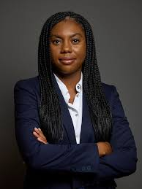
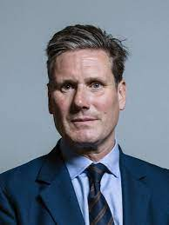
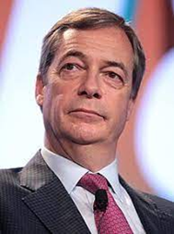
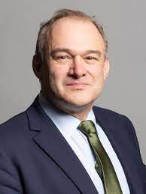
Welcome to the Politics Transition lesson!
Have a go at these questions:
Who are the most popular political parties in the United Kingdom?
Can you recognise these party leaders?
How often is the UK general election held?
What does Left Wing and Right Wing mean?
Labour
Greens
Scottish National Party
Plaid Cymru
Liberal Democrats
Conservatives
Kemi Badenoch
Keir Starmer
Nigel Farage
Ed Davey
Whenever the Prime Minister chooses, up to a maximum of 5 years since the previous one which was in December 2019

Slide 4
What is a general election?

Slide 5
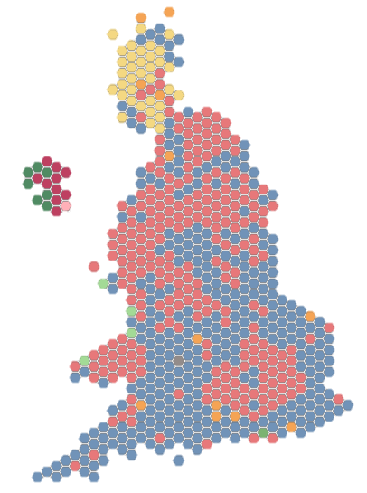
The UK is split into 650 different areas called constituencies.
During a general election the public is asked to vote for which candidate they would like to represent them in Parliament for the constituency they live in.
Several candidates compete for votes in each constituency.

Slide 6

How are candidates elected?
Candidates are elected using the First Past the Post system.
Each eligible person votes once.
The candidate with the most votes in a constituency is chosen as its MP, and will be entitled to take a seat in the House of Commons.

Slide 7




The First Past the Post system means that a candidate can win even if they don't get the majority of votes.
For example:
Candidate 1
27%
Candidate 2
23%
Candidate 3
26%
Candidate 4
24%

Slide 8
And the winner is …
Candidate 1
27%

Slide 9
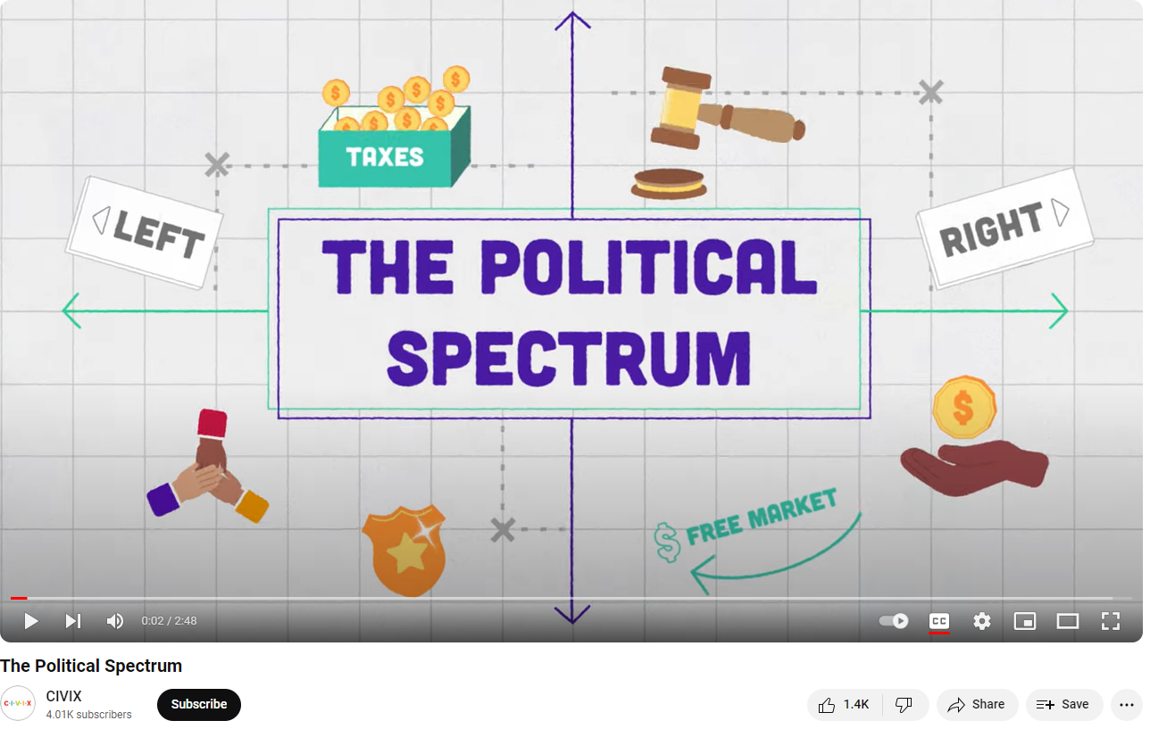
The way we classify political parties is traditionally into left wing and right wing

Slide 10
https://www.youtube.com/watch?v=XJA3EhyVPc0 Can you add anything to your notes from this video?

Slide 11
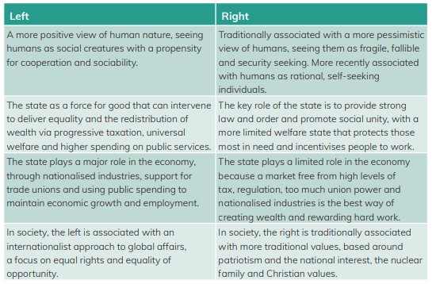
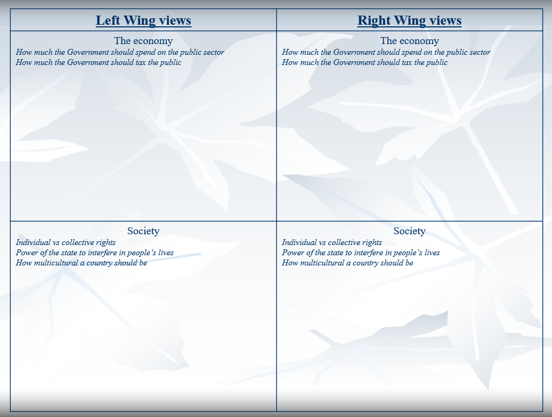
What does Left wing and Right wing mean?
Task: Read through the descriptions of these terms and write a minimum of 2 bullet points per side to explain what they believe in

Slide 12
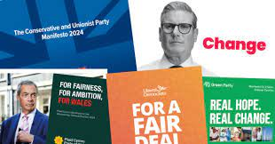
All the party’s release manifestos before every election. These are important because they:
Set out the main policies if elected
They offer a ‘vision’ of what they would do in Government
The House of Lords cannot block policies which are in a manifesto (because the party would be in Government which means they have been elected based on those policies)

Slide 13
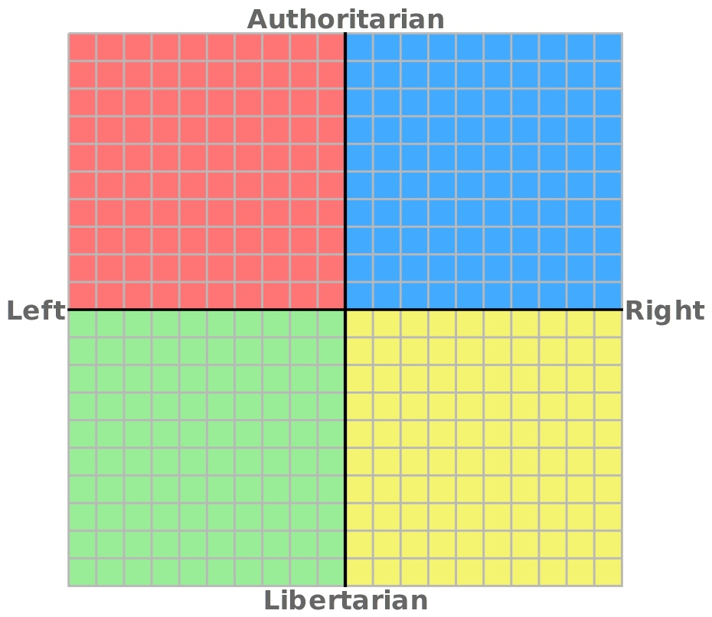
Traditional
The horizontal line refers to economics
Left = higher taxes, more state spending, more regulation
Right = lower taxes, lower spending, less regulation
The vertical line refers to social issues
Traditional = more right wing socially (more focused on tradition and strong law and order)
Progressive = more left wing socially (more focused on making reforms and being progressive)
Progressive

Slide 14
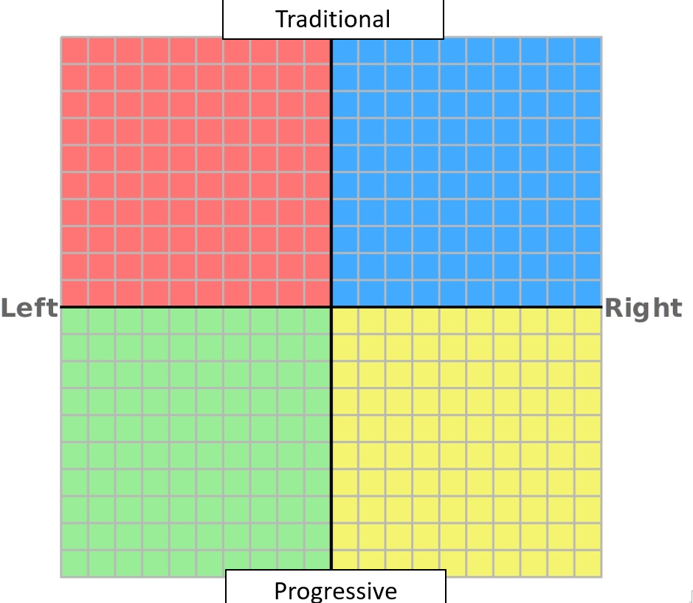
Plan to lower taxes
Going back to how things ‘used to be’
(marriage should only be between a man and a woman)
Raising taxes
Changing how the country works
(Changing the voting system or moving to net zero quickly)

Slide 15





Political party Manifestos
You will be given a political party manifesto with the political party name removed.
Tasks:
Read through the main policies
Try to plot it on the spectrum
Can you work out which political party is which?

Slide 16
Where was it on the political spectrum?
Which political party did you think it was?
Welfare & the economy
• Pledge for a further 2% NI cut BY 2027
• Introduce tougher sanctions rules so people who refuse to take up suitable jobs after 12 months on benefits
• Launching a new Help to Buy scheme, which would give first-time buyers an equity loan of up to 20%
• Deliver 1.6 million well-designed homes in the right places
NHS & Education
• Increase NHS spending above inflation every year
• Recruit 92,000 new nurses and 28,000 new doctors
• Creating mandatory National Service for all school leavers at 18
• Fund 100,000 high quality apprenticeships
• introduce clear age-limits on what children can be taught and guarantee the contested concept of gender identity is not taught to children.
Environment
• Deliver net zero by 2050
Police & Migration
• Back the police, by giving officers new powers and tools to catch criminals, including technology like facial recognition
• Have a legal cap on migration to guarantee that numbers fall every year
• Stop the boats
Defence & Foreign Policy
• Boost defence spending to 2.5%
• Maintain the Trade and Corporation Agreement with the EU, but do nothing to infringe UK sovereignty
Rights
• We will maintain the ban on prisoners voting from jail.
• Legislate so that an individual can only have one sex in the eyes of the law in the United Kingdom
Party 1

Slide 17
Where was it on the political spectrum?
Which political party did you think it was?
Welfare & the economy
• No increase to National Insurance, Income Tax or VAT
• Change the law to stop tax avoidance
• Retain the triple lock for the state pension
• Creation of 1.5 million new homes & Abolish no fault evictions
NHS & Education
• Provide 700,000 more urgent dental appointments and recruit new dentists to areas that need them most
• Cut NHS waiting times with 40,000 more appointments each week
• Recruit an additional 8,500 new staff in children and adults mental health services
• End VAT exclusions for Private Schools
• Recruit 6,500 new teachers in key subjects
Environment
• Set up Great British Energy, a publicly-owned clean power company, to cut bills for good and boost energy security, paid for by a windfall tax on oil and gas giants
• Clean power by 2030
Police & Migration
• More neighbourhood police by ending wasteful contracts through the Neighbourhood Policing Guarantee
• Launch a new Border Security Command with hundreds of new specialist investigators and use counter-terror powers to smash criminal boat gangs.
Defence & Foreign Policy
• Commitment to NATO
• Britain will stay outside of the EU
Rights
• Give 16 and 17 year olds the right to vote
• Legislation to remove the right of hereditary peers to sit and vote in the House of Lords
• Replace the House of Lords with an alternative second chamber
• Protect the Equality Acts single-sex exceptions
Party 1
Party 2

Slide 18
Where was it on the political spectrum?
Which political party did you think it was?
Welfare & the economy
• Tackle personal tax avoidance to raise funds and ‘close loops’
• Review to create a genuine living wage across all sectors
• Increasing building of new homes to 380,000 a year across the UK, including 150,000 social homes a year, through new garden cities and community-led development of cities and towns
• Banning no-fault evictions
• Support pensioners by protecting the triple lock
NHS & Education
• £8.4 billion package to reform the HNS
• Give everyone the right to see a GP within seven days, or within 24 hours if they urgently need to, with 8,000 more GPs to deliver on it
• Extend free school meals to all children in poverty
• Put a dedicated, qualified mental health professional in every primary and secondary school
• Increase school and college funding per pupil above the rate of inflation every year
Environment
• Meet the UK’s commitment under the Paris Agreement to reduce emissions by at least 68% from 1990 levels by 2030
• Introduce a ban on new coal mines.
Police & Migration
• Restore proper community policing
• End prison overcrowding.
• Fix the Work Visa System to help address the labour shortages
Defence & Foreign Policy
• Rejoin the Single Market
• Longer term, Rejoin the EU
• Spend at least 2.5% of GDP on defence
Rights
• Giving 16- and 17-year-olds the right to vote
• Reform the House of Lords
• Reform the gender recognition process to remove the requirement for medical reports, recognise non-binary identities in law, and remove the spousal veto
Party 1
Party 2
Party 3

Slide 19
Where was it on the political spectrum?
Which political party did you think it was?
Party 4 - ‘Our contract with you’
Welfare & the economy
• Raise Inheritance Tax to only those with above £2million
• Reform the UK Tax System
• Enforce a 2-strike rule for job offers for those on benefits, where if they refuse two job offers they lose their benefits
• Allow married couples with children to have a transferable marriage tax allowance
NHS & Education
• All NHS and Social Care front line staff to pay no income tax for 3 years to improve retention
• Ban transgender ideology in Primary and Secondary schools, classing teaching of gender identity etc as a ‘safeguarding’ issue
• Require Single Sex toilet facilities based on biological sex
• Ban the teaching of Critical Race Theory
Environment
• Scrap Net Zero
• Scrap Renewable Energy subsidies
• Focus on cheap, secure energy sources
Police & Migration
• Increase recruitment to go from 235 police officers per 100,000 people to 300 police officers per 100,000 people – equal to 40,000 more police officers over 5 years
• Scrap all Diversity, Equality and Inclusion Roles
• Freeze all non-essential immigration
• Create a 6 point plan to stop the boats
Defence & Foreign Policy
• Leave the European Convention on Human Rights (ECHR)
• Cut foreign aid by 50%
• Increase defence spending to 2.5% and then 3% of GDP within 6 years
Rights
• Return to single sex spaces and facilities
• Replace the Equality Act and scrap all Diversity, Equality and Inclusion rules
Party 4
Party 1
Party 2
Party 3

Slide 20
Where was it on the political spectrum?
Which political party did you think it was?
Party 5 - ‘Real hope, real change!’
Welfare & the economy
• Introduce a minimum wage of £15 an hour for all, no matter your age
• Introduce a wealth tax.
• £29bn over the next five years to insulate homes to EPC B standard or above
• Provide 150,000 new social homes a year and end the so-called ‘right to buy’, so that these homes can belong to communities for ever
NHS & Education
• We would guarantee rapid access to a GP and same day access in case of urgent need.
• Guaranteed access to an NHS dentist for everybody with £3 billion investment by 2030
• Reduces the stress in our education system by ending high-stakes, formal testing at primary and secondary schools and by abolishing OFSTED.
• End of all university tuition fees.
• £8bn investment in schools that would include £2bn for a pay uplift for teachers.
Environment
• Invest £40bn per year over the course of the next parliament, including £7bn annually on climate adaptation
• Use wind to provide around 70% of the UK’s electricity by 2030
• Transition to a zero-carbon society as soon as possible, and more than a decade ahead of 2050.
Police & Migration
• End violence against women and girls.
• An end to the routine use of stop and search
• Work with other countries to establish safe routes by which those fleeing persecution, war, or climate disaster may arrive in the country of their choice to make their case without having to risk their lives.
Defence & Foreign Policy
• Rejoin and play its full part in the family of nations that is the European Union, as soon as possible
• Recognition of the state of Palestine and an urgent international effort to end the illegal occupation of Palestinian land.
• An end to all UK arms exports to and military cooperation with Israel, which make the British government complicit in these war crimes.
Rights
• Support self-ID, so that trans and non-binary people could be legally recognised in their chosen gender through self-declaration
• Votes for 16-year-olds and residence-based voting rights.
Party 4
Party 1
Party 2
Party 3
Party 5

Slide 21
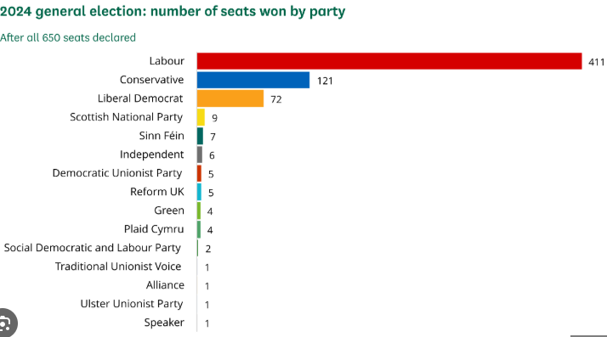
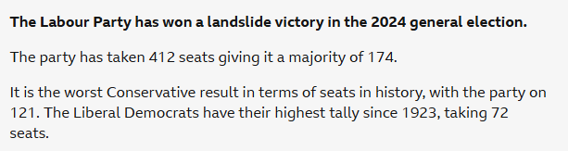
Why do you think Labour were so popular?
How has that influenced their policies?
Why were the Conservatives unpopular?
Is it their policies or other reasons for unpopularity?
Why are the smaller parties doing less well? Why might reform only win 3 seats when they got more votes than the Lib Dems?

Slide 22
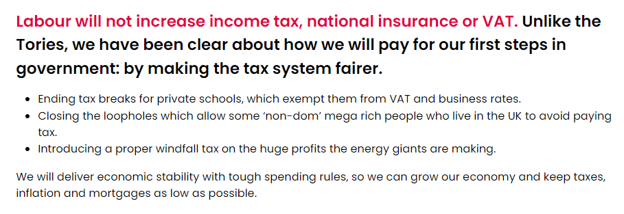
Why do you think Labour are so popular?
How has that influenced their policies?
Labour were desperate to win the election (they’ve not been in power since 2010) and so have promised to only raise a few taxes. This means it is very difficult to promise major improvements to public services because there will not be the money to pay for them!

Slide 23
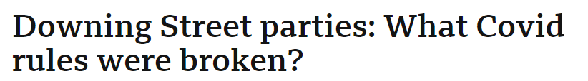
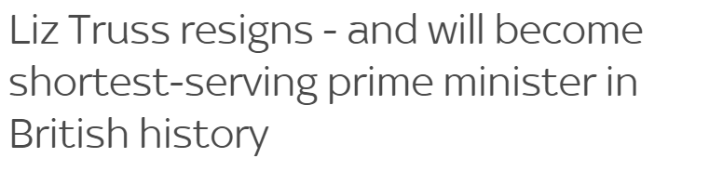
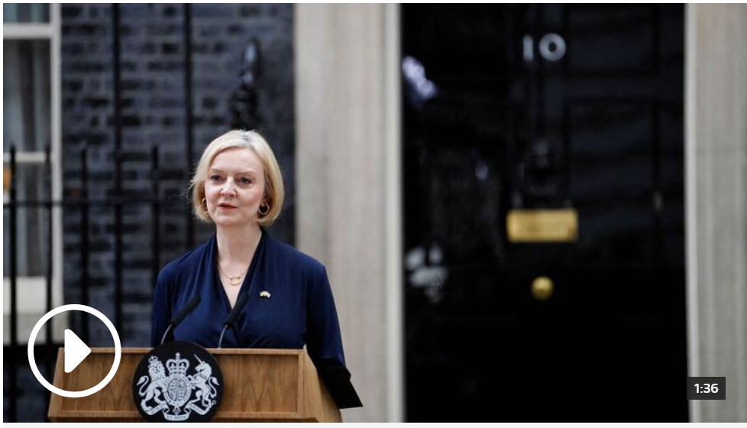
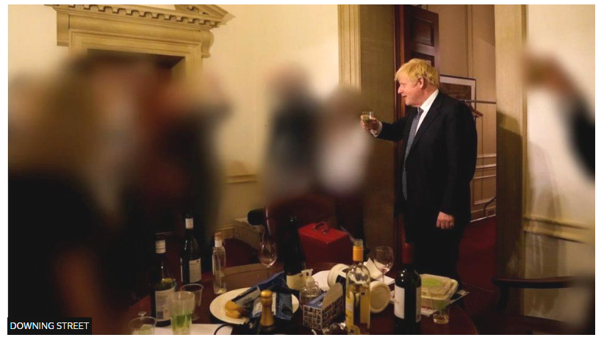
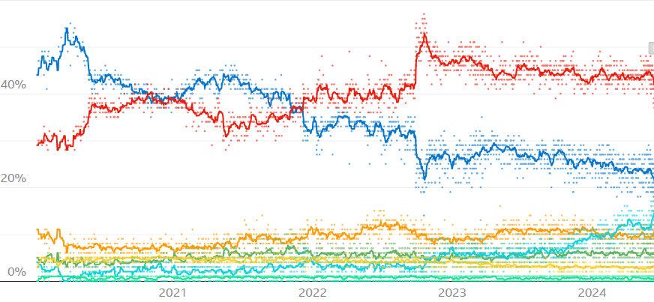
Why were the Conservatives unpopular?
Is it their policies or other reasons for unpopularity?
Partygate scandal starts to come out in the news
Boris Johnson announces he is resigning
Liz Truss mini budget which crashes the markets

Slide 24
Reform got votes in lots of constituencies but will rarely get enough to win the seat.
If they do this in enough places then they get millions of votes but because First Past the Post is a ‘winner takes all’ system they will get very few MPs
The First Past the Post system means that a candidate can win even if they don't get the majority of votes.
For example:
Candidate 1
27%
Candidate 2
23%
Candidate 3
26%
Candidate 4
24%

Slide 25
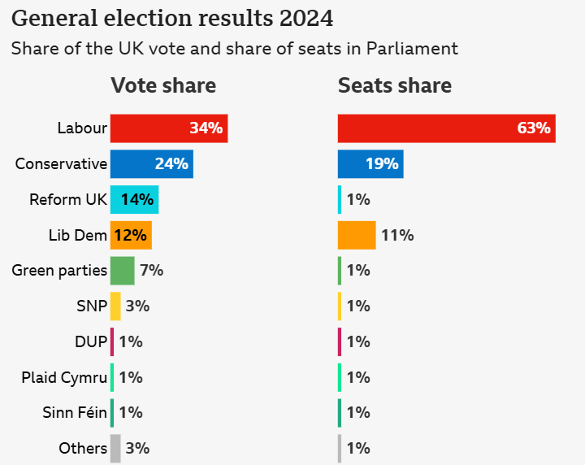
First Past the Post can be a very unrepresentative voting system!

Slide 26
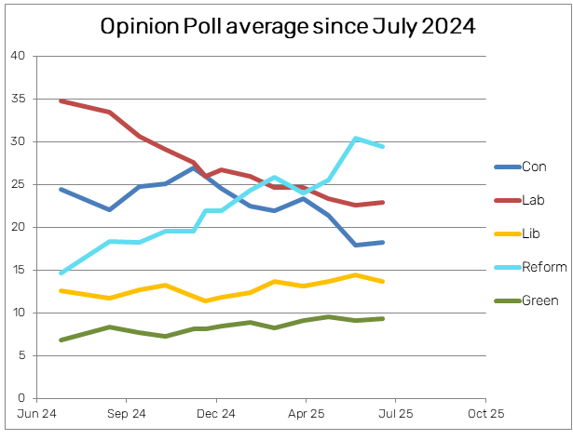
Are we now in a period of 5-party politics?
Any ideas why Labour popularity has fallen?
Why has Reform popularity increased?

Slide 27
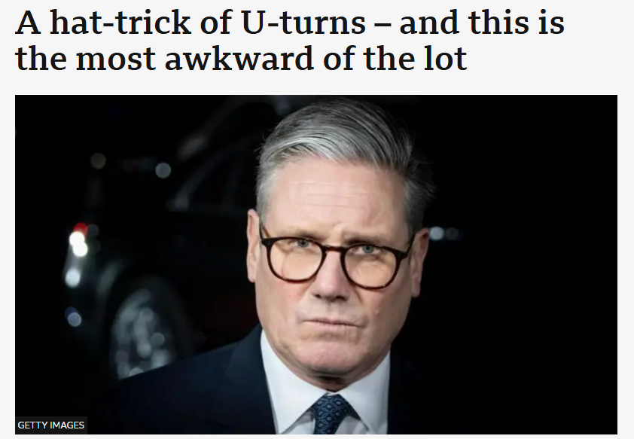

Slide 28
Transition work – for first lesson back in September
Knowledge Tasks
Task 1 – Read through the ‘Democracy’ sheet and answer these questions:
What are the 3 parts of democracy?
What does each of these mean?
Why is Democracy so important?
Task 2 – Read through the ‘Constitution’ sheet and answer these questions:
What are the functions of a Constitution?
What is the difference between a Codified and an uncodified constitution?
Task 3 – Read through the ‘What is Government?’ sheet and answer these questions:
What is legitimacy and how can it be gained?
What is the source of all political power in the UK?
What is sovereignty and what are the differences between legal, political and popular sovereignty?
What is the difference between the state and the Government?
What are the three branches of Government and what are their roles?
Task 4 – Political news stories
Over the summer use some of the sources of information below to keep up to date about politics in the UK. We’d like you to find out about 5 stories in the news
Extension task:
1 Go to this website and take the quiz to see where you are on the Political Spectrum.
https://www.politicalcompass.org/ - you could also find out which party is closest to you on the political spectrum.
2 Read or watch one of the books from the Reading List attached at the back of this sheet

Slide 29


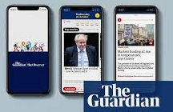
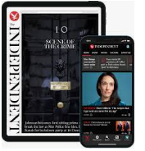

Before September…
You must be reading the news!
Download one of these apps on your phone

Slide 30
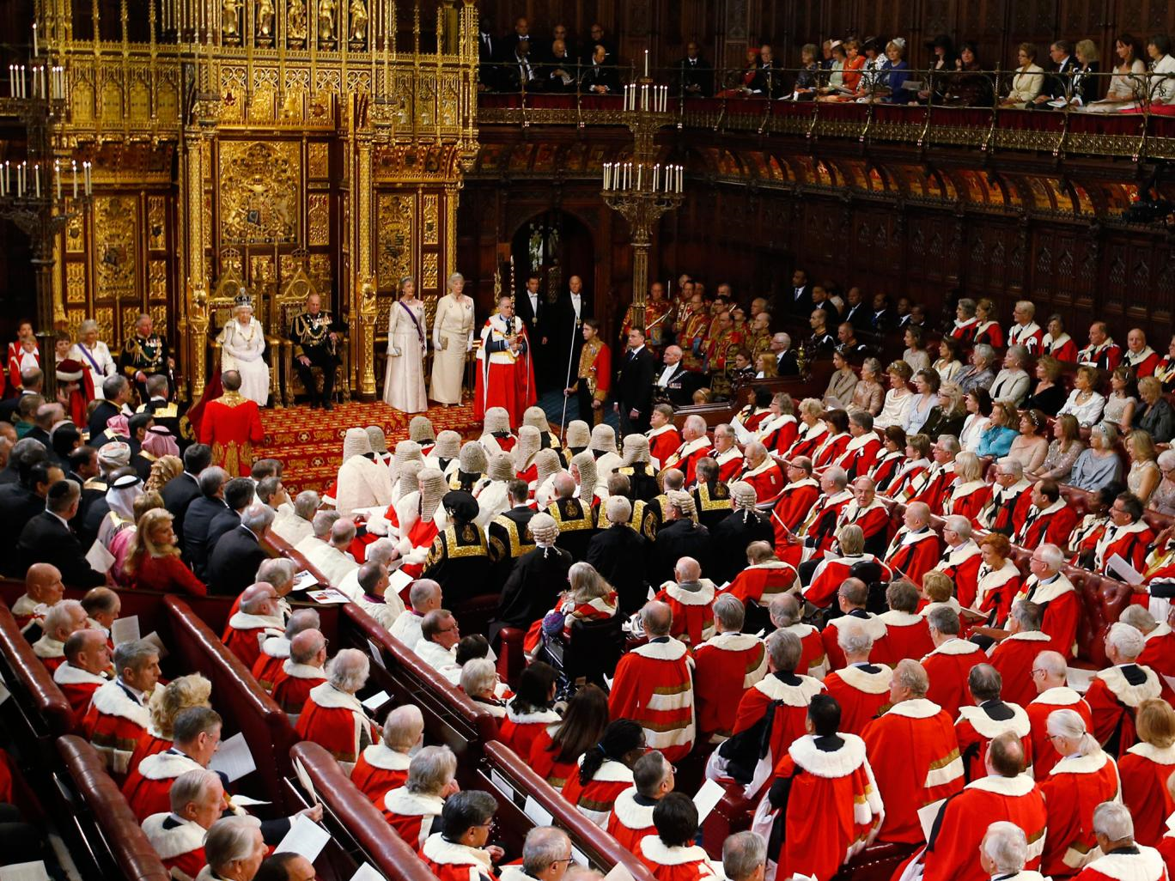
Should people who are unelected decide our laws?

Slide 31

How much influence do pressure groups have on our Government?

Slide 32
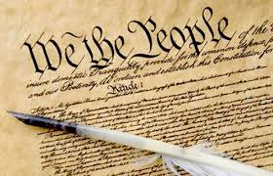
Why does the UK not have a written constitution?

Slide 33
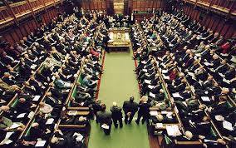
Is Parliament working properly for the people of Britain? How does it work?

Slide 34
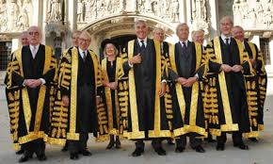
Are Judges really ‘enemies of the people’?

Slide 35
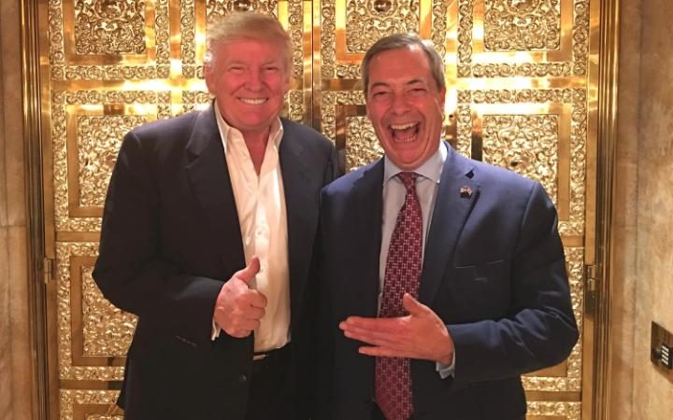
Are these the most successful politicians of our generation?

Slide 36
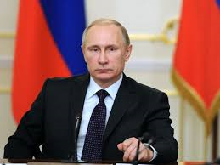
Is this the most dangerous man in the world?

Slide 37
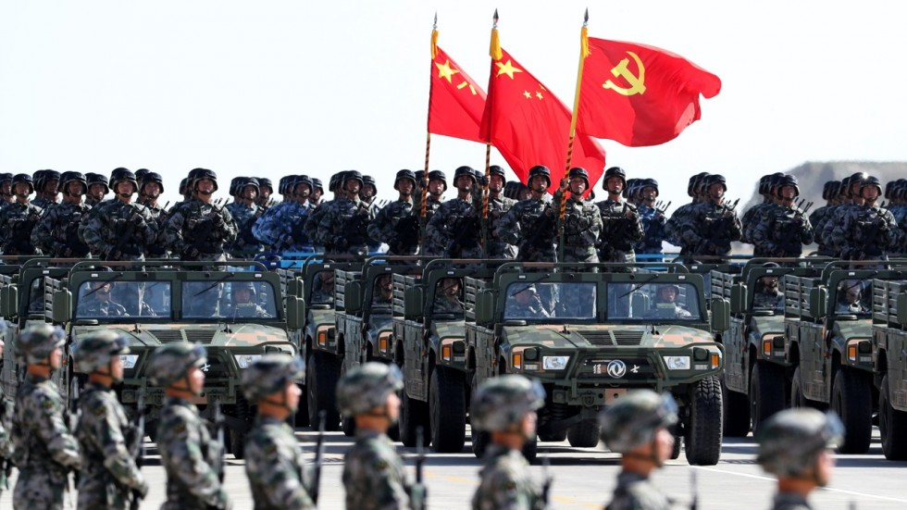
Is China a superpower?

Slide 38
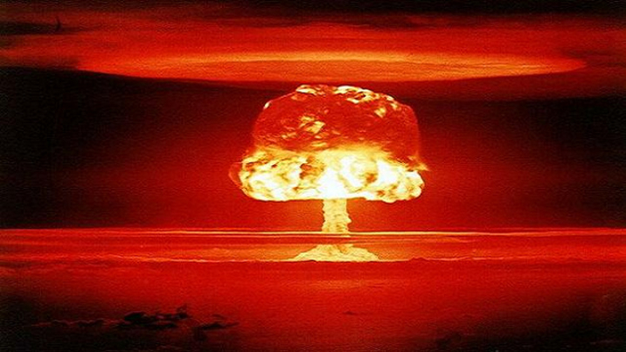
Do nuclear weapons make the world safer?

Slide 39
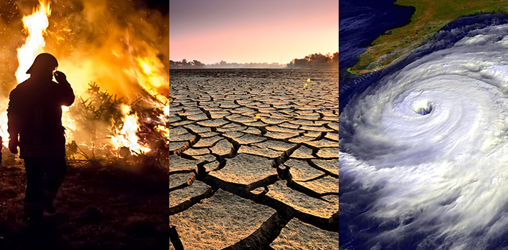
What is the best way to deal with climate change on a global level?

Slide 40
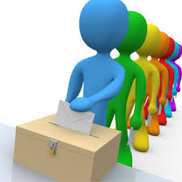
What will you study?
  Unit 1: UK Politics (33% of final grade)
Political participation: Democracy and participation, political parties, electoral systems, voting behaviour and the media.
Ideologies: conservatism, liberalism, socialism.
2 hour exam

Slide 41
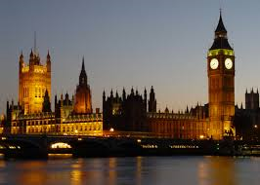
What will you study?
Unit 2: UK Government (33% of final grade)
UK Government: The constitution, parliament, Prime Minister and executive, relationships between the branches.
Optional ideologies: One idea from the following: anarchism, ecologism, feminism, nationalism, multiculturalism.
2 hour exam

Slide 42

What will you study?
Unit 3 – Global Politics (33% of your final grade)
Theories of Global Politics
Sovereignty and globalisation
Global governance
Power and developments
Regionalism and the European Union.
2 hour exam
Mixture of longer and shorter questions

