Slide 1





To explore how colour constructs meaning in a music video?
LO: To be able to understand how music videos construct meaning to audiences through colour.
Media Studies Taster Lesson
Starter: List as many connotations of these colours as you can think of:
Once done answer this question:
What is a convention?
A way in which something is usually done.

Slide 2
We are going to look at two types of colours seen in music videos these are the following:
NEON
BLACK & WHITE
You will watch music videos with these colours in and will complete these questions as you watch:
What genre is the music video?
How is colour used as a convention in the music video?
How is the colour used to make us feel?
Is the song slow or fast, why?
How do we know the artist is a star?
Is the artist over-sexualised? If yes/no – why?

Slide 3
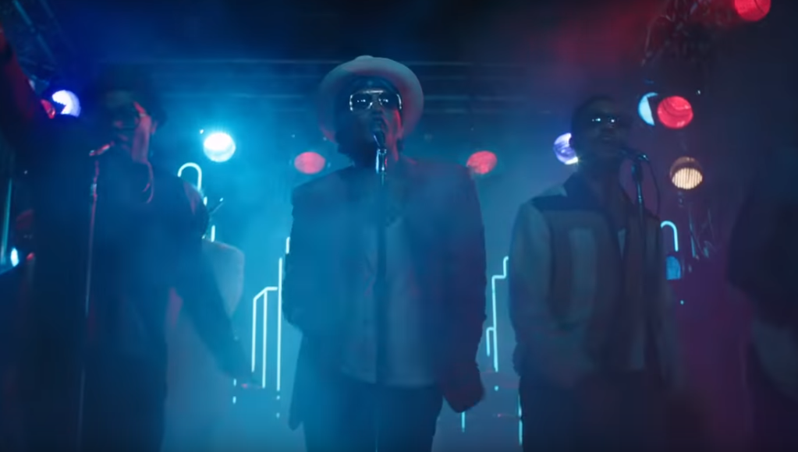
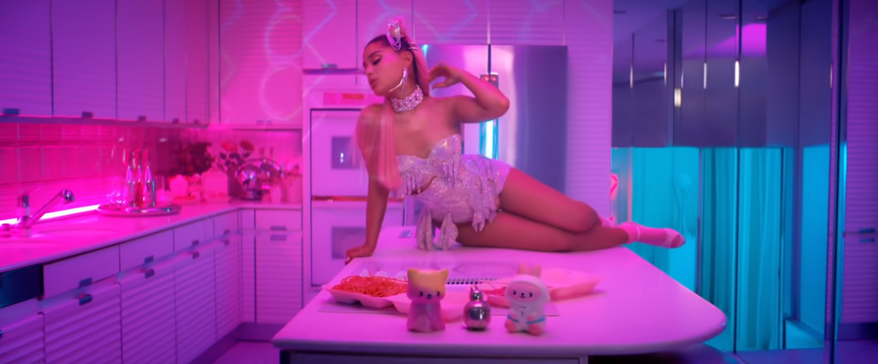
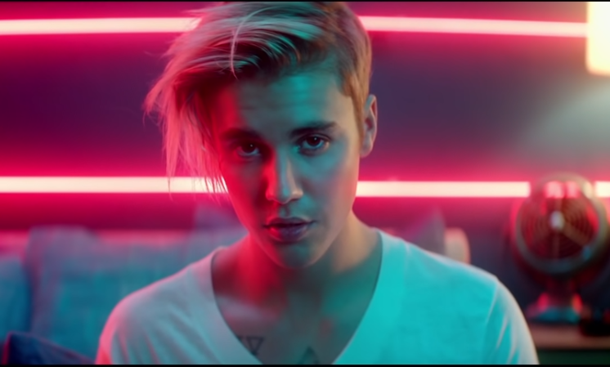
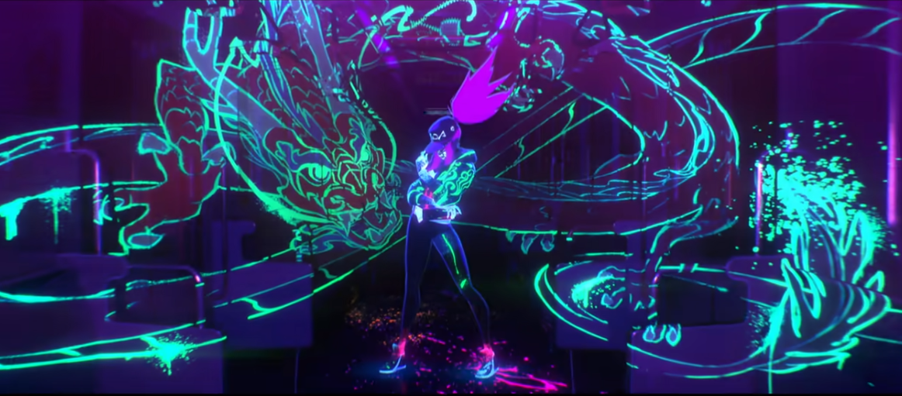
NEON

Slide 4
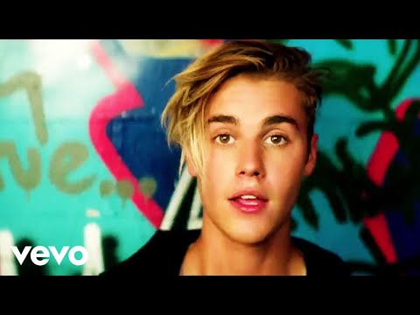
Task:
Make notes on how colour is used as a convention in Justin Bieber’s music video.
Success criteria:
What genre is the music video?
How is colour used as a convention in the music video?
How is the colour used to make us feel?
Is the song slow or fast, why?
How do we know the artist is a star?
Is the artist over-sexualised? If yes/no – why?

Slide 5
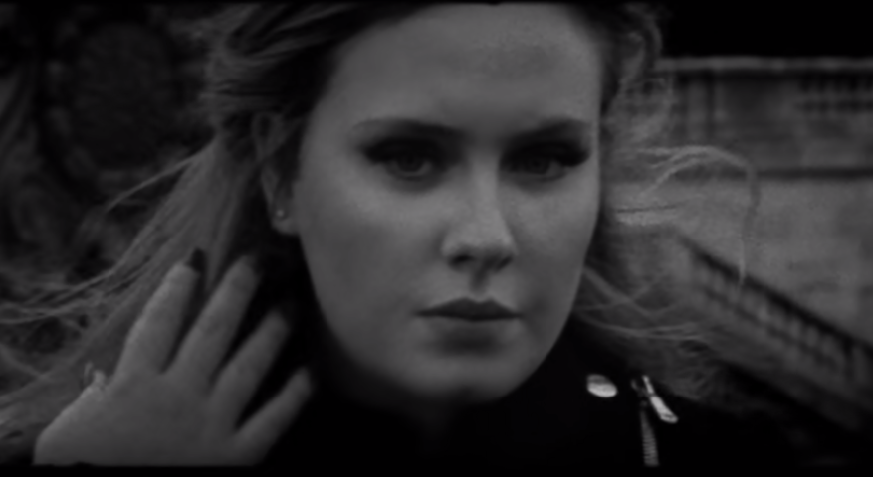

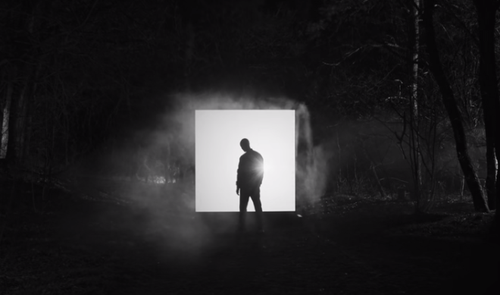

BLACK & WHITE

Slide 6
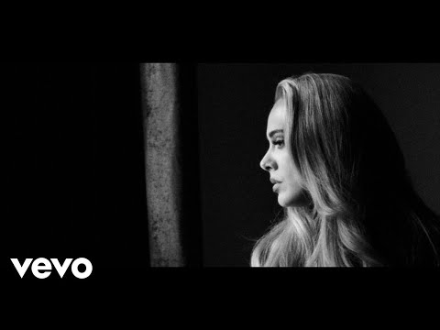
Task:
Make notes on how colour is used as a convention in Adele’s music video.
Success criteria:
What genre is the music video?
How is colour used as a convention in the music video?
How is the colour used to make us feel?
Is the song slow or fast, why?
How do we know the artist is a star?
Is the artist over-sexualised? If yes/no – why?

Slide 7
Class Feedback

Slide 8
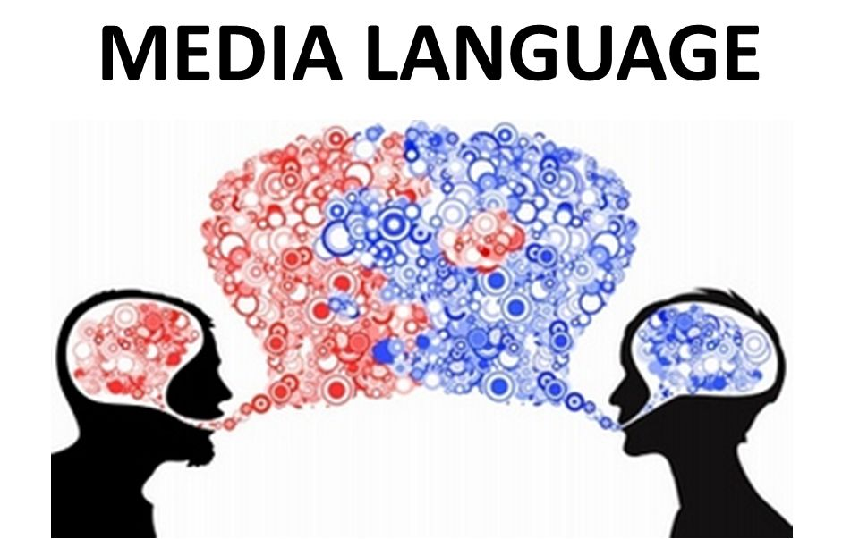
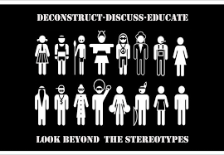
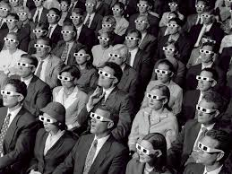

In Media Studies we examine and analyse a range of media forms in order to understand how media products attract consumers into buying into their material. We do this through learning what Media Language, Representation, Industry & Audience is and how these components work together.
REPRESENTATION
AUDIENCE
The Language that we use as media students and professionals is key to being able to communicate your ideas properly so that others can understand you.
Everything has an audience! Without it, it would be hard to make money. You need to be able to understand the role that audiences play in the media.
INDUSTRY
This is about understanding how the media represent- people, places & events. As well as trying to understand how the context (The time it was made) impacts representation.
Understanding what a Institutions motivations are, as well as the processes associated with media production is vital to studying media.

Slide 9

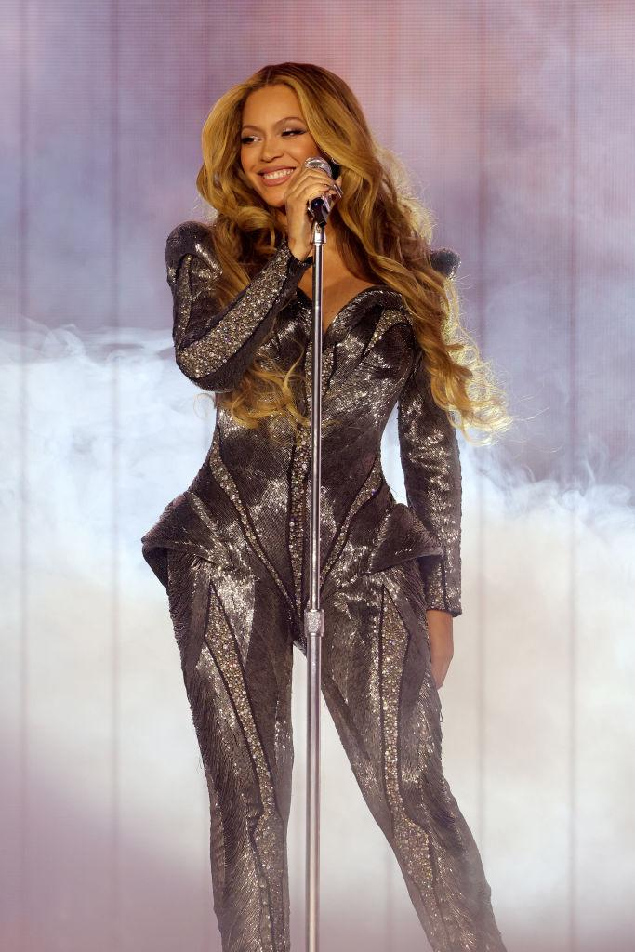
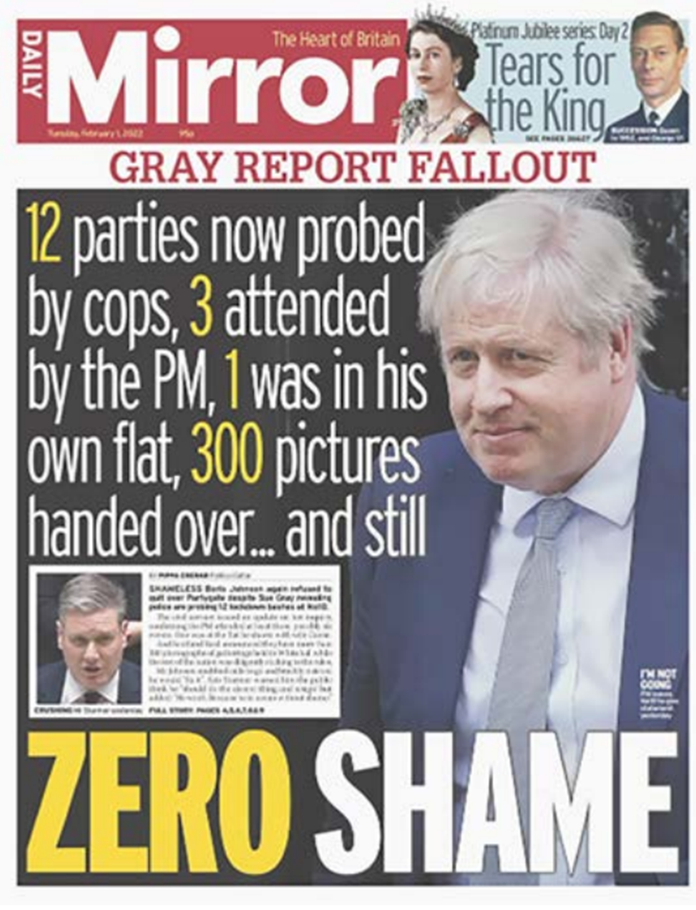
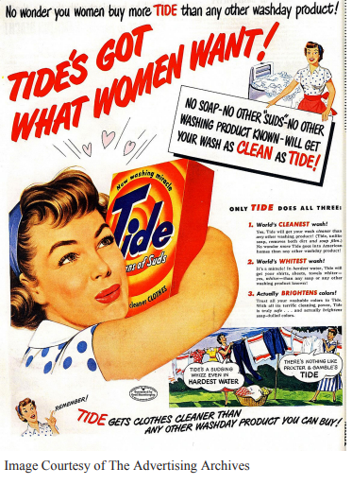



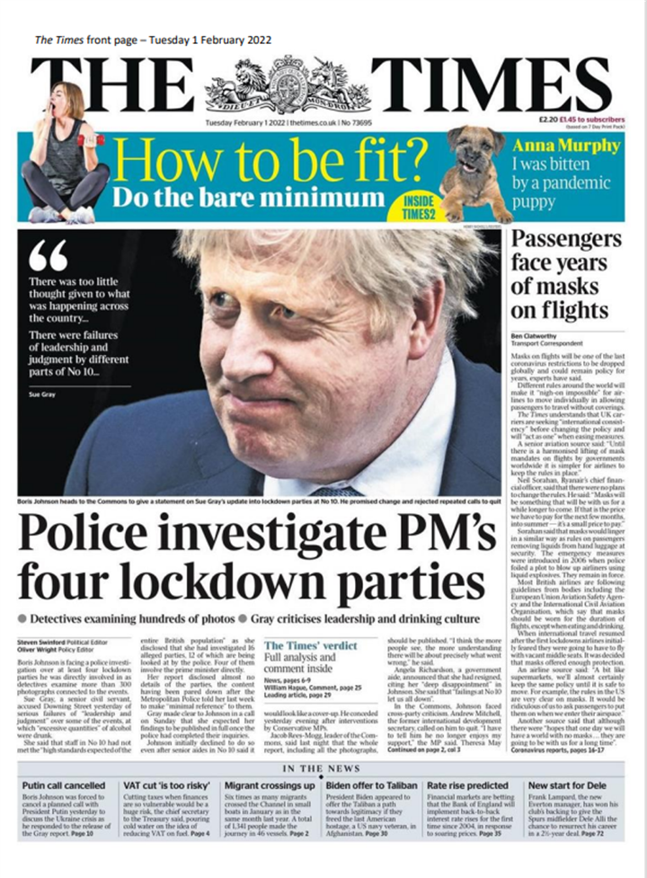
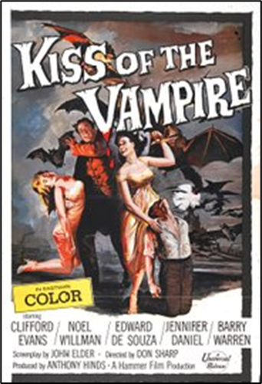

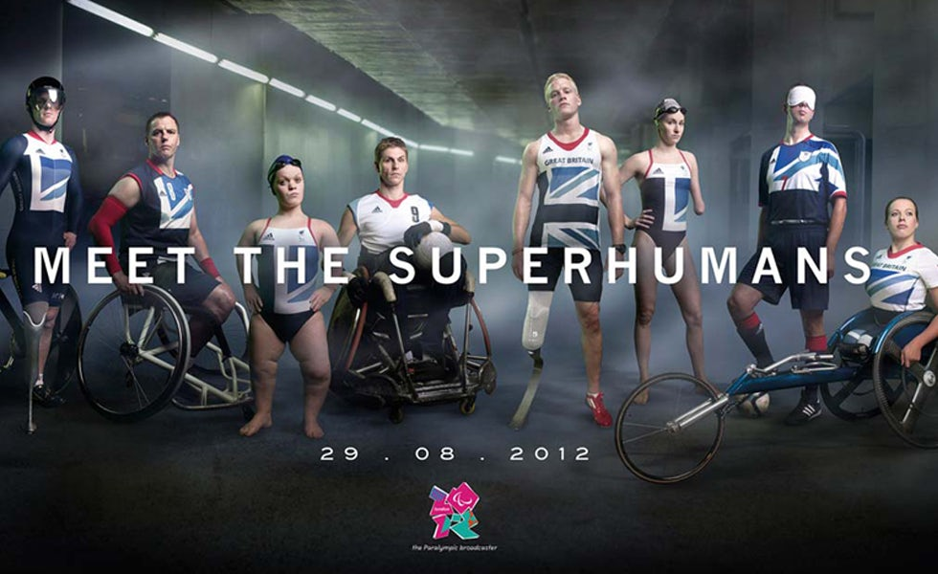
Component one :

Slide 10
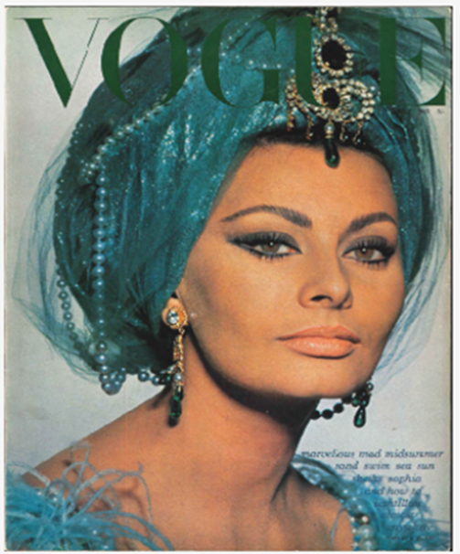




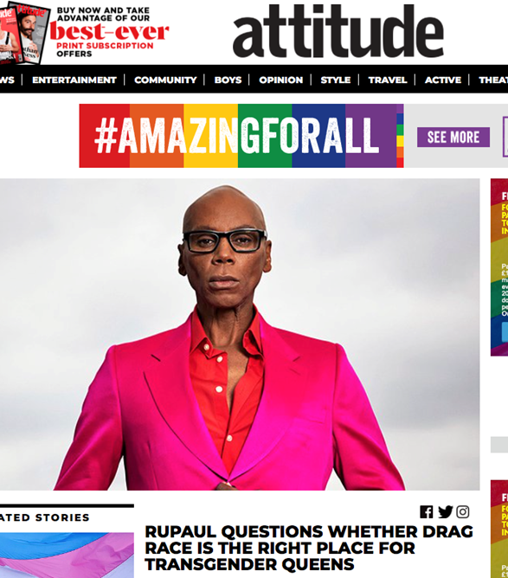
Component 2 :
In-depth studies of texts in pairs

