Slide 1
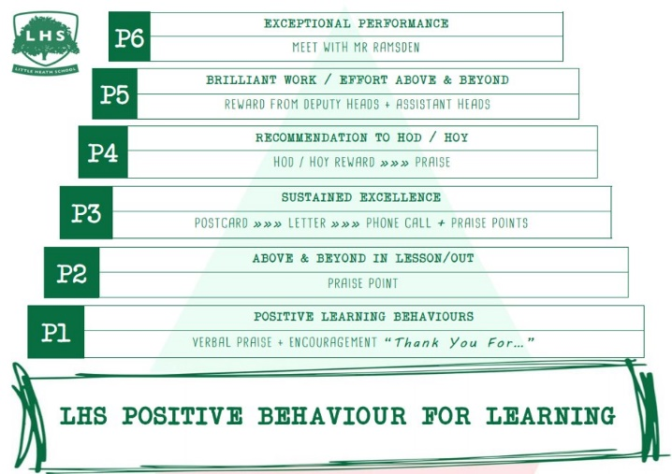


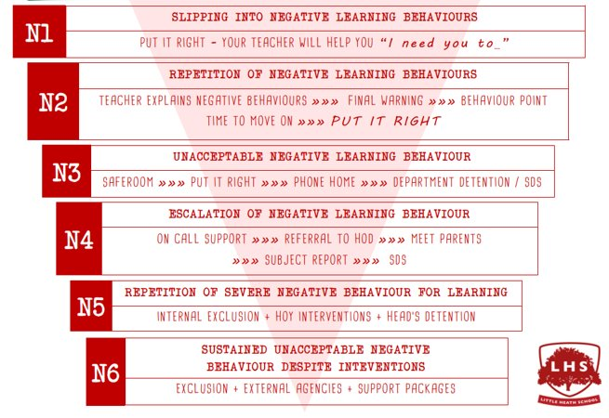
LO: To understand the Film Studies course and be able to identify some film form areas in relation to a short film.
Title: Film Studies Induction
Starter:
What does film mean to you? Why?
Discuss with the person next to you – be prepared to feedback!
Thank you for being ready to learn!

Slide 2

Welcome to Film Studies!

Slide 3
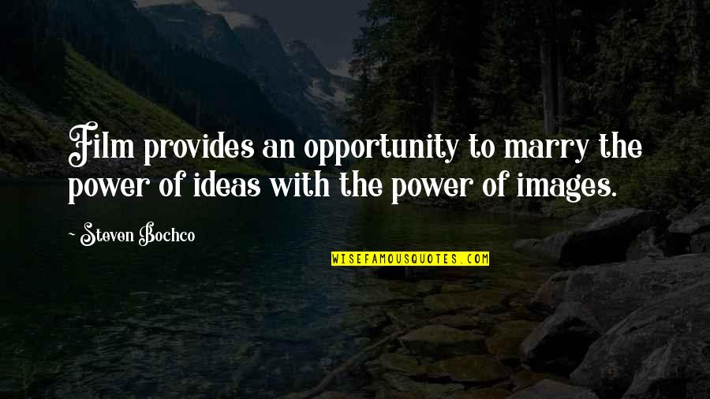
Why do you think film is important?
Write your idea on your post it note!

Slide 4
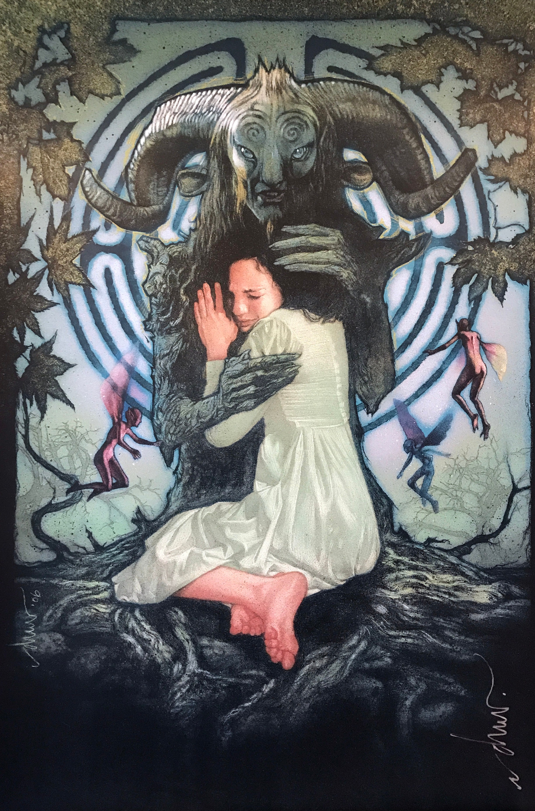
Joining Film Studies?
Whether you’re coming back to the subject after doing it at GCSE, or joining for the first time - we’re really pleased that you’ve chosen our subject.
A level Film is taught by both myself, Mr Chan (Head of Film & Media Department), and Miss Moore - Film Teacher and is based in S7, S8 and S9.
If you have any questions at all please email me at lchan@littleheath.org.uk
Pan’s Labyrinth
2

Slide 5
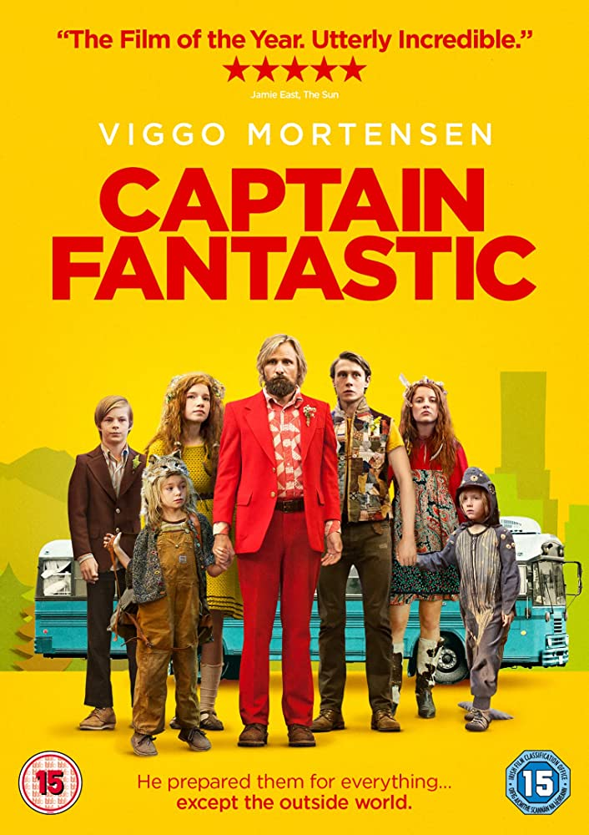
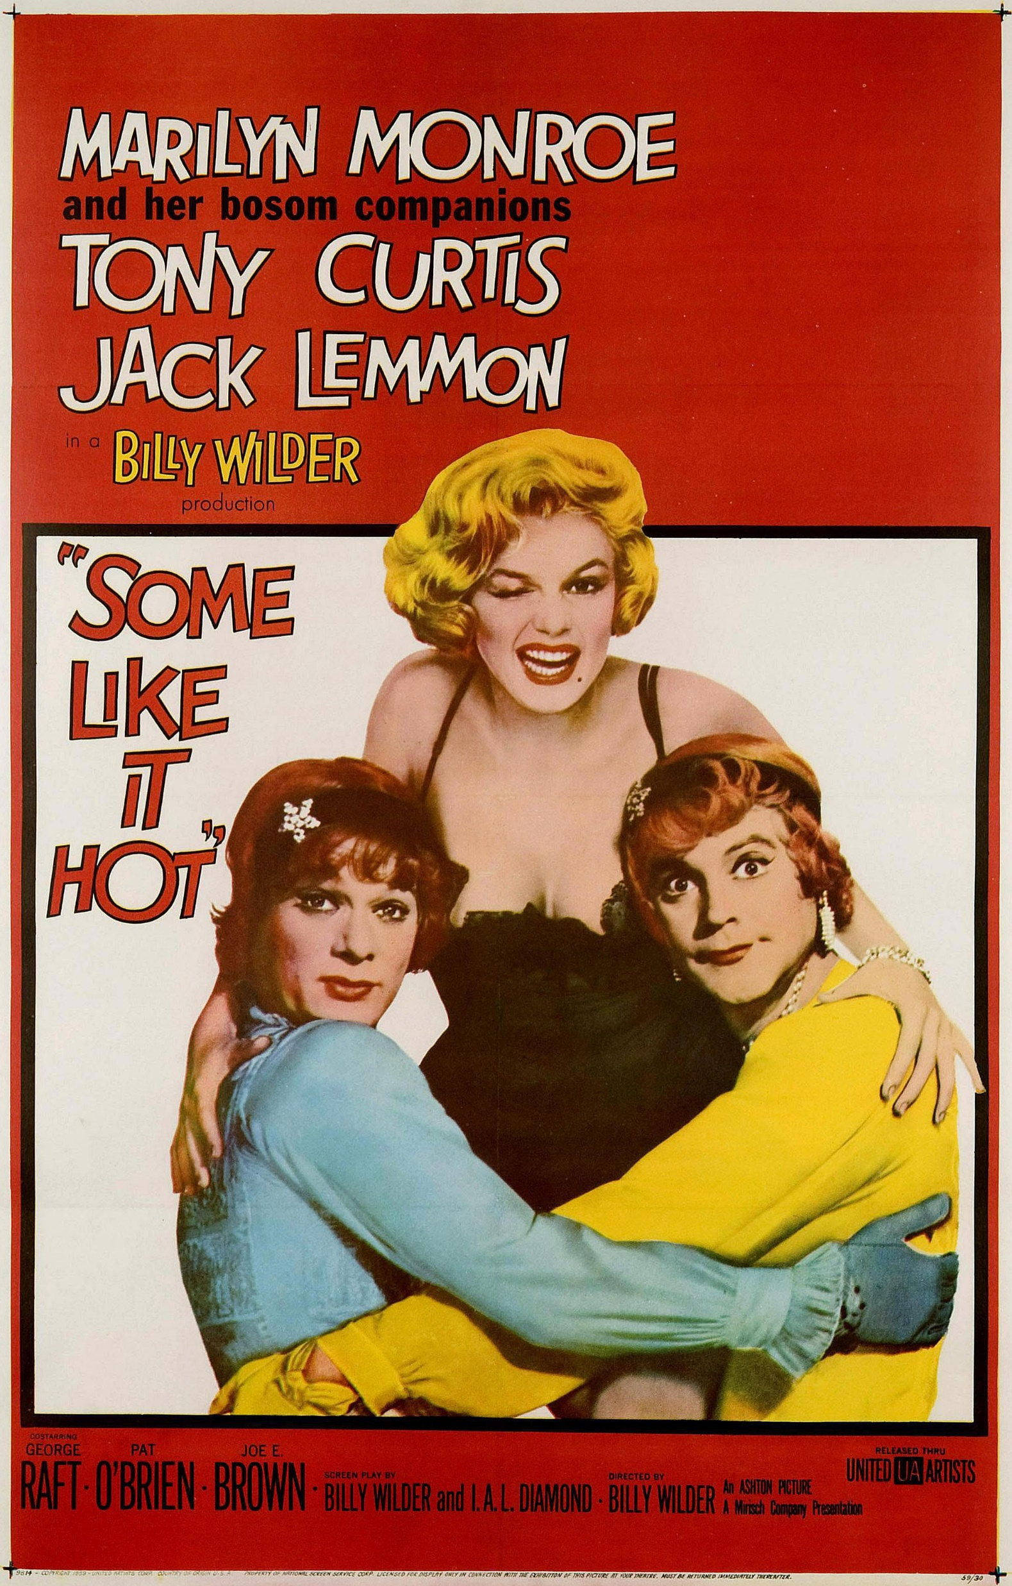
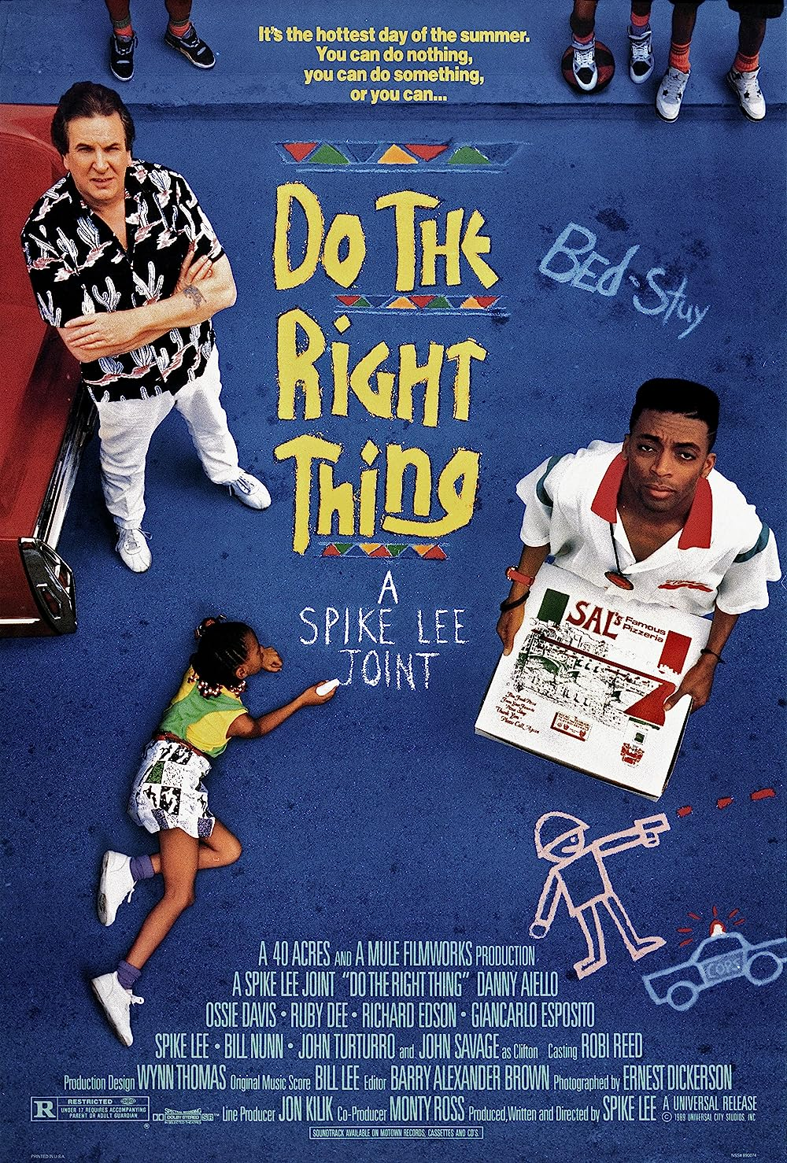
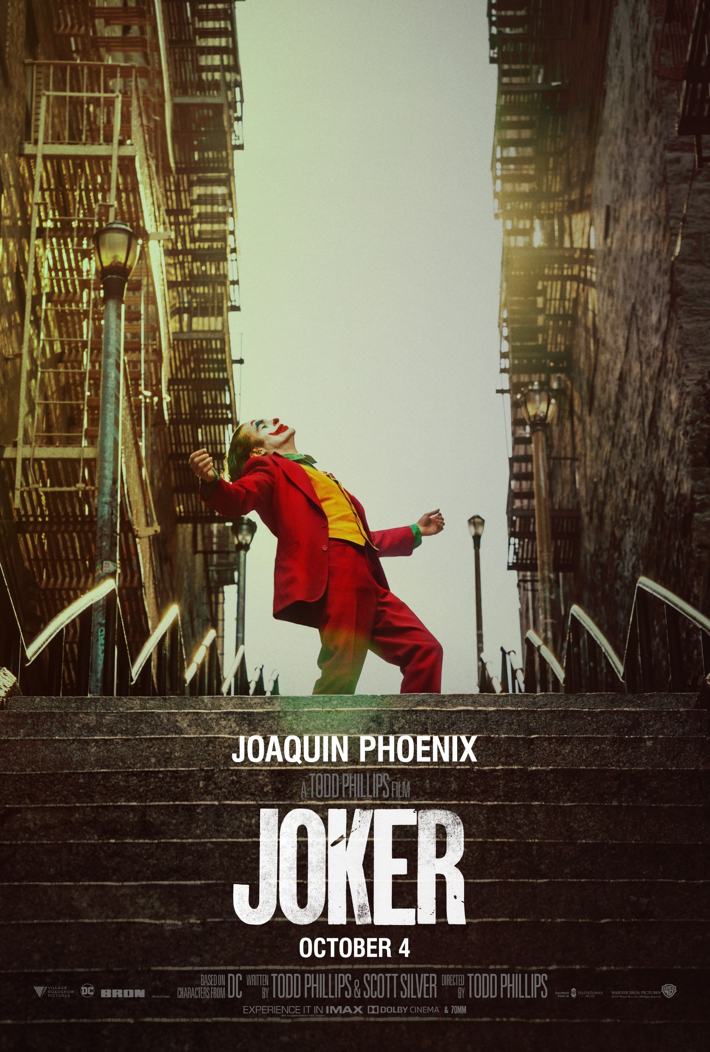
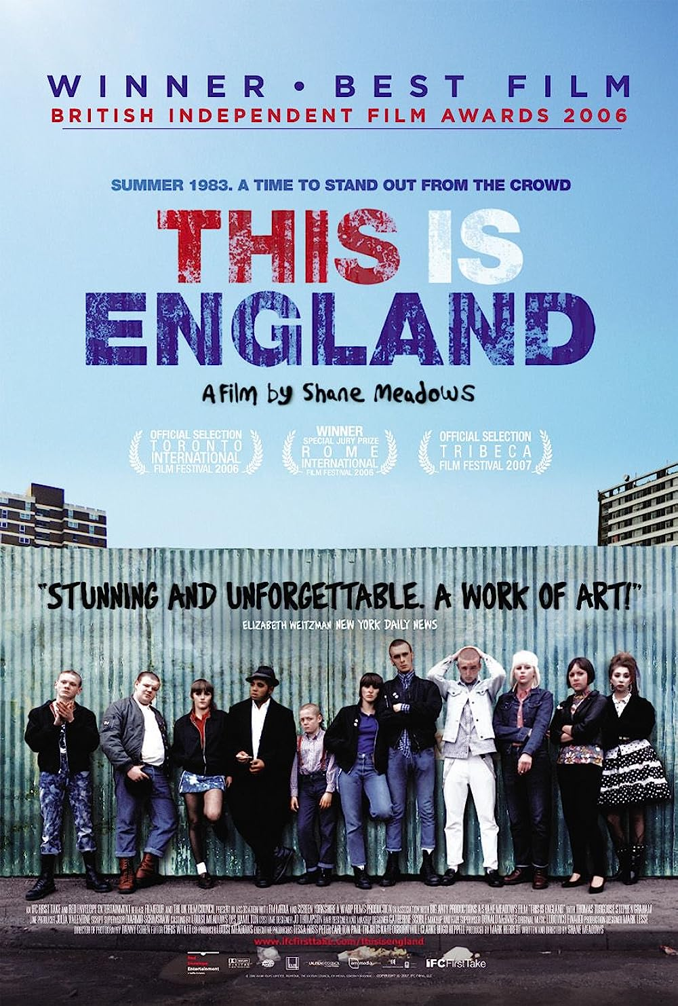
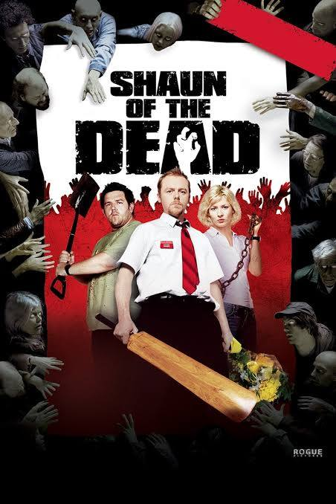
Film Studies Course Content
EXAM ONE – AMERICAN AND BRITISH FILM
Classic Hollywood
Modern Hollywood
Independent films
British films
You will study the following films:
Some Like it Hot
Do the Right Thing
Captain Fantastic
Joker
This is England
Trainspotting

Slide 6
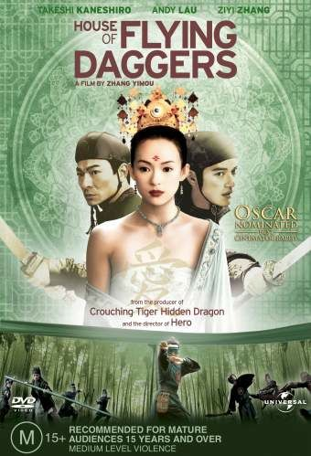
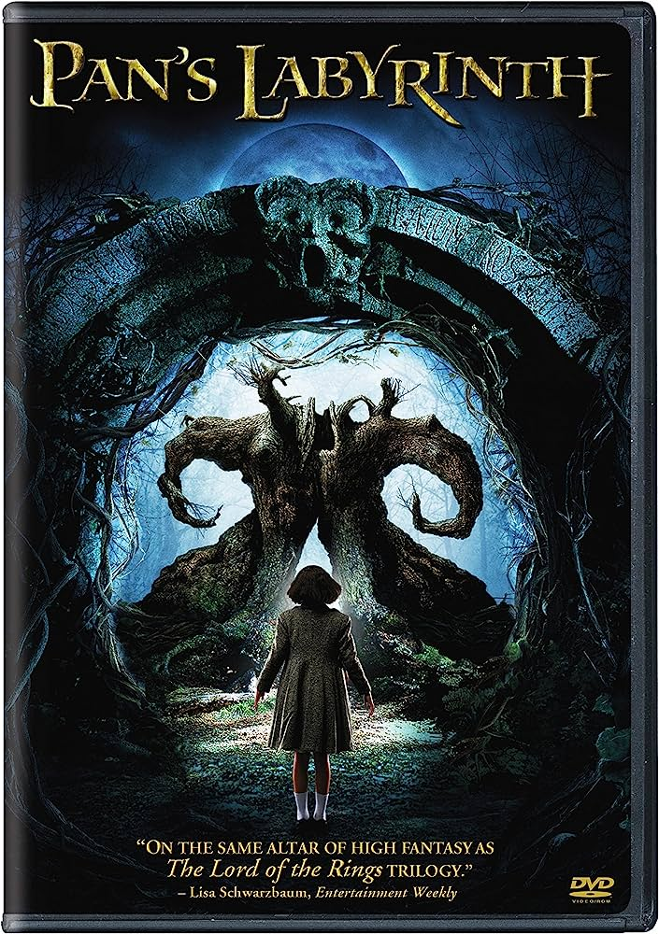
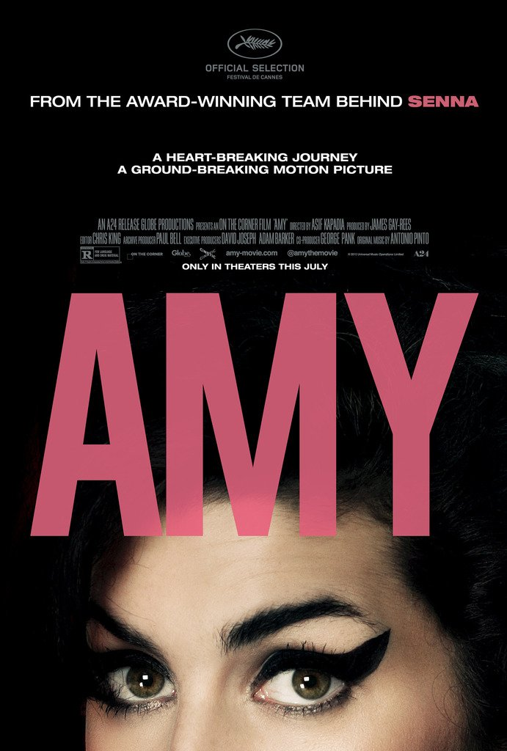
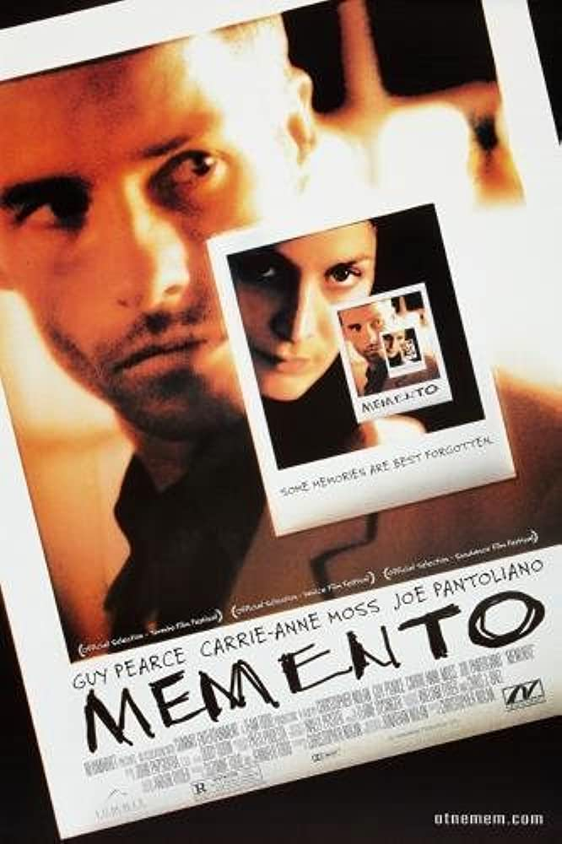
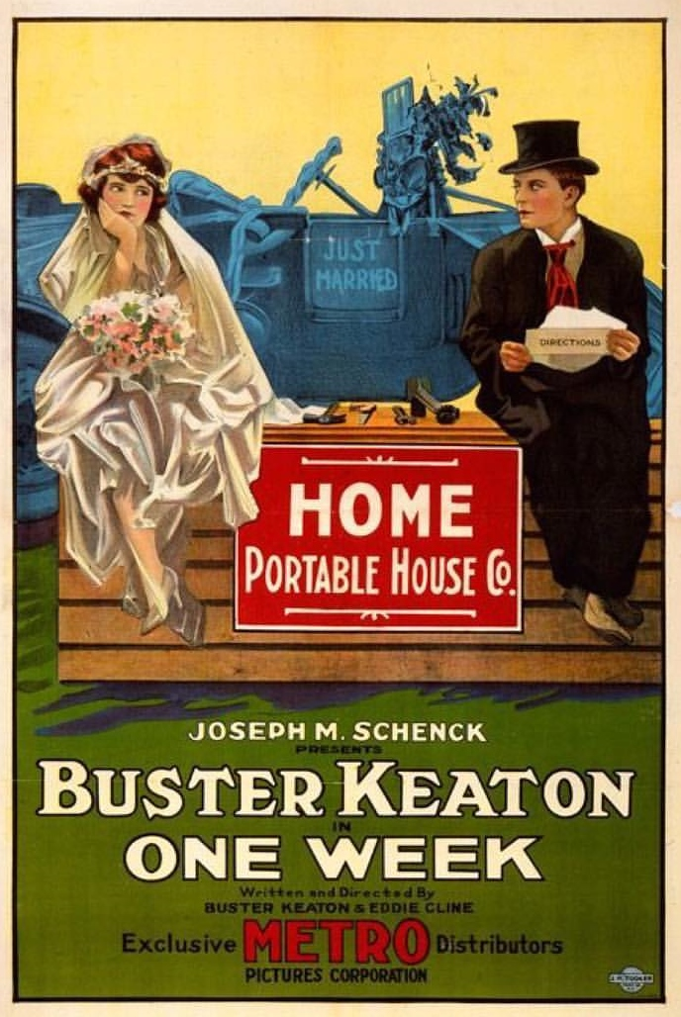
Film Studies Course Content
EXAM TWO – VARIETIES OF FILM
Global Films
Documentary film
Film Movements
You will study the following films:
Pan’s Labyrinth
House of Flying Daggers
Amy
Buster Keaton Short Films
Memento

Slide 7
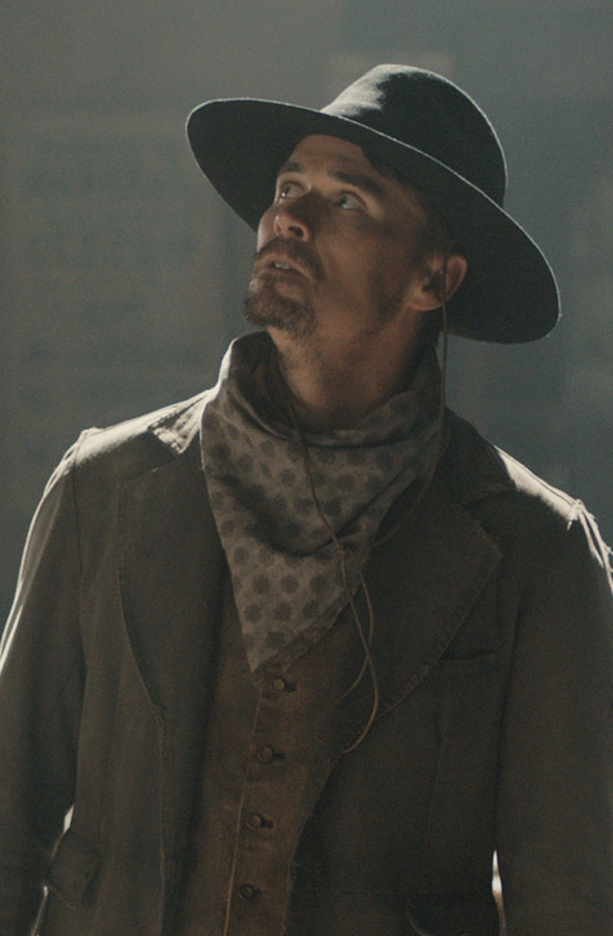
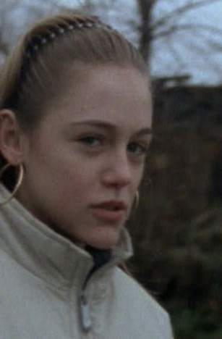
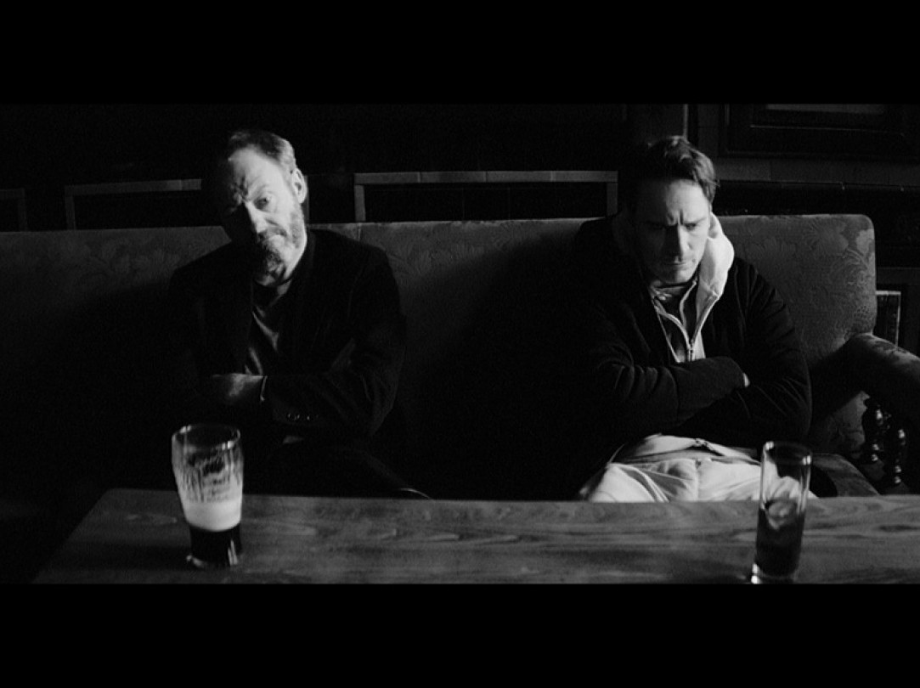
Coursework:
The Short Film
Throughout the duration of the first year we will study a range of short films and screenplays in addition to the main texts. These short films will then form the inspiration for the short films that you have to make.
Your coursework you will have a choice of writing a screenplay for an original short film and producing a digital storyboard OR making a 5 minute short film. You will take influences from the short films that we’ve studied as well as any other cinematic influences.

Slide 8

What makes a good Film Studies student?
Creativity
Good communication skills – lots of discussion!
Organisation (there’s a lot to do in two years!)
Excellent analytical skills (think English literature)
Able to be subjective & take criticism
An interest in film – someone who watches a lot of films and has an open mind about what they watch.
Its NOT all just Marvel & Disney films!

Slide 9

Any questions about the course?
FILM STUDIES lesson this way…
lchan@littleheath.org.uk

Slide 10
Narrative- telling a story
Task:
In your pair, you have a set of still images. In 5 minutes, you need to:
  Order the images to create a narrative.
  Decide on a title for your film.
  Be prepared to explain the narrative you have created.
Let’s watch and compare!
How is the film going to end?

Slide 11
Read any good films lately?
In Film Studies, films are texts seen in the same way as literary texts, constructions we can learn to read through an understanding of the language that is used to communicate meanings. This process of analysis is the basis from which to study any film.

Slide 12
How do we analyse film?
Key term: Film form
The following are the tools used by filmmakers to tell stories, communicate their ideas and evoke emotional responses in the viewer.
Lighting
Mise en Scene
Cinematography
Aesthetics
Contexts
Lovefield
Editing
Sound
Performance

Slide 13
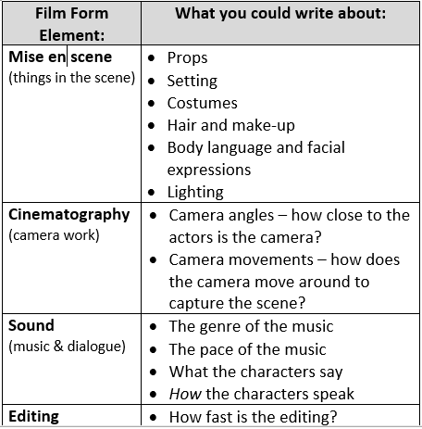

Choose one feature from the element of film form that you have looked at, and write a summary about how it has been used and how it creates meaning or impact for you, the audience.
Use the help sheet!

Slide 14
The BBFC Challenge!
The BBFC (The British Board of Film Classification) are only allowed to use 48 characters to describe the content of a film!
Can you:
Think of a film.
In 48 words or less describe the film with out giving away the title and present it to the class?

Slide 15
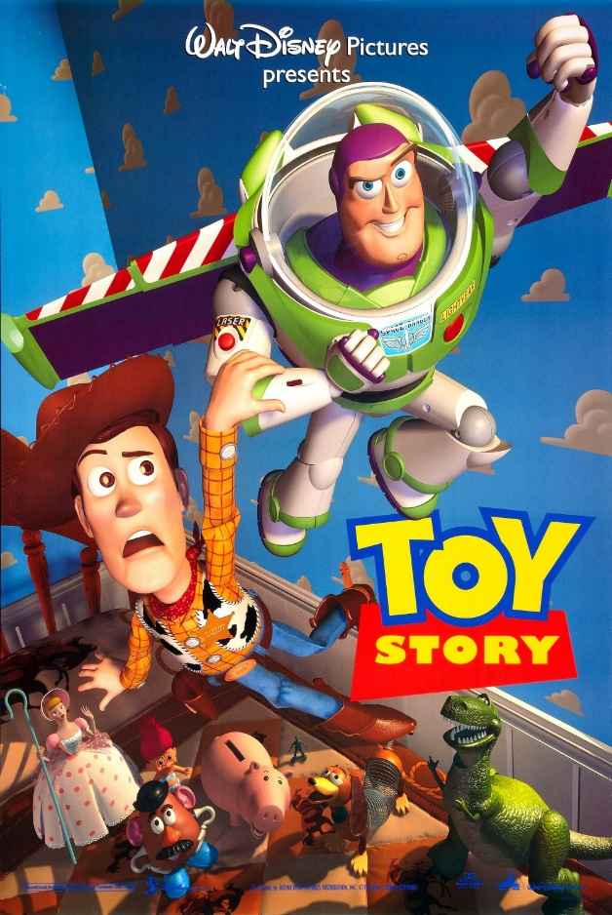
A group of toys have their comfortable lives disrupted by the arrival of a new toy. Two fight for leadership, this leads to an escape and a rescue. They make friends at the end.
Toy Story!

Slide 16
Summer Transition Work

