Slide 1
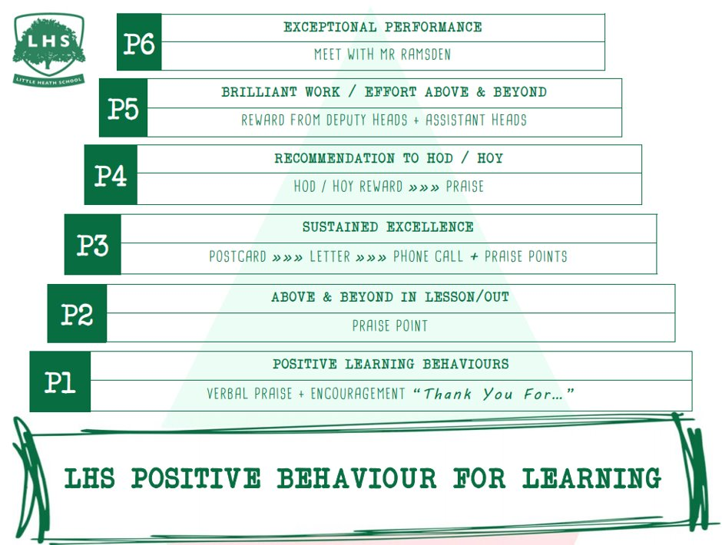
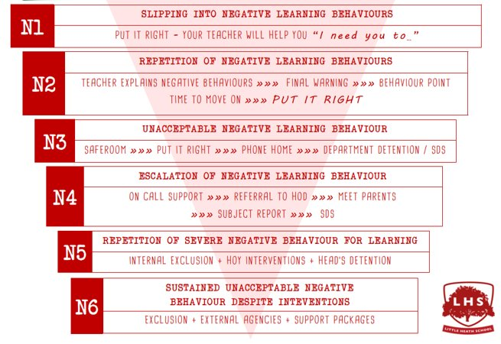


A Level Pe
An introduction to the course and what to expect from exams and coursework
Aims:
To understand the content from each exam component
To comprehend what is expect from the practical component outside of school
Thank you for being ready to learn!

Slide 2
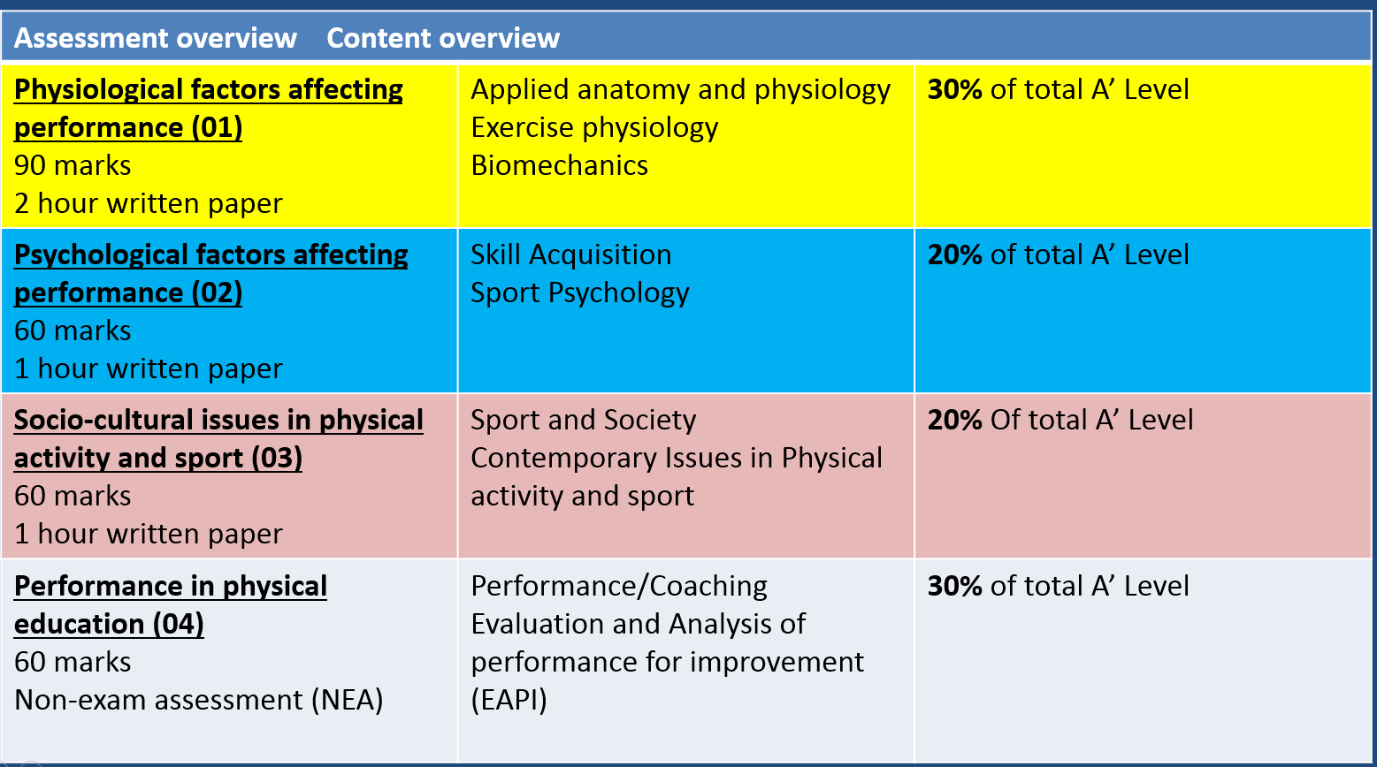
A Level PE – 2 year course

Slide 3
Objective for today
Overview of the course. How the course is split and how much is each content worth.
Knowledge from paper 1
Knowledge from paper 2
Knowledge from paper 3
How practical and coursework will be assessed.
Expectations from A level pe

Slide 4
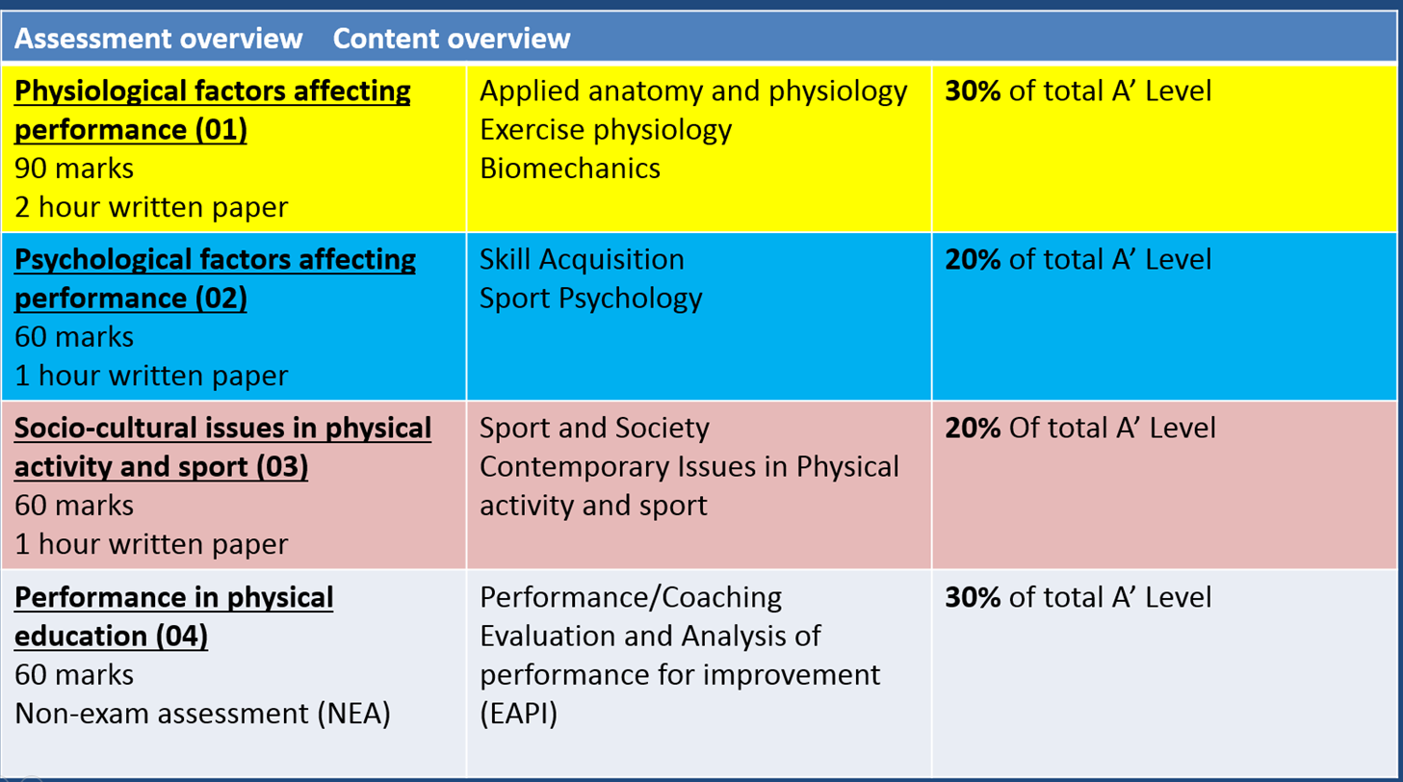
Paper 1
Body systems including cardiovascular, respiratory
Energy systems
Diet
Sport injury
Biomechanics of the body in sport.

Slide 5
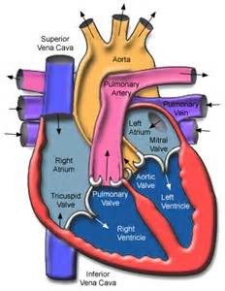
Label the Heart
Use the work sheet to identify what you know

Slide 6
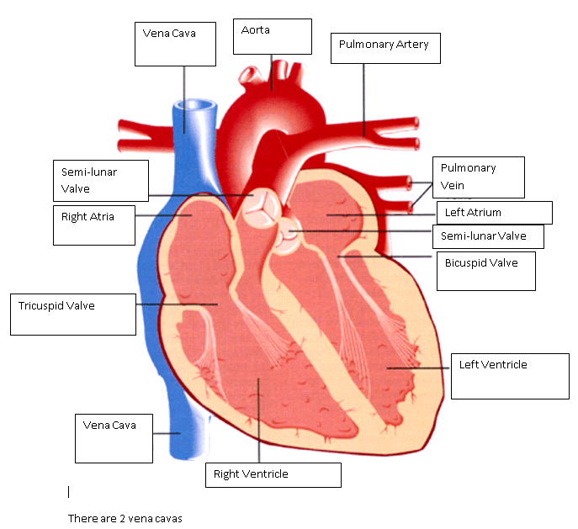
Answers

Slide 7
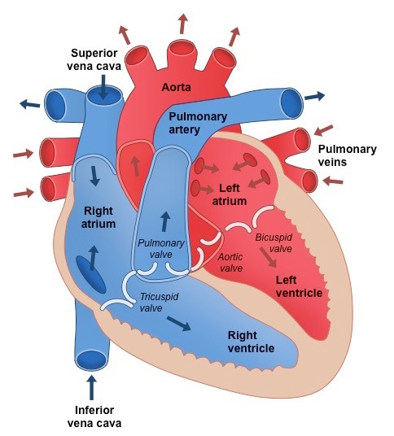
Route of Blood Around the Body
Using the cards provided,
Identify the correct order in
Which blood moves around
the heart.
This might help you

Slide 8
2. Route of Blood
Vena Cava
Right Atrium
Tricuspid Valve
Right Ventricle
Semi-lunar Valve
Pulmonary Artery
Lungs
Pulmonary Vein
Body
Aorta
Semi-luna valve
Left ventricle
Bicuspid valve
Left Atrium

Slide 9
Paper 2
Personality in sport
Aggression in sport
Sports confidence
How do we learn and skill and remember it.

Slide 10
Short Term Memory Store
Often referred to as the workplace
Information is compared to that previously learned and stored in the long term memory
E.g. when learning to pass in basketball, the individual deems it is important to extend the elbows from the demonstration and remembers to do this
If it helps, the individual will then store this in the long term memory for future use

Slide 11






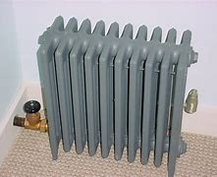

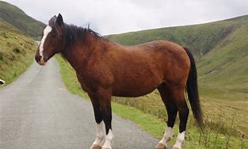
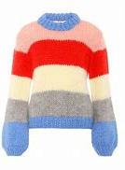


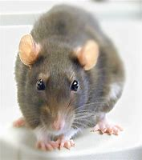

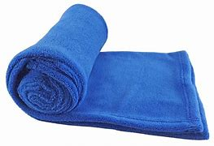
Look at these pictures How many can you remember?

Slide 12
Short Term Memory Game 2
You will be shown 2 numbers, you task is to see if you can remember them.
Look at the number below for 30 seconds
Can you now remember it.
5946238106
01189 427337
Notes:
Chunking.

Slide 13



Feedback
Game 3
A volunteer needs to throw some paper into the bin. They will throw backwards and not be able to see the bin. They will do this 3 times, all differently.
They will then received 3 types of Feedback on attempting to throw the paper into the bin 3 times:
No feedback
Knowledge of results – scored or not
Knowledge of performance – eg. “throw to the left a bit”

Slide 14
Paper 3
Development of sport in the UK. How has is changed over time.
Technology in sport
Deviance in sport.
Governing bodies and how they support athletes reach top level sport.

Slide 15
Identify 3 examples where technology helps create fair outcomes.
VAR
Hawk Eye
Starting blocks
Ref cam
TMO
Cricket camera
Any other examples

Slide 16
Pressure to win – management, sponsorship
Desire to win – intrinsic and extrinsic motivation
Nature of the game – physical, aggressive, ice hockey, bats, boxing,
Spectators and alcohol/drugs – increases violence, passion, over confident in rowdy situations.
Rivalries between clubs
Spectators to see others being violent - encourages
Media increase tension – pre game tension, social media,
Officials – unfair decisions, poor control over the game,
2. What causes violence in sport?

Slide 17
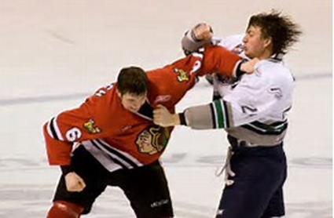
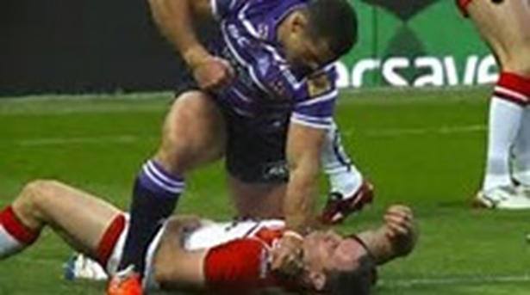
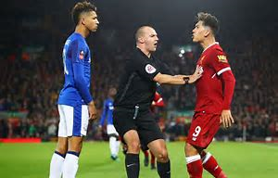
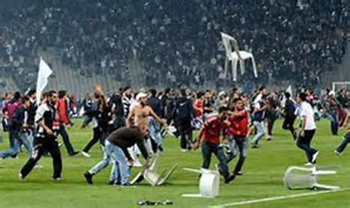
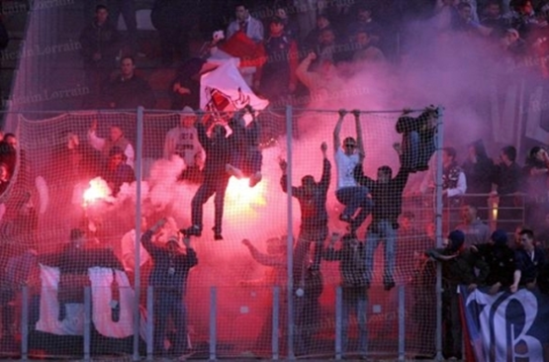

Slide 18
3. How has technology become entertaining to watch?
Action replays
Slow motion
More camera angles
Pause live sport and rewind it
Improved analysis – more ex professionals commentating

Slide 19
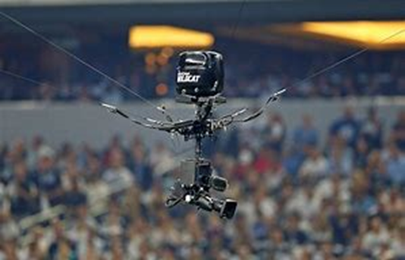
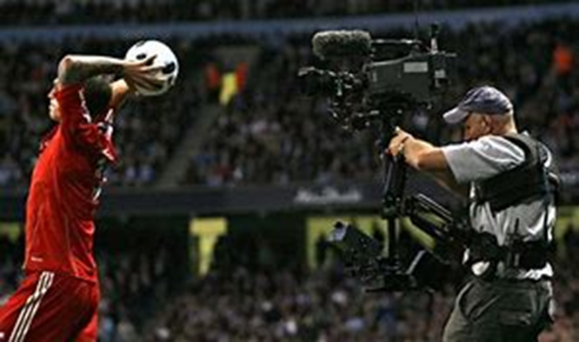
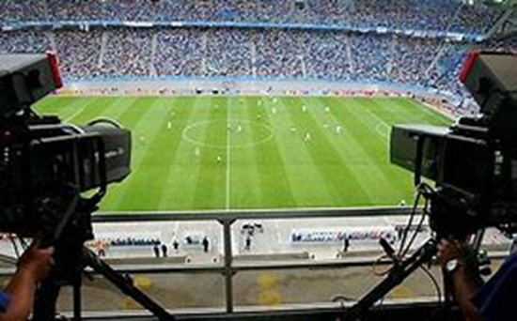
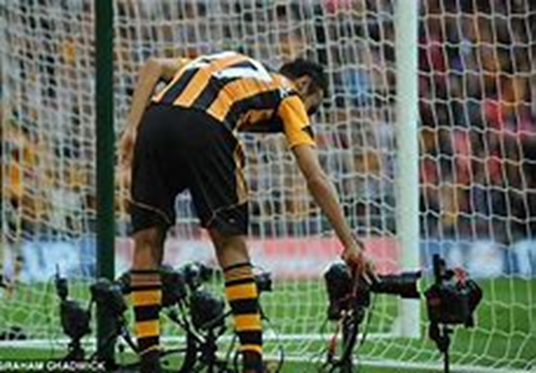
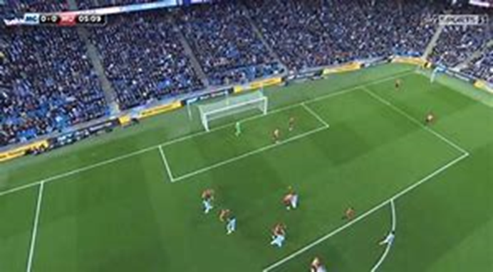

Slide 20
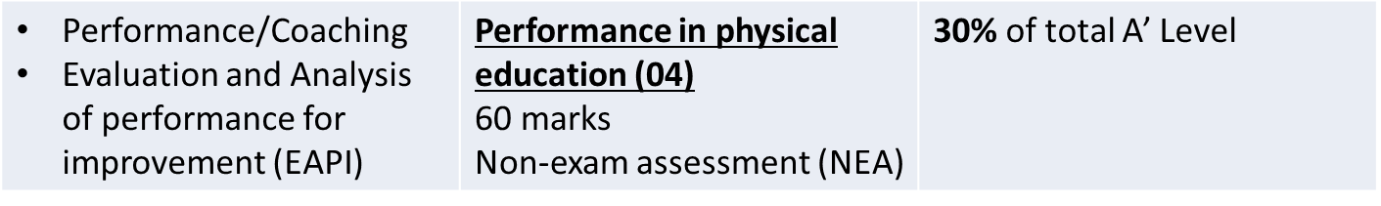
Practical and Coursework

Slide 21
Practical and Coursework
Practical
Coursework
1 sport
In your own time. We cannot teach all sports from the class.
You need to keep a log of competition. This helps to show the level you participate at.
EAPI talk (Evaluation and Analysis of performance for improvement)
You will watch a performer from your sport and identify their strengths and weaknesses eg are they good at passing)
Then create a development plan for their major weakness.

Slide 22
300 marks in total
Content overview | Assessment overview
Applied anatomy and physiology Exercise physiology Biomechanics | Physiological factors affecting performance (01) 2 hour written paper | 30% of total A’ Level 90 marks
Skill Acquisition Sport Psychology | Psychological factors affecting performance (02) 1 hour written paper | 20% of total A’ Level 60 marks
Sport and Society Contemporary Issues in Physical activity and sport | Socio-cultural issues in physical activity and sport (03) 1 hour written paper | 20% Of total A’ Level 60 marks
Performance/Coaching Evaluation and Analysis of performance for improvement (EAPI) | Performance in physical education (04) Non-exam assessment (NEA) | 30% of total A’ Level 90 marks

Slide 23
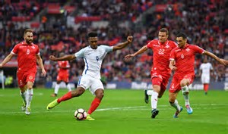
Our expectations
You will only need 1 sport for A’ level
You will need to be participating in a competitive sport outside of school.
You will need to support your own learning by working outside of lessons.
Ask us for help if you need it.

Slide 24

ANY QUESTIONS?

