Slide 1
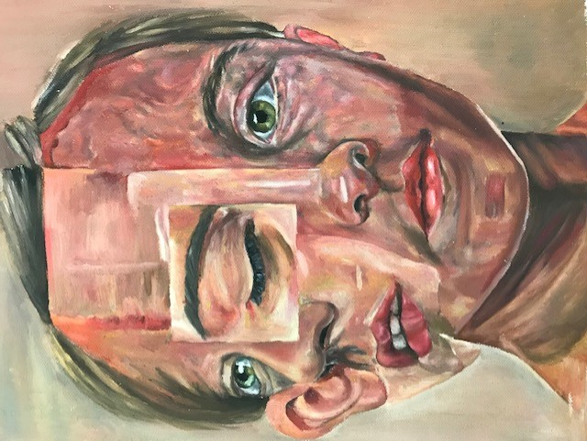

A Level Art & Design

Slide 3
General Information
Entry requirements?
Students need at least grade 4 at GCSE, or evidence of suitable skill level if you have not taken GCSE.
Exam board?
AQA, Art Craft and Design endorsement
Which subjects does it link to?
Textiles/Media Studies/Film + more
What type of students might like this course?
Creative students who enjoy personalised learning
Amount of homework and independent study?
Independent study skills are essential, and there is a requirement to work hard outside of lessons
Average class size
Classes vary in size, but on average will have 10 to 15 students
What makes a successful student of Art?
Having a passion for the visual arts
Taking risks to develop their practical skills further
Being able to manage deadlines

Slide 4
Course structure
Year 1
Coursework Portfolio: Component 1: Personal Investigation
We provide a choice of starting points to choose from and then you will complete an in-depth personal investigation practical unit for the majority of the two year course. This is an extended unit, which is designed to enable you to experiment with a wide range of materials and processes, before specialising in an area of art and design that interests you the most.
Year 2
Terms 1 to 3.
Completing personal investigation projects including:
Supporting essay
Final outcomes
Term 3 to 5:
Unit 2: AQA Externally Set Assignment

Slide 5
Starting points
Magical Worlds
Past and Present
Illusion
Lighting
Journeys
Distorted Figures
Create a mind map from a starting point to consider how your project could develop
Research artwork to inspire you

Slide 6
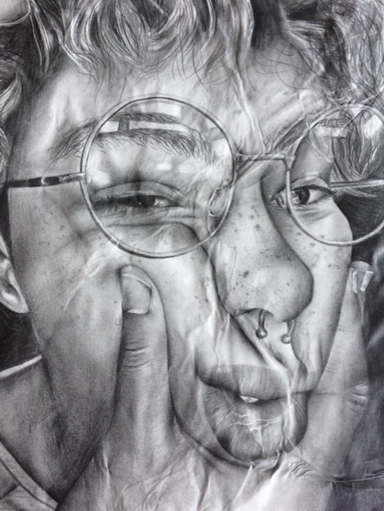
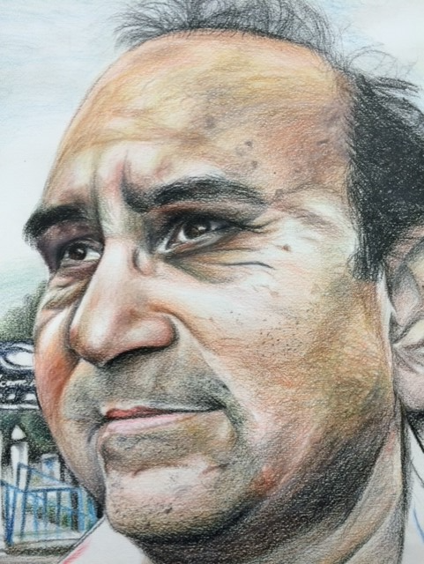
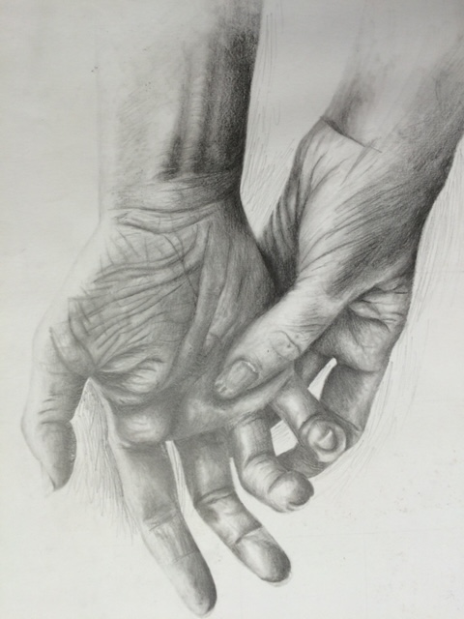
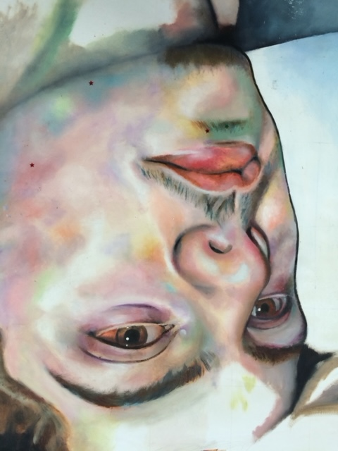
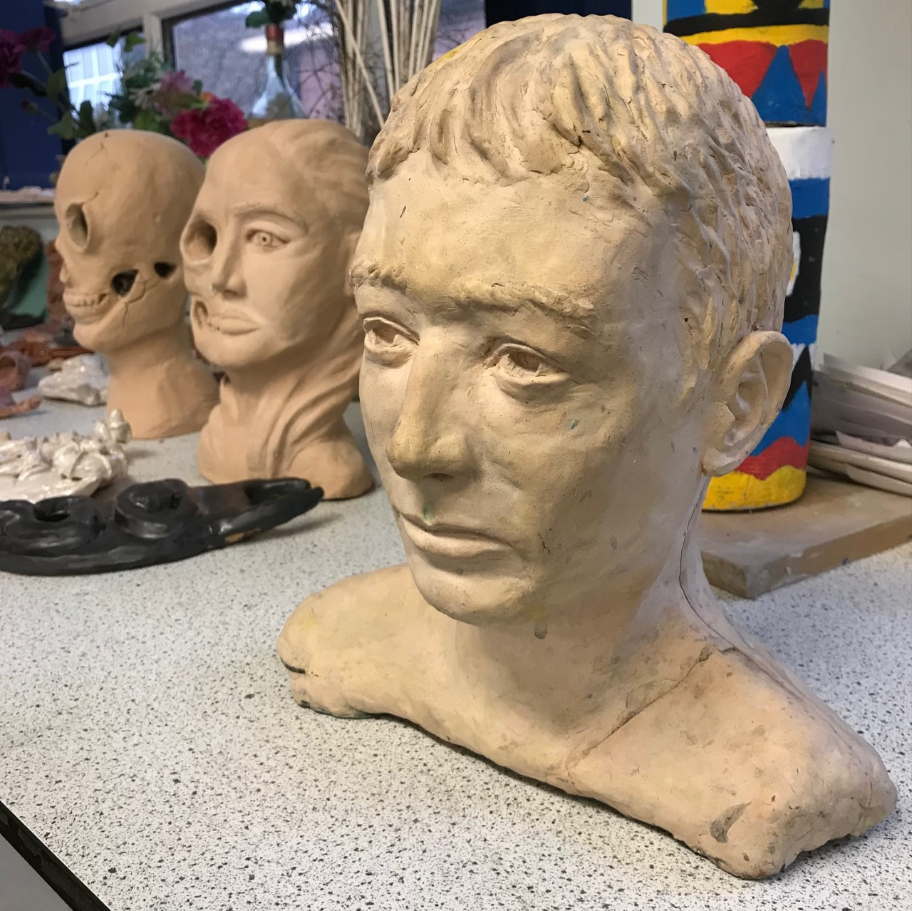
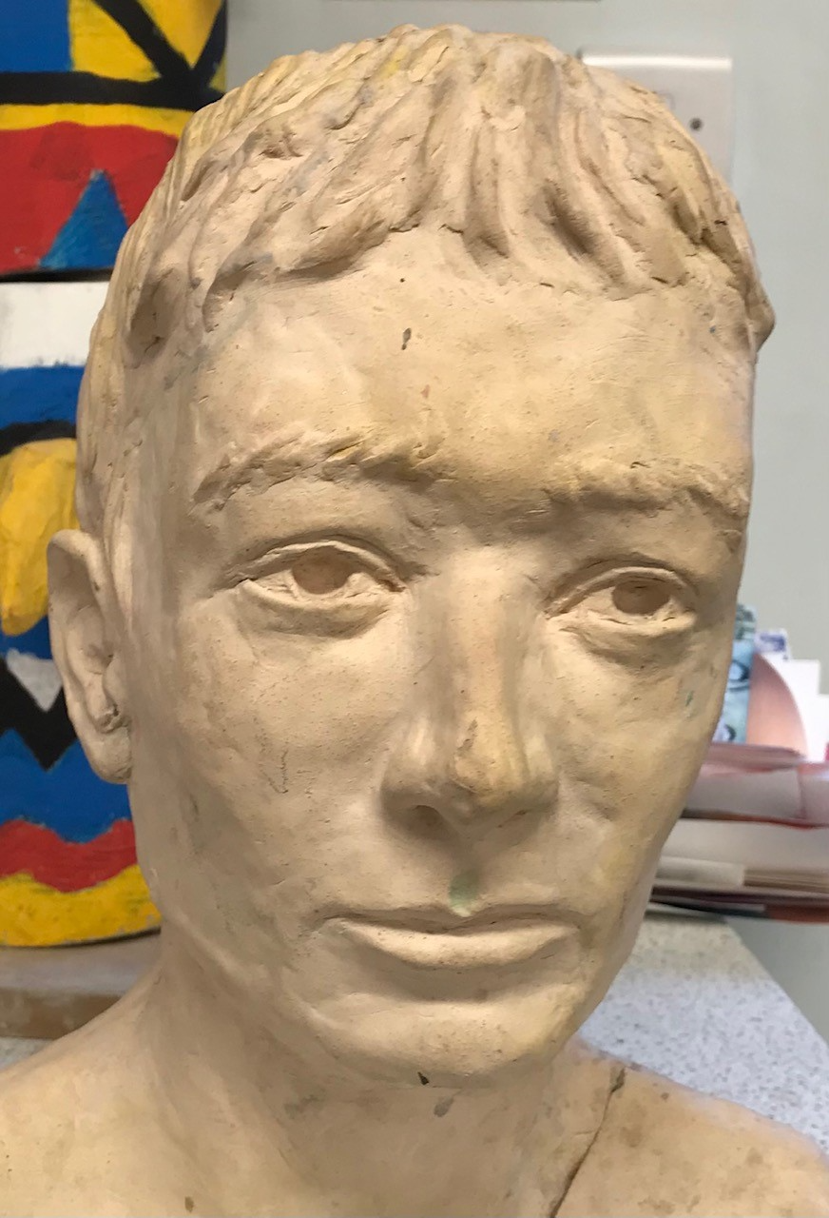
Examples of A Level work
Observational Work

Slide 7
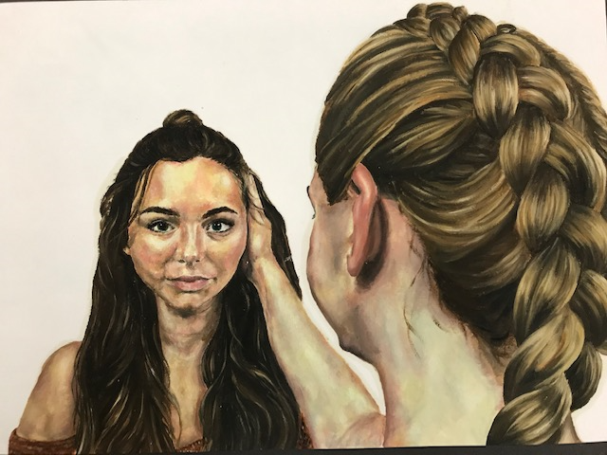
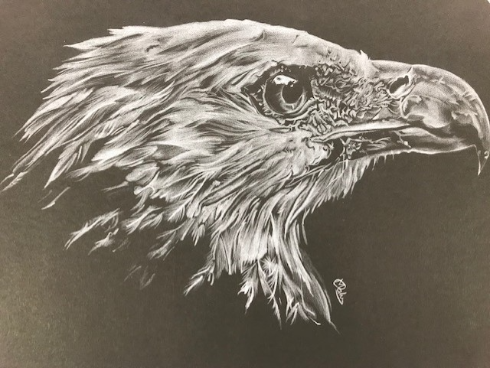
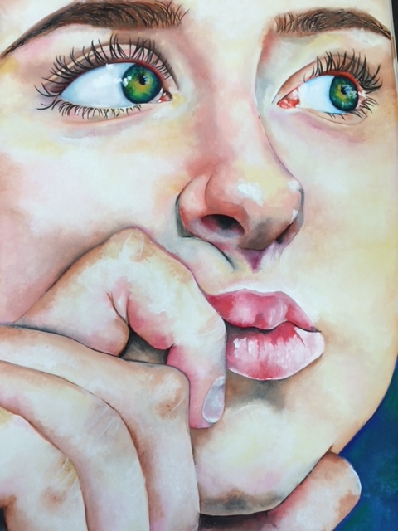
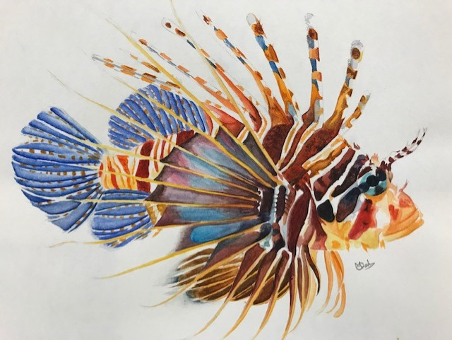
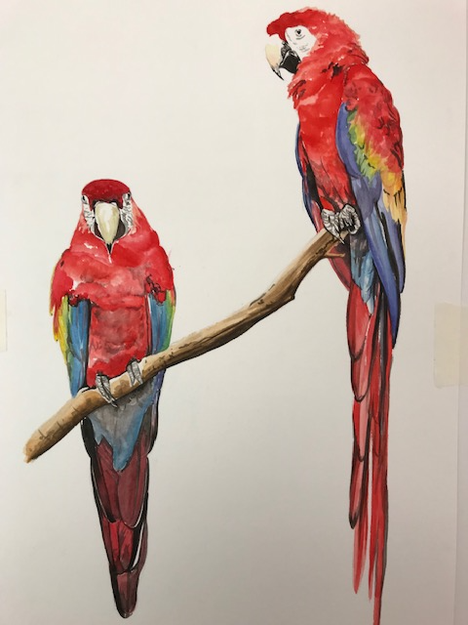
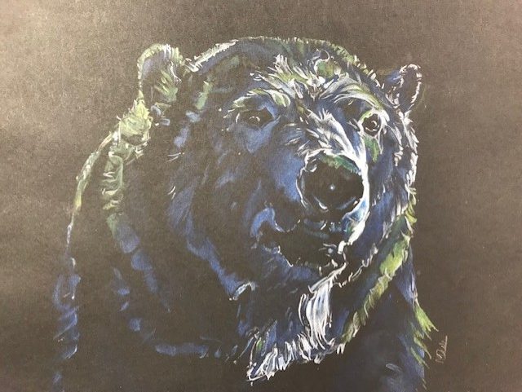

Slide 8
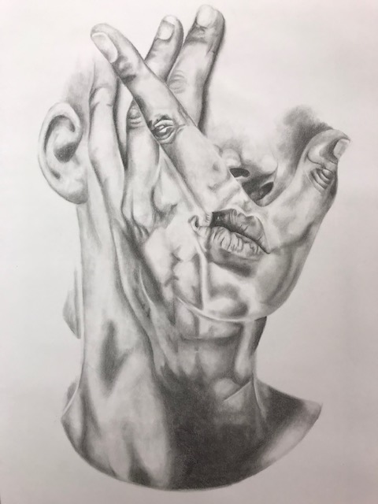
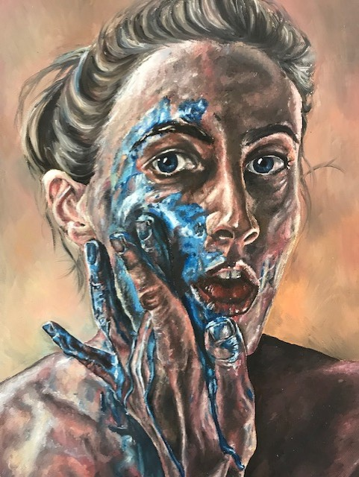
Artist Research

Slide 9
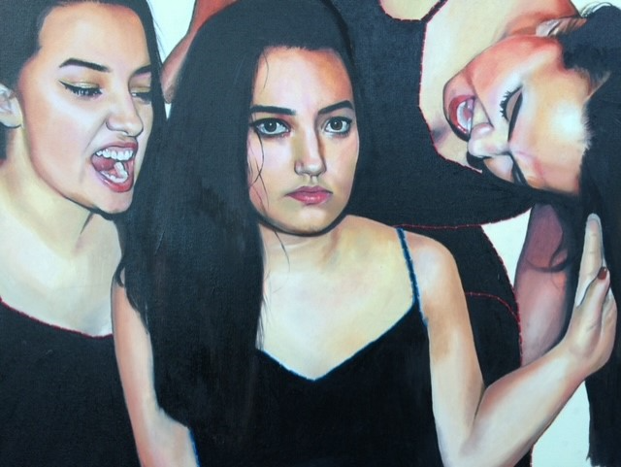
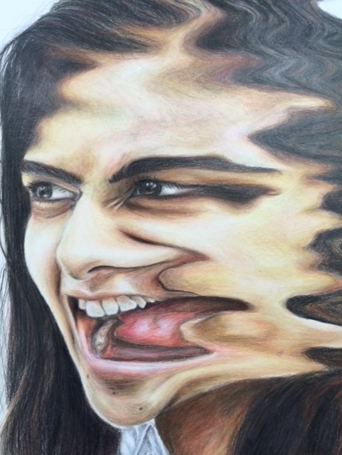
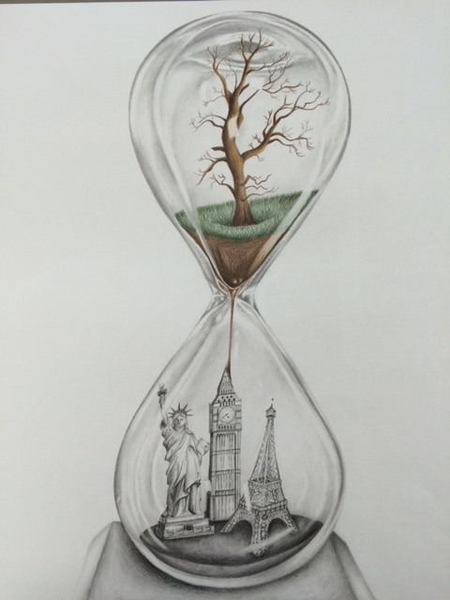
Final pieces

Slide 10
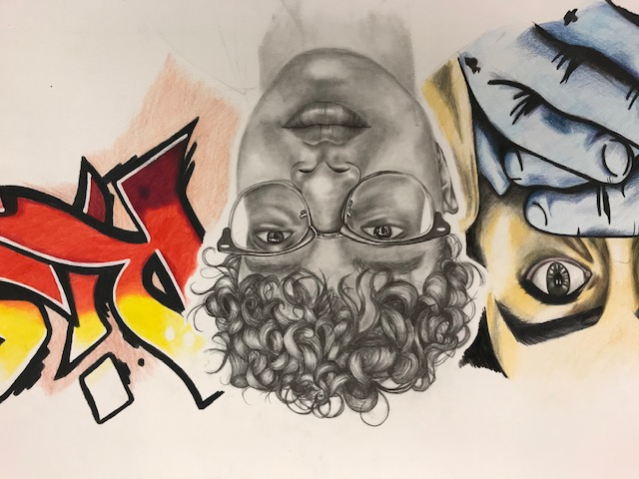
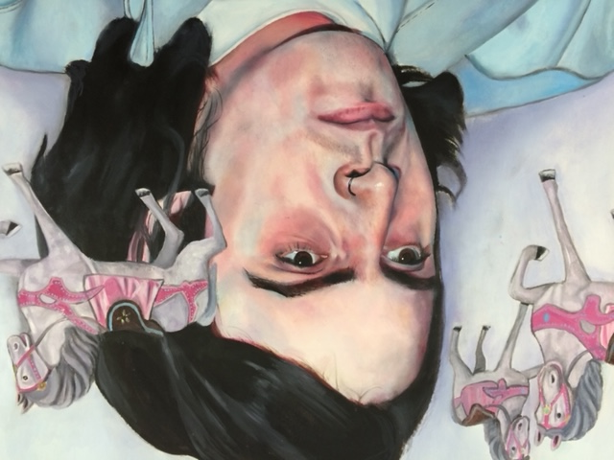
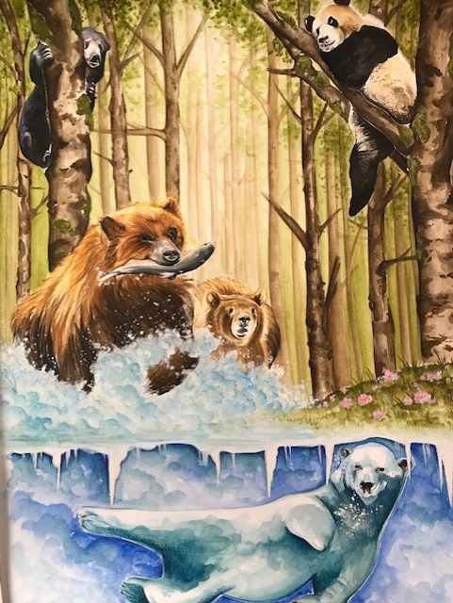
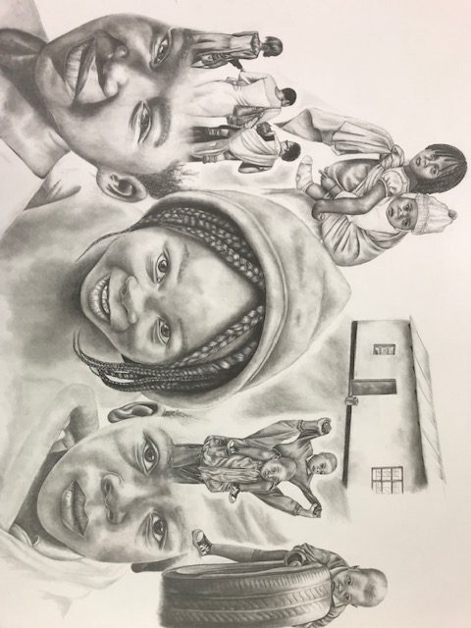
Final Pieces

Slide 11
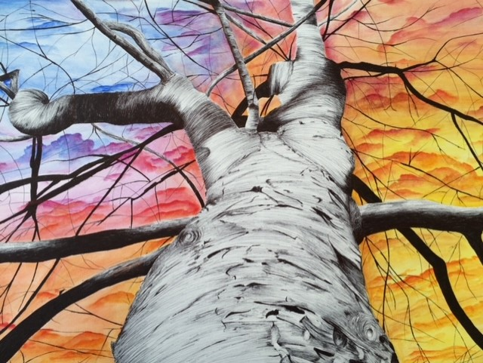
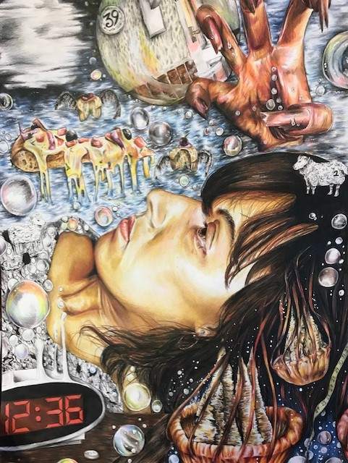
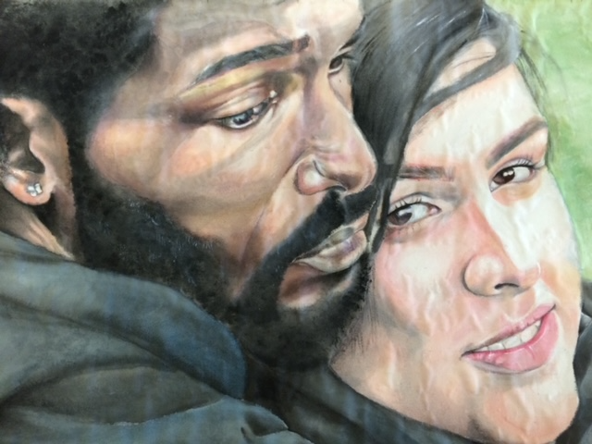
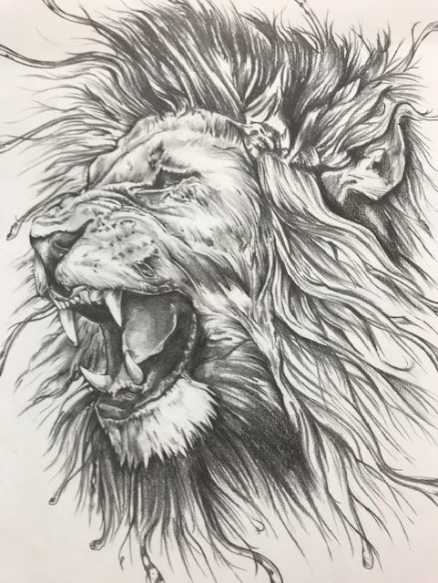
Final Pieces

Slide 12
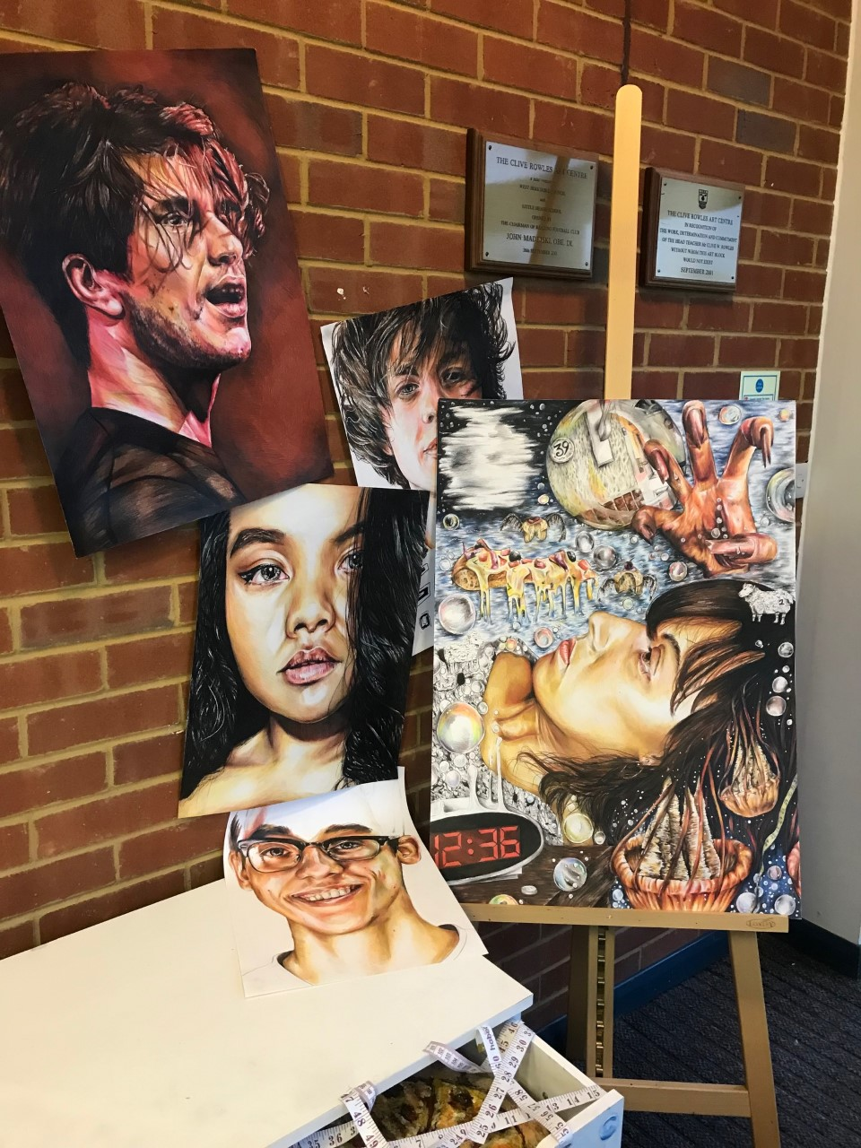
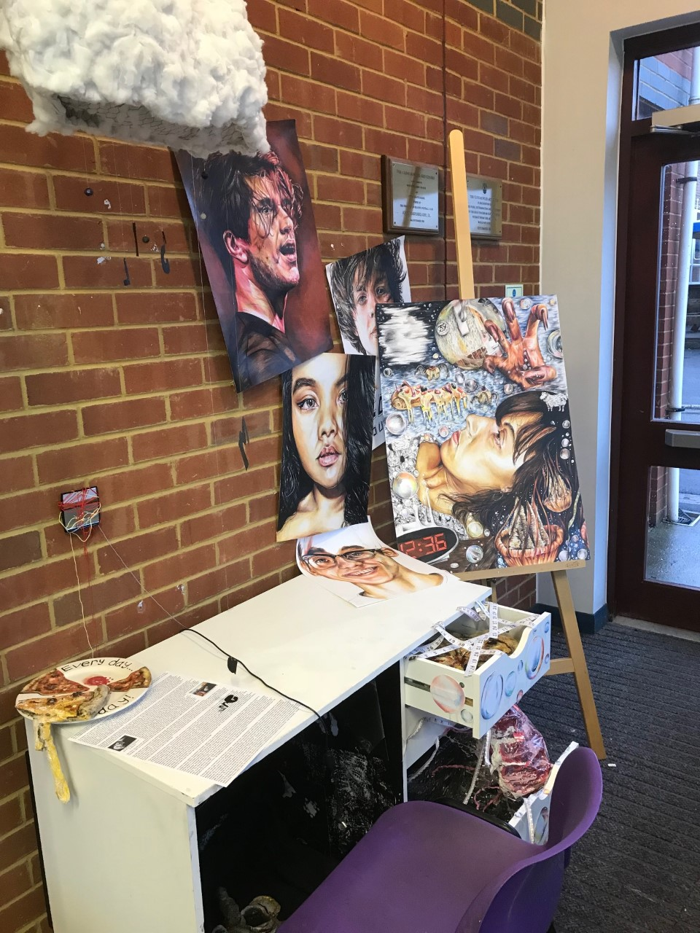

Slide 13
TRANSITON / SUMMER WORK
Confirm your starting point selection
Take photos to draw from in September
Find images of artists’ work to inspire you
Extension: Create a drawing or artist copy to present in your sketchbooks in September

